Slide 1
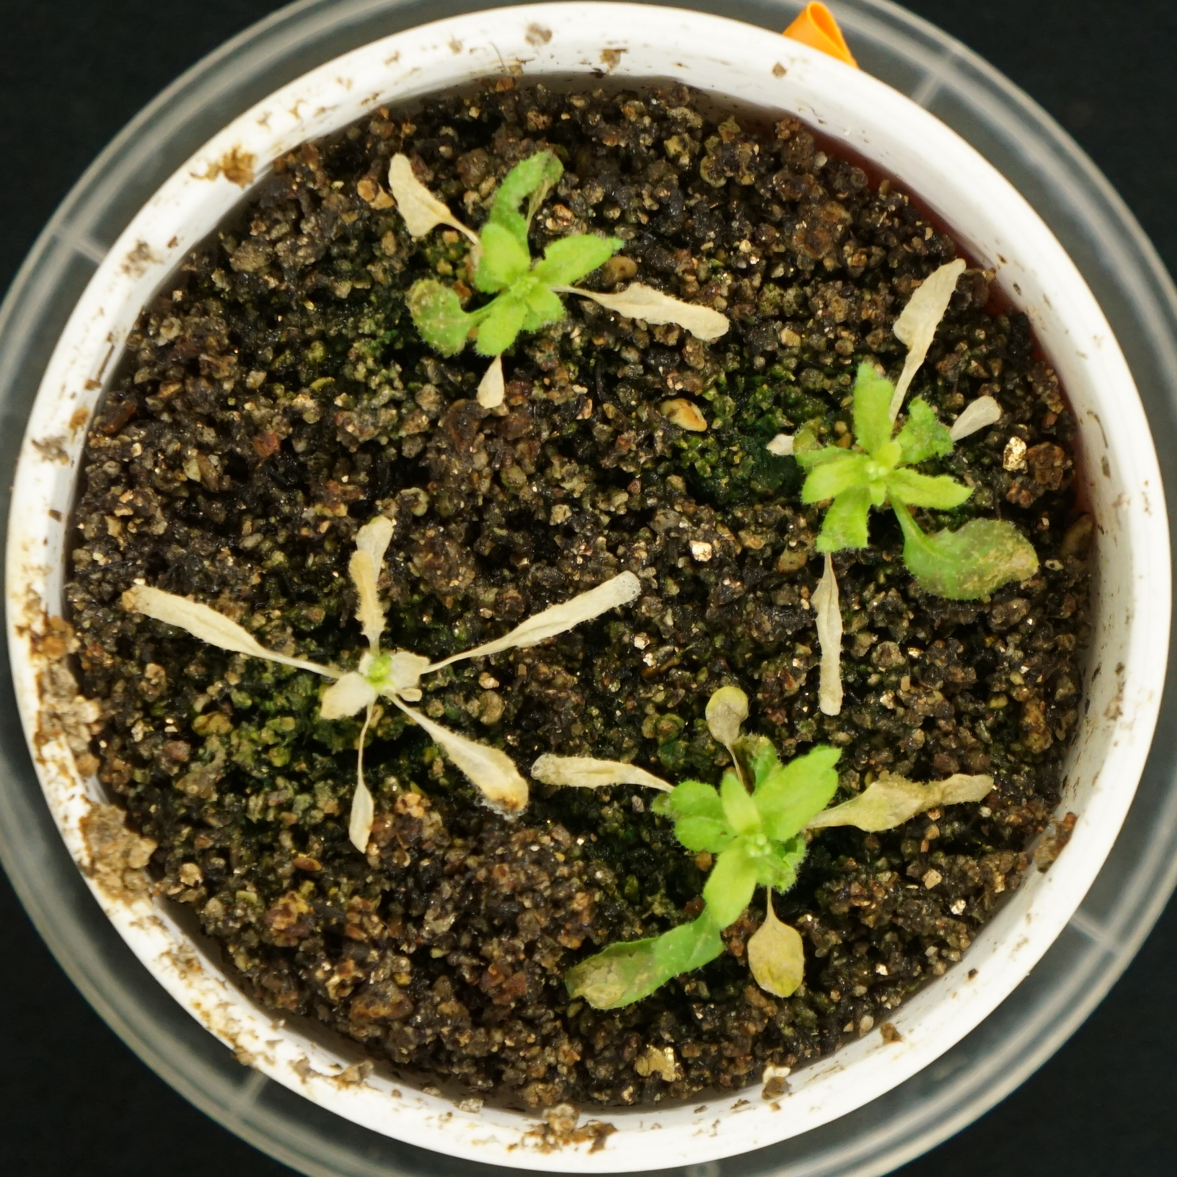
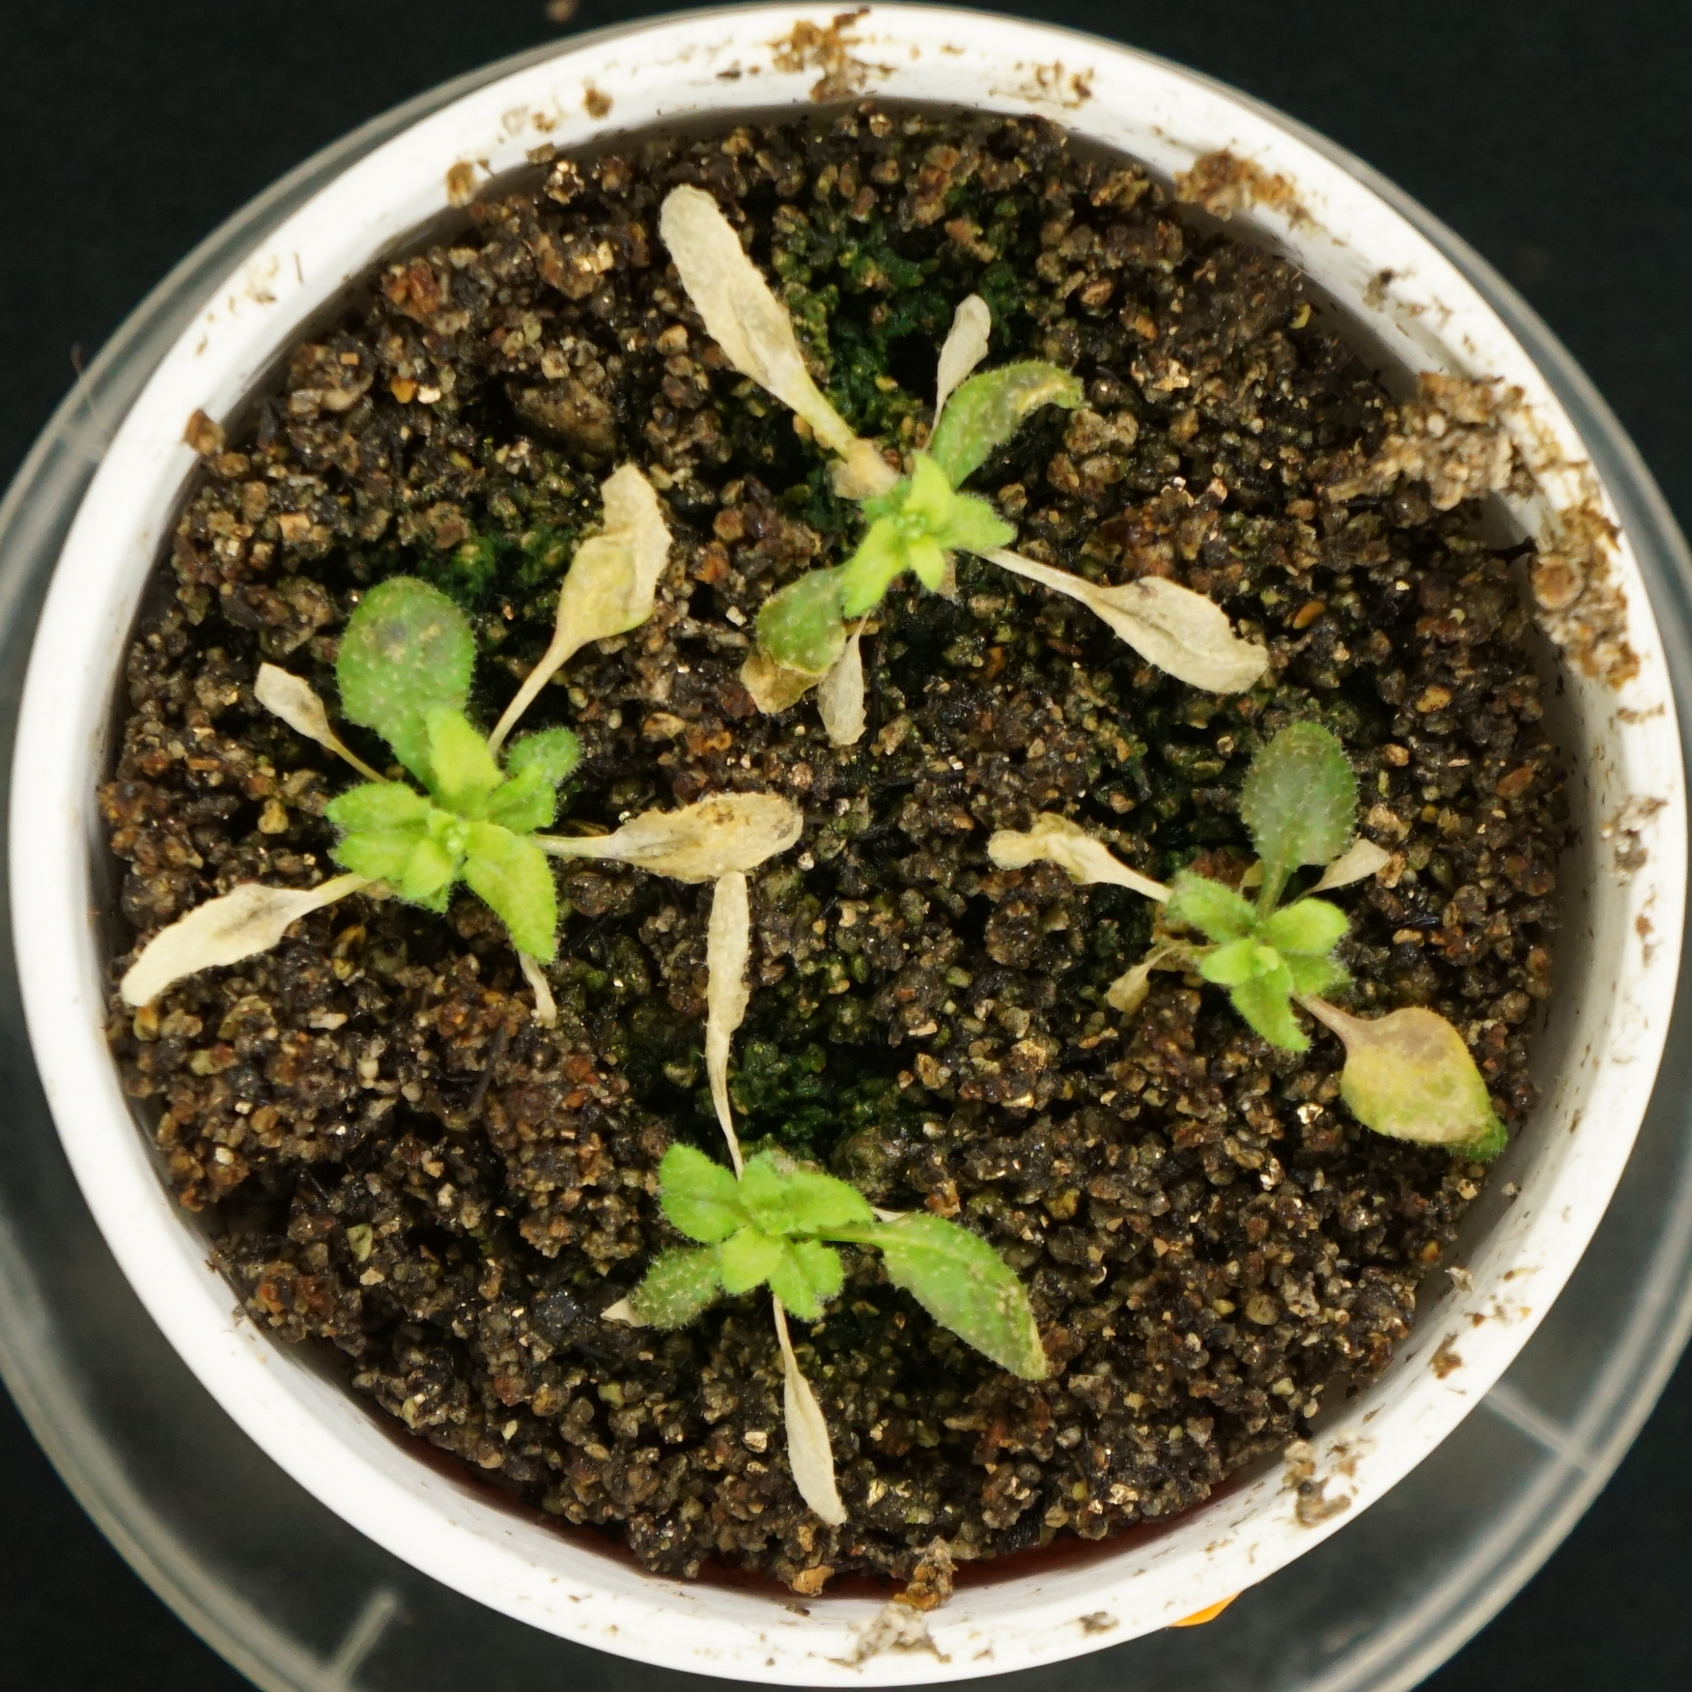
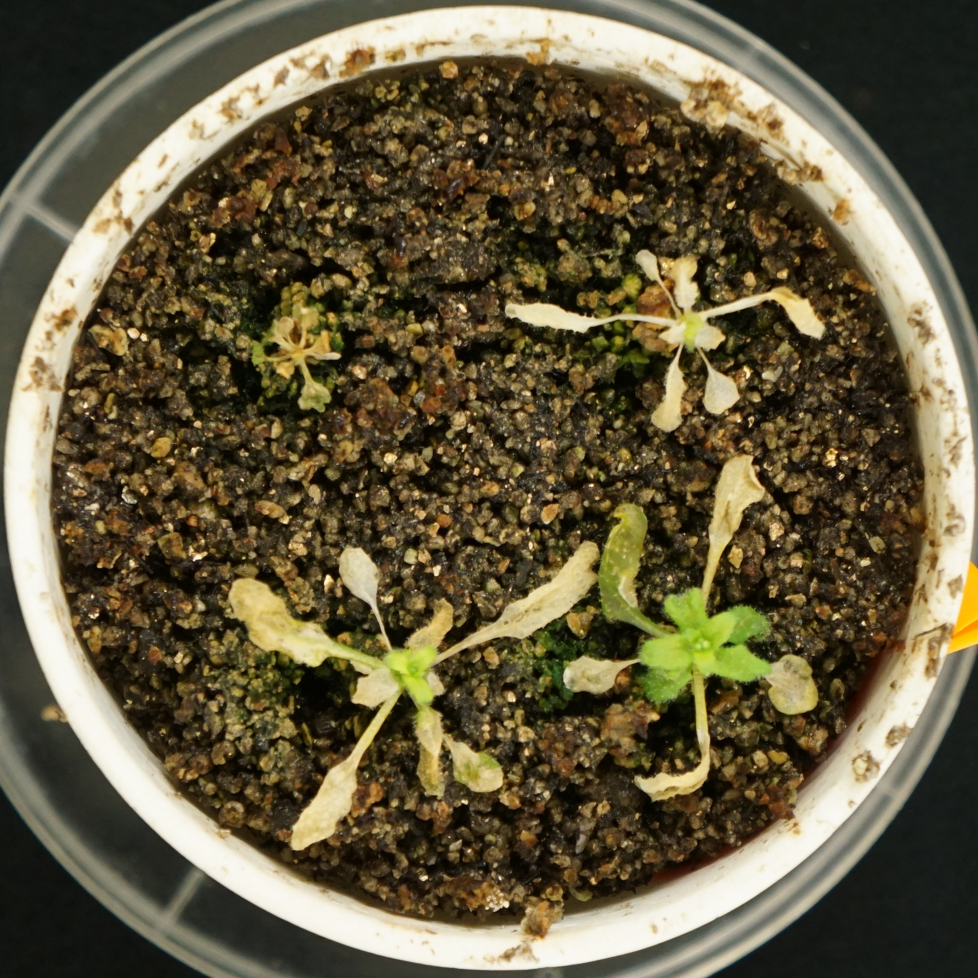
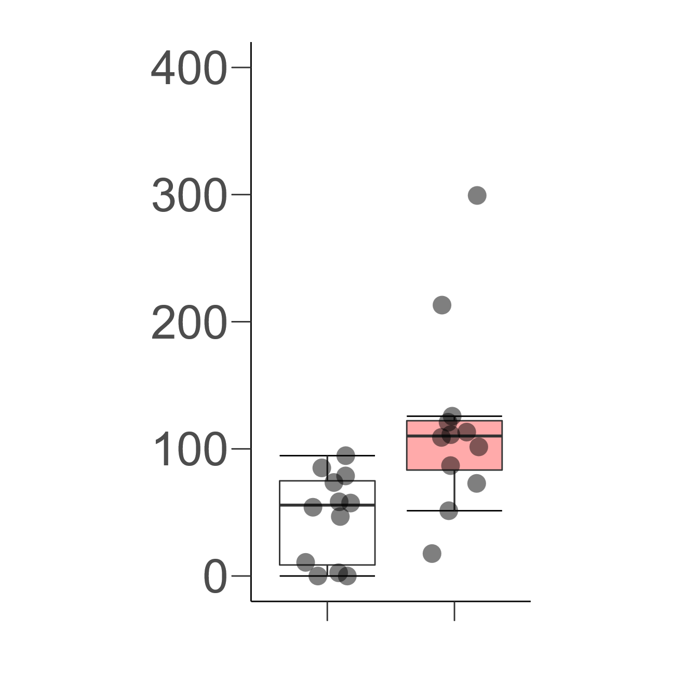
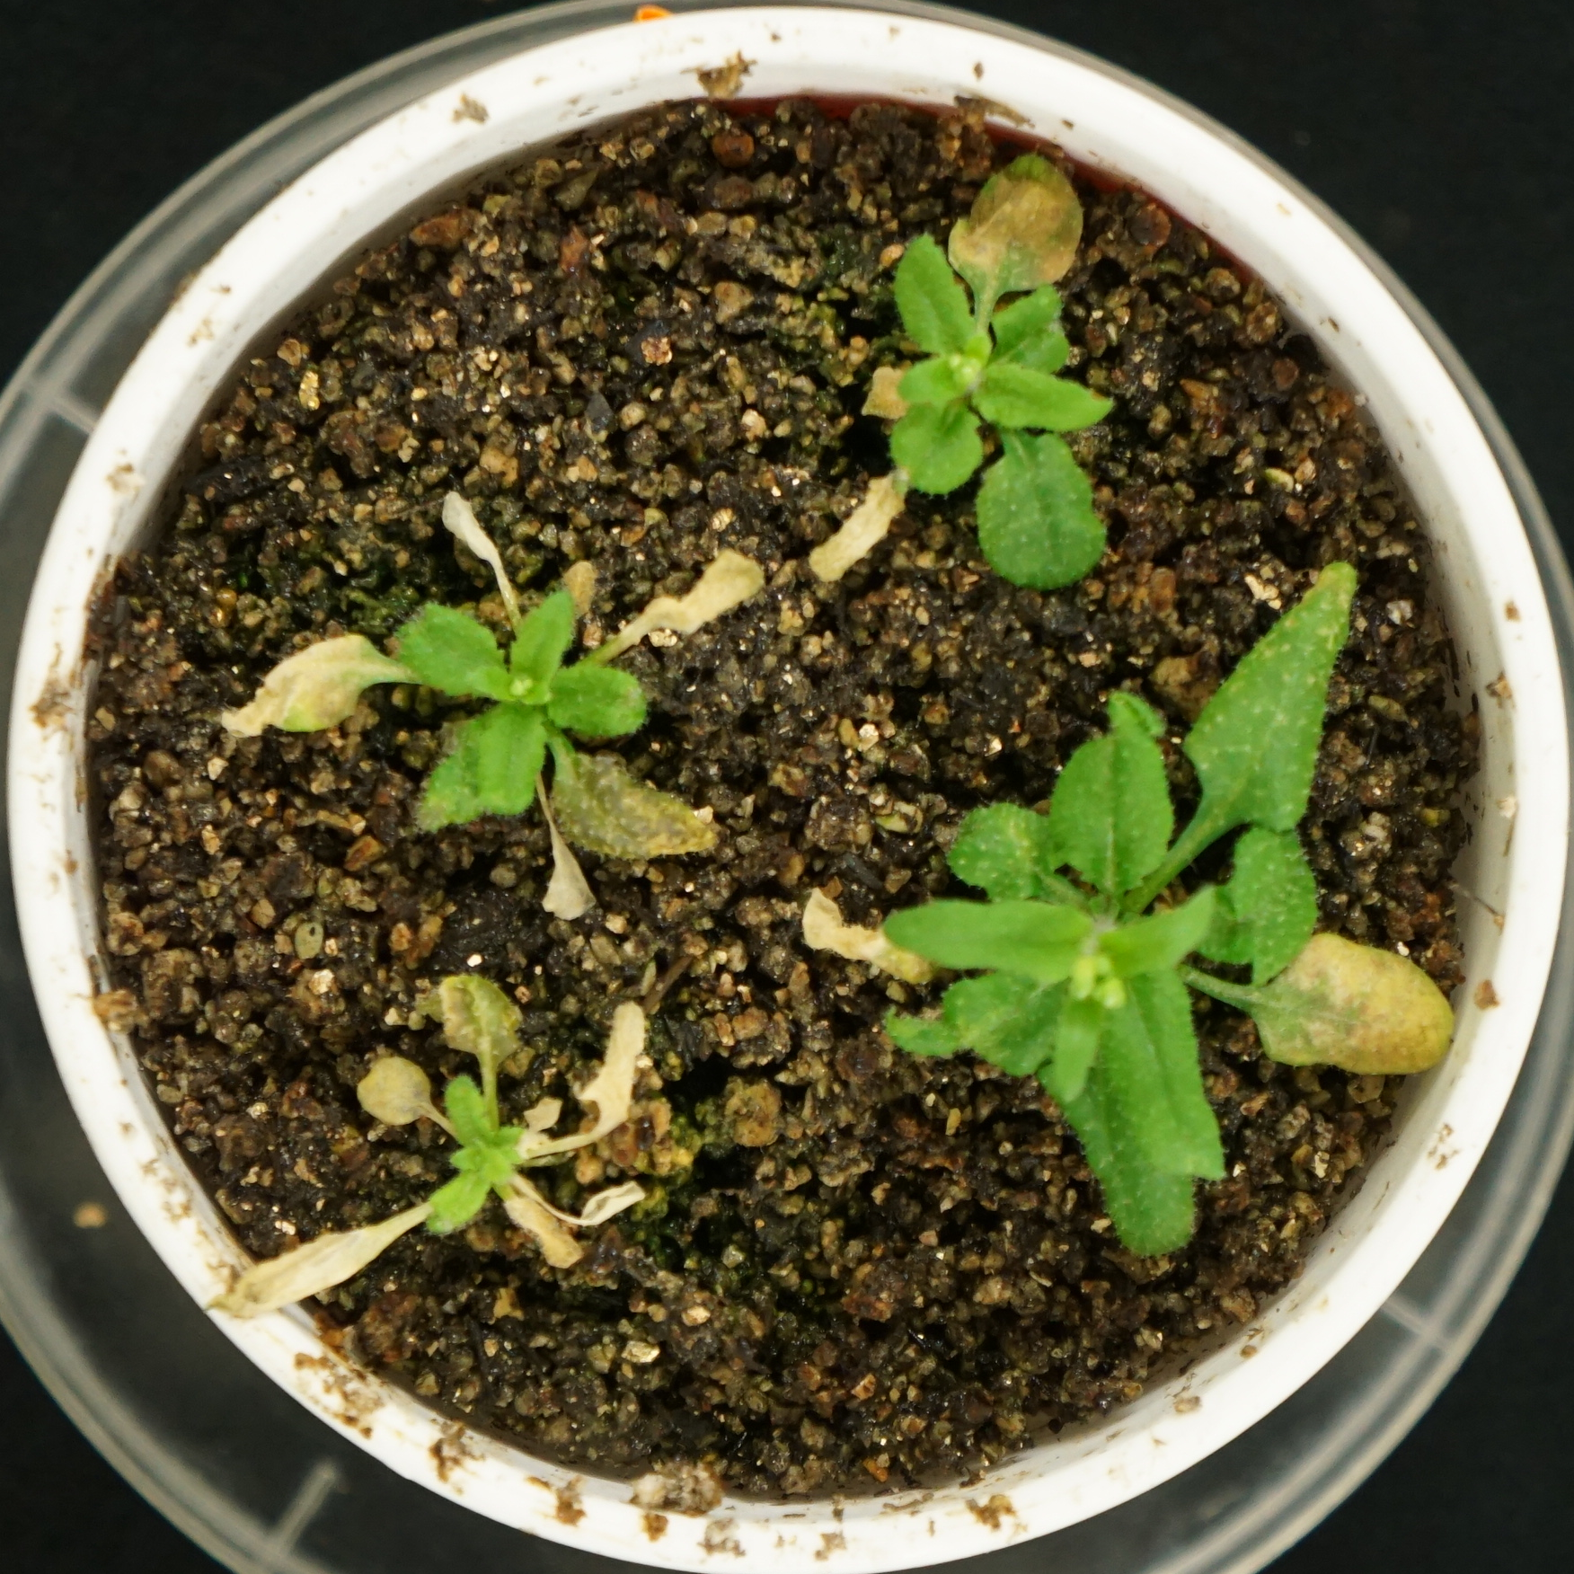
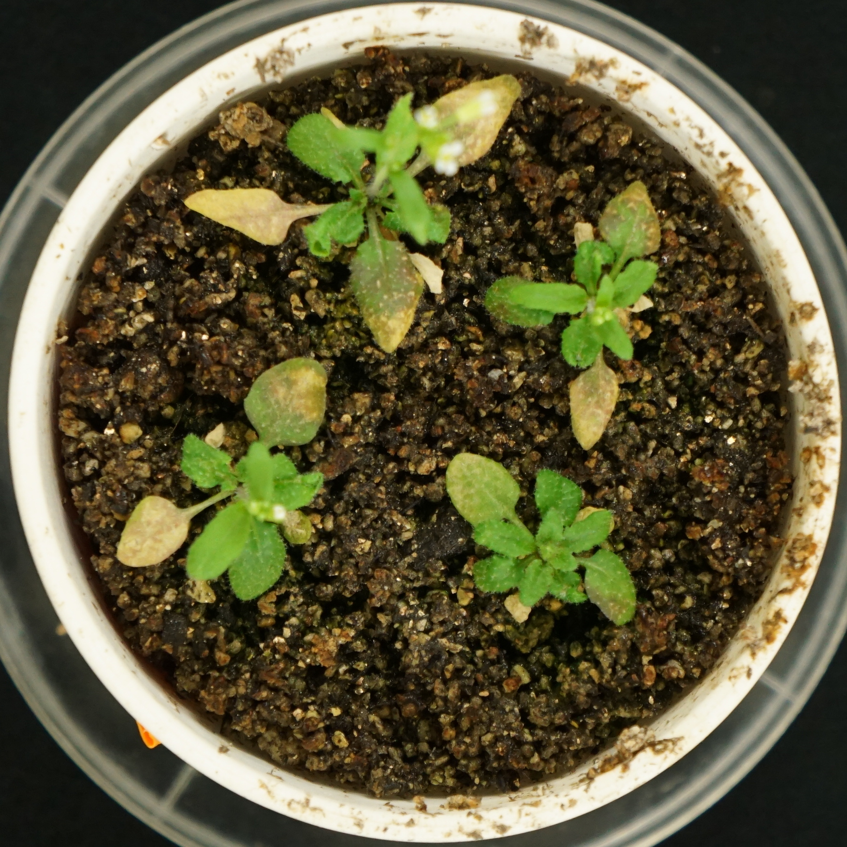
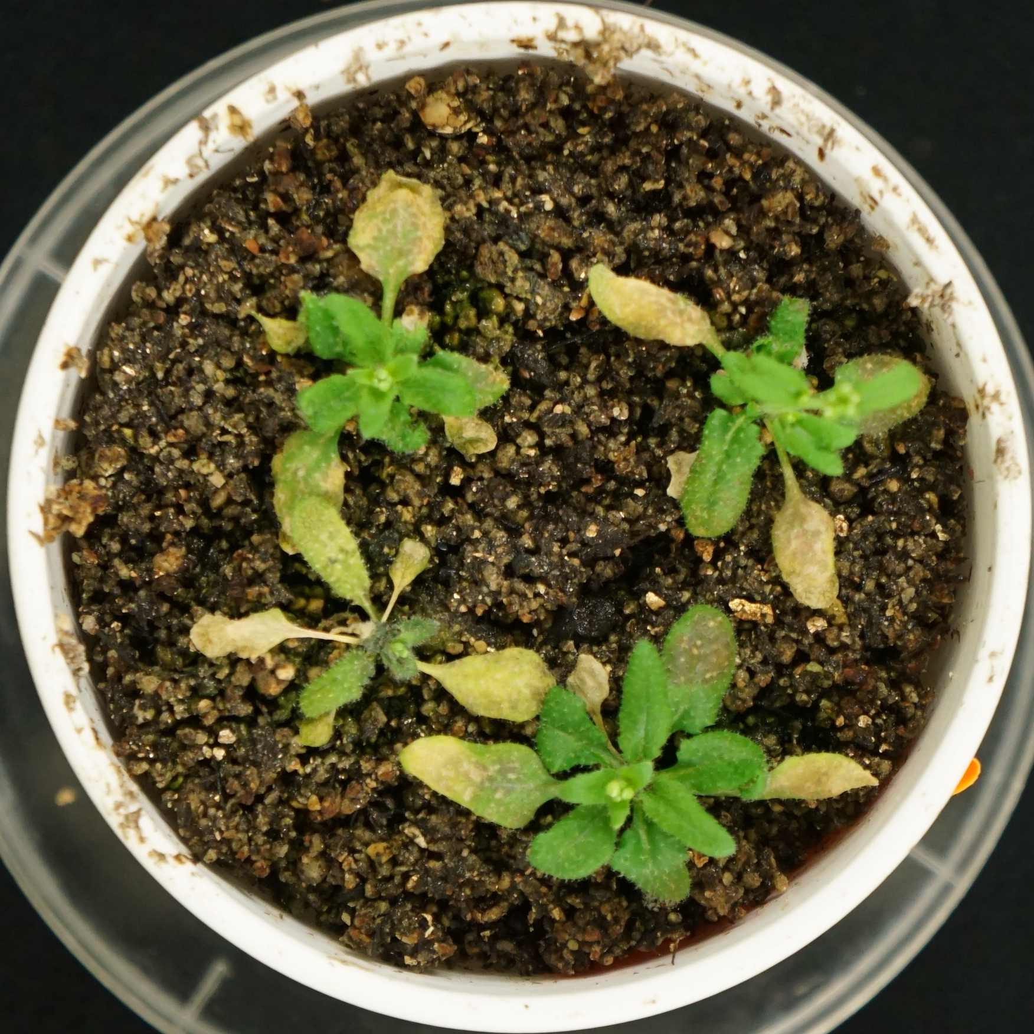
A
B
Water
Green leaf area (mm²)
b
a
Ethanol
Water
Ethanol
Bar = 2 cm
Supplemental Figure 1.

Slide 2
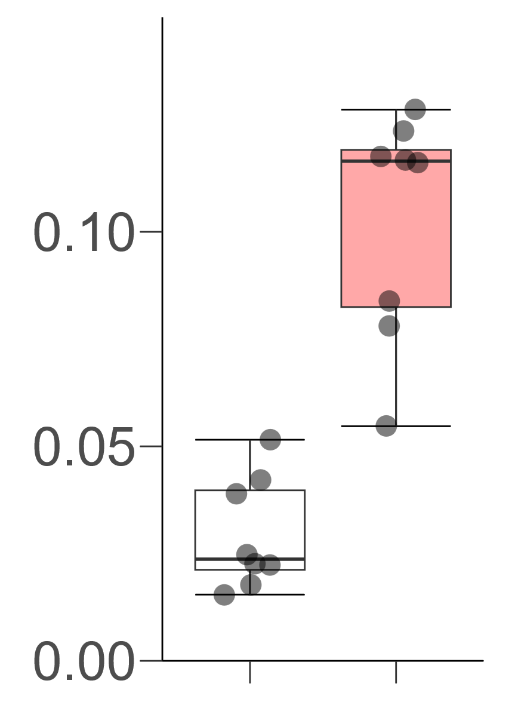
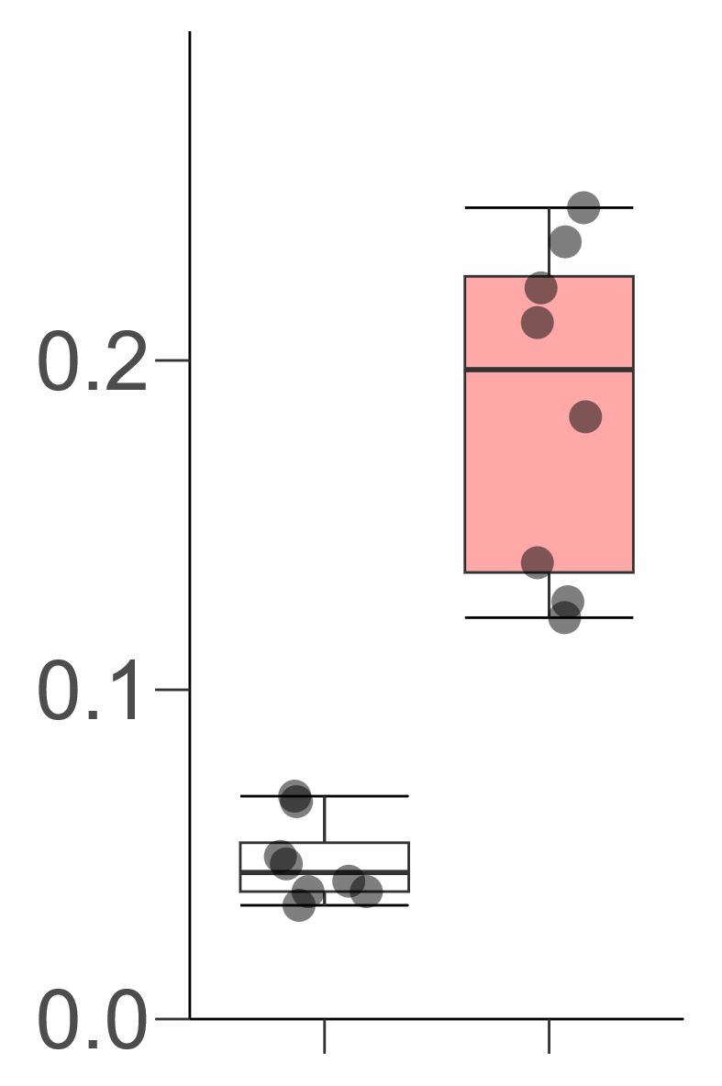
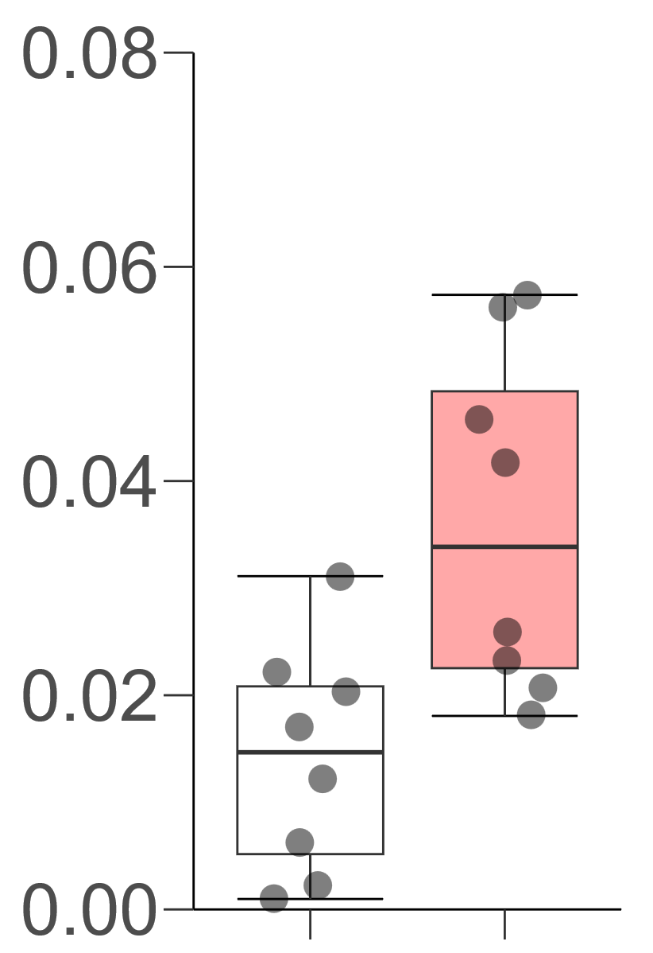
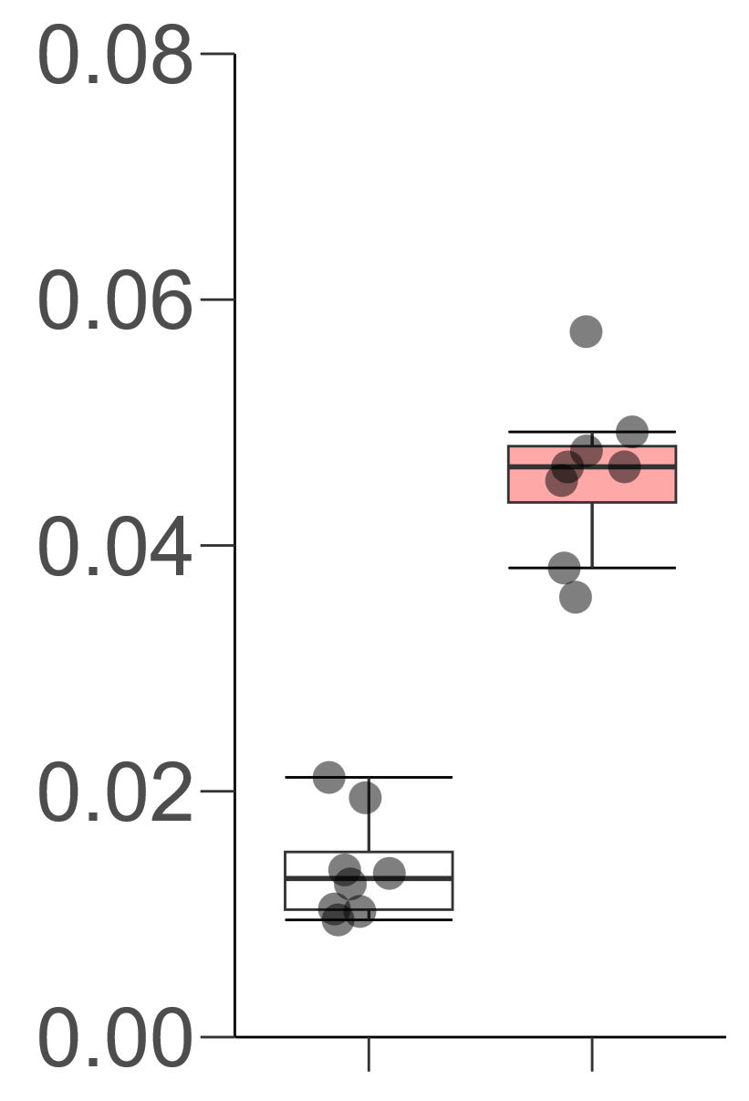
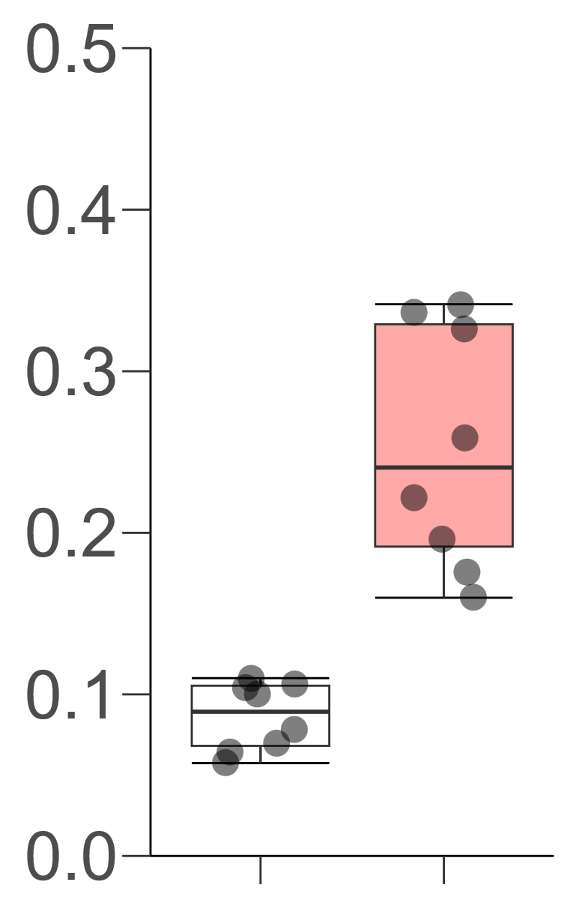
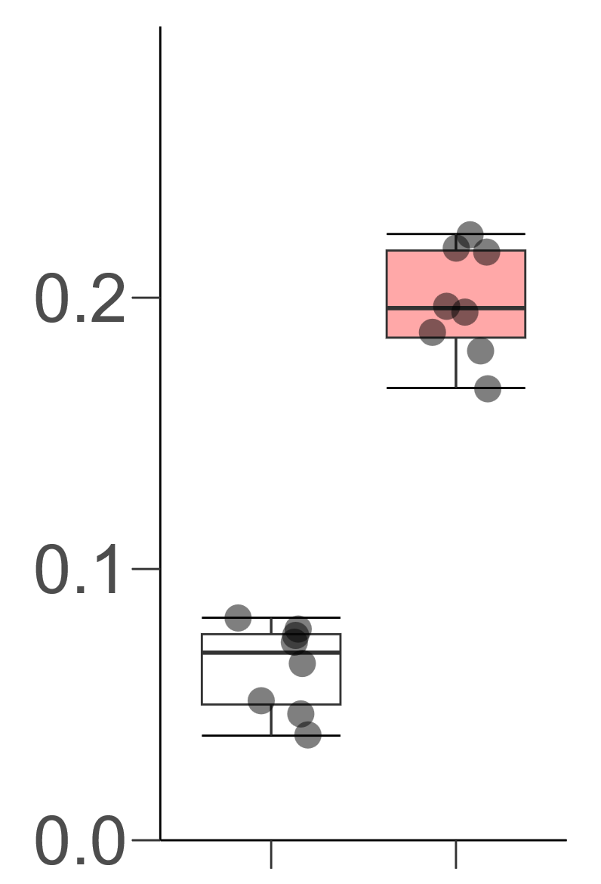
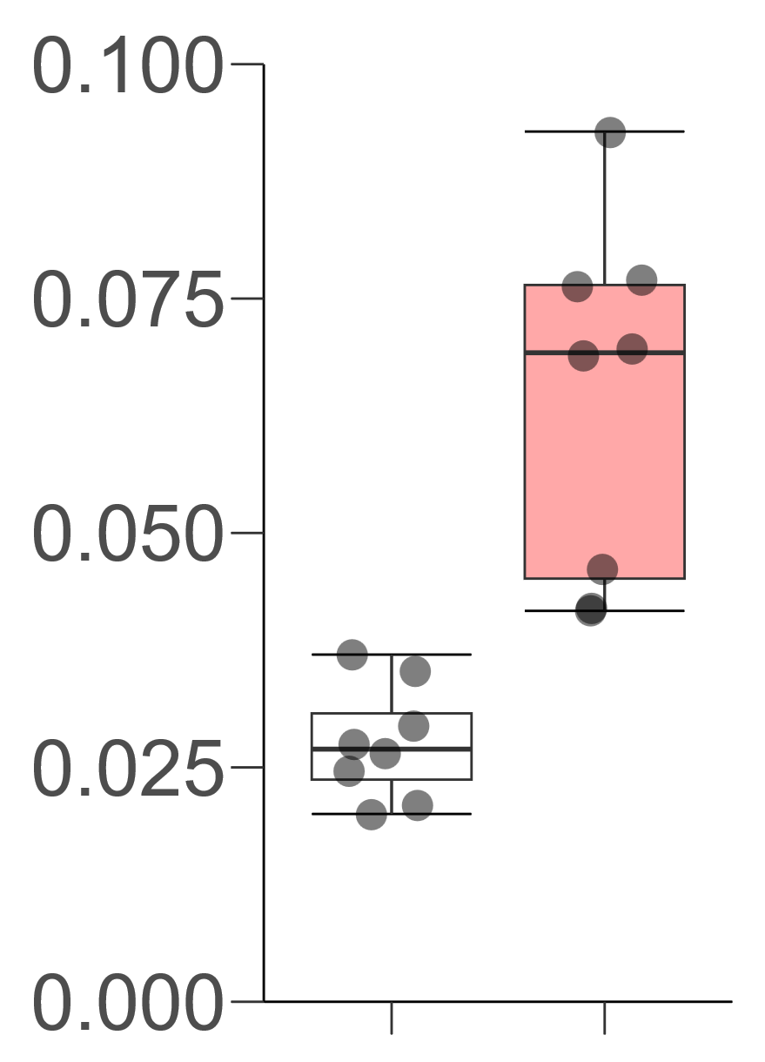
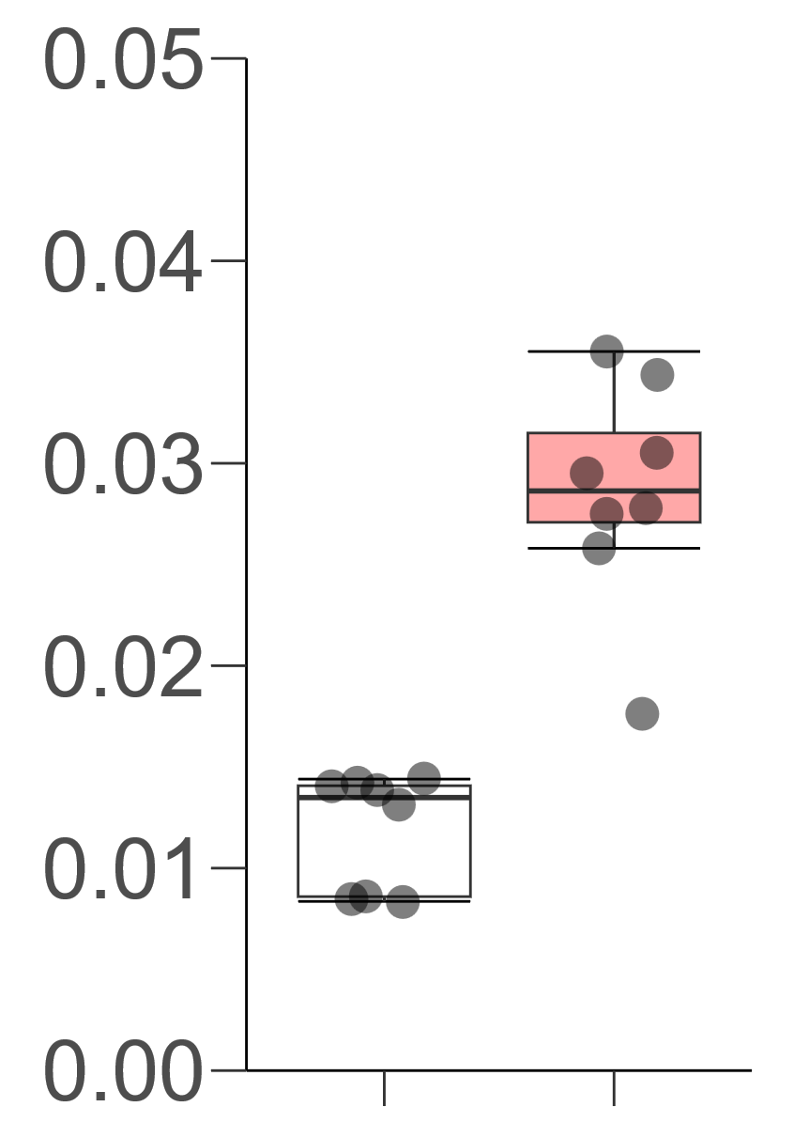
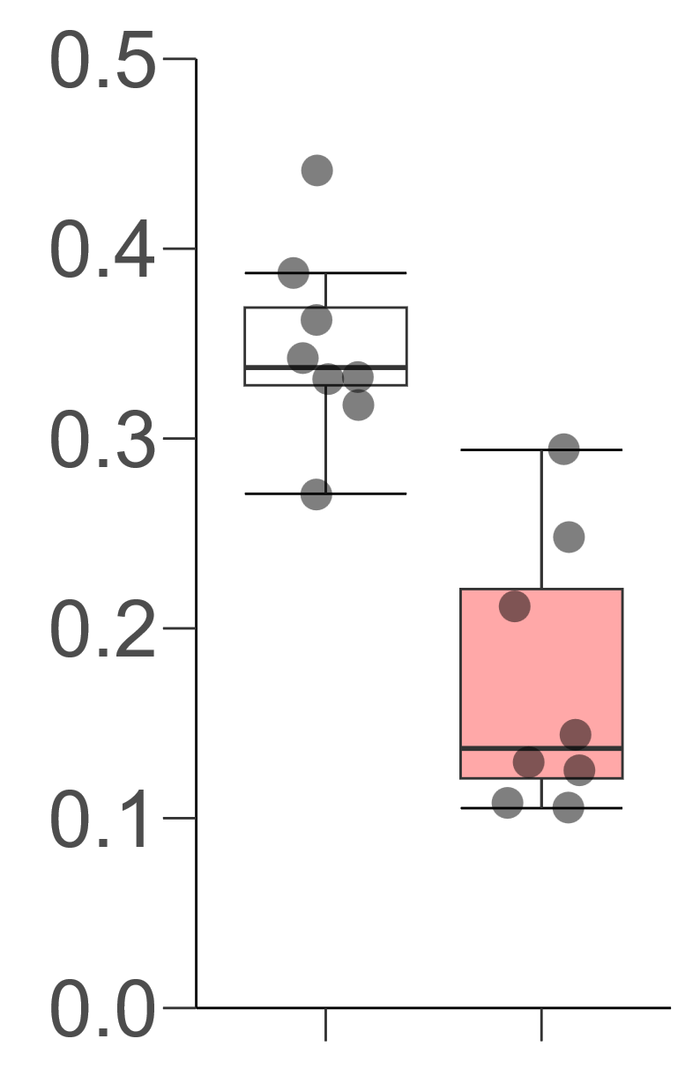
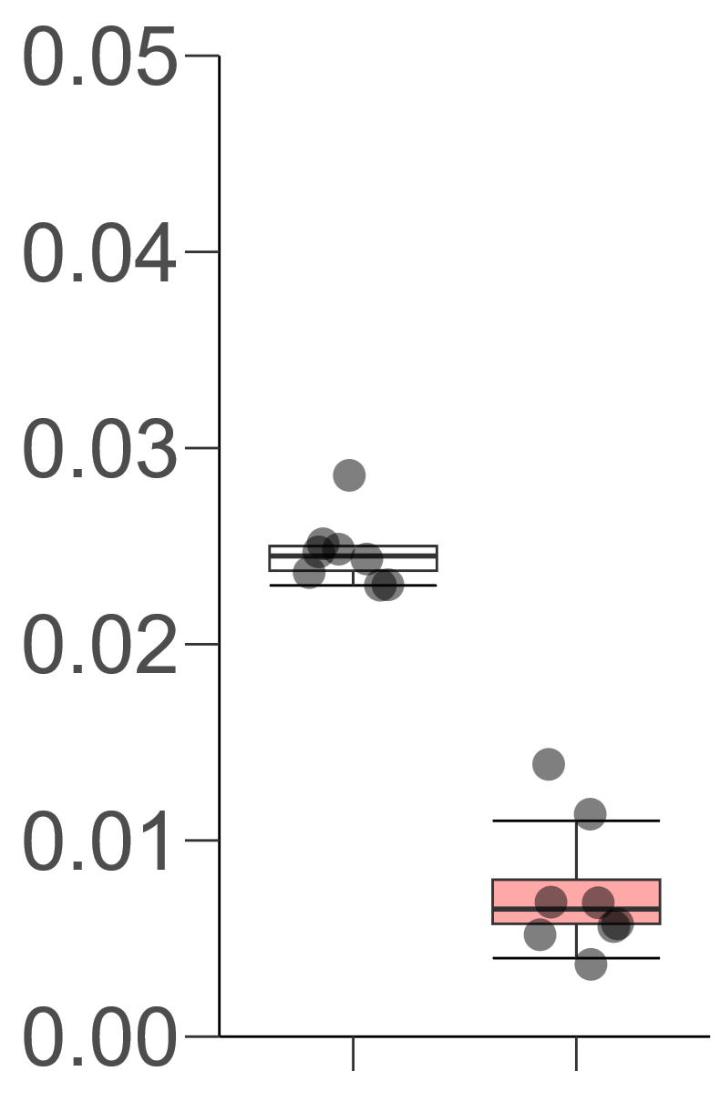
AT5G61600
AT1G64360
AT5G22430
AT4G33980
b
b
b
b
Expression level
(copies / ACT2)
a
Expression level
(copies / ACT2)
a
Expression level
(copies / ACT2)
a
Expression level
(copies / ACT2)
a
W6d
E6d
W6d
E6d
W6d
E6d
W6d
E6d
AT2G47880
AT2G21650
AT4G33040
AT5G42900
b
b
b
b
Expression level
(copies / ACT2)
Expression level
(copies / ACT2)
Expression level
(copies / ACT2)
a
Expression level
(copies / ACT2)
a
a
a
W6d
E6d
W6d
E6d
W6d
E6d
W6d
E6d
AT1G49500
AT1G68238
a
b
a
Expression level
(copies / ACT2)
Expression level
(copies / ACT2)
b
W6d
E6d
W6d
E6d
Supplemental Figure 2.

Slide 3
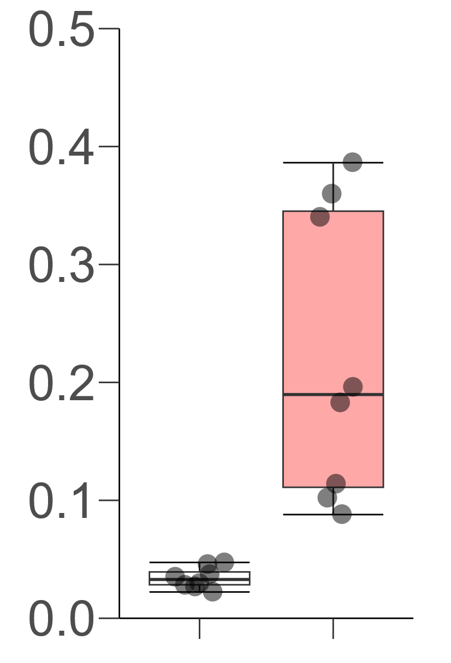
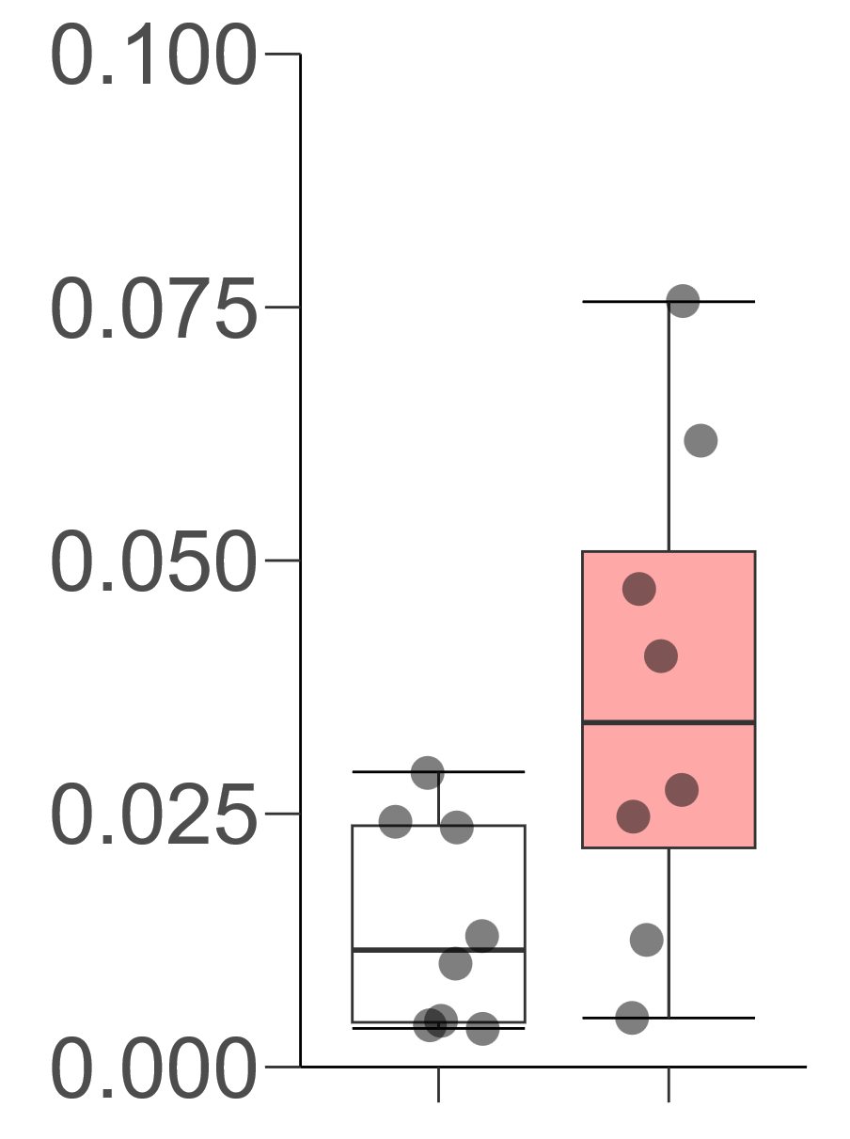
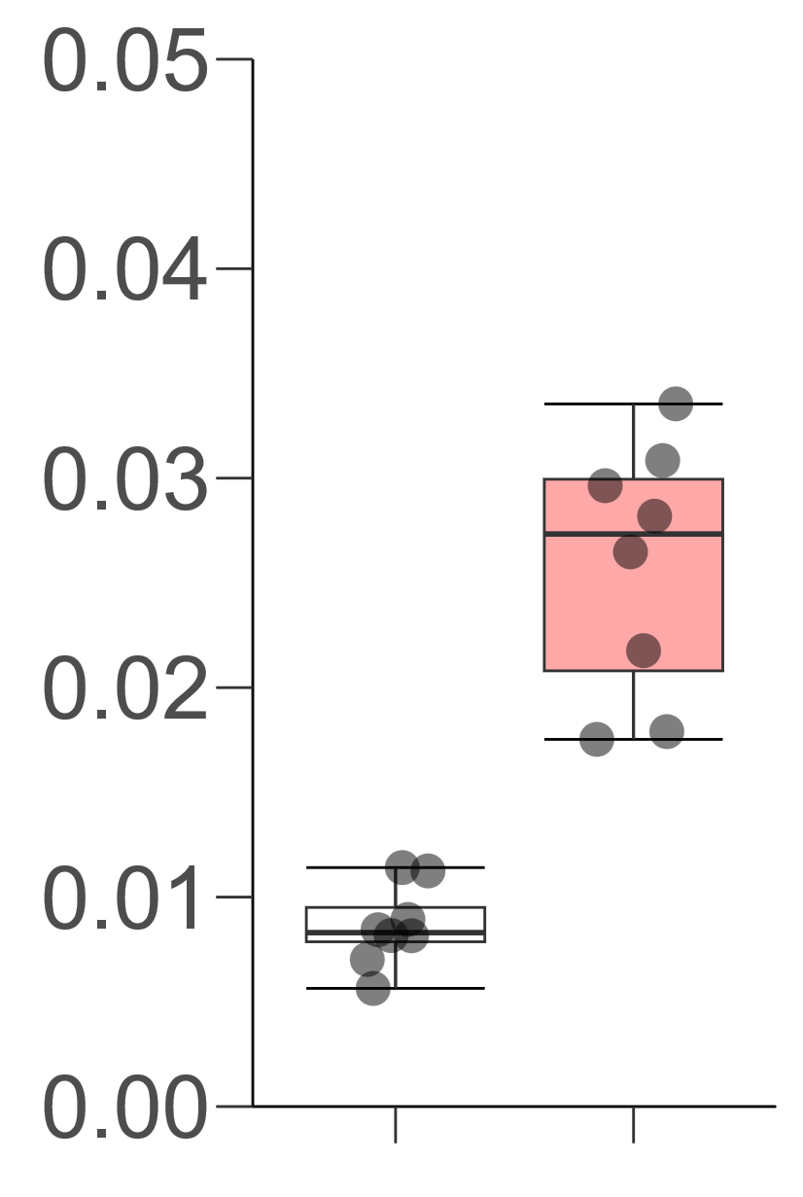
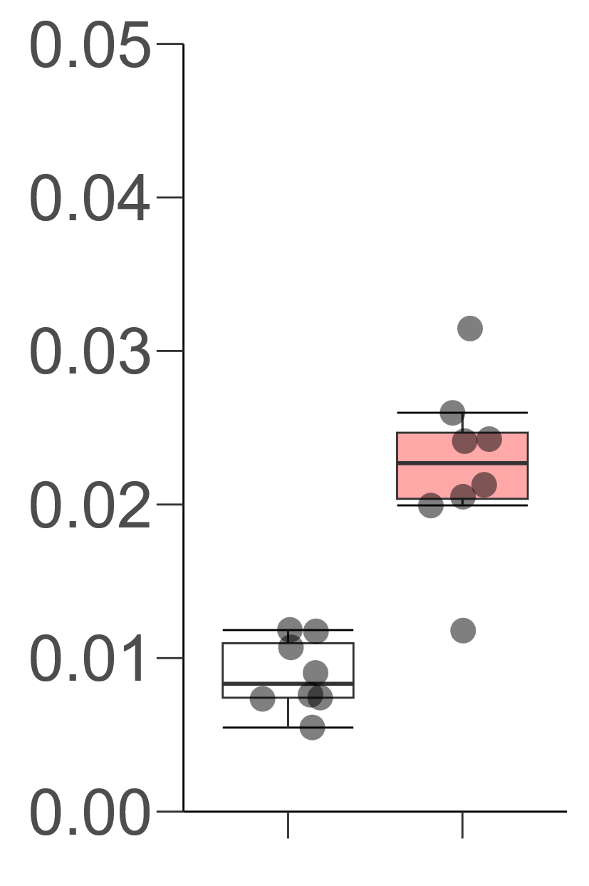
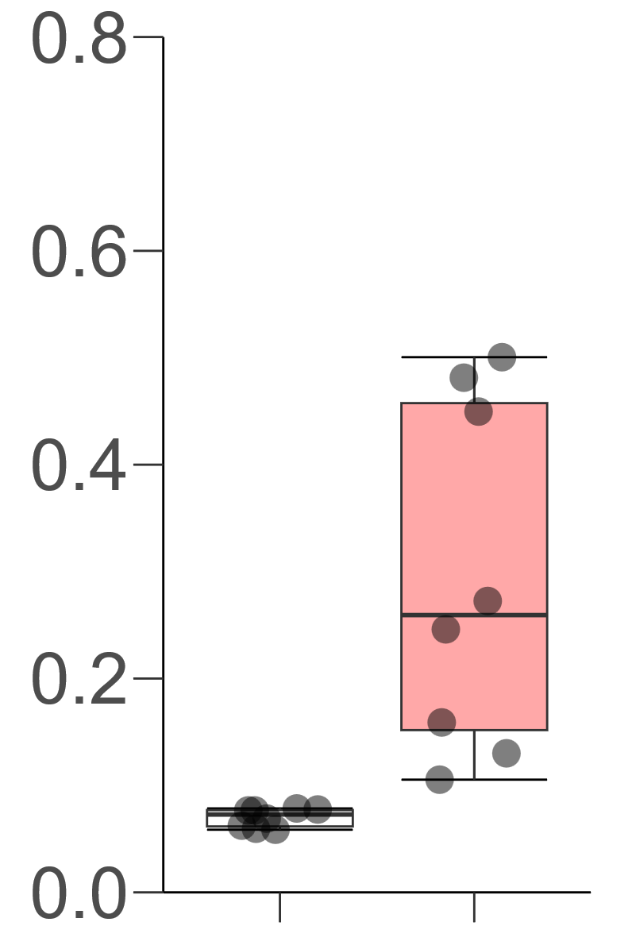
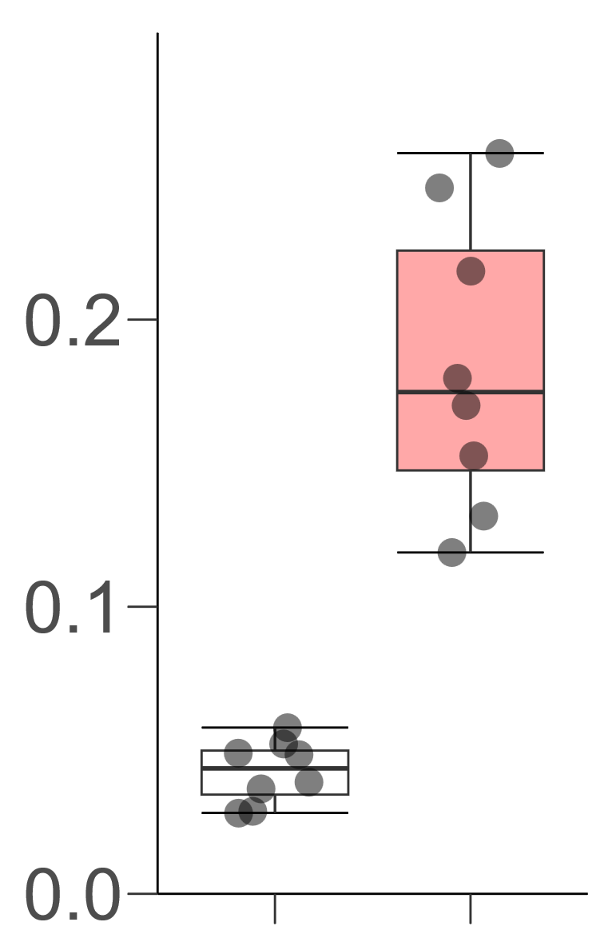
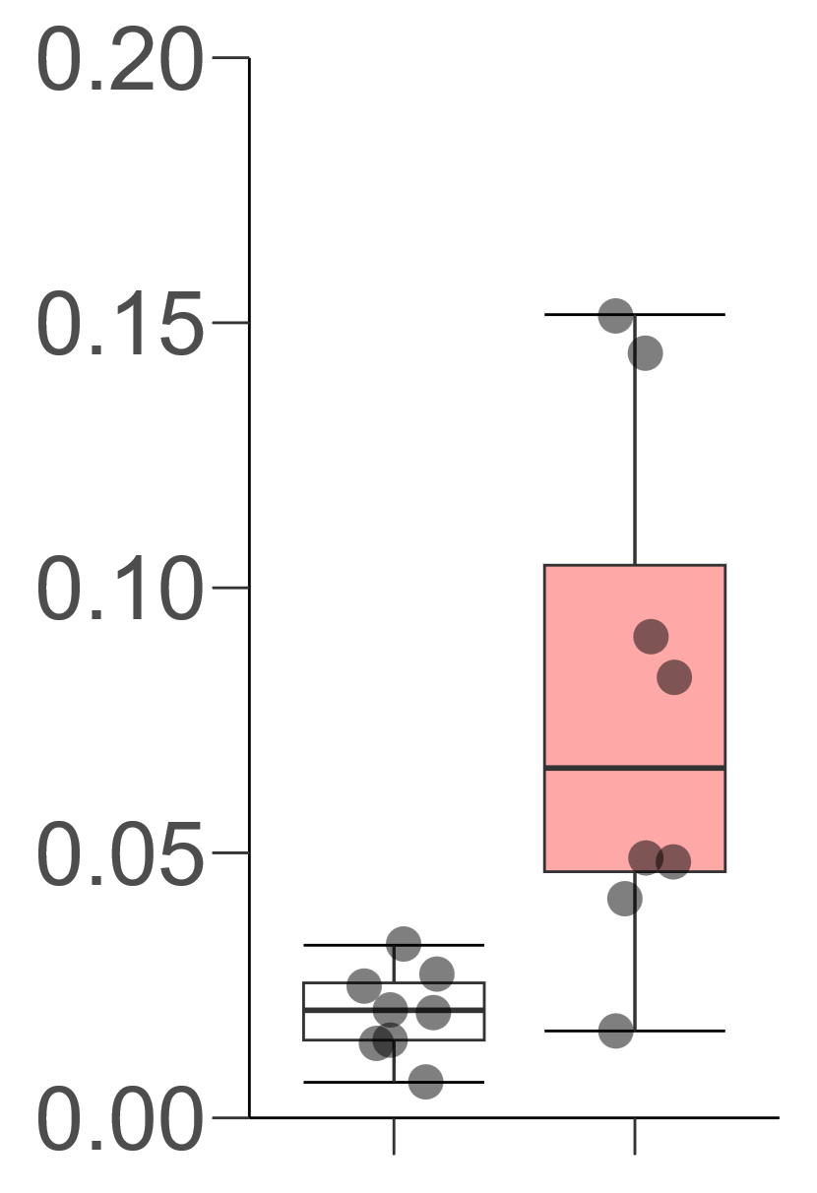
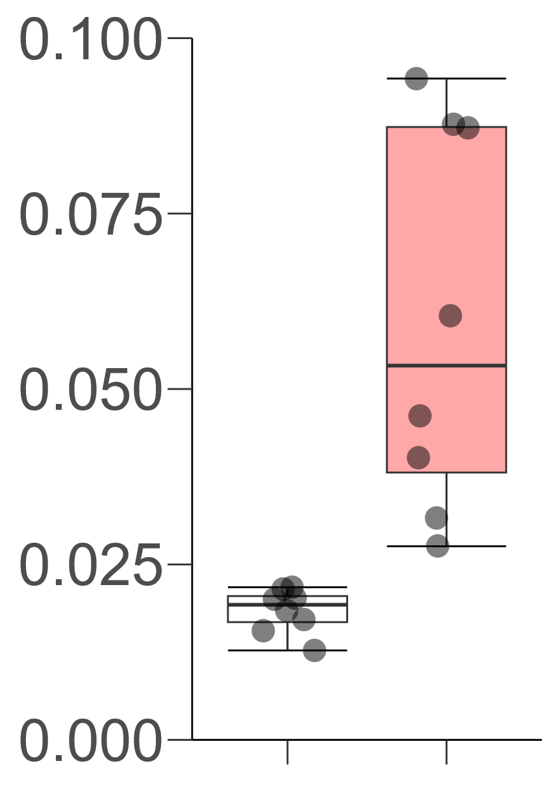
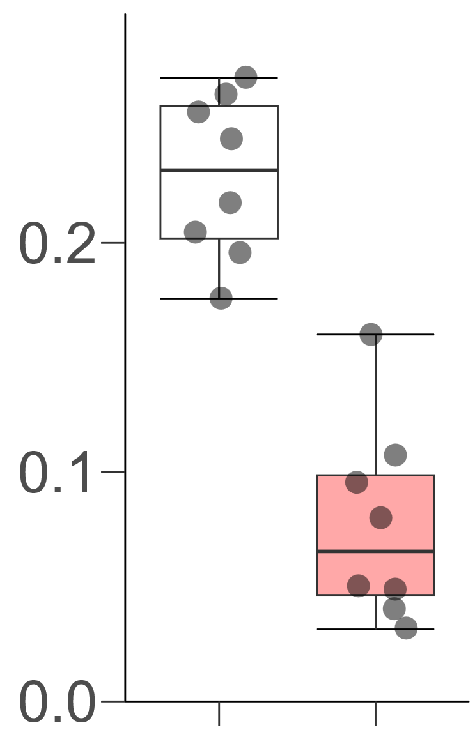
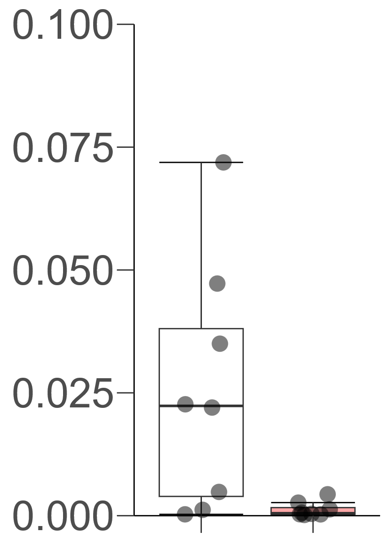
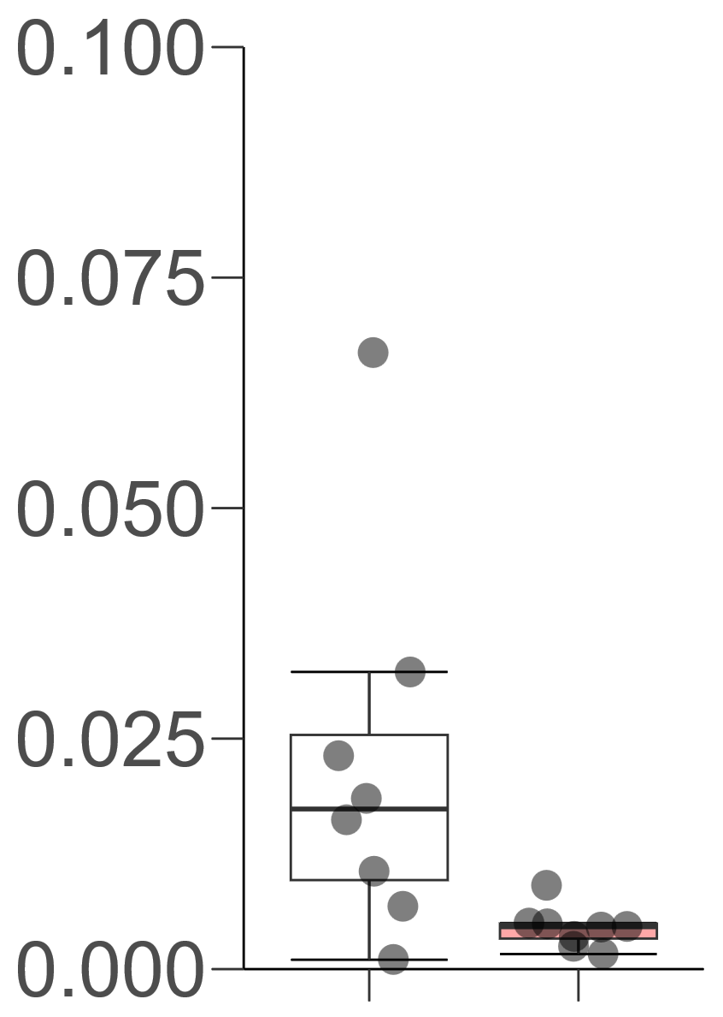
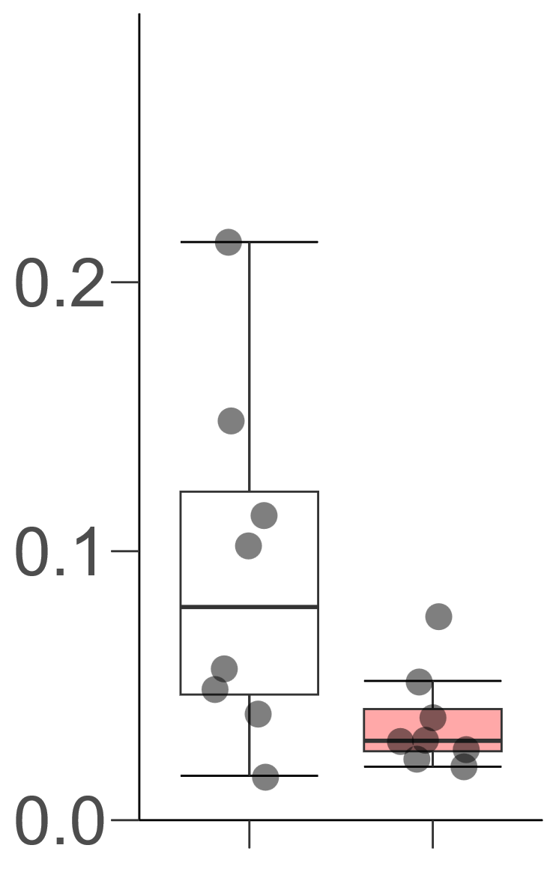
AT1G64360
AT5G22430
AT4G33980
AT5G42900
b
b
b
b
Expression level
(copies / ACT2)
Expression level
(copies / ACT2)
a
Expression level
(copies / ACT2)
a
Expression level
(copies / ACT2)
a
a
E6dF2h
E6dF2h
E6dF2h
E6dF2h
W6dF2h
W6dF2h
W6dF2h
W6dF2h
AT2G47880
AT2G21650
AT1G70640
AT4G33040
b
b
b
b
Expression level
(copies / ACT2)
Expression level
(copies / ACT2)
Expression level
(copies / ACT2)
Expression level
(copies / ACT2)
a
a
a
a
W6dF2h
E6dF2h
W6dF2h
E6dF2h
E6dF2h
E6dF2h
W6dF2h
W6dF2h
AT1G49500
AT2G24850
AT3G57260
AT5G03350
a
a
a
Expression level
(copies / ACT2)
b
Expression level
(copies / ACT2)
Expression level
(copies / ACT2)
Expression level
(copies / ACT2)
a
b
b
b
W6dF2h
E6dF2h
W6dF2h
E6dF2h
E6dF2h
E6dF2h
W6dF2h
W6dF2h
Supplemental Figure 3.

Slide 4
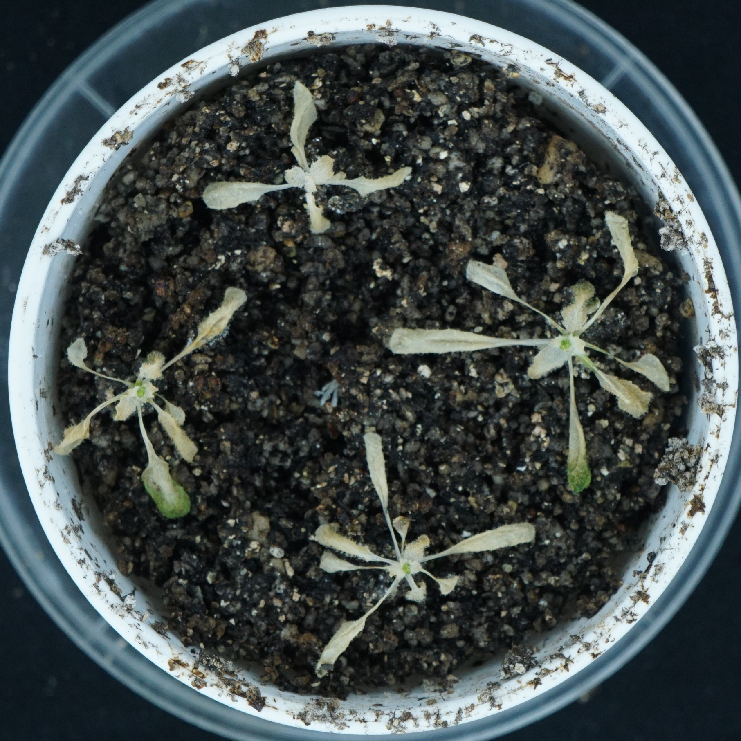
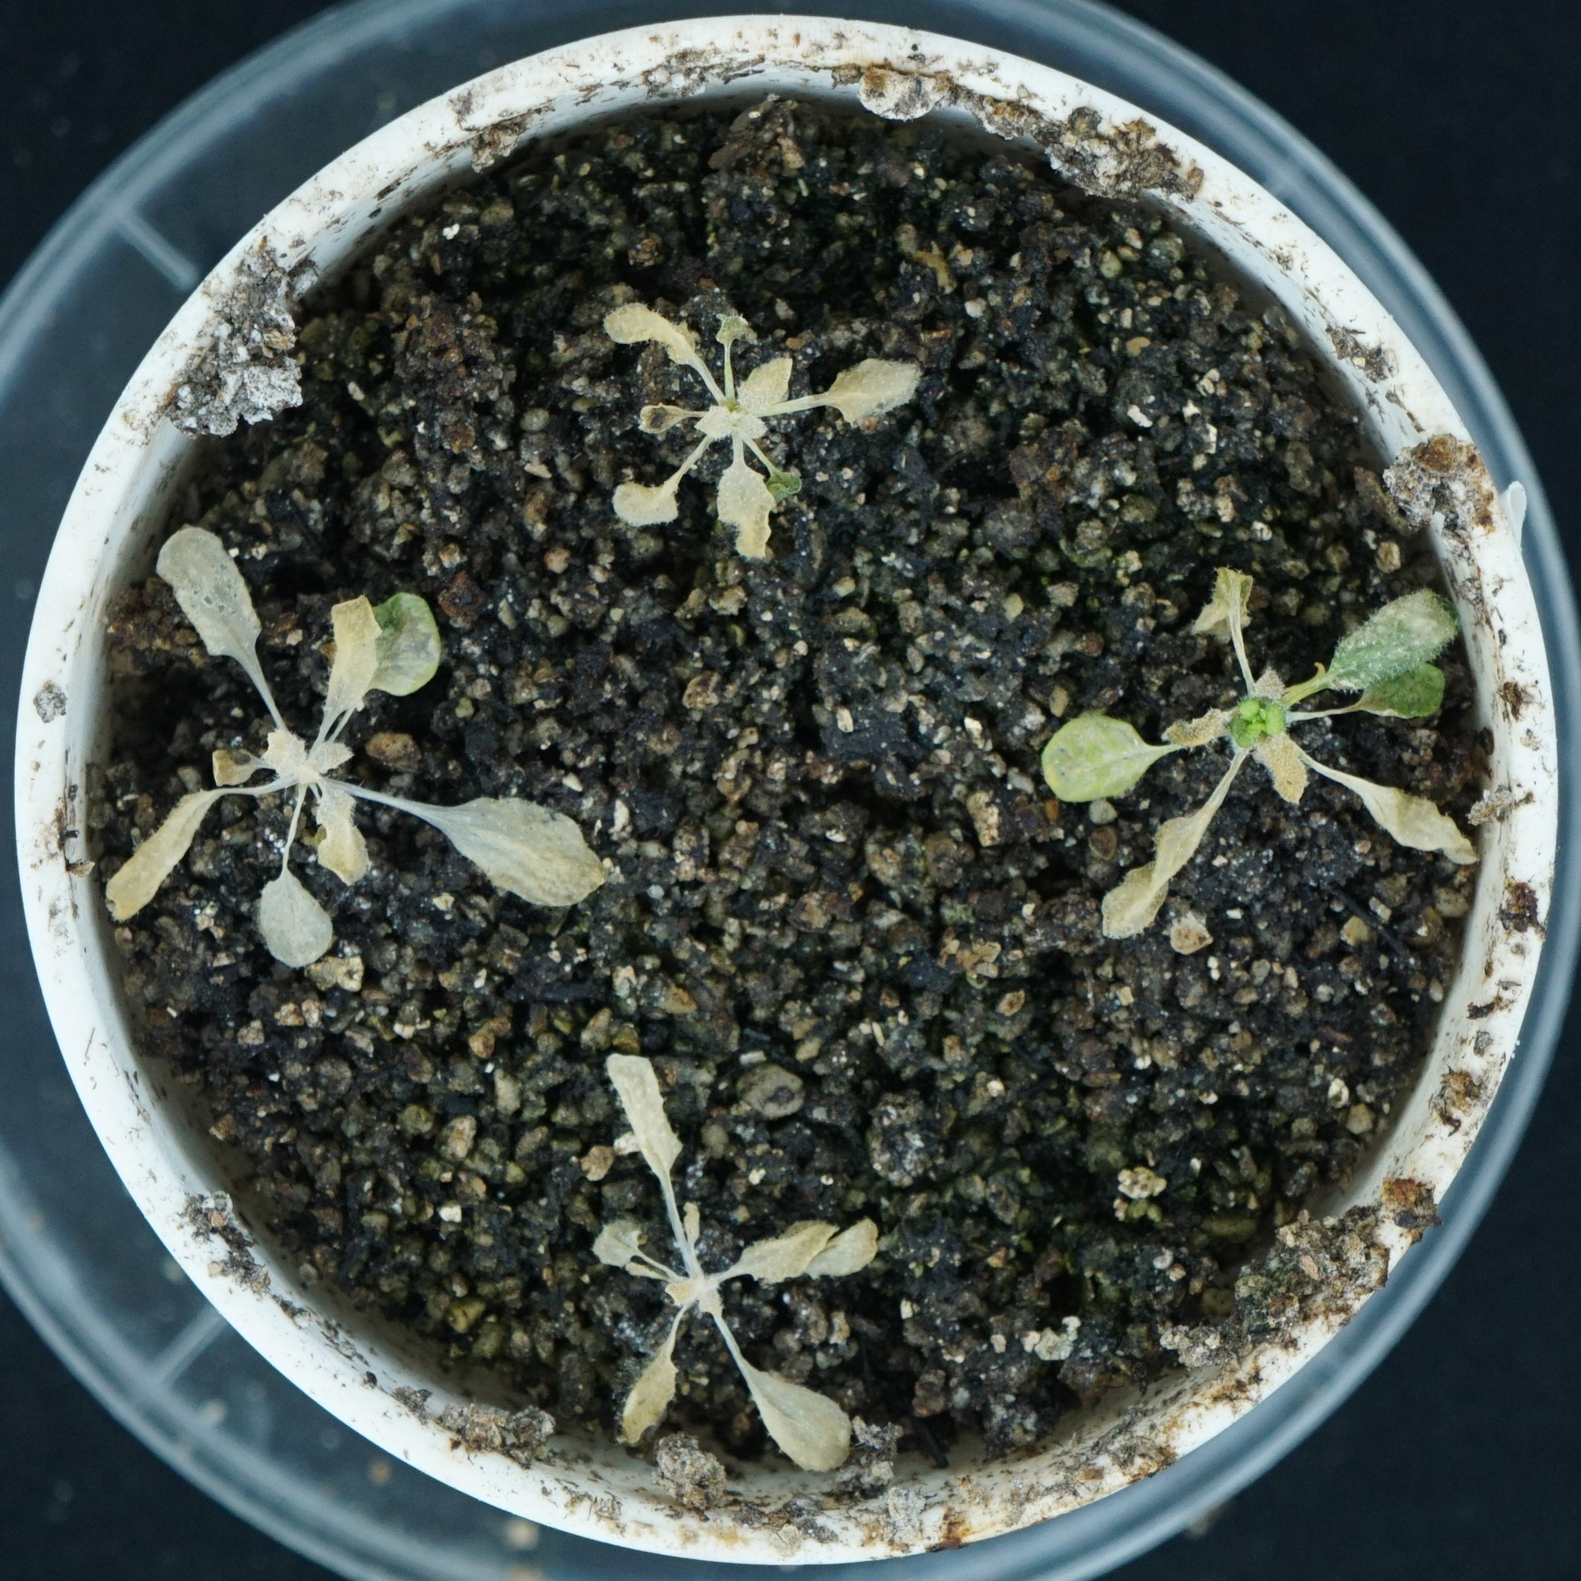
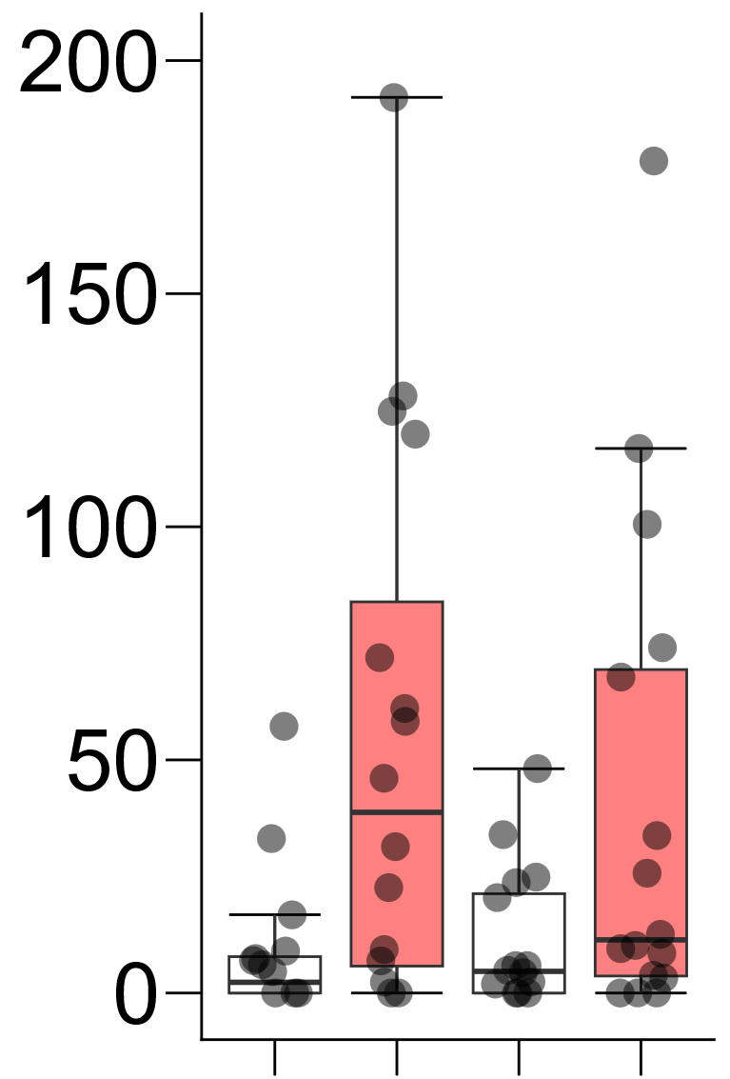
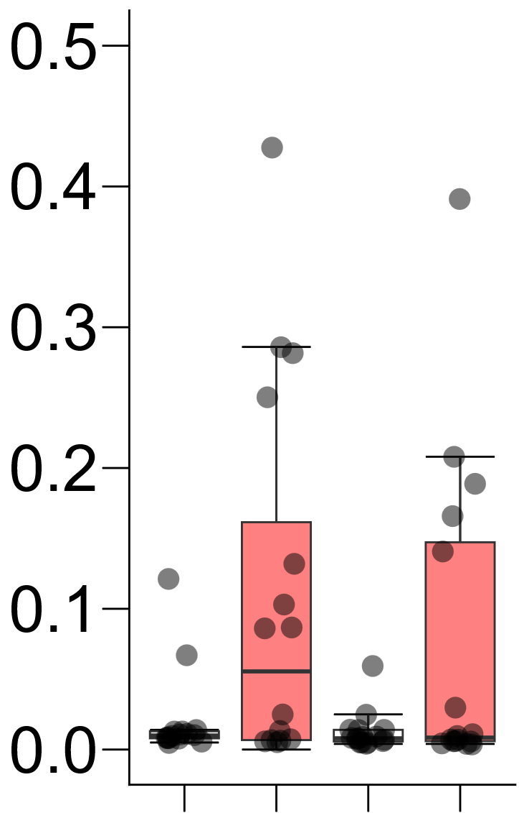
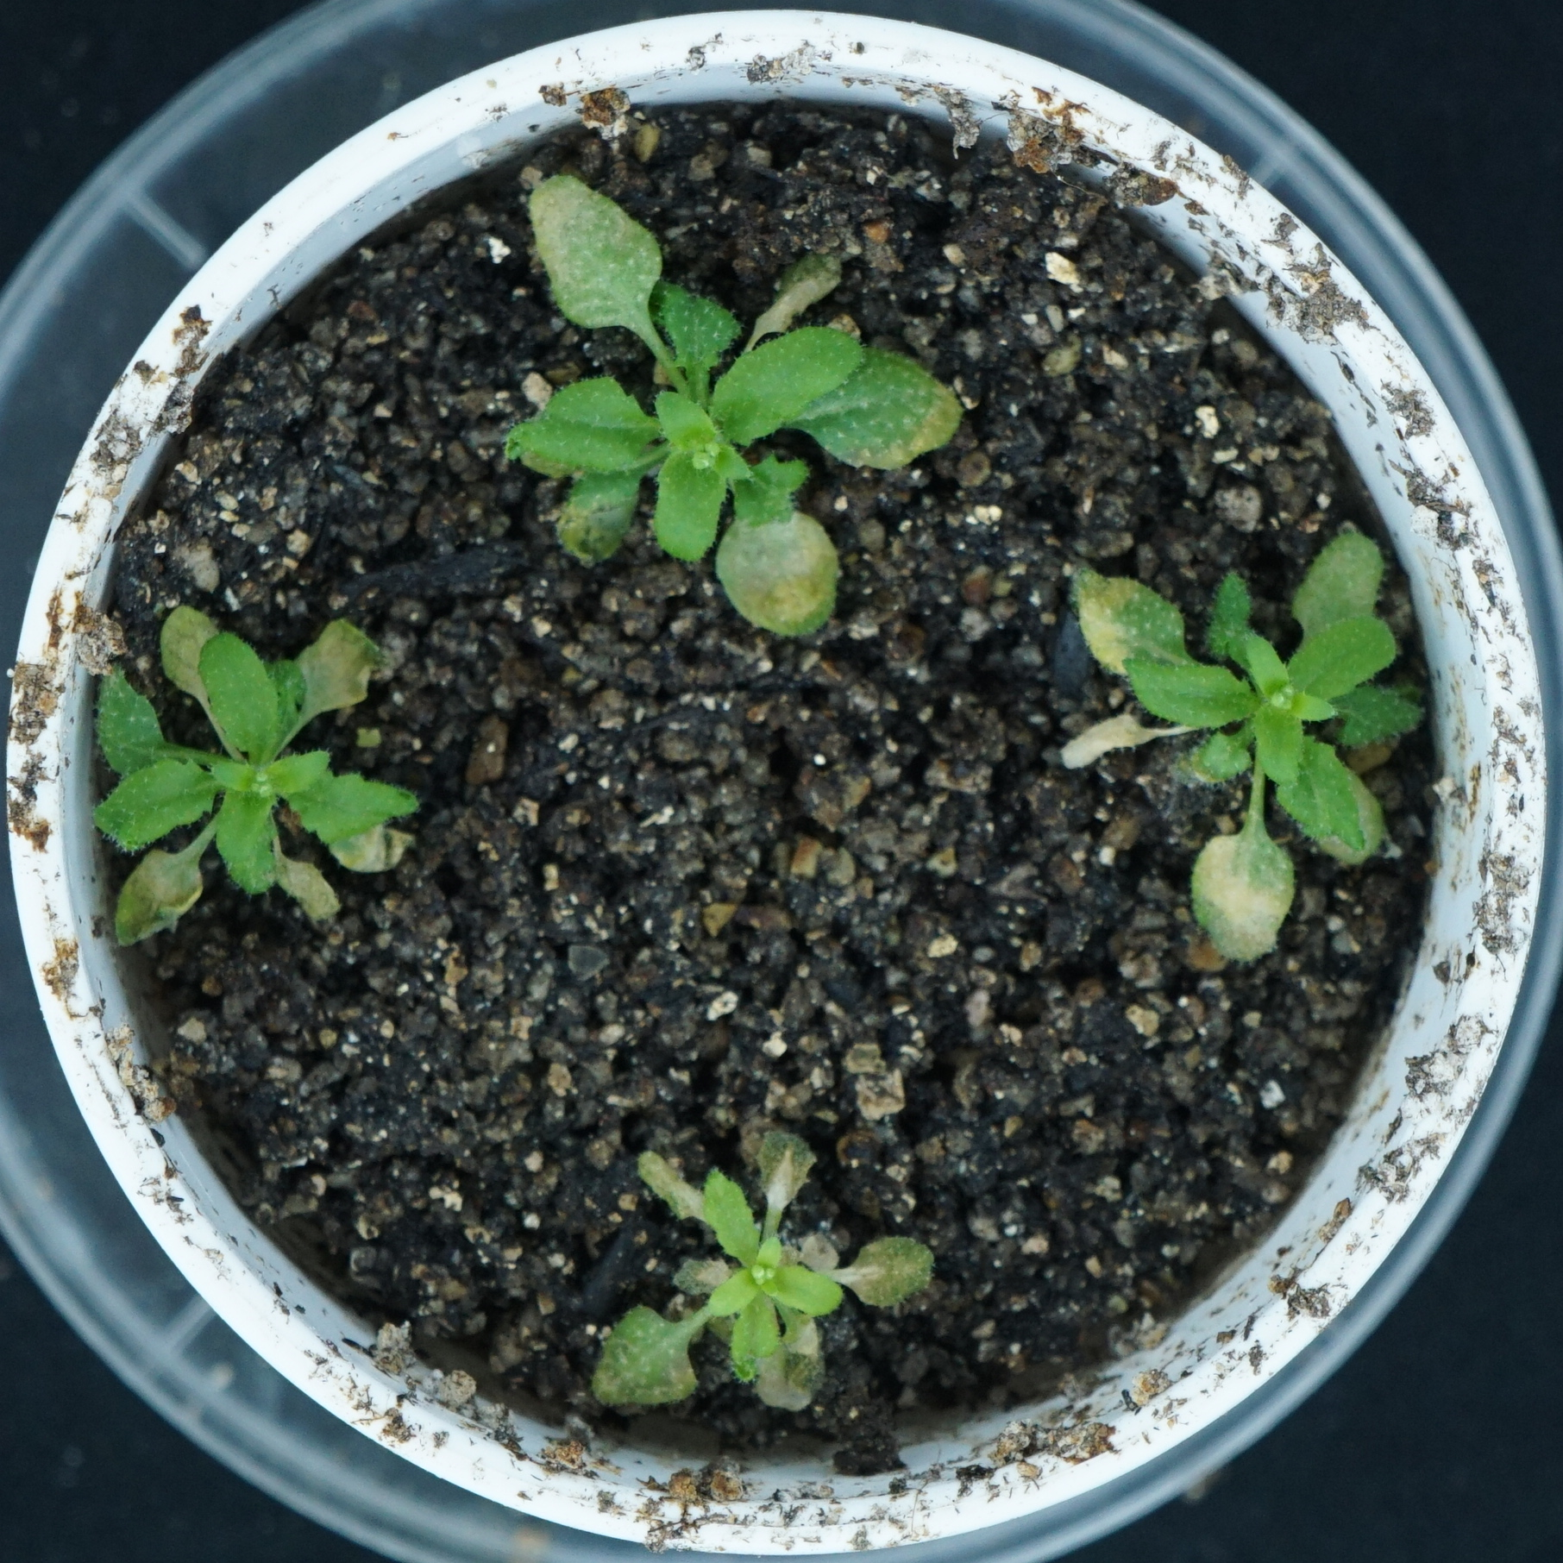
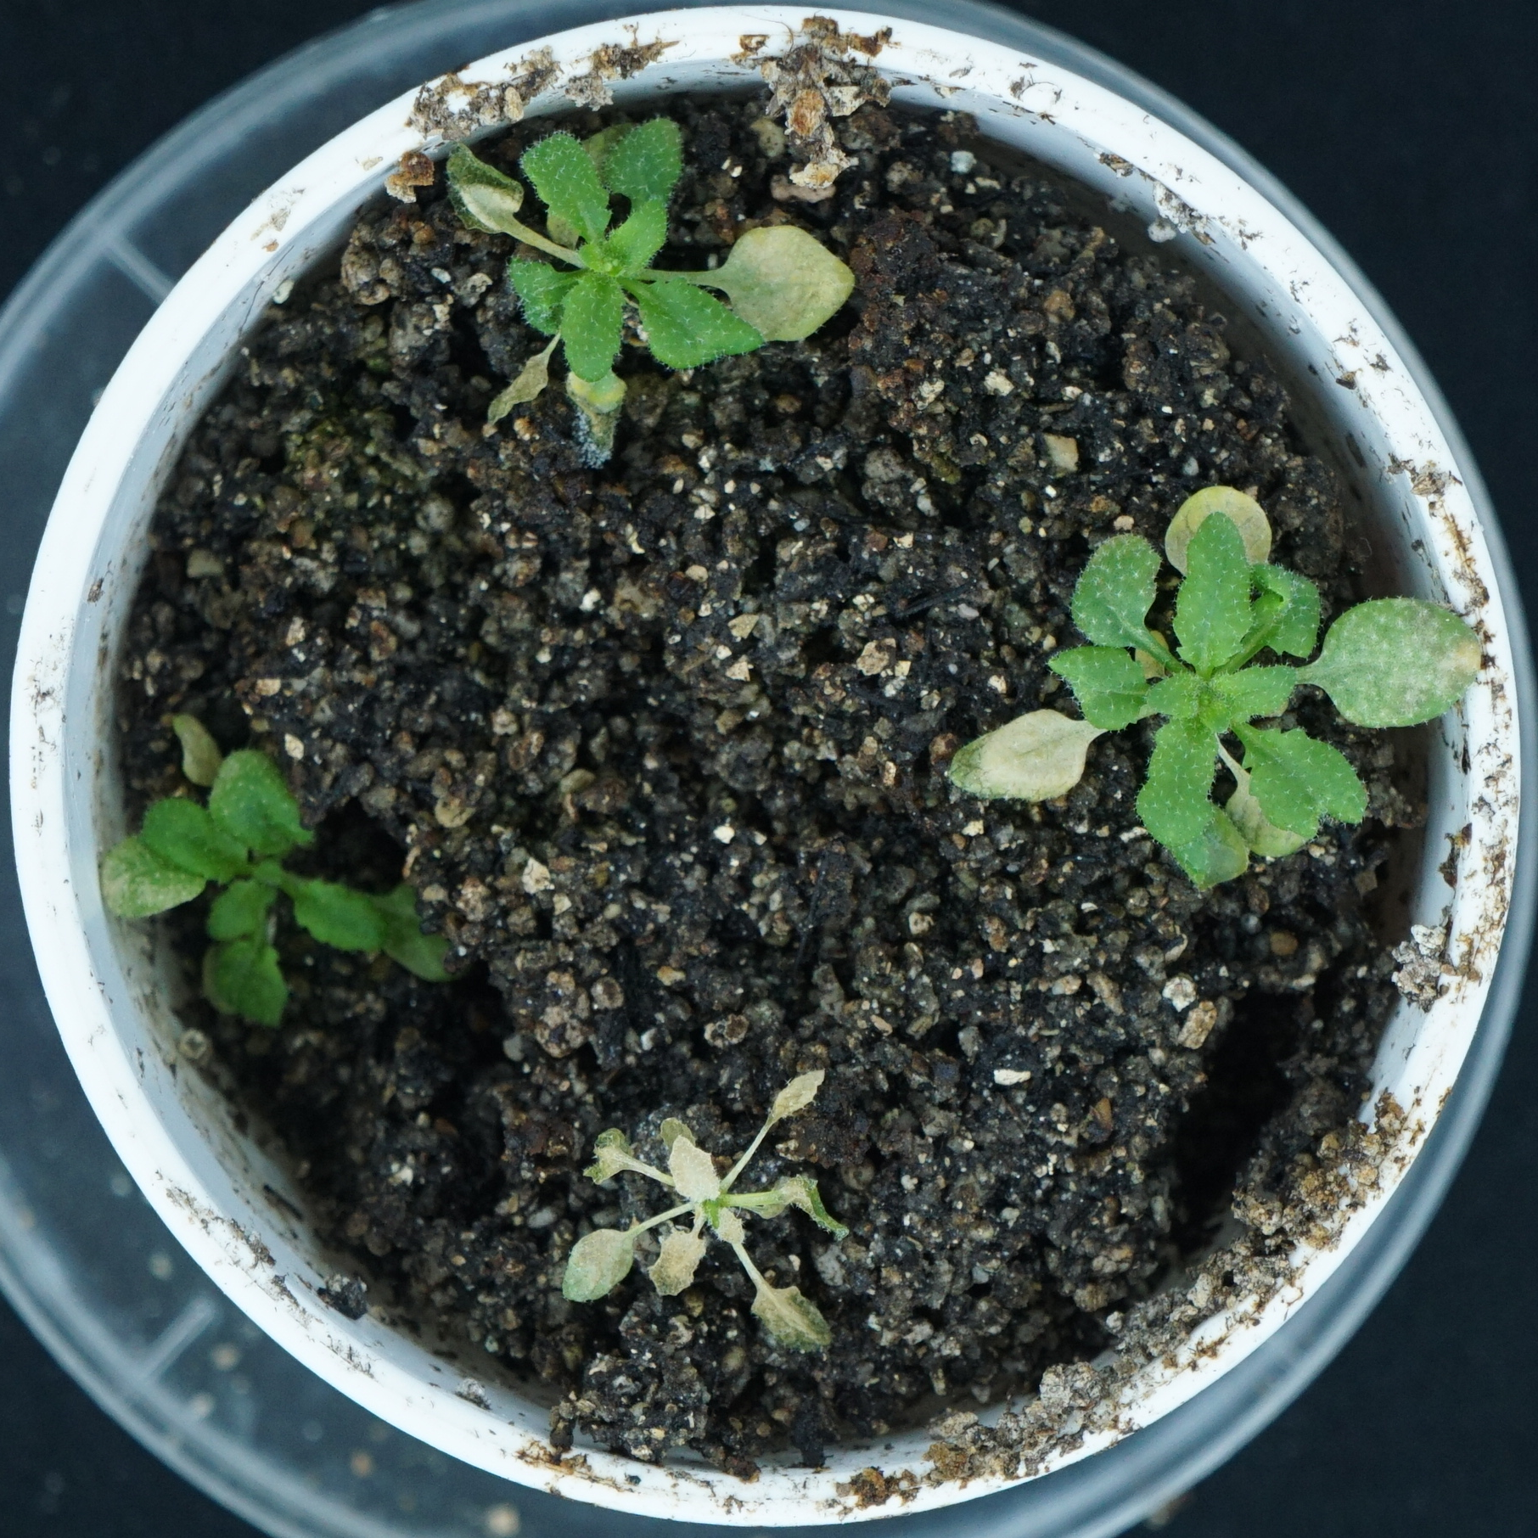
A
Col-0
eto1
B
b
C
Water
ab
b
Green leaf area (mm²)
Fresh weight (g)
ab
a
a
a
a
Ethanol
Water
Water
Water
Water
Ethanol
Ethanol
Ethanol
Ethanol
Bar = 2 cm
Col-0
eto1
Col-0
eto1
Supplemental Figure 4.

Slide 5
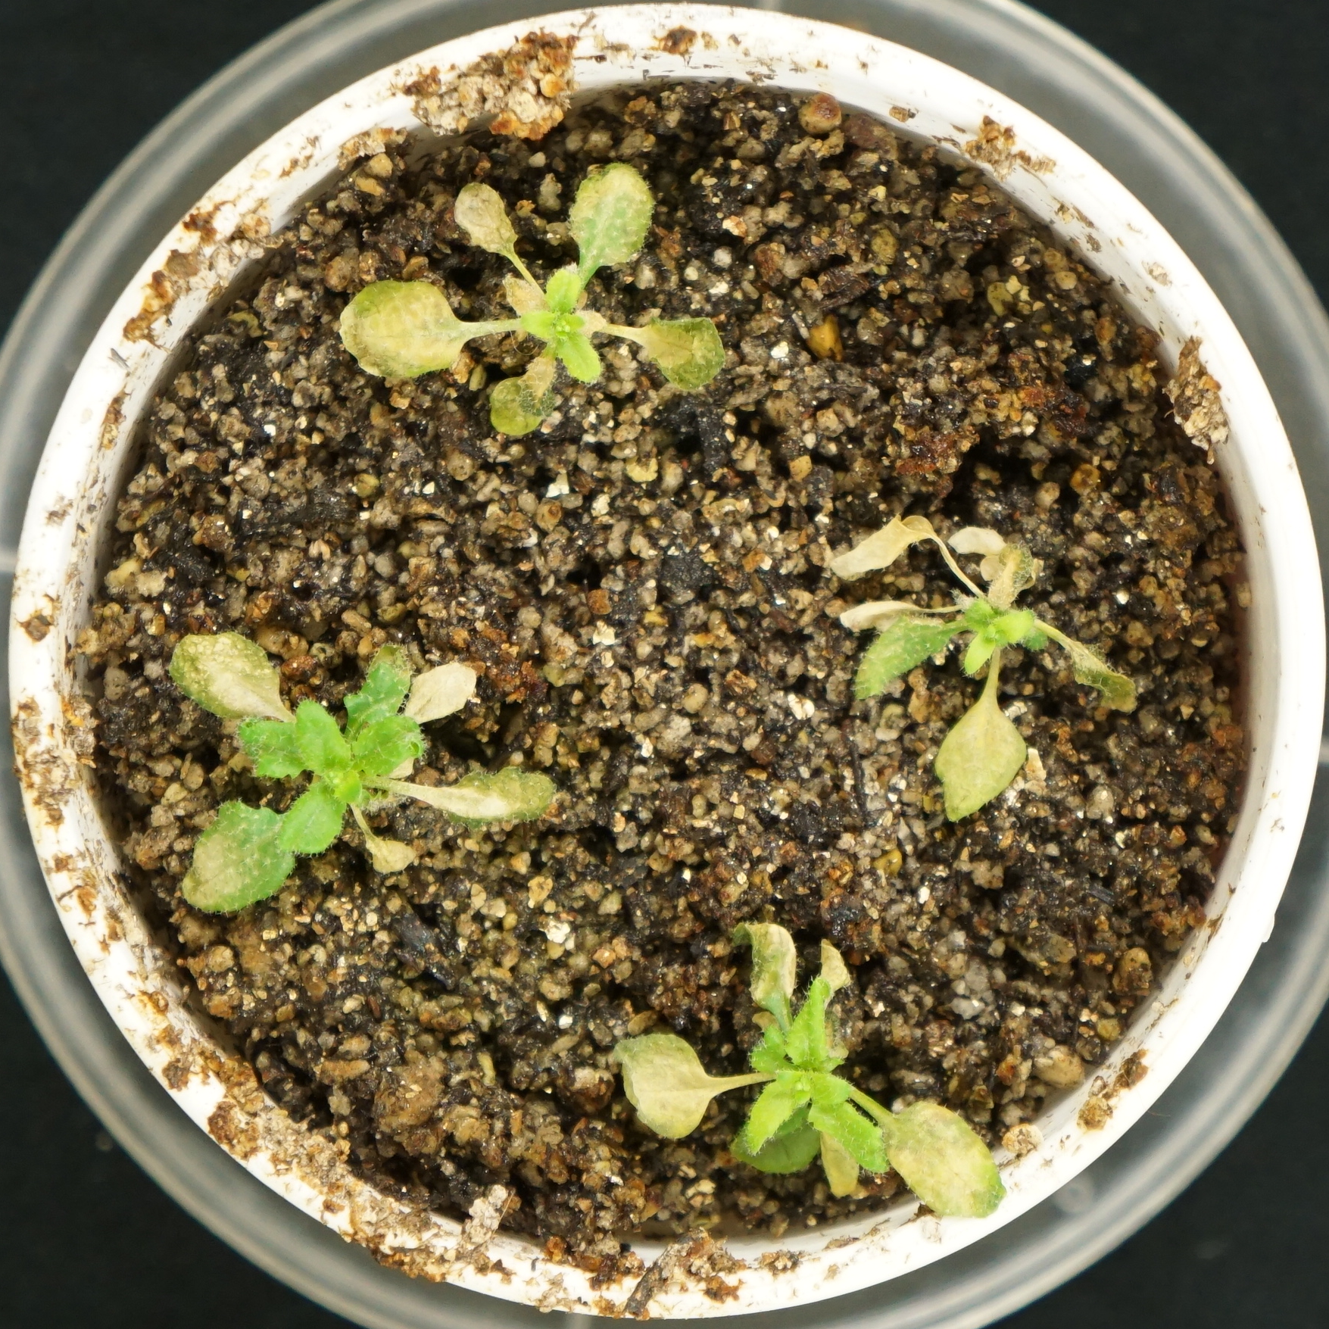
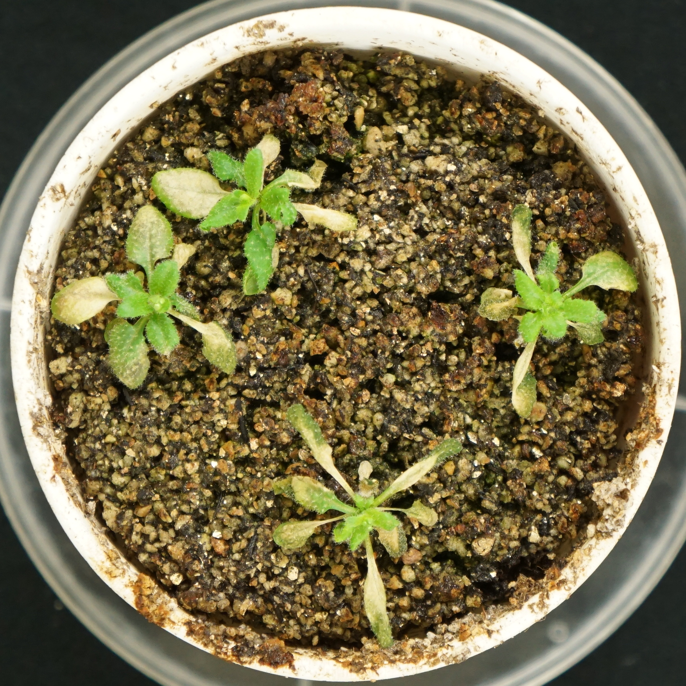
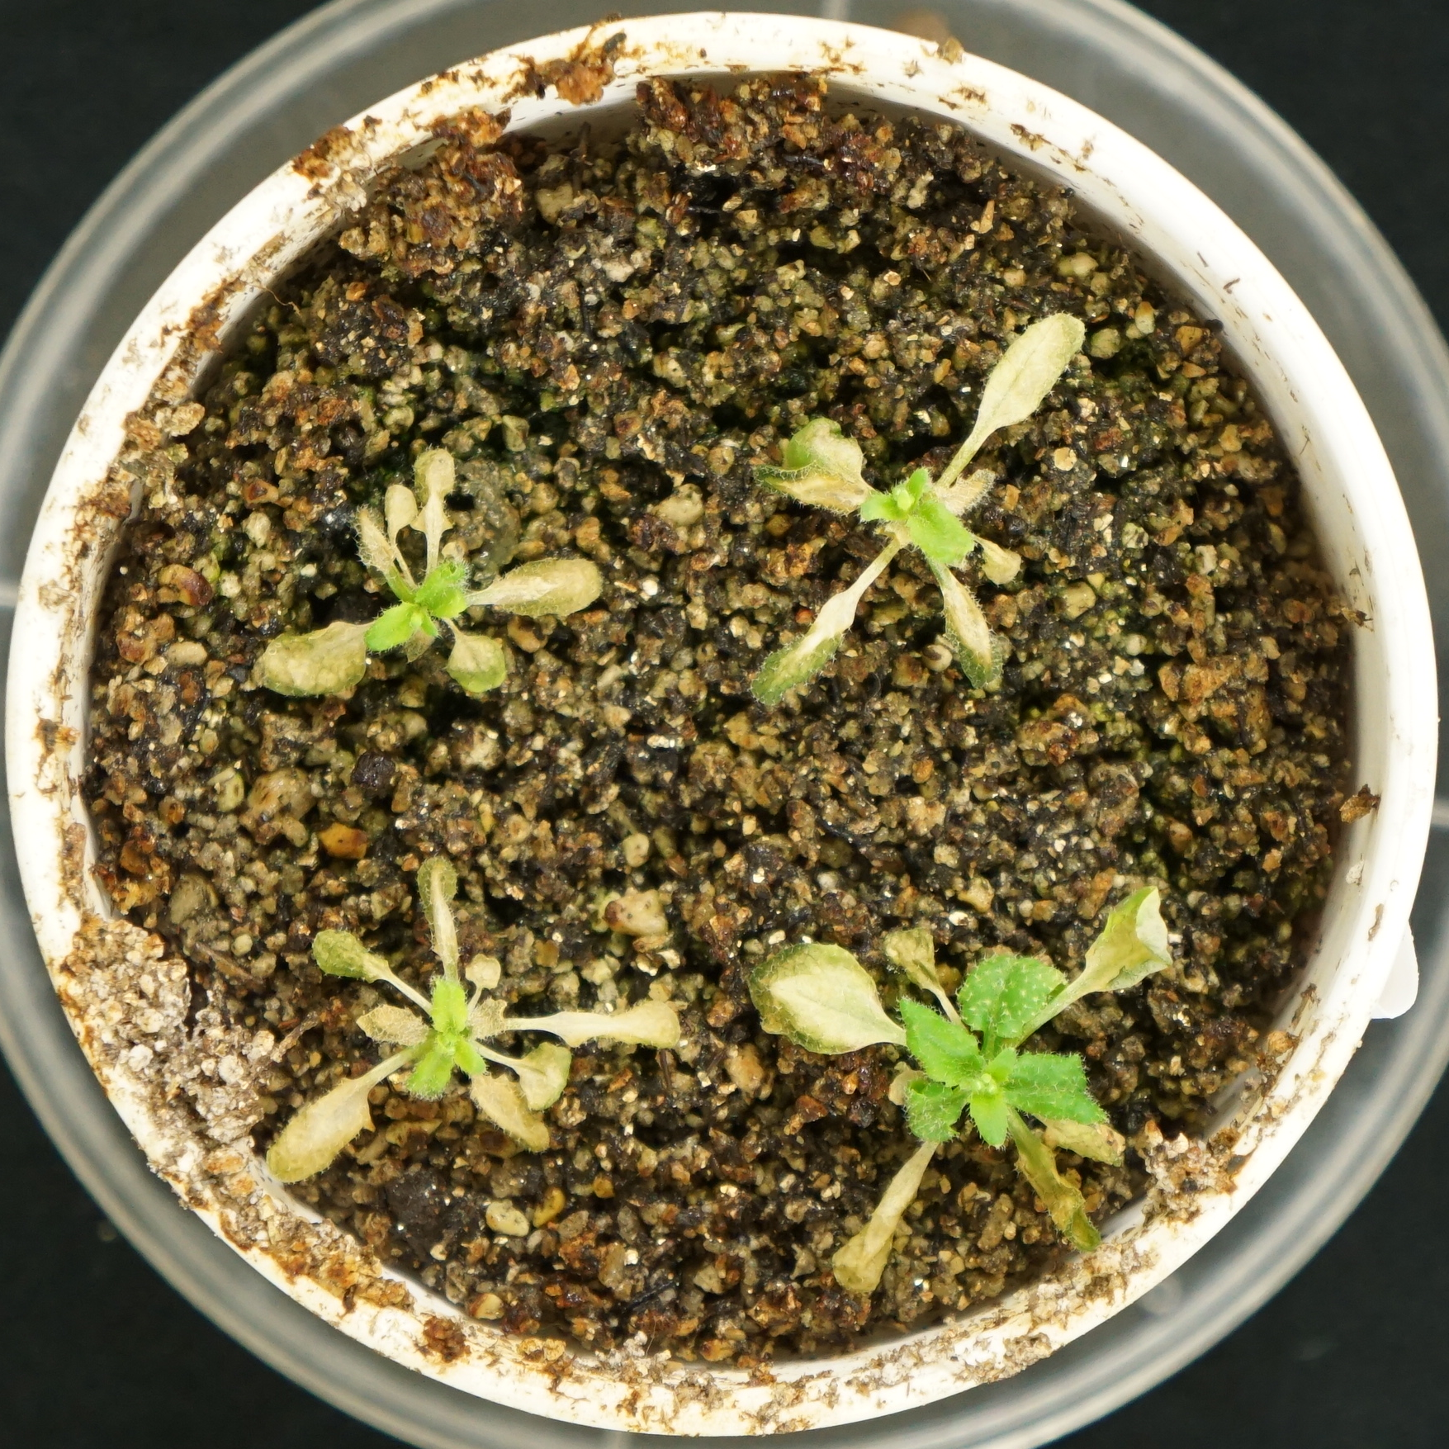
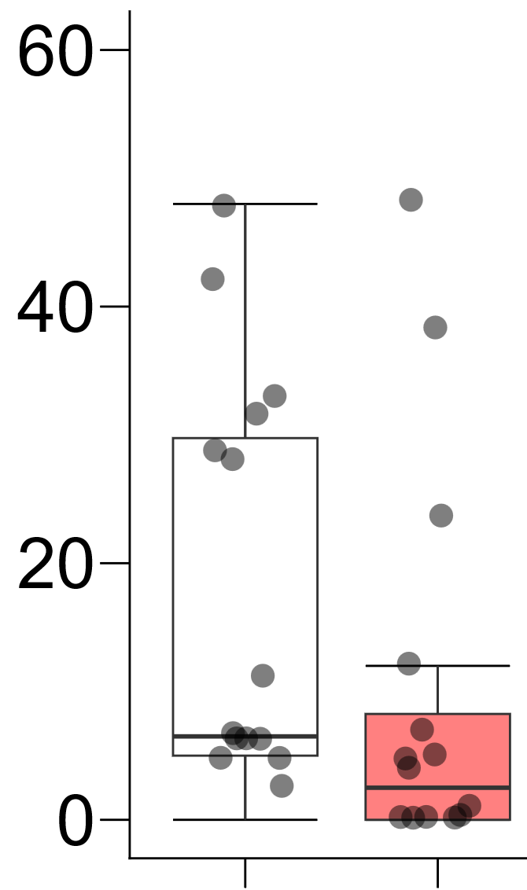
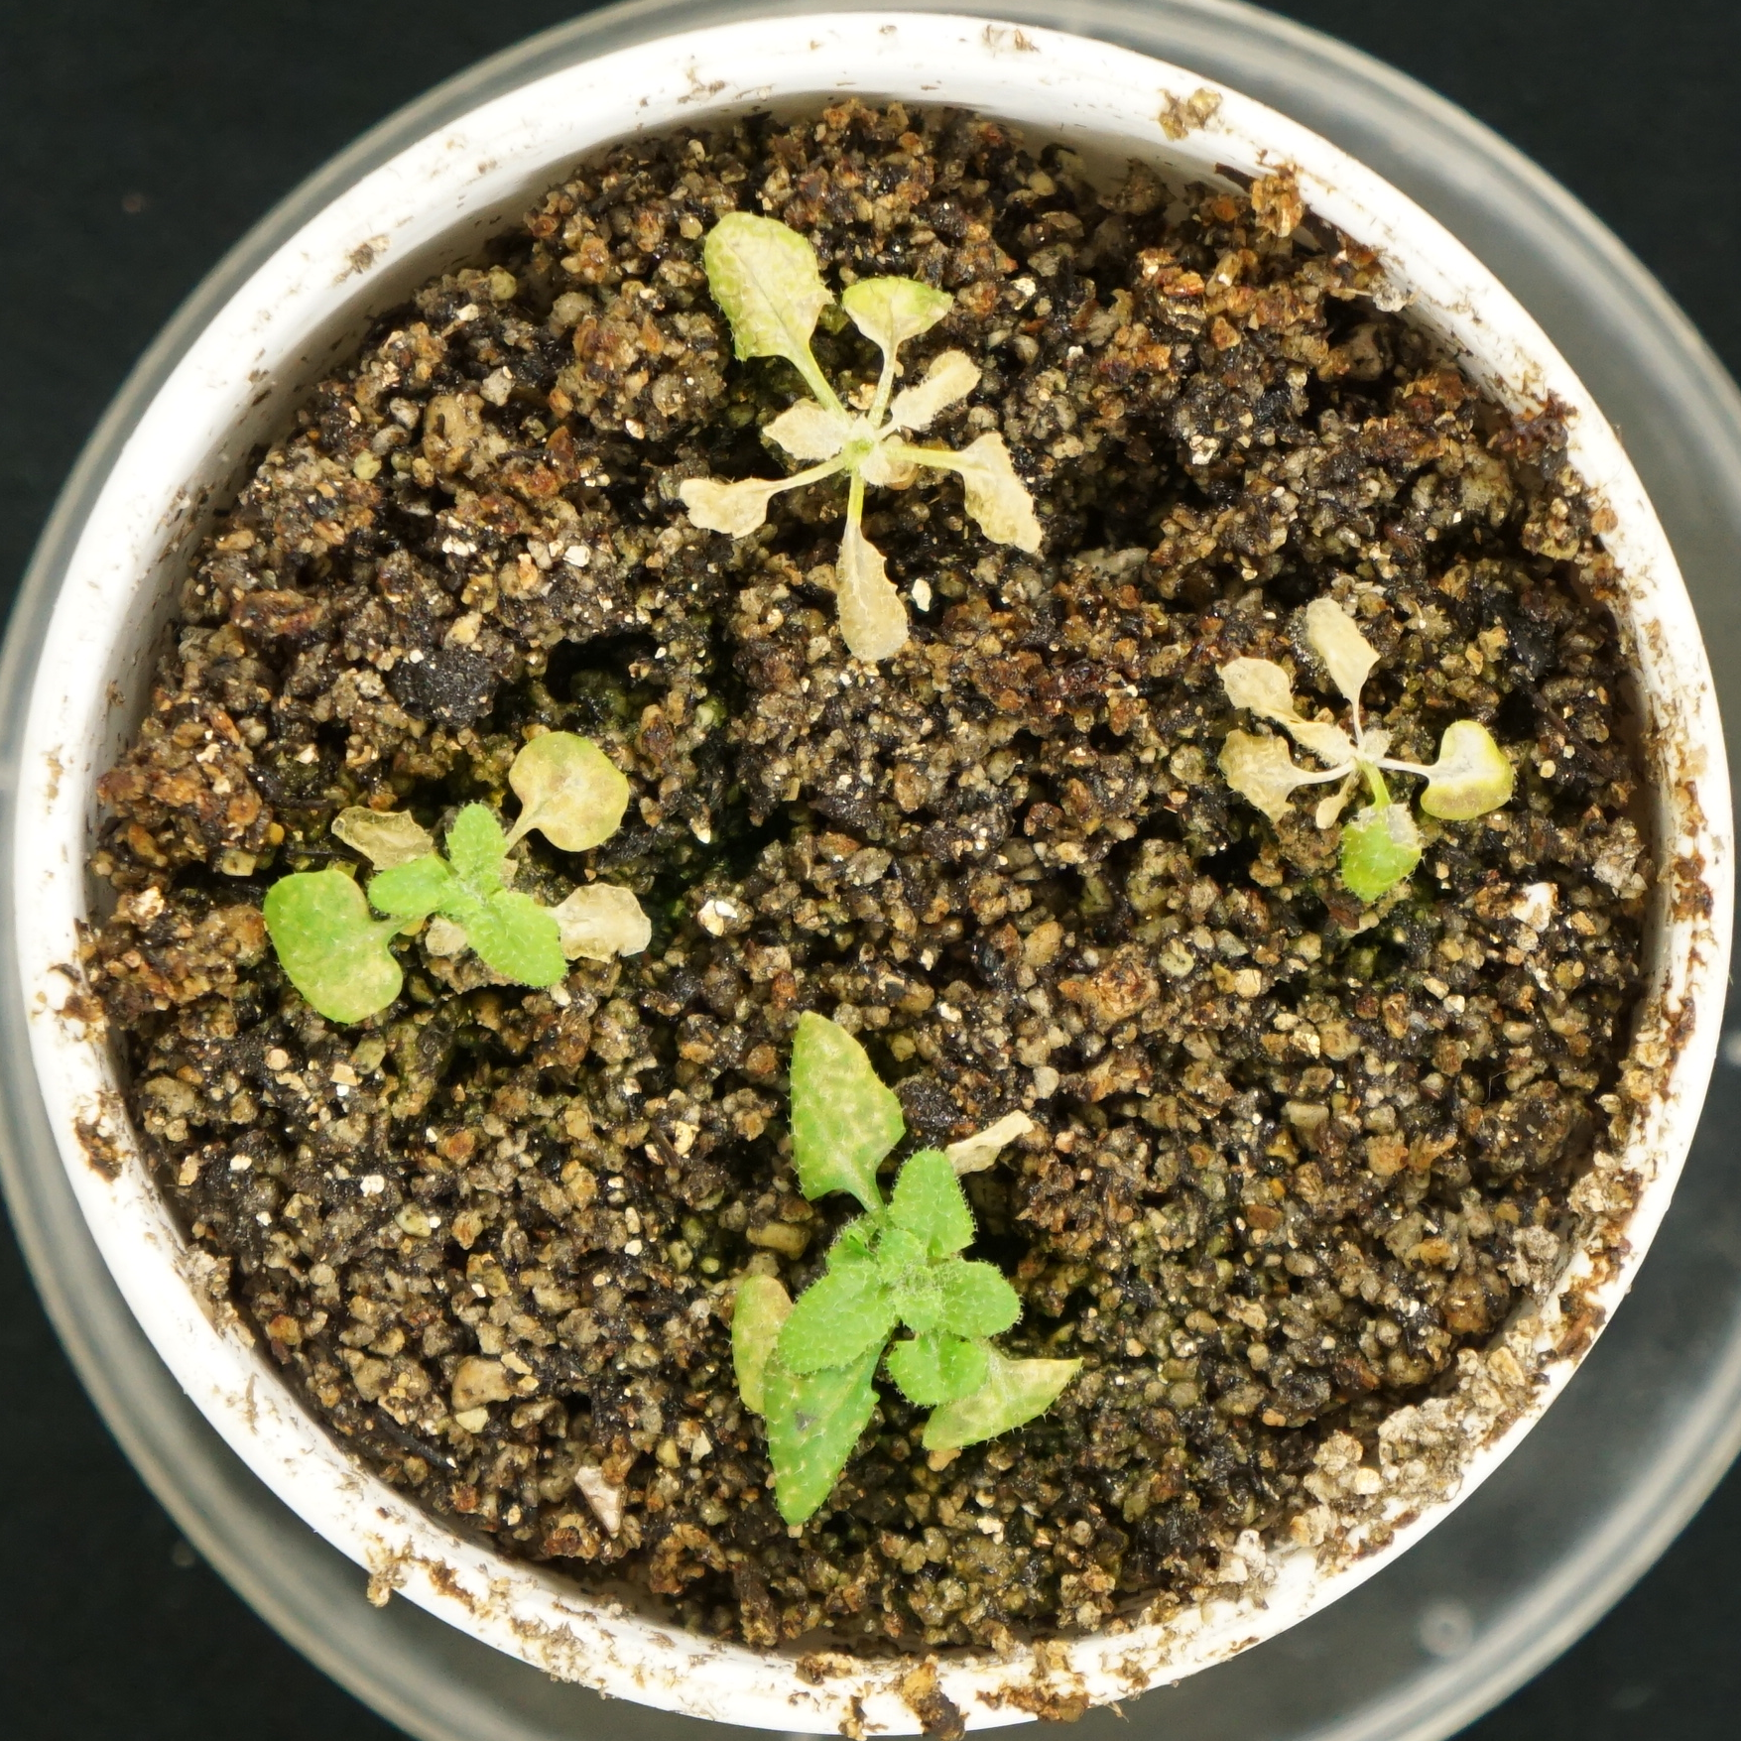
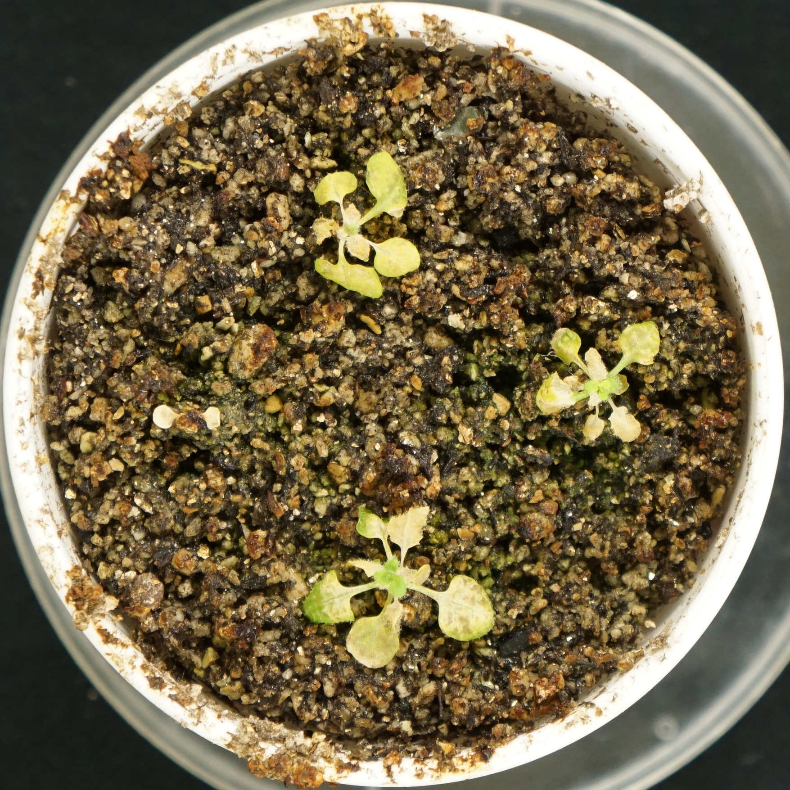
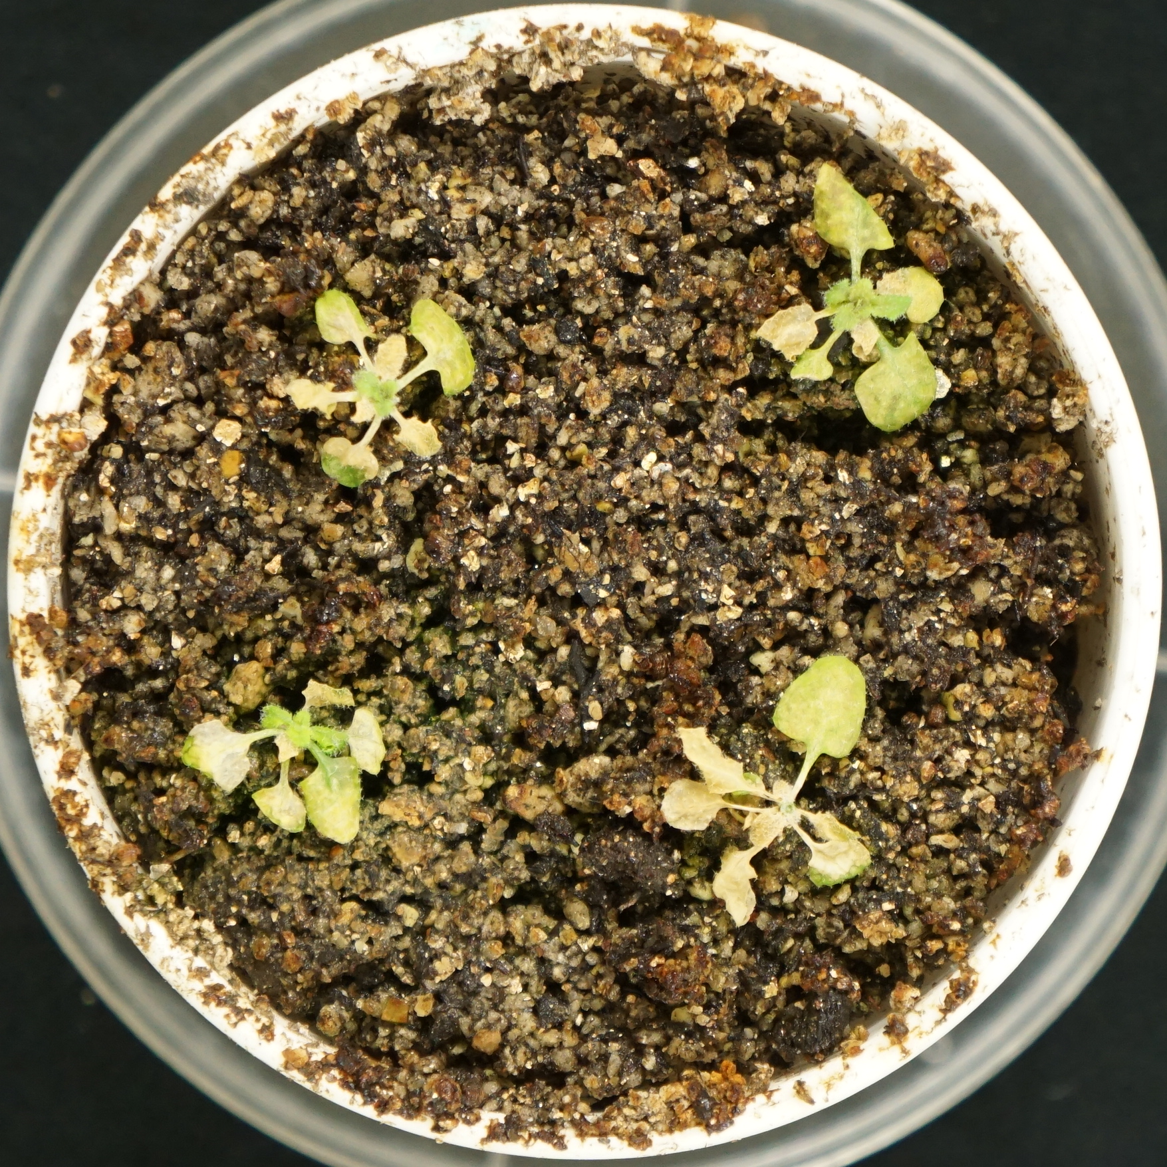
A
B
Col-0
a
a
Green leaf area (mm²)
ein2
Col-0
ein2
Bar = 2 cm
Supplemental Figure 5.

Slide 6
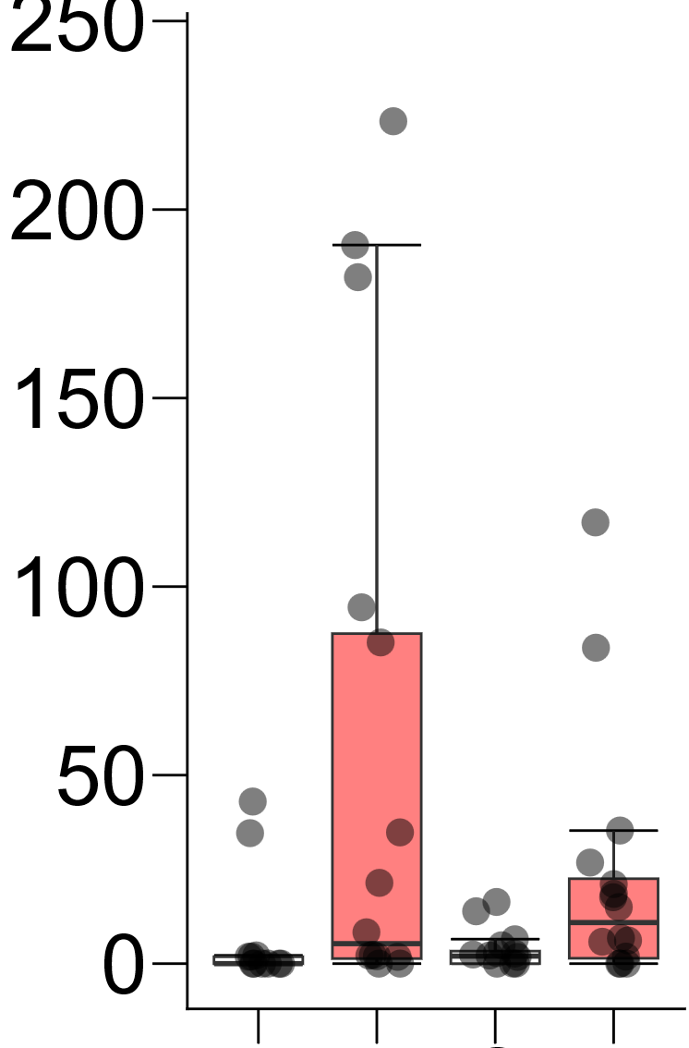
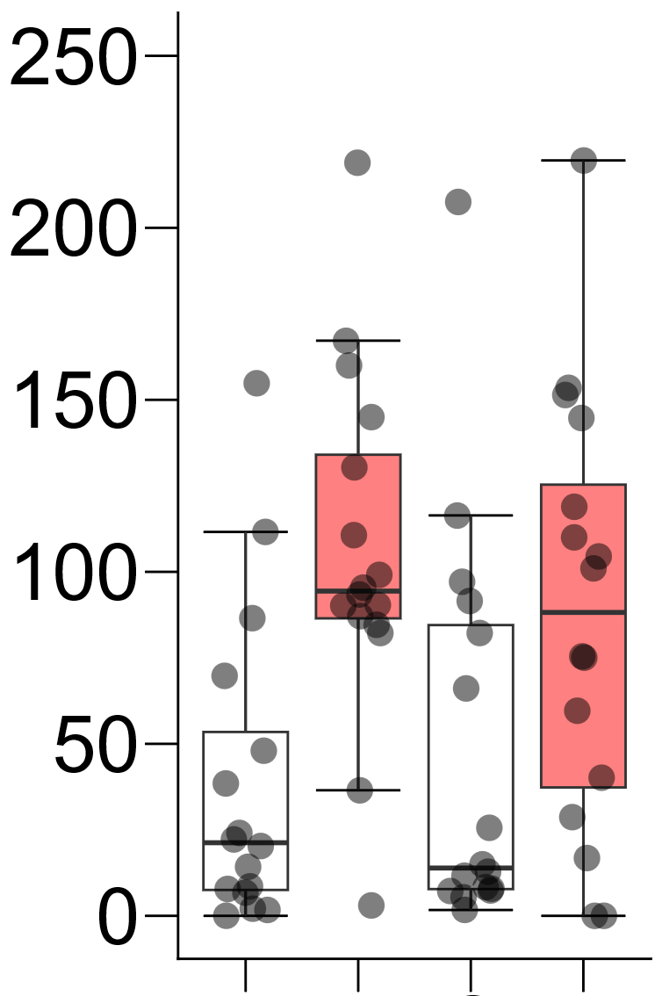
A
250
B
b
b
b
Green leaf area (mm²)
ab
a
a
Green leaf area (mm²)
a
a
1-ACC
-
-
+
+
AgNO₃
-
-
+
+
Ethanol
-
+
-
+
Ethanol
-
+
-
+
6d
3d
Supplemental Figure 6.

Slide 7
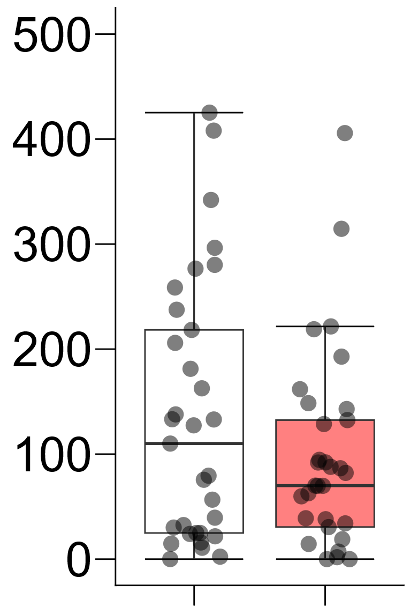
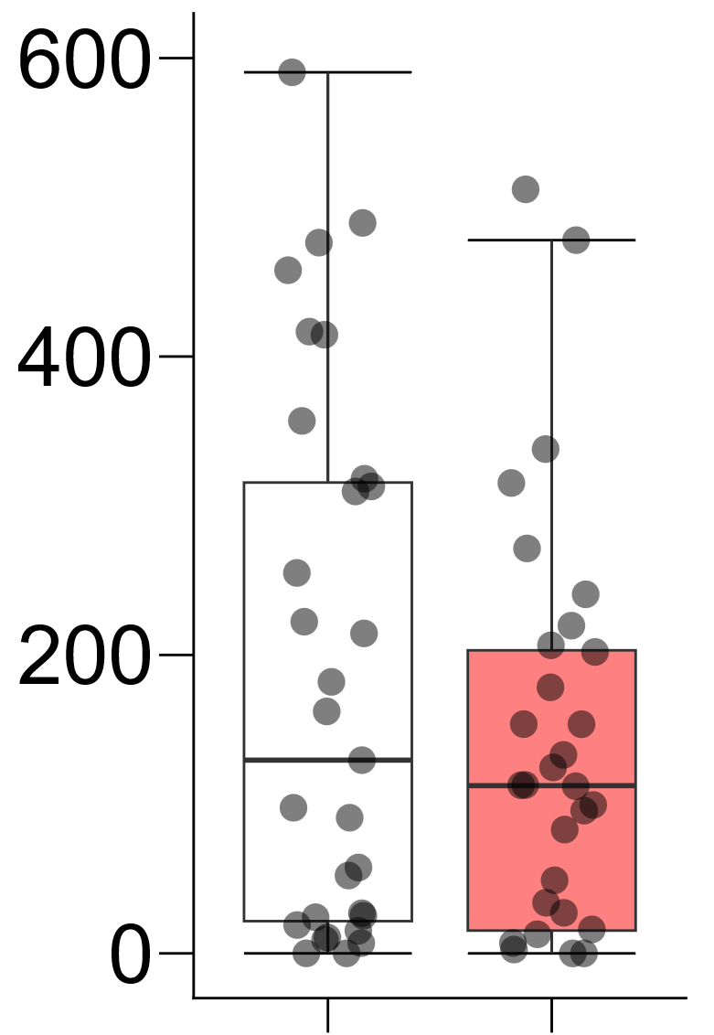
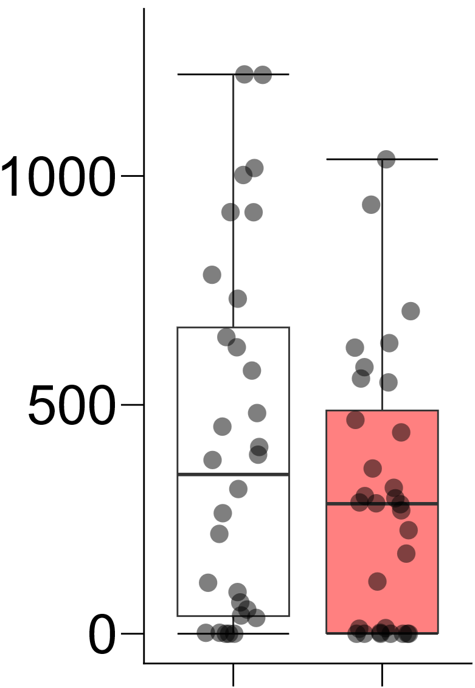
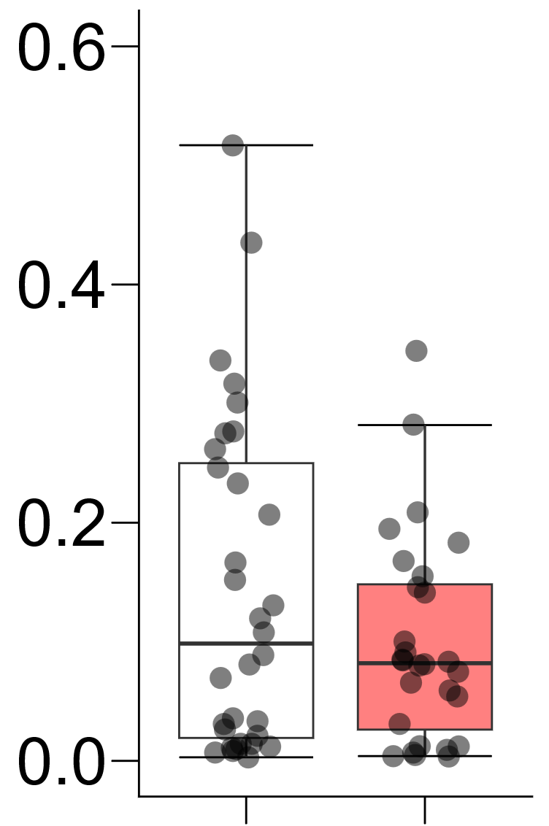
A
a
B
a
a
a
Green leaf area (mm²)
Green leaf area (mm²)
Col-0
ein2
Col-0
ein2
C
a
a
D
a
a
Green leaf area (mm²)
Fresh weight (g)
Col-0
ein2
Col-0
ein2
Supplemental Figure 7.

Slide 8
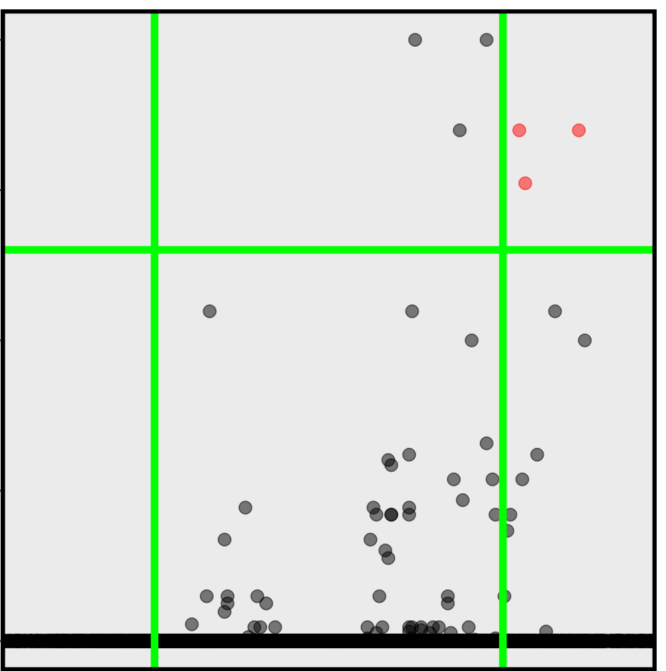
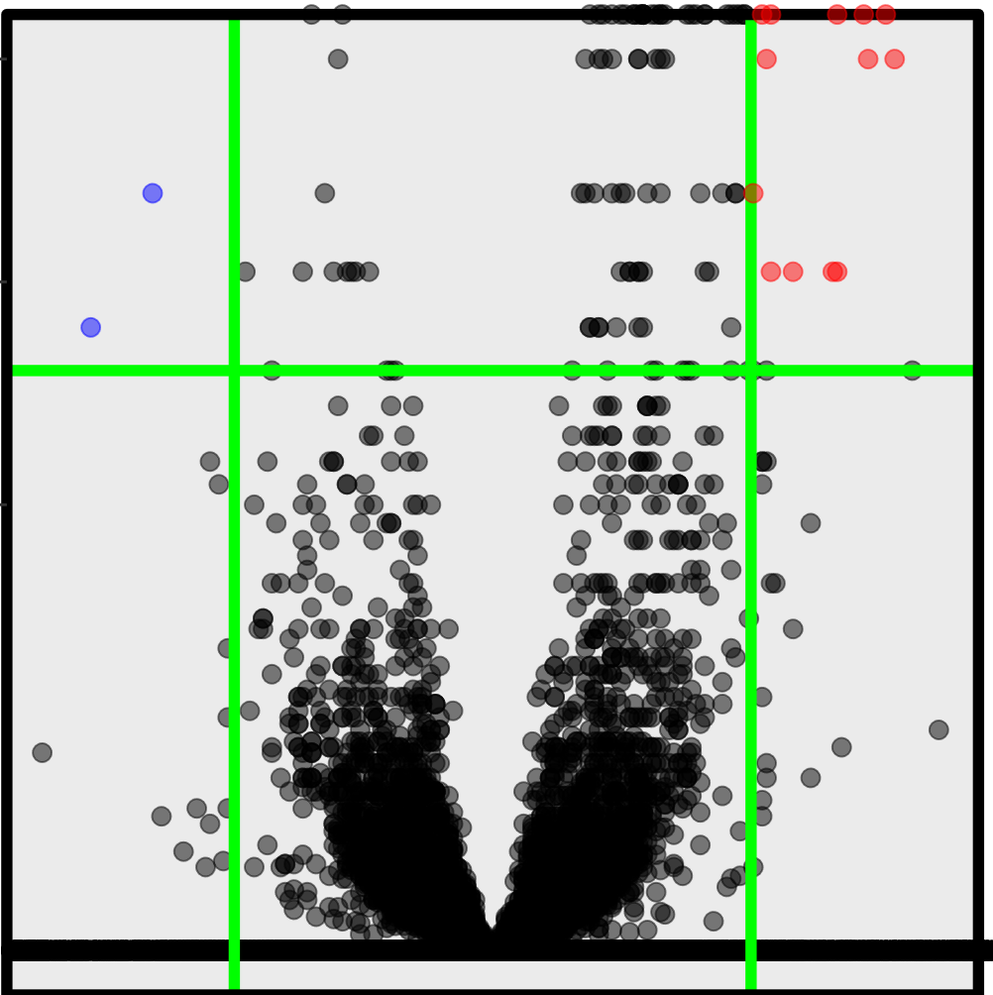
A
+Water
W1d
B
2.0
gE1d vs W1d
2.0
gE3d vs W3d
0
13
14
1.5
1.5
Gaseous Ethanol
1.0
1.0
+Ethanol
gE1d
-Log10 q-Value
-Log10 q-Value
0.5
0.5
0
13
14
0.0
0.0
+Water
W3d
-1.0
-0.5
0.0
0.5
1.0
-1.0
-0.5
0.0
0.5
1.0
C
Log2 Fold Change
Log2 Fold Change
0
11
14
Up-regulated DEGs
Down-regulated DEGs
+Ethanol
gE3d
gE1d vs W1d
gE1d vs W1d
Gaseous Ethanol
3
0
13
0
0
2
0day
11
DAS
14
gE3d vs W3d
gE3d vs W3d
Supplemental Figure 8.

Slide 9









AT1G72060
1.25
AT2G05540
AT4G35770
0.3
b
b
b
b
3.0
a
a
1.00
2.0
b
0.2
a
a
0.75
a
c
c
Expression level
(copies / ACT2)
Expression level
(copies / ACT2)
Expression level
(copies / ACT2)
0.1
0.50
1.0
0.25
0
gE3d
0
gE3d
0
W1d
gE1d
W3d
W1d
gE1d
W3d
W1d
gE1d
W3d
gE3d
AT2G33830
AT3G47340
AT5G56870
4.0
a
a
0.3
a
0.6
ab
b
b
a
3.0
b
b
0.2
b
b
0.4
Expression level
(copies / ACT2)
Expression level
(copies / ACT2)
Expression level
(copies / ACT2)
2.0
0.1
c
1.0
0.2
0
gE3d
0
gE3d
0
W1d
gE1d
W3d
W1d
gE1d
W3d
W1d
gE1d
W3d
gE3d
0.20
AT1G02640
a
10.0
AT1G22530
a
0.08
AT1G76590
0.15
7.5
b
ab
b
0.06
bc
b
a
c
bc
b
c
Expression level
(copies / ACT2)
Expression level
(copies / ACT2)
Expression level
(copies / ACT2)
0.10
5.0
0.04
0.05
2.5
0.02
0
gE3d
0
gE3d
0
W1d
gE1d
W3d
W1d
gE1d
W3d
W1d
gE1d
W3d
gE3d
Supplemental Figure 9.

Slide 10









A
Water
treatment
+Water
Subzero-
temperature
C
Up-regulated DEGs
Down-regulated DEGs
0
W3d
W3dF2h
E3d vs W3d
E3d vs W3d
7d
3d
2h
3
0
4
2
1
11
0
7
10
DAS
Subzero-
temperature
E3dF2h vs
W3dF2h
E3dF2h vs
W3dF2h
Ethanol
treatment
+Ethanol
E3d
E3dF2h
7d
3d
2h
D
Bevul5G073300
Bevul1G104100
0
7
10
B
DAS
b
4.0
334
W3dF2h vs W3d
401
Expression level
( / 18s rRNA)
a
a
Expression level
( / 18s rRNA)
3.0
b
2.0
-Log10 q-Value
1.0
W3d
E3d
W3dF2h
E3dF2h
0.0
-6.0
-3.0
0.0
3.0
6.0
Bevul2G042800
Bevu3G143500
Log2 Fold Change
a
a
4.0
3
E3d vs W3d
3
3.0
Expression level
( / 18s rRNA)
Expression level
( / 18s rRNA)
b
b
-Log10 q-Value
2.0
1.0
W3dF2h
0.0
W3dF2h
E3dF2h
E3dF2h
-4.0
0.0
4.0
Log2 Fold Change
Bevu5G186200
Bevul9G126700
10.0
E3dF2h vs W3dF2h
a
12
4
7.5
a
-Log10 q-Value
Expression level
( / 18s rRNA)
Expression level
( / 18s rRNA)
5.0
b
2.5
b
0.0
W3dF2h
-8.0
-4.0
0.0
4.0
8.0
W3dF2h
E3dF2h
E3dF2h
Log2 Fold Change
Supplemental Figure 10.

