Slide 1
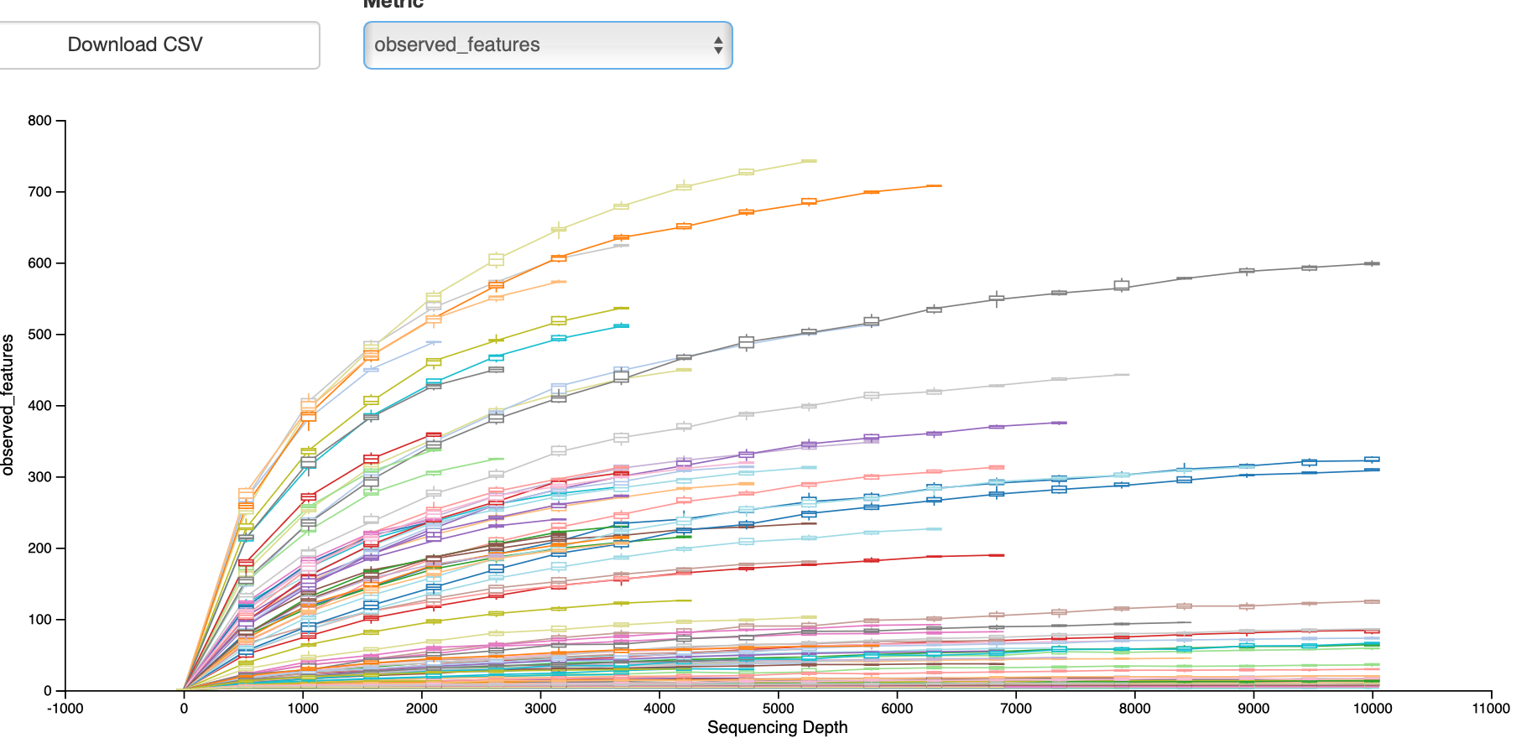
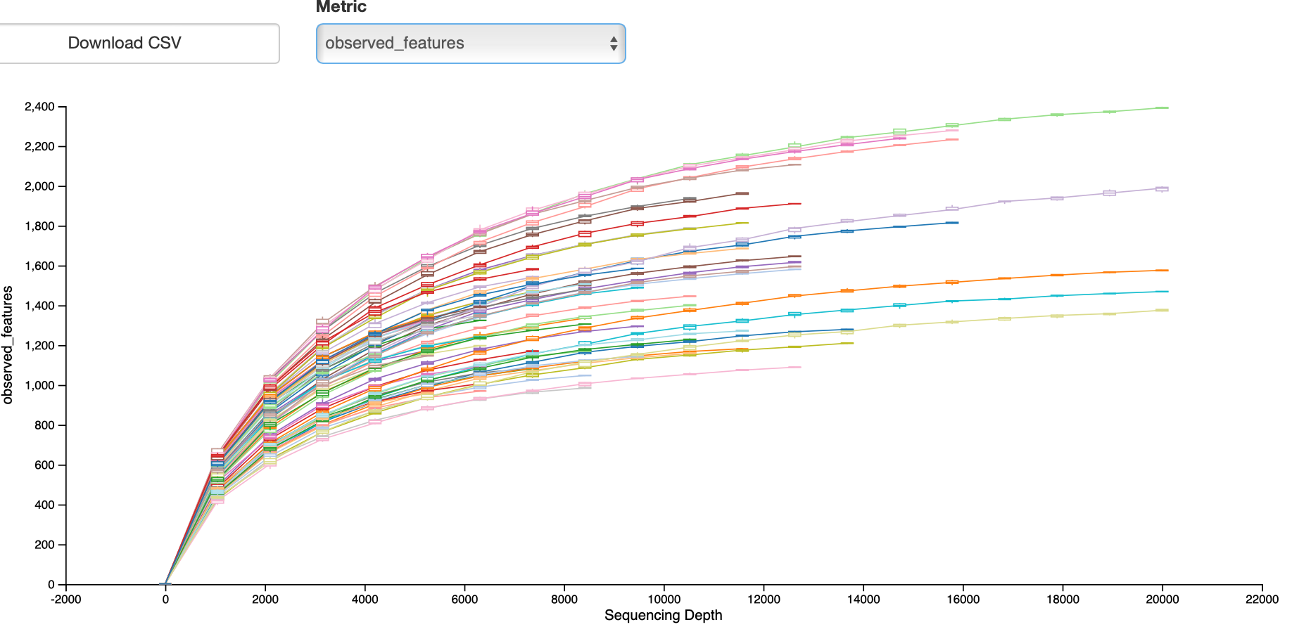
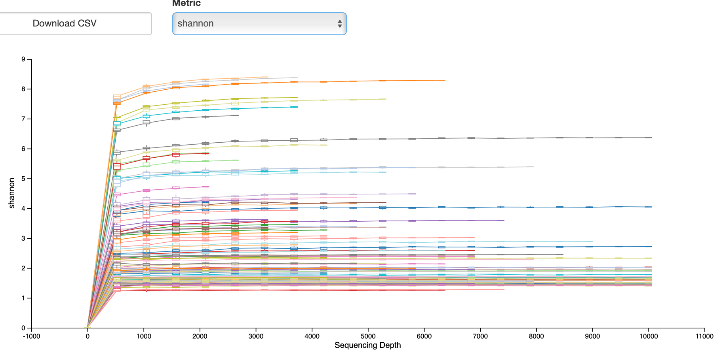
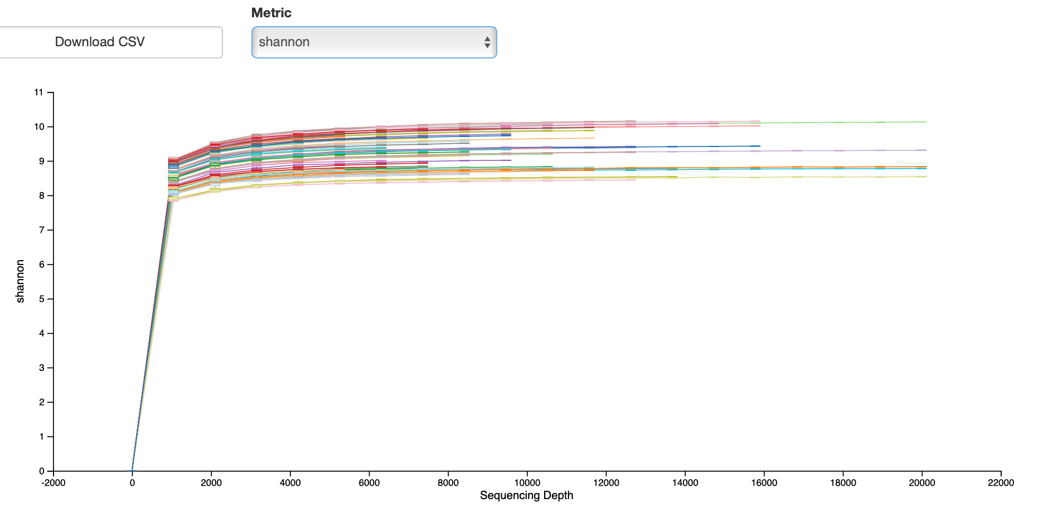
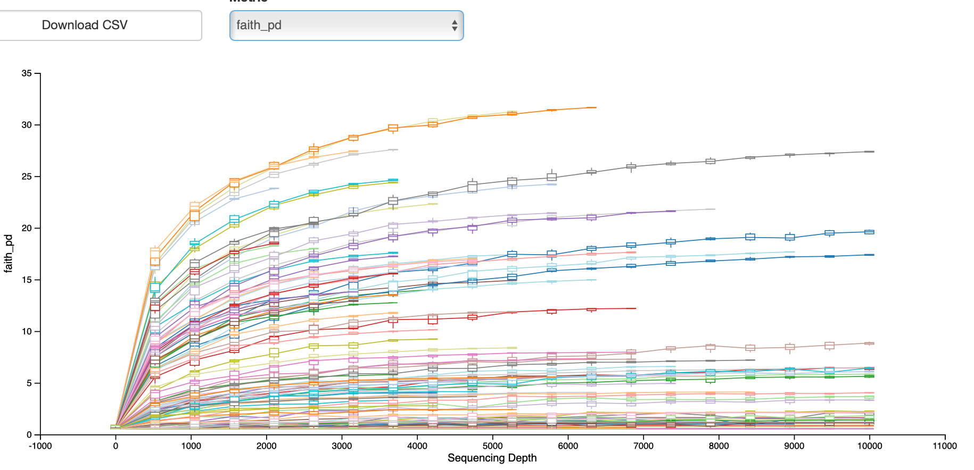
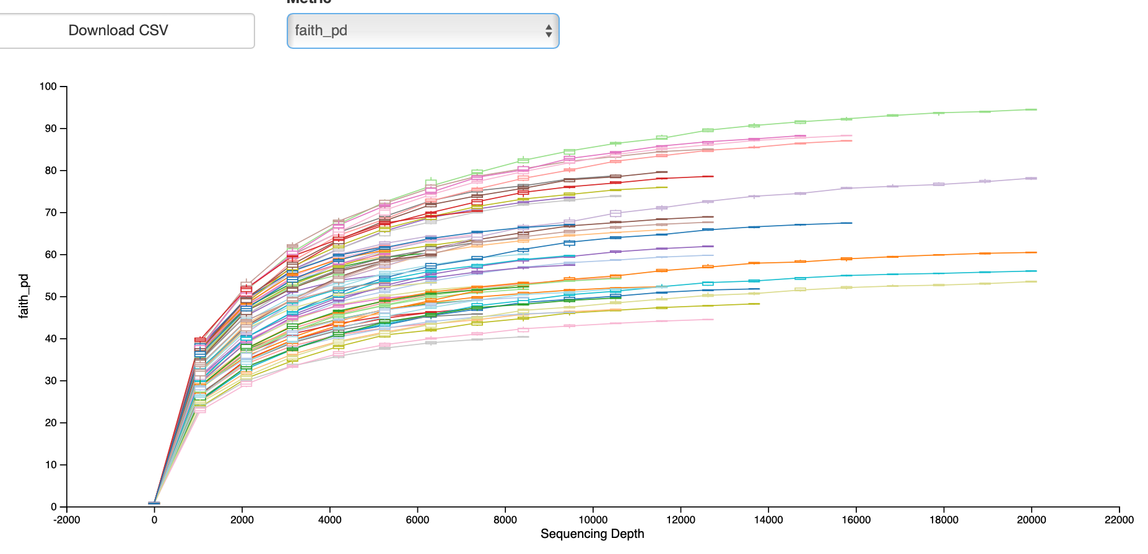
A
D
B
E
C
F
Figure S2. Rarefaction curves.
A-C – Plant tissue dataset; D-E – Soil dataset; A, D – Observed futures; B-E – Shannon diversity; C-F – Faith PD

