Slide 1
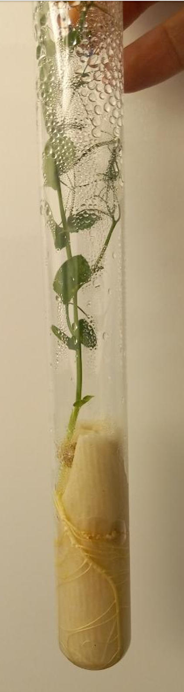
Fig. S3. PW plants grown in glass tubes for nodulation assessment

