Slide 1
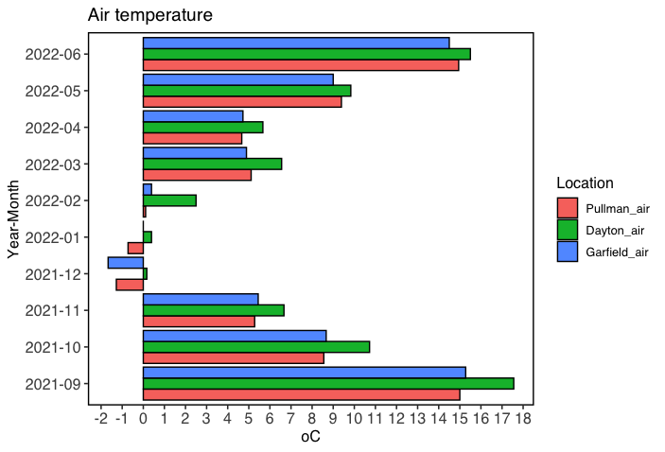
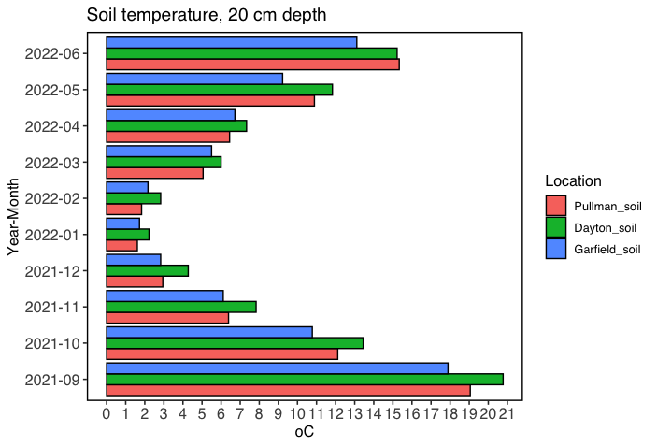
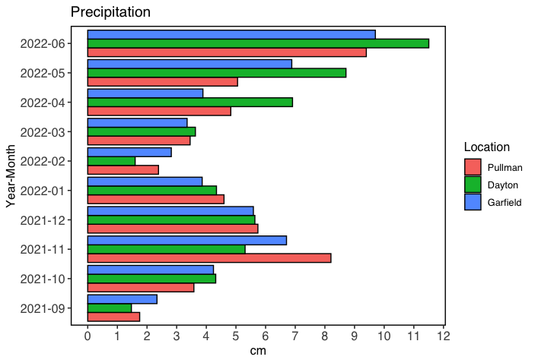
A
B
C
Figure S1. Weather conditions in the sampling sites
A – Average air temperature, ºC; B – Average soil temperature at 20 cm depth, ºC; C – Total precipitation per month , cm.

