Slide 1
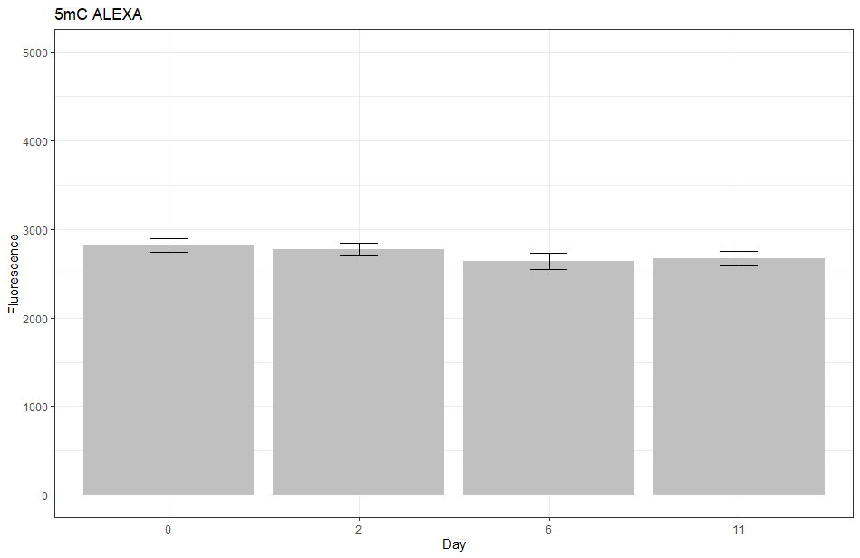
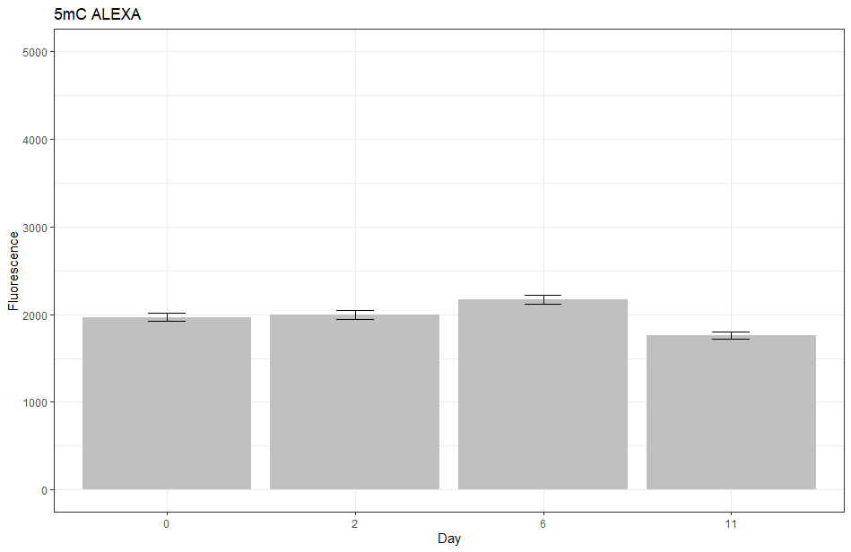
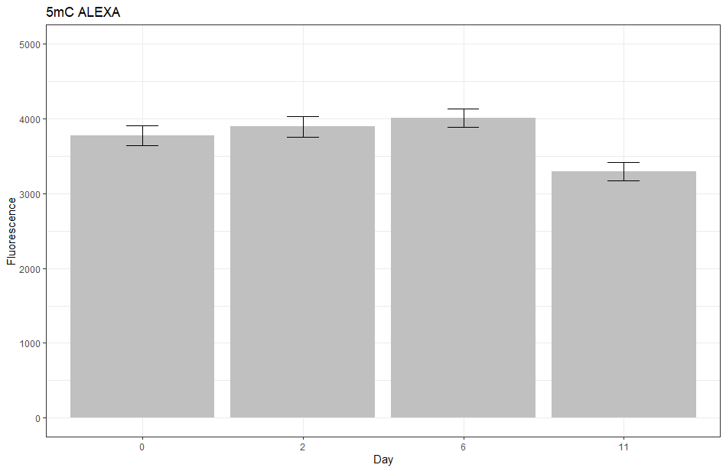
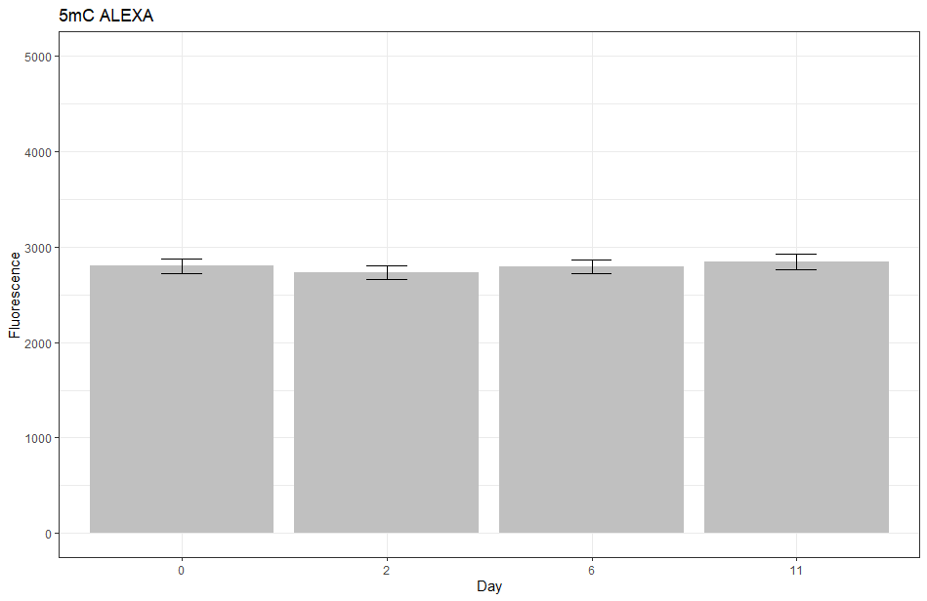
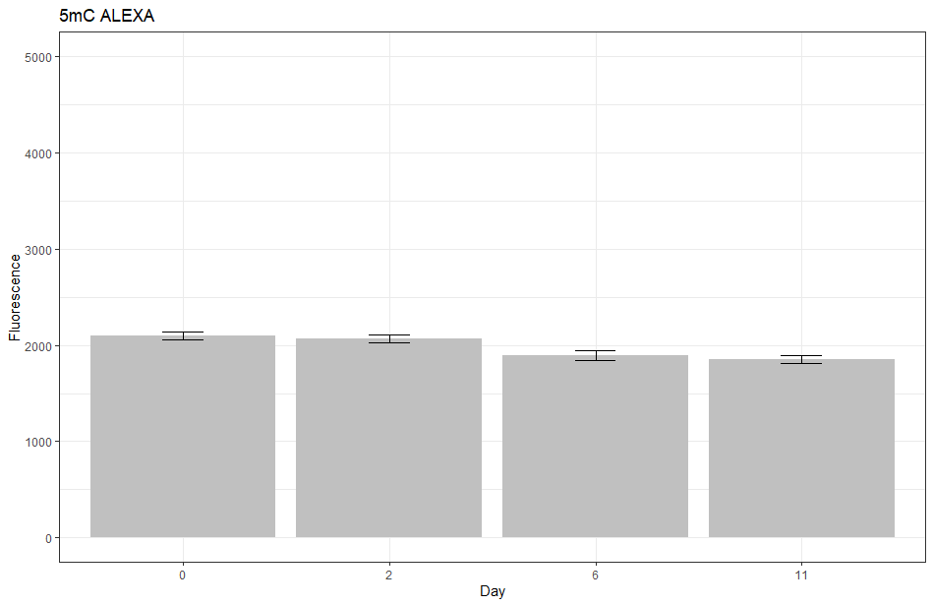
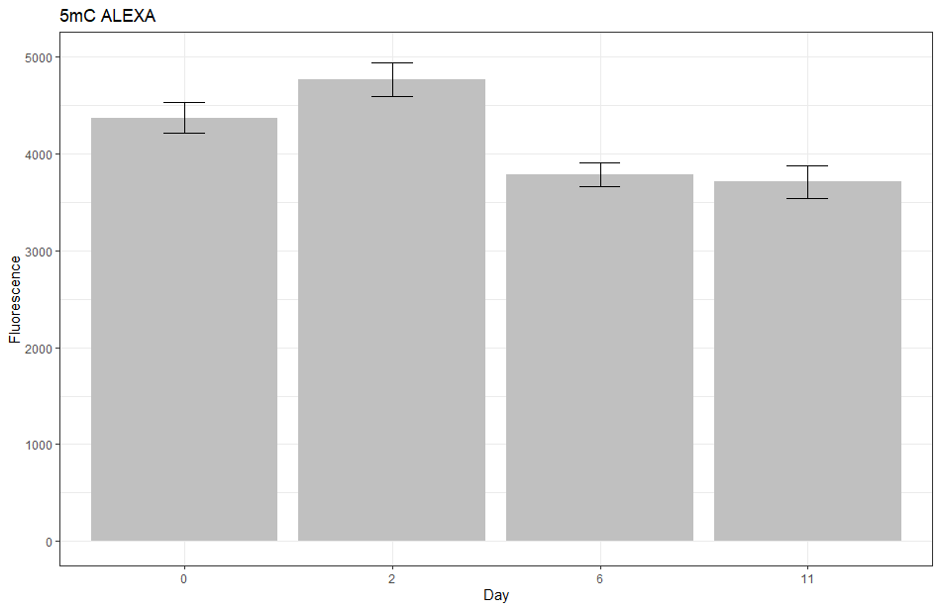
F. esculentum EC
F. tataricum MC
F. tataricum NC
a
e
i
5000
5000
5000
b
b
a
c
H3 unmodified
4000
a
4000
4000
Fluorescence
a
Fluorescence
3000
b
c
3000
a
c
3000
2000
b
b
Fluorescence
1000
2000
2000
1000
1000
0
2
6
11
0
2
6
11
0
2
6
11
Day
Day
Day
b
f
j
a
5000
5000
5000
a
b
b
H4 unmodified
4000
a
a
a
a
4000
4000
3000
3000
3000
Fluorescence
Fluorescence
a
b
c
Fluorescence
2000
2000
d
2000
1000
1000
1000
0
2
6
11
0
2
6
11
0
2
6
11
Day
Day
Day

