Slide 1
Manuskript: Liquid in vitro culture system allows gradual intensification of osmotic stress in Solanum tuberosum through sorbitol
Supplementary Figures

Slide 2
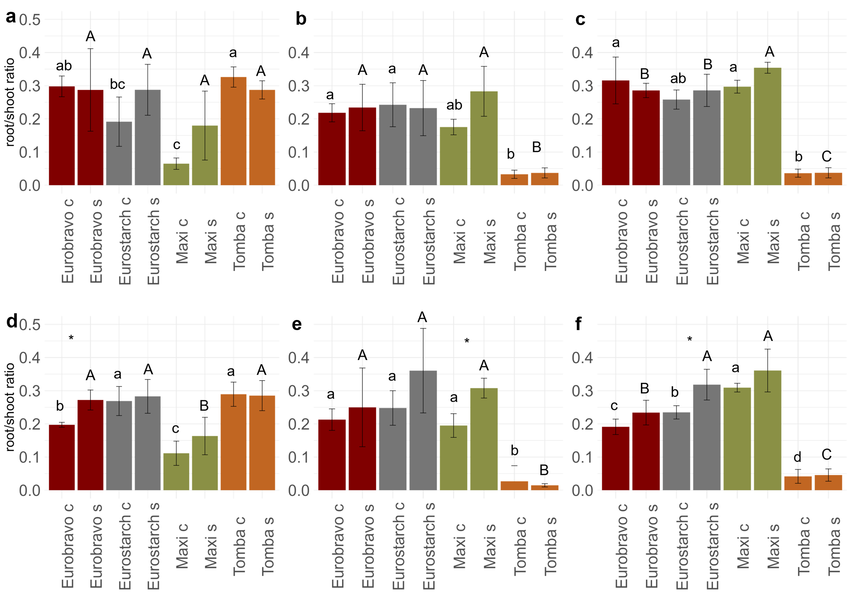
Fig. S1 Root/shoot ratio of the dry mass after seven and 14 days of osmotic stress with standard deviation. a+d: seven+14 days, experiment 1. b+e: seven+14 days, experiment 2. c+f: seven+14 days, experiment 3. c: control, c: stress. Statistical analysis: ANOVA and Tukey-Test. Lower case letters compare control values between the genotypes. Upper case letters compare stress values between genotypes. Asterisks compare control and stress variant within one genotype. Significance codes: *** = p < 0.001; ** = p < 0.01; * = p < 0.05. n=5.

