Slide 1
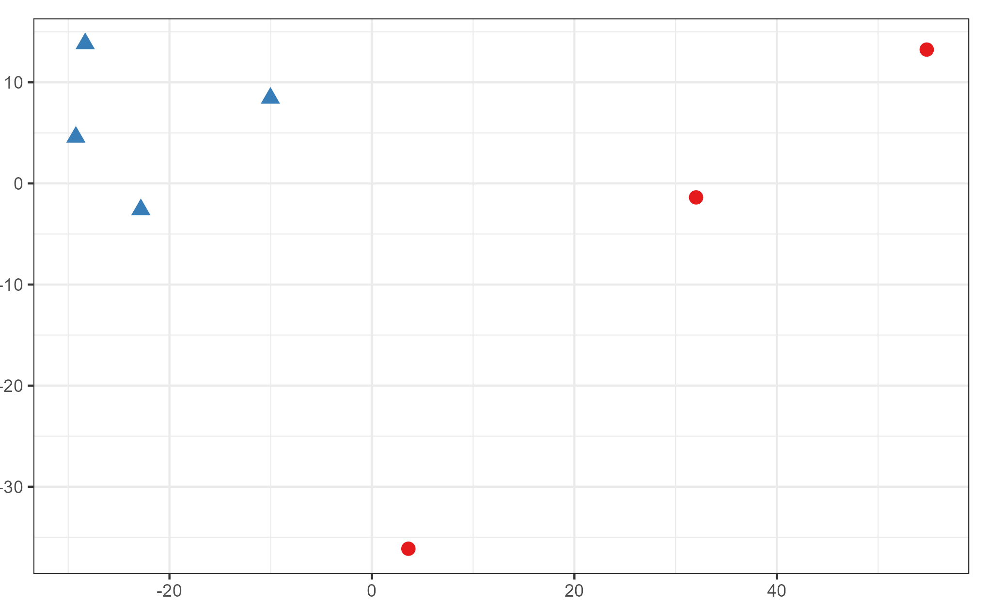
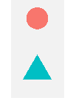
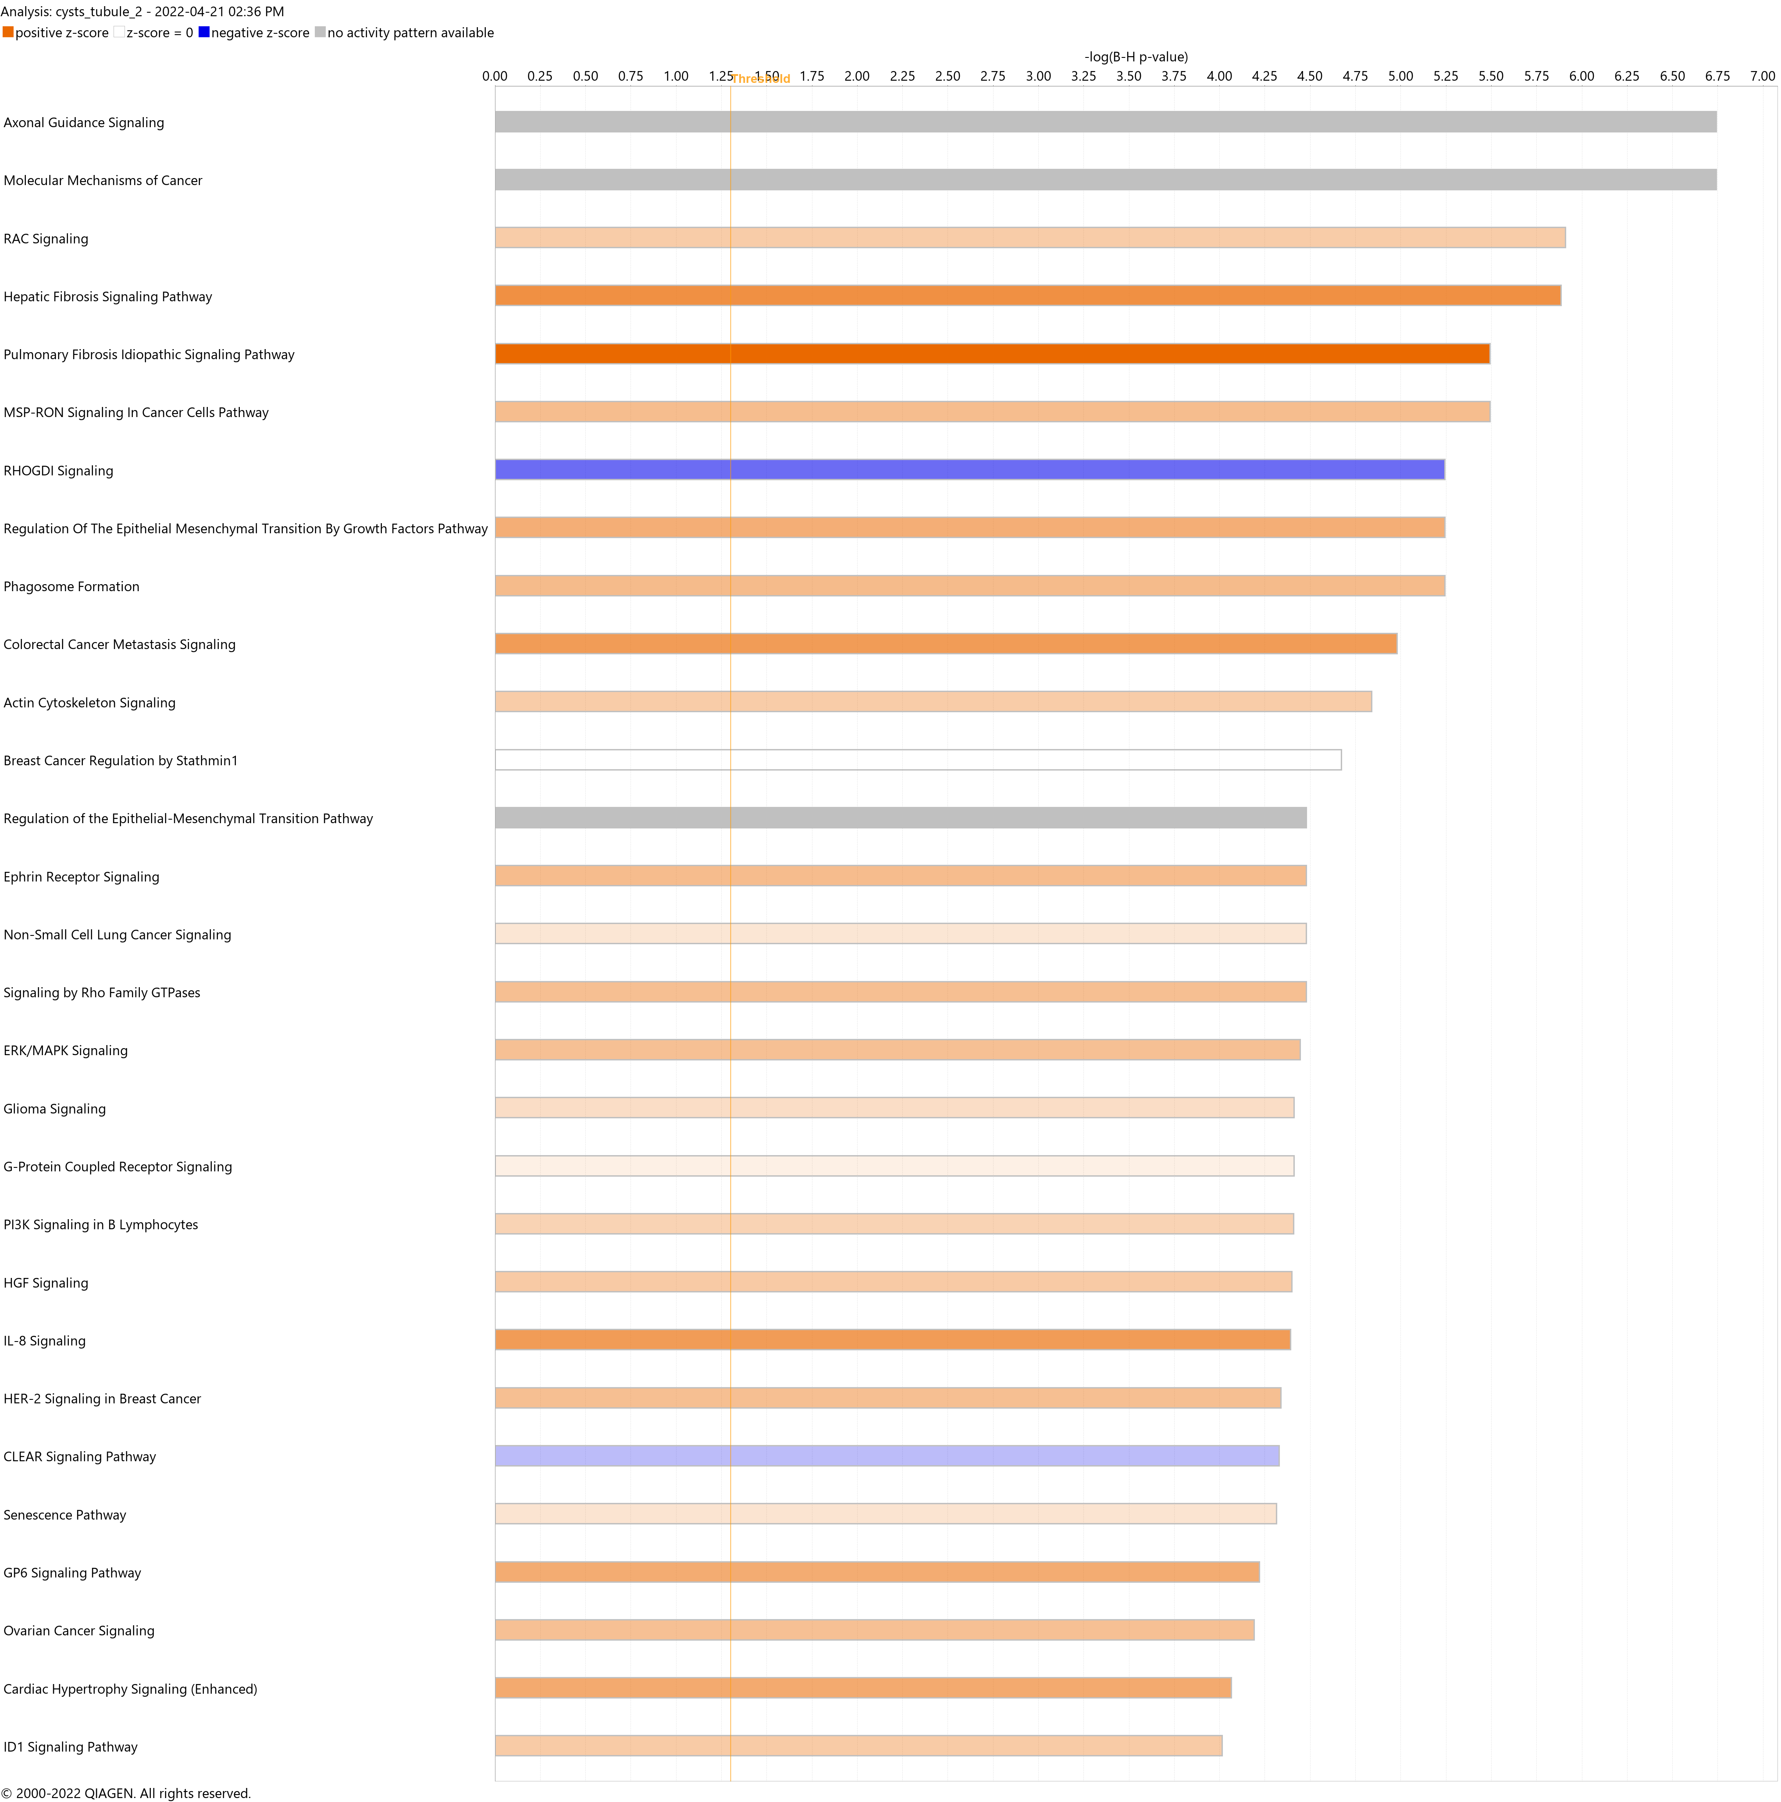
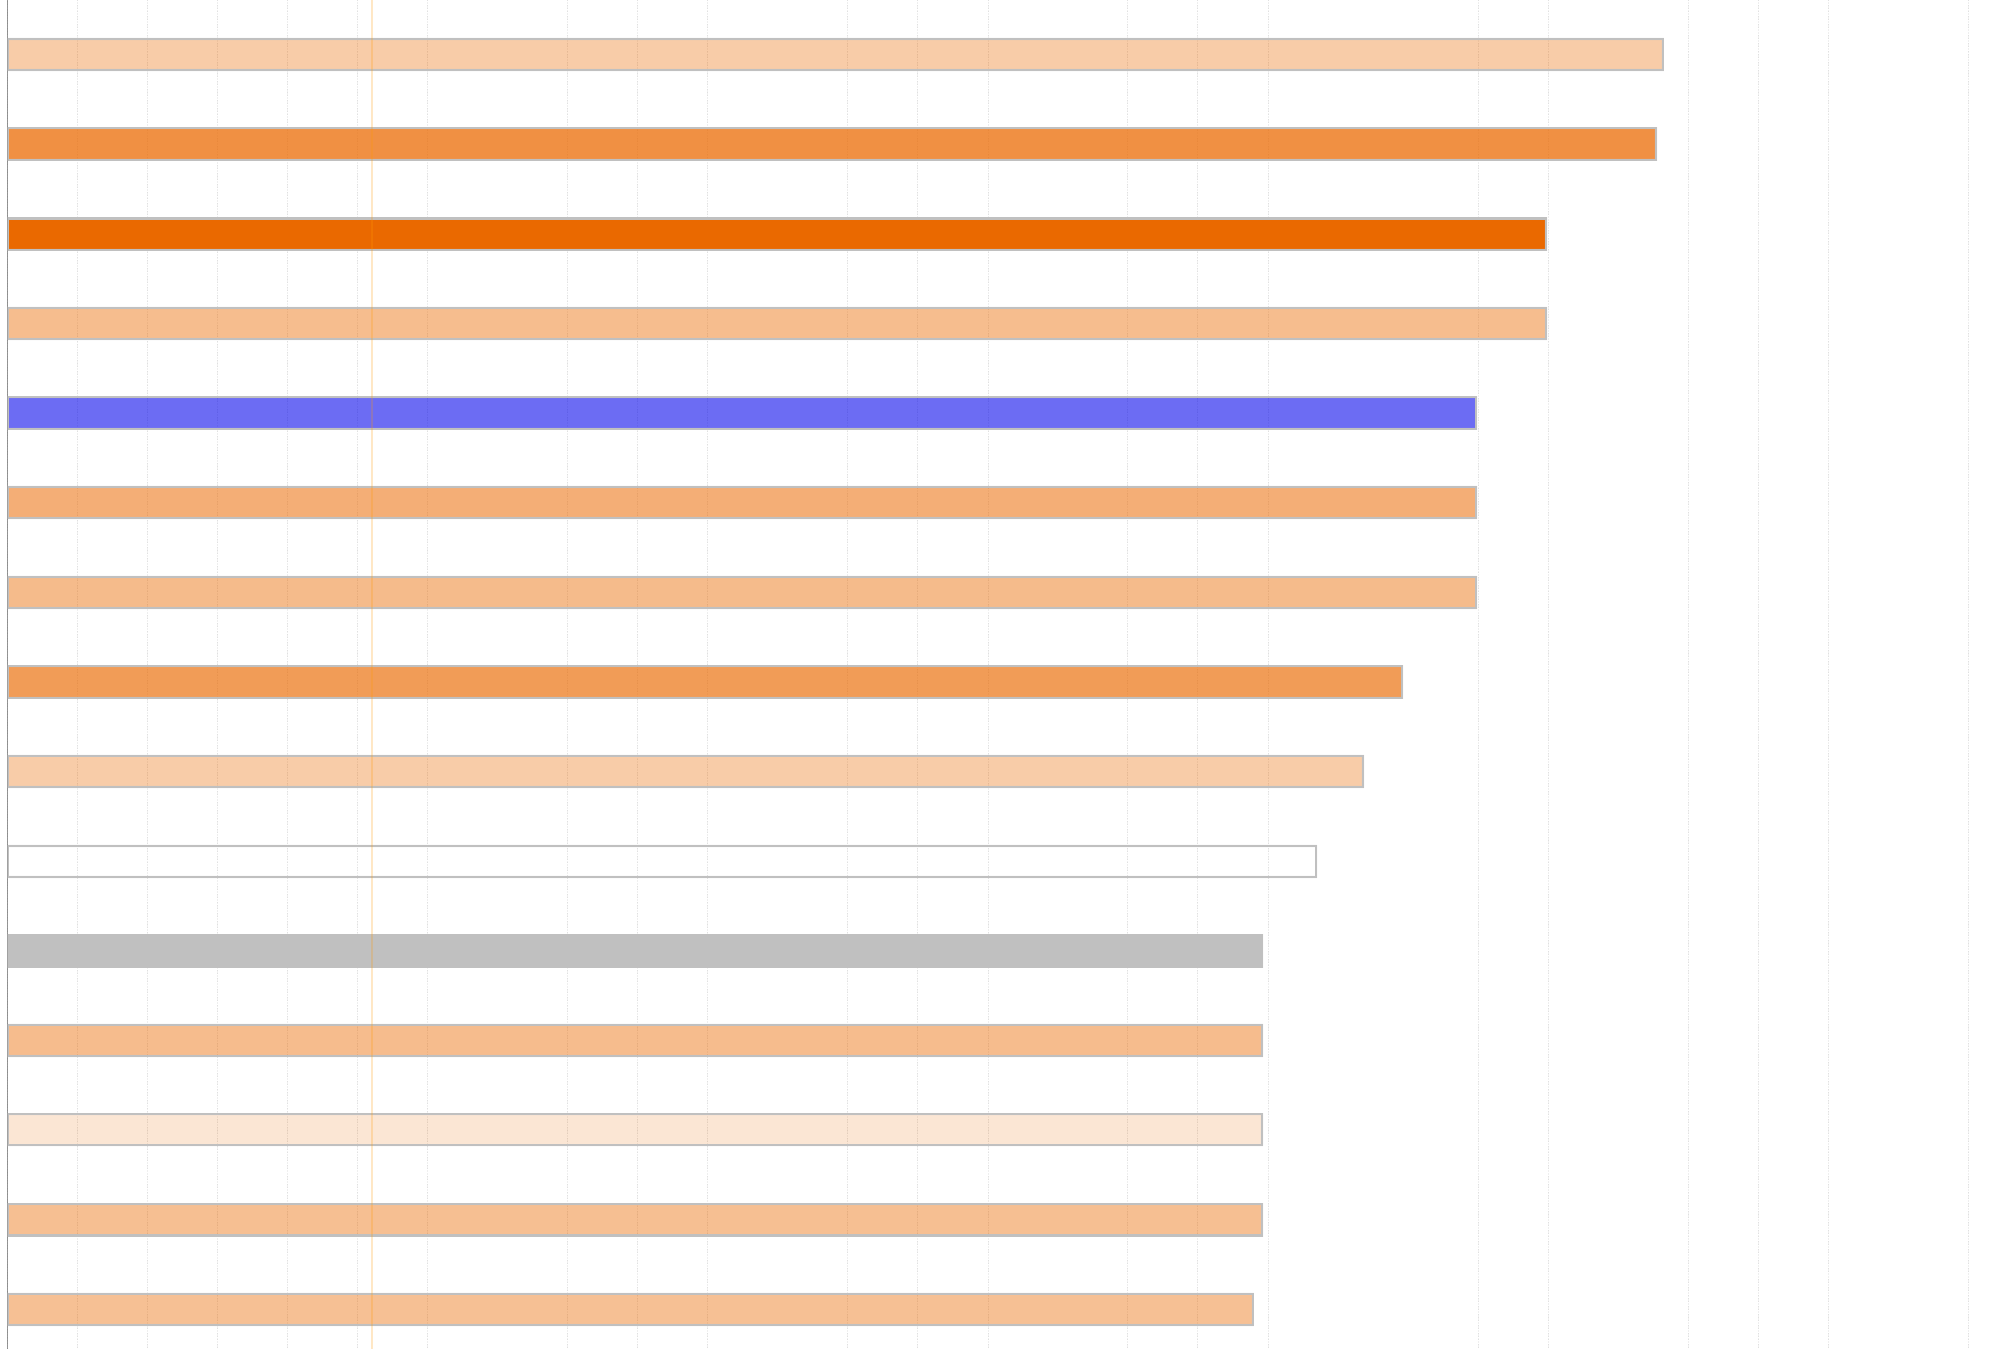
Supplementary figure 1
A
Tubule
Cyst
PC2: 18% variance
PC1: 63% variance
B
Rac signaling
Fibrosis signaling - 1
Fibrosis signaling - 2
MSP-RON signaling
RhoGDI signaling
EMT by Growth Factors
Phagosome Formation
Cancer pathway -1
Actin Cytoskeleton Signaling
Stathmin1 pathway
Positive z-score
EMT
z-score = 0
EphrinR signaling
Negative z-score
Cancer pathway -2
No activity pattern
available
Rho family signaling
ERK/MAPK signaling

