Slide 1
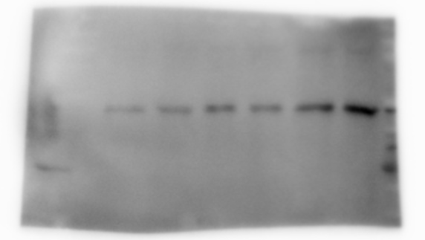
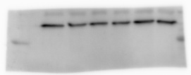
Supplementary figure 3
MpkCCD_{cl4}
forskolin
α,βMe-ATP
untreated
forskolin
Ladder lane
50
Pannexin-1
37
37
GAPDH
MDCK
50
Pannexin-1
37
37
GAPDH

