Slide 1
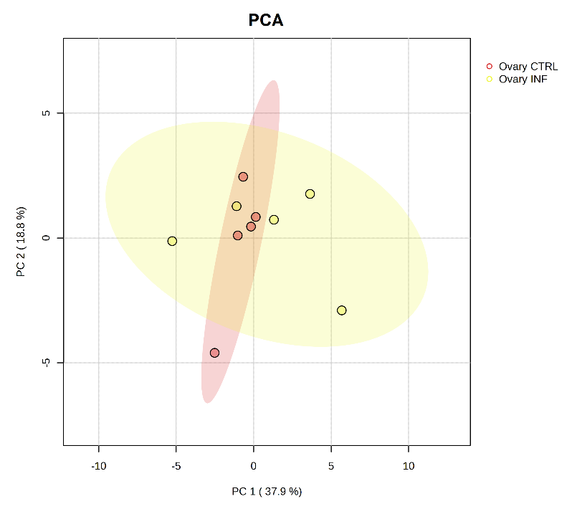
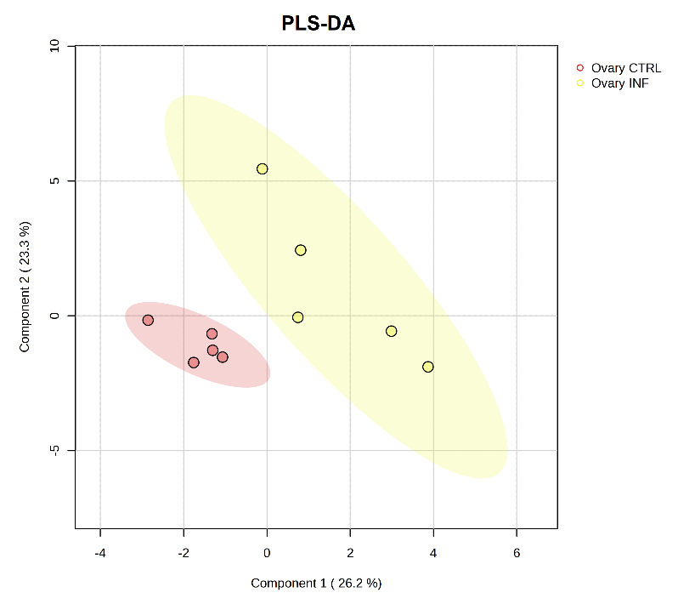
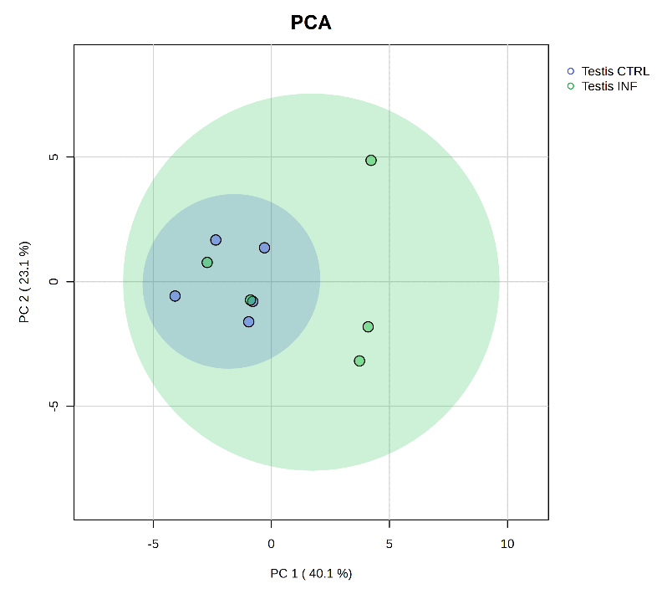
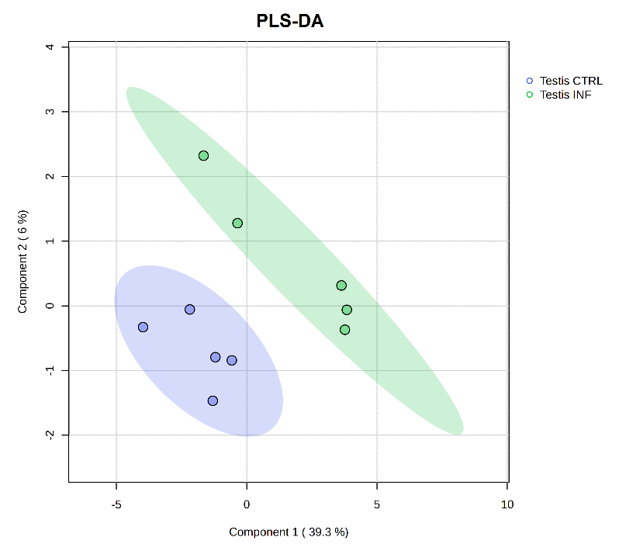
A
B
C
D
Notes:
Supplementary figure S1. Principal Component Analyses, PCA (A and C) and partial least squares discriminant analysis, PLS-DA (B and D) analyses of ovaries (A, B) and testes (C, D), in European sea bass 48h of bacterial post-injection.

Slide 2
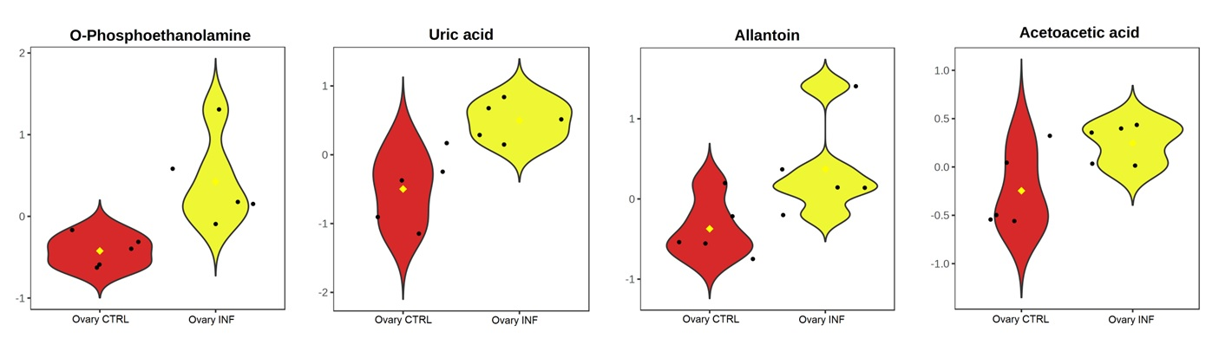
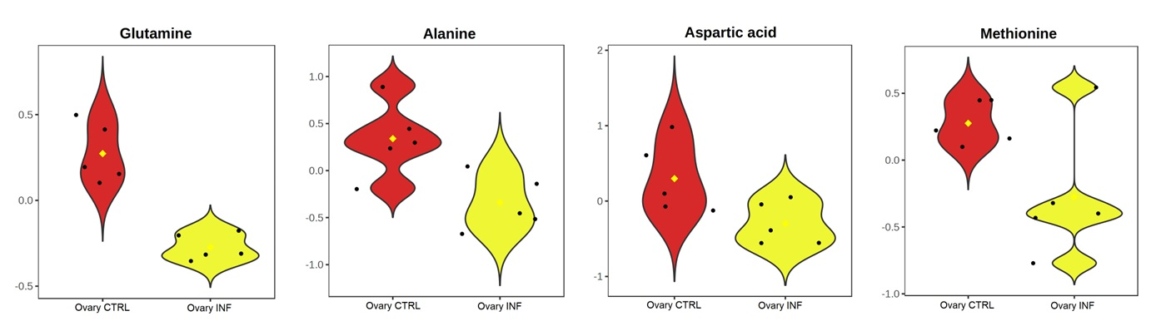
A
B
Notes:
Supplementary figure S2. Violin plots showing the most significant (P-value <0.05, 2-fold change) metabolites released (A) or repressed (B) in the ovaries of European sea bass 48h of bacterial post-injection.

Slide 3
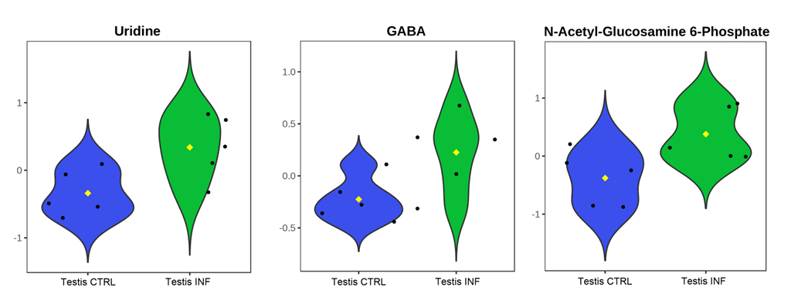
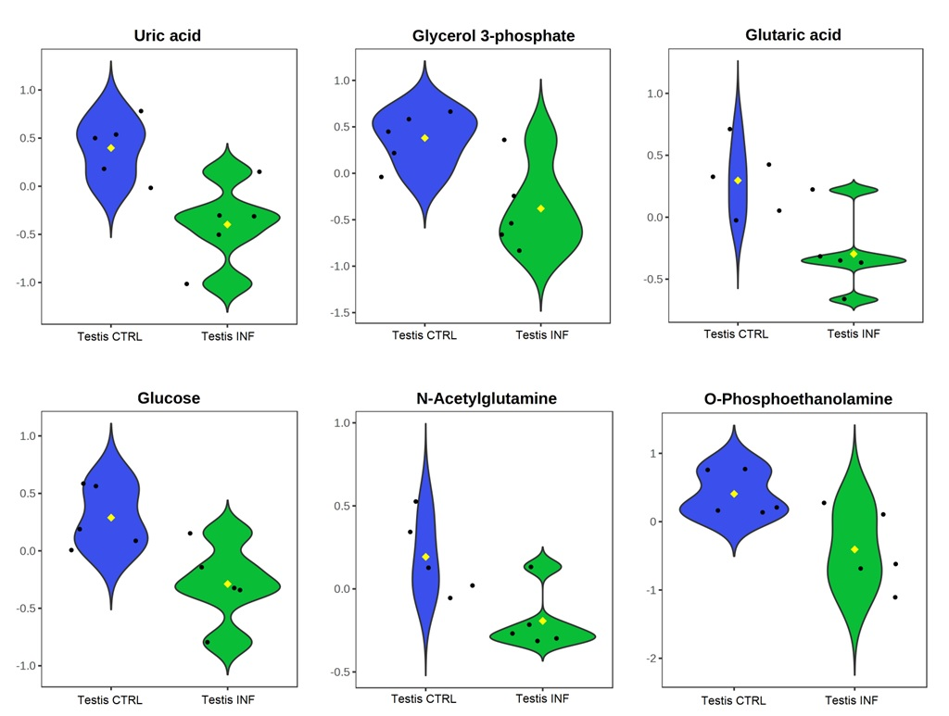
A
B
Notes:
Supplementary figure S3. Violin plots showing the most significant (P-value <0.05, 2-fold change) metabolites released (A) or repressed (B) in the testes of European sea bass 48h of bacterial post-injection.

Slide 4
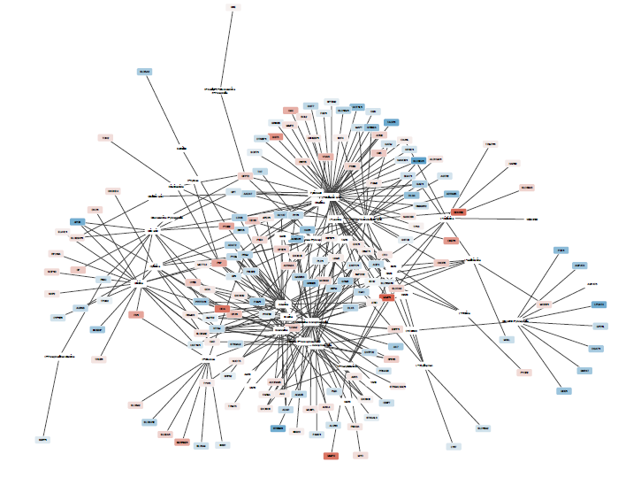
DEGs (log2FC)
downregulation
upregultion
Notes:
Supplementary figure S4. Gene-metabolite network generated using the Prefuse Force Directed Layout in the European sea bass testes 48h of bacterial post-injection. These networks connect metabolites with VIP > 1 to differentially expressed genes (DEGs) with an adjusted p-value ≤ 0.05 from the comparison between infected testes and controls. Node colors represent gene expression changes (log2FC): blue indicates downregulated genes, white indicates no change, and red indicates upregulated genes. Log2FC values range from -5.74 (darker blue) to 6.66 (darker red).

