Slide 1
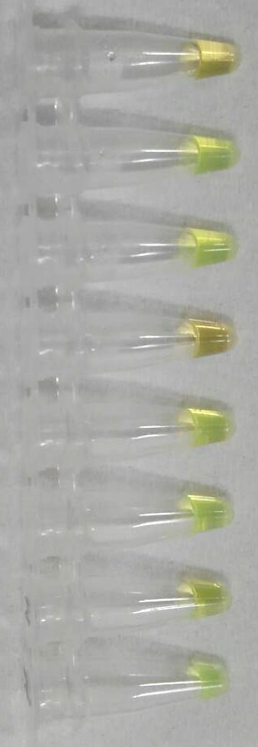
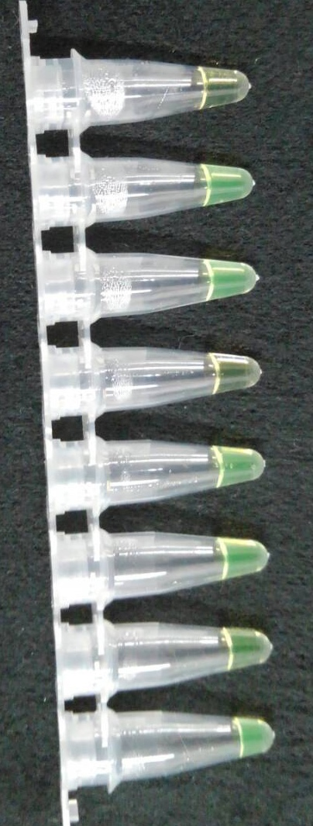
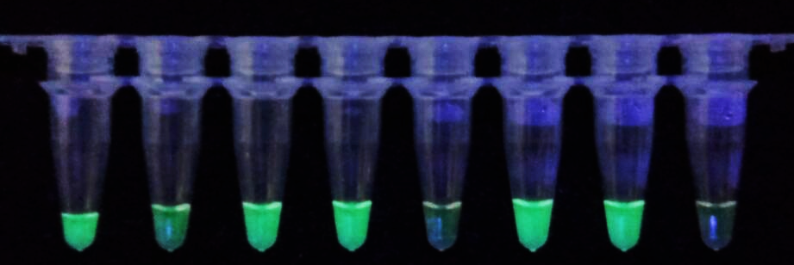
(a) White background under natural light
Pos. Neg. + + - + + -
(b) Black background under natural light
(c) Under UV light

