Slide 1
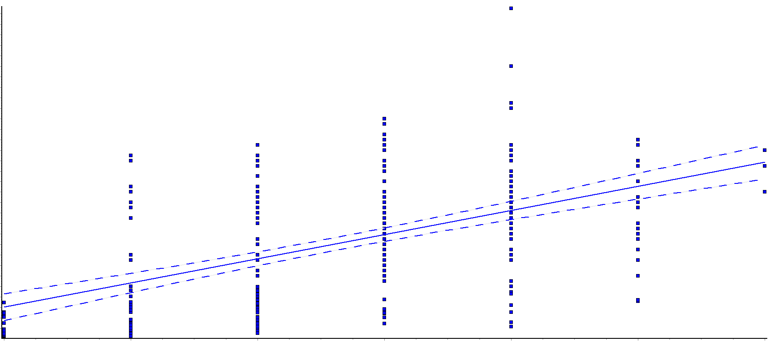
Supplementary Figure 1
60
45
r = 0.52, p<0.0001
SCORE2/SCORE2-OP
30
15
0
0
1
2
3
4
5
6
CV risk score (arbitrary units)
Supplementary Figure 1. Correlation between SCORE2/SCORE2-OP and CV risk in
299 elderly individuals from the inChianti database. Regression coefficient.
CV = cardiovascular, r = regression coefficient.

