Slide 1
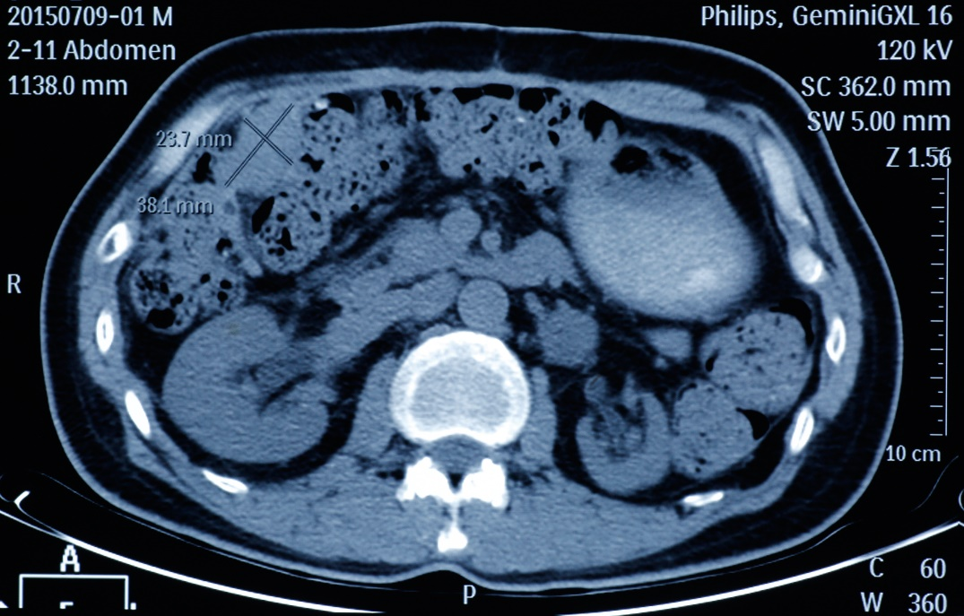
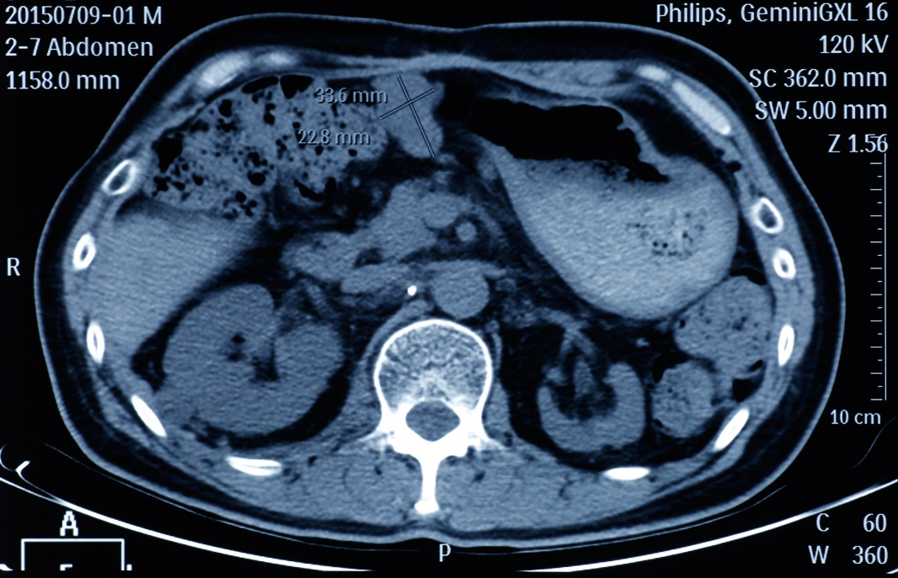
Supplementary Figure 1. Axial CT Images of Targeted Tumor Lesions
Two tumor lesions in size of 38.1mm×23.7mm (left panel) and 33.6mm×22.8mm (right panel) were confirmed as seminal vesicle carcinoma located at right upper outer quadrant and inferior xiphoid process region respectively demonstrated by axial CT.

