Slide 1

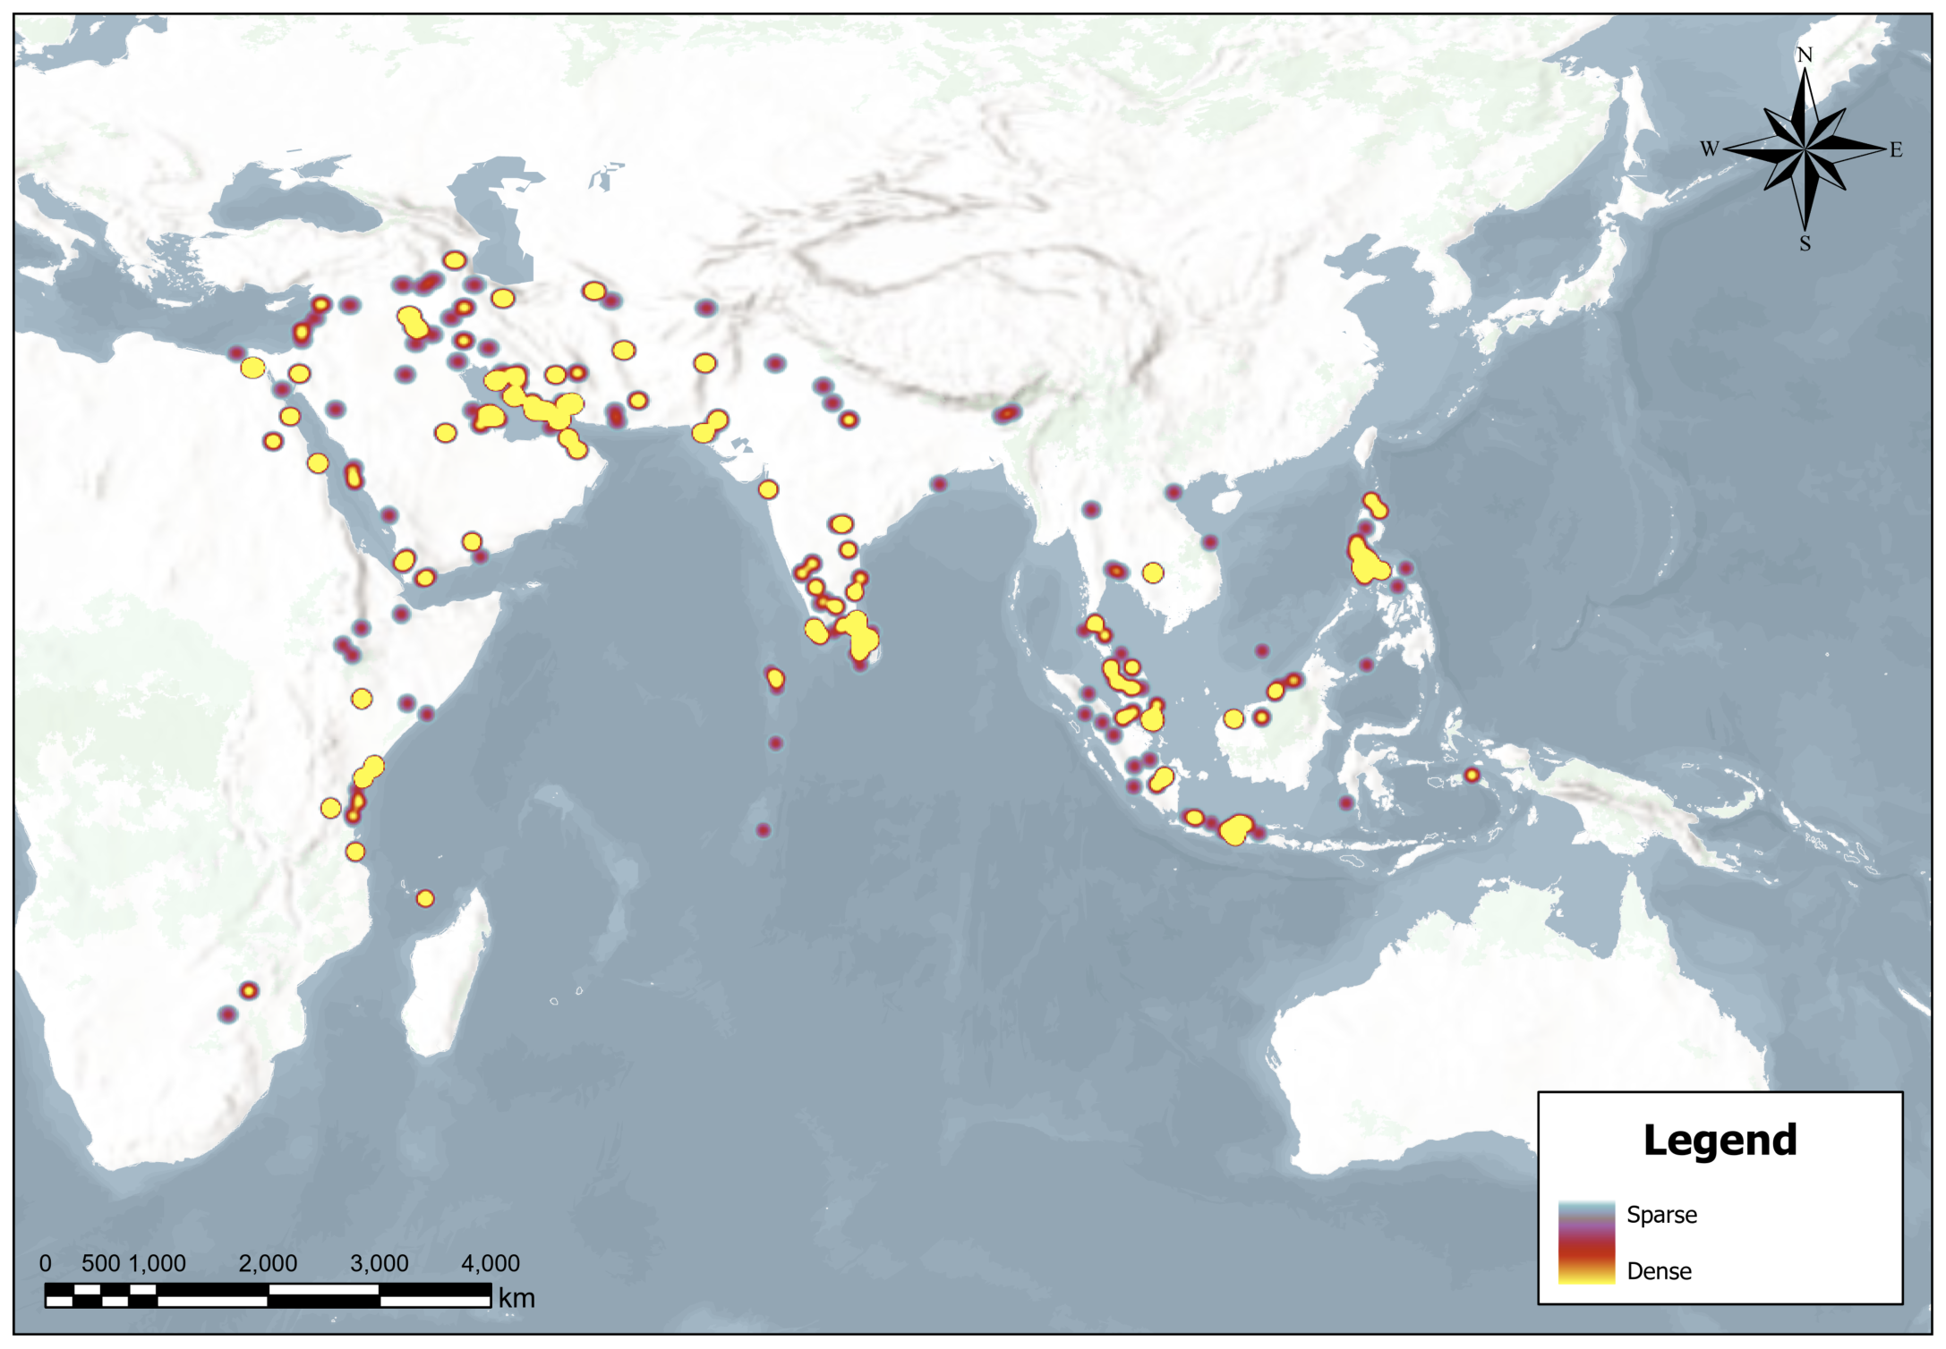
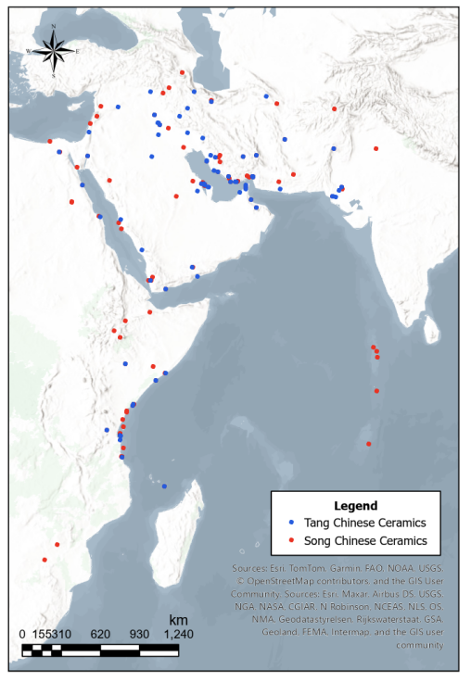
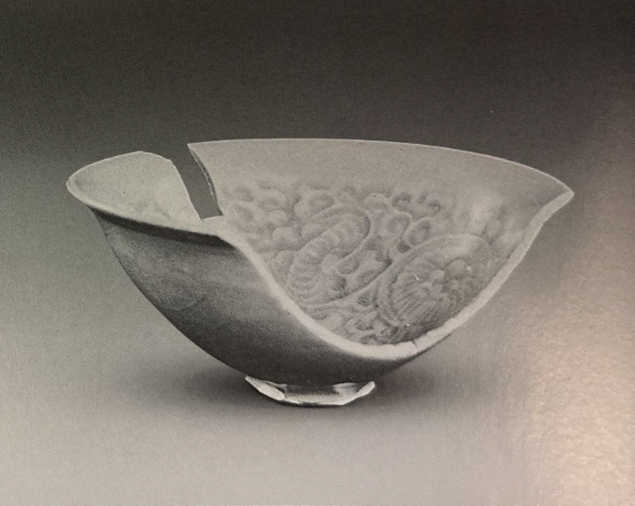
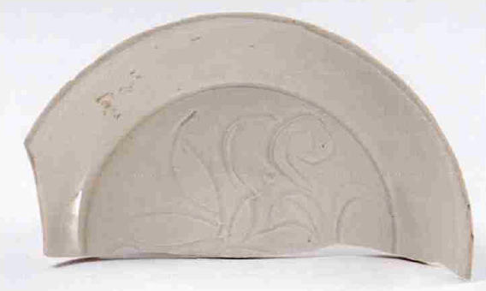
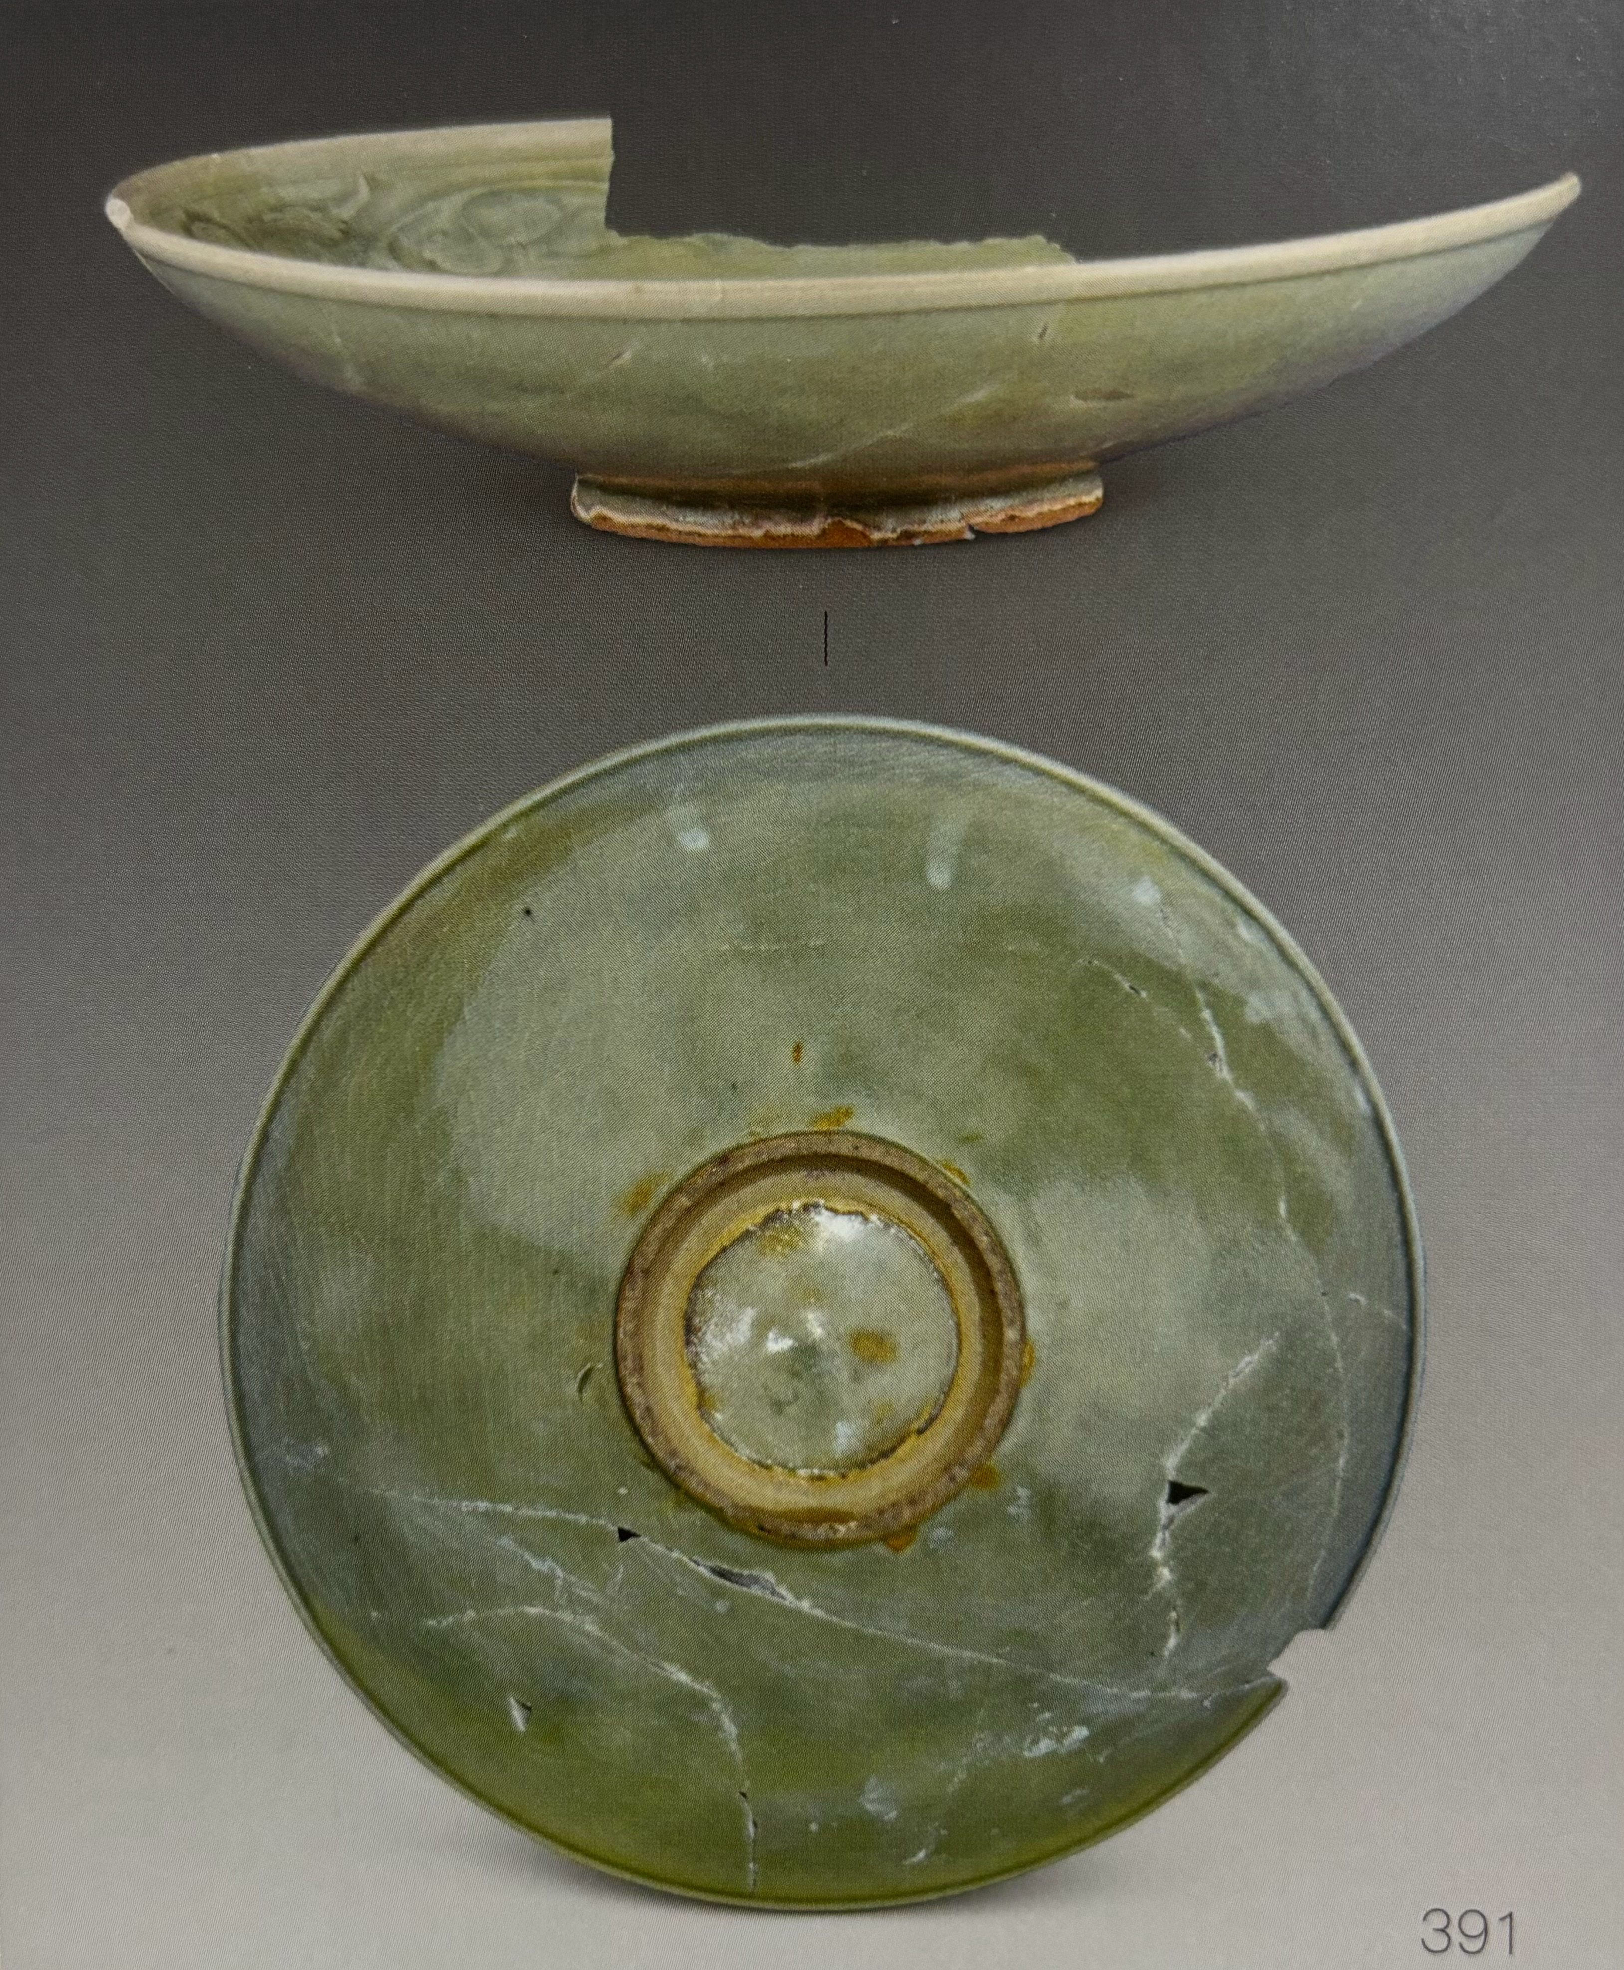
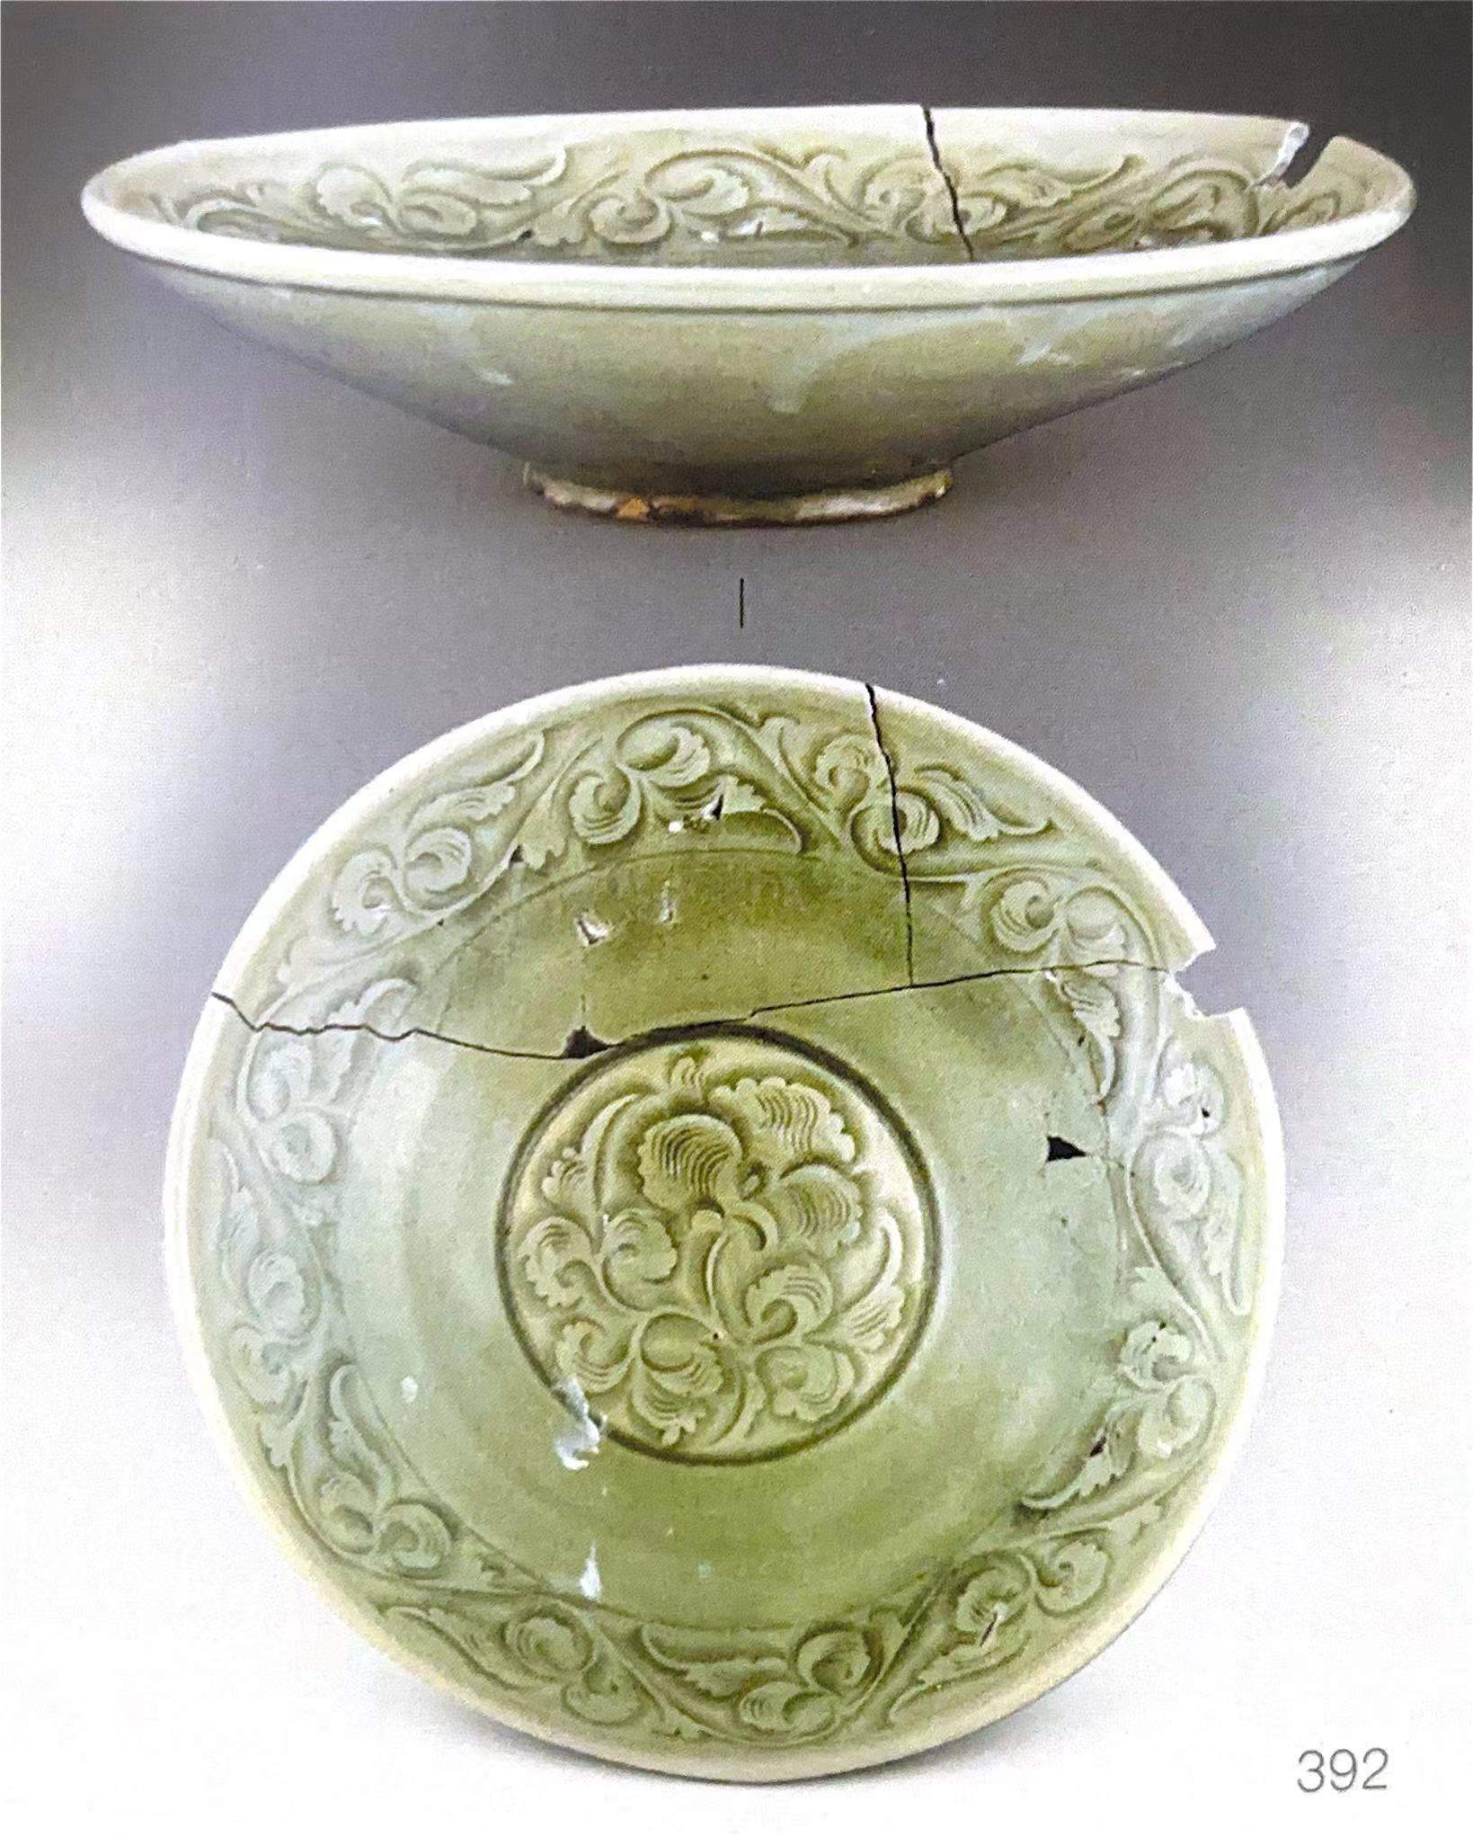
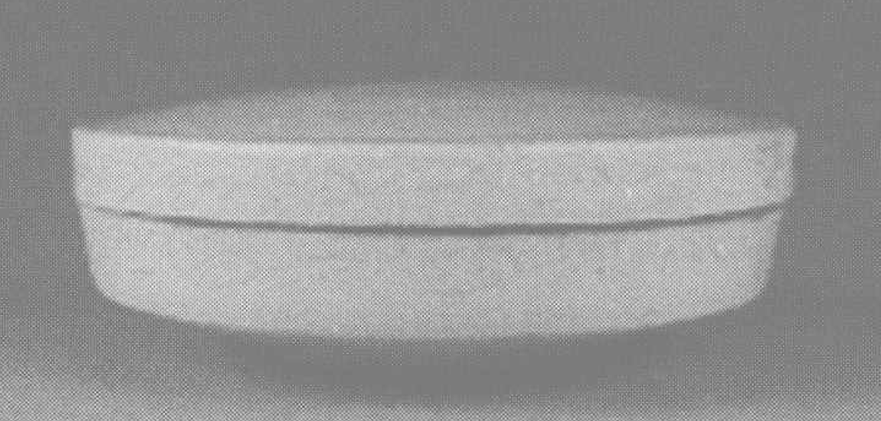
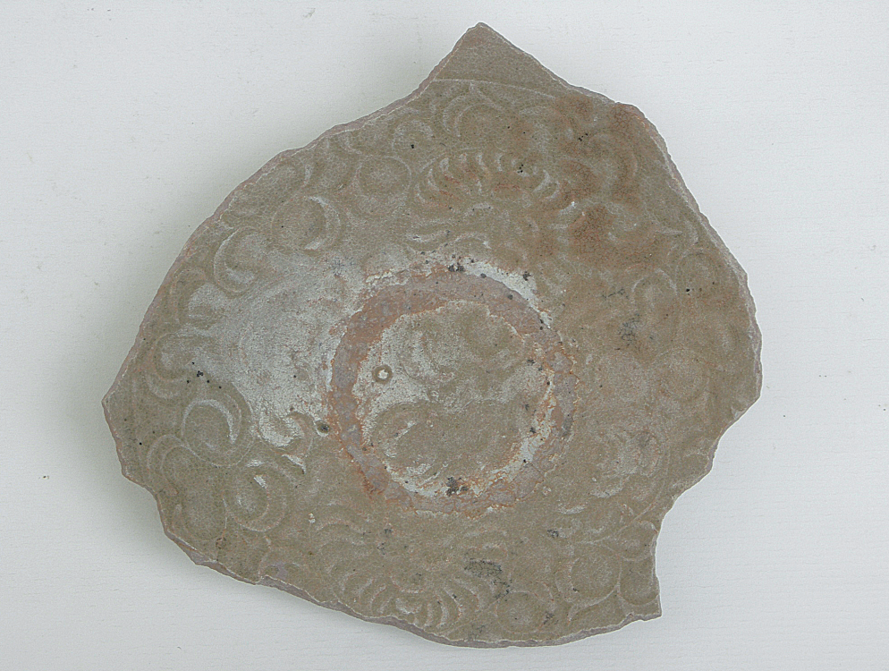
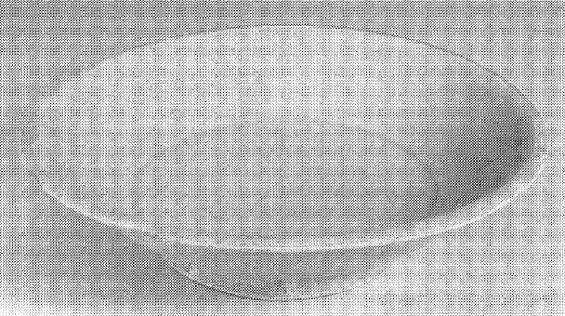
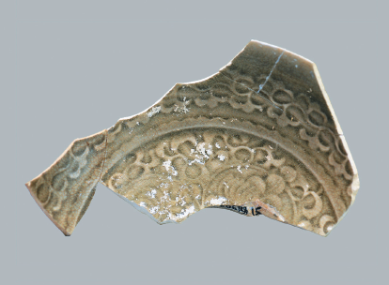
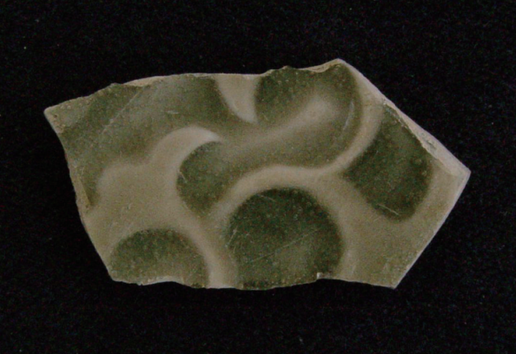
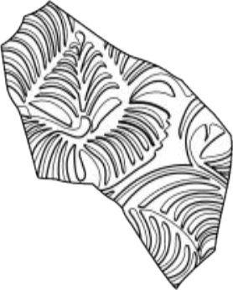
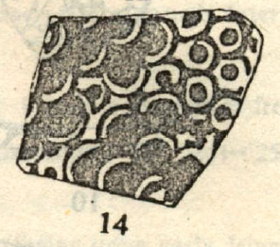
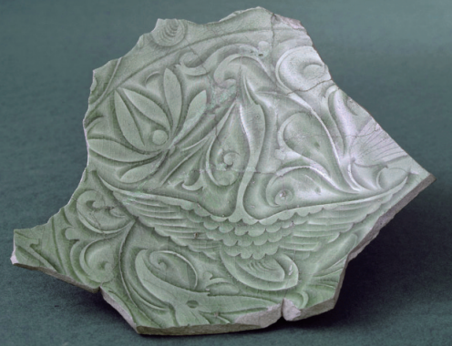
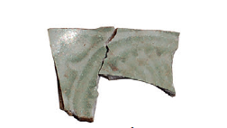
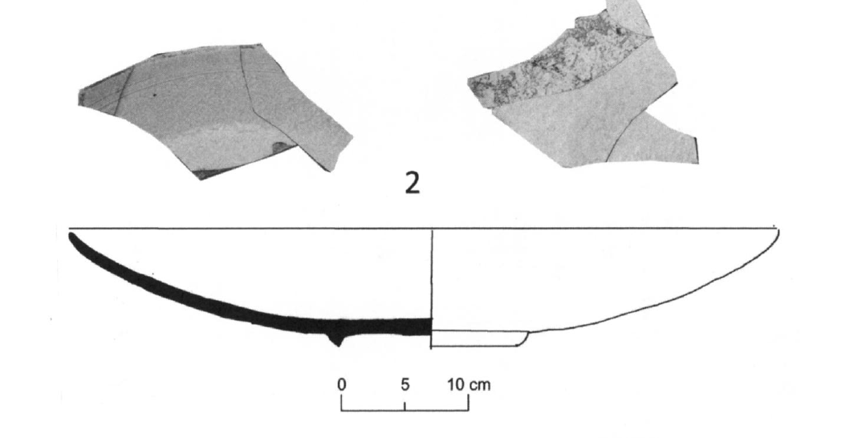
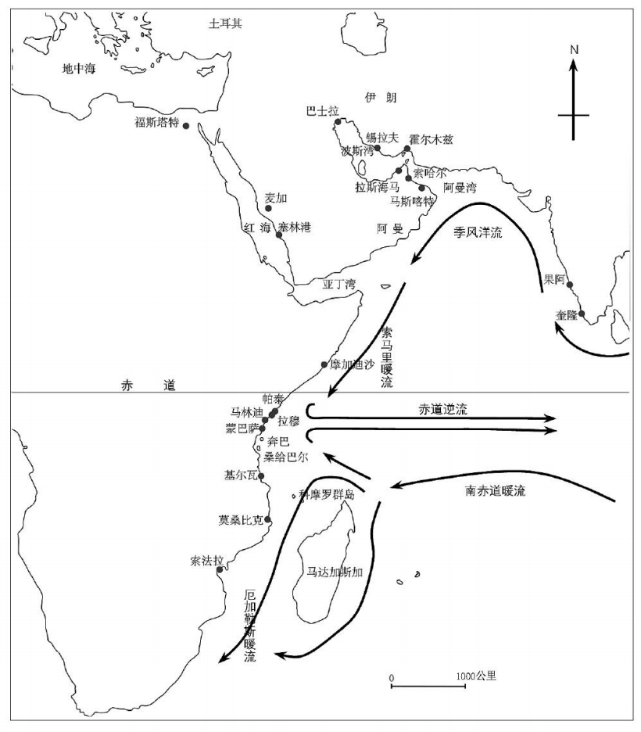
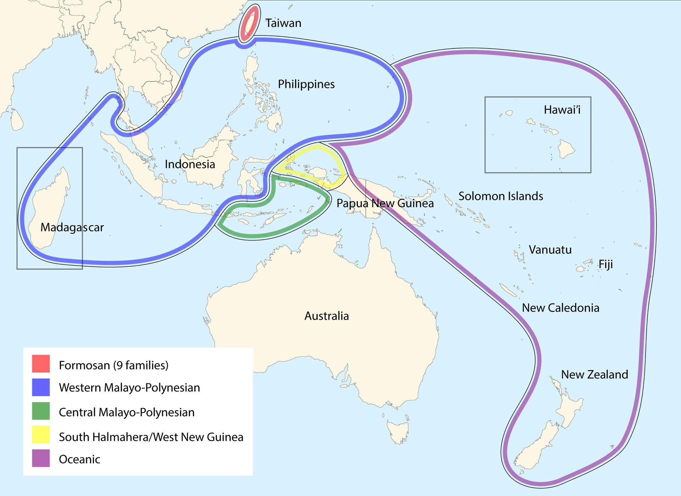

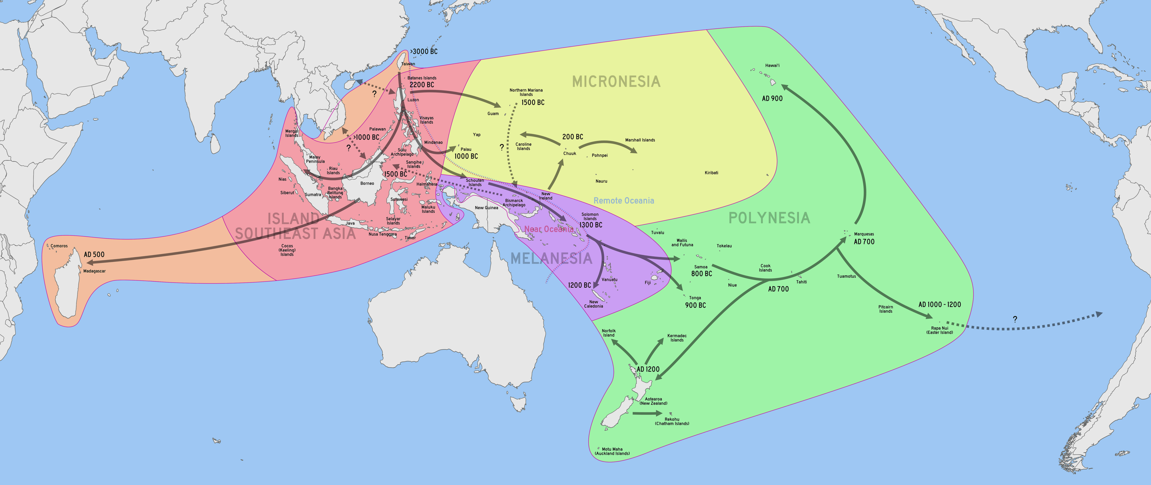

Author:
Weile Li
Post-doctoral Fellow
Center for Quantitative History
The University of Hong Kong
Cooperation Email: weileli@hku.hk
Indian Ocean Maritime Trade Routes
of Tang and Song (618–1279 AD) Chinese Ceramics
Route 1
Route 2
Route 2
Fig.1 Distribution map of Chinese Ceramics During the 7th to 13th Centuries Unearthed in South Asia, Southeast Asia, West Asia, and Africa (drawn by the author)
Between the 7th and 13th centuries, Chinese trade routes primarily carrying goods like ceramics exited the Strait of Malacca and continued westward along the Indian Ocean coast (see Fig.1 & Fig.2).
This route, known as Route One, passed through India, Sri Lanka, Iran, and the Arabian Peninsula, eventually reaching Africa to the west.
From the Indian Subcontinent and Sri Lanka region, another route, Route Two, extended southward past offshore islands like the Maldives and the British Indian Ocean Territory, then crossed the Indian Ocean westward to areas such as Madagascar, Kenya, and Tanzania.
Route One was established earlier, during the Tang Dynasty (618-907 AD). Based on archaeological evidence, Route Two was not fully developed until the late Song Dynasty (960-1279 AD).
Tab.1 Yaozhou Kiln Celadon Unearthed from Regions along the Maritime Silk Road (Selection)
Tab.2 Ding Kiln White Porcelain Unearthed from Regions along the Maritime Silk Road (Selection)
Fig.2 Distribution Map of Sites in the Islamic World with Excavated Tang and Song Chinese Ceramics
(drawn by the author)
Site | Figure | Chronology
Penglai Shuicheng (China) |  | 1000-1127 AD
Nanhai No.1 Shipwreck (China) |  | 1180-1279 AD
Kim Lan Site (Vietnam) |  | 1000-1200 AD
Allalppidi Site (Sri Lanka) |  | 1000-1127 AD
Siraf Site (Iran) |  | 1000-1127 AD
Sharmah Site (Yemen) |  | 1000-1127 AD
Fustat Site (Egypt) |  | 1000-1150 AD
Mambrui Site (Kenya) |  | 1000-1127 AD
Sanje ya Kati Site (Tanzania) | None | 1050-1127 AD
Site | Figure | Chronology
Kenli Haibei Site (China) |  | 1000-1234 AD
Danyang Situ Commune (China) |  | 960-1127 AD
Intan Shipwreck (Indonesia) |  | 917-971 AD
Matale Site (Sri Lanka) | None | 681-907 AD
Anuradhapura Site (Sri Lanka) | None | 681-907 AD
Sohar Site (Oman) |  | 800-1000 AD
Kawa am Saila (Yemen) | None | 1100-1300 AD
Al-Habil Site (Yemen) | None | 1100-1300 AD
Kilwa Site (Tanzania) |  | 1160-1230 AD
Evidence for the Distribution of Chinese Ceramics
Compared to ceramics from kilns such as the Yue Kiln and Jingdezhen Kiln, the absolute quantity of Yaozhou Kiln celadon exported was relatively small, yet their distribution was quite widespread. Yaozhou celadon has been unearthed at multiple important sites along the entire Route 1. These Yaozhou celadon are almost all decorated with stamped floral patterns, such as interlocking branches or chrysanthemum motifs, and the vast majority date to the mid-late Northern Song period (see Tab.1). This suggests that this maritime route was stable during that time.
By the same logic, the presence of earlier white porcelain from the Northern China Ding Kiln at sites along this route—such as Matale and Anuradhapura in Sri Lanka, Sohar in Oman, Kawa am Saila and Alhabil in Yemen, and Kilwa in Tanzania—indicates that this route was already established by the Five Dynasties and early Song period. Ding Kiln white porcelain was disseminated via this route to West Asia and East Africa (see Tab.2).
Route 2 extended from regions such as the Indian Subcontinent and Sri Lanka, crossing the Indian Ocean and passing through islands that are present-day Maldives and the British Indian Ocean Territory, ultimately reaching the Swahili world. Generally constrained by technological limitations, ancient seafaring vessels typically navigated along continental shelves. Longquan-type celadon has been unearthed at the Polonnaruwa site in Sri Lanka and on Diego Garcia Island, while Fujian celadon has been discovered at sites such as Ungwana in Kenya. The discovery of Longquan-style imitations on Diego Garcia Island indicates that, no later than the Song Dynasty, maritime vessels capable of venturing into the open ocean had already emerged along the Indian Ocean rim. This advancement relied partly on progress in shipbuilding and navigation technology, and partly on the utilization of the Indian Ocean monsoon.
Monsoons and Ocean Currents
One factor that aided navigation was the monsoon and ocean currents of the Indian Ocean. As early as the Roman period, Arab merchants utilized the patterns of ocean currents to conduct monopolistic maritime trade between the Indian Ocean and the Red Sea (see Fig.3).
In the summer, influenced by the southwestern monsoon, a clockwise circulation forms in the northern Indian Ocean. The direction of this current aligns closely with the Route 2 from South India, through the British Indian Ocean Territory, to East Africa. It is possible that some ships or artifacts may have ended up on islands in the Indian Ocean along the way.
In winter, under the influence of the northeastern monsoon, a counterclockwise circulation forms, which facilitated merchants from South India and Sri Lanka in transporting goods via the Arabian Sea to the coasts of the Persian Gulf and the Red Sea.
Regarding the latter, specifically Route 1 mentioned above, as early as the Roman Empire, merchants utilized the reverse Hippalos monsoon to travel from regions such as Ocelis and Eudaemon (Aden) in the southern Arabian Peninsula to the Malabar mart on the western coast of the Indian Peninsula.
Fig.4 Distribution Map of the Austronesian Languages and Primary Subdivisions
(drawn by Stefano Coretta)
Fig.5 Chronological Dispersal of Austronesian People Across the Pacific
(drawn by Benton et al, 2012, adapted from Bellwood, 2011)
The Distribution of the Austronesian Languages
Around 1500 to 2000 years ago, the ancestors of the Malagasy people in Madagascar set out from Borneo in Southeast Asia and migrated to Madagascar (see Fig.4 & Fig.5). The Malagasy language they speak shows strong connections to certain languages in Borneo. Their migration route aligns with Route 2. Although they were not merchants, their journey may have later “guided” Arab or Persian merchants, indicating that this maritime route was not without basis.
Fig.3 Map of Winter Ocean Currents in the Indian Ocean
(drawn by Taiyi Wang, 2022)
The 8th International Congress for Underwater Archaeology
Poster session: Session I - Trade and Material Culture
The work described in this paper was fully supported by a grant from the Research Grants Council of the Hong Kong Special Administrative Region, China (Project Reference Number: AoE/B-704/22-R)

