Slide 1
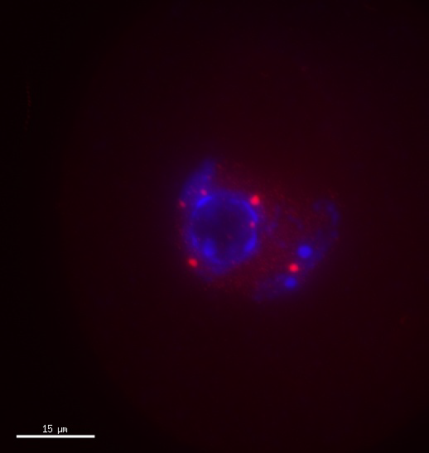
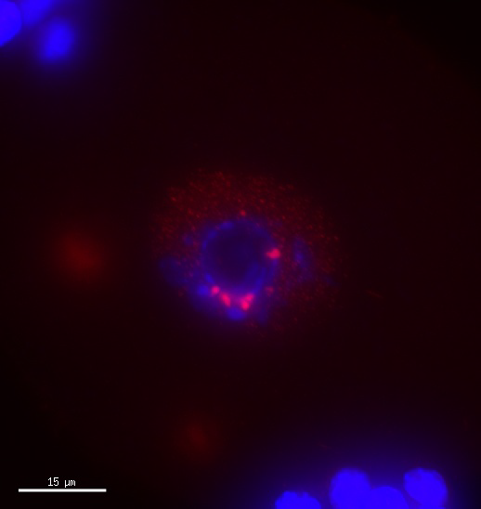
Supplementary Movie 1. Surrounding Nucleolus (SN) oocyte
ZSCAN4
ZSCAN4
Nucleolus
Nucleolus
Folicle cells

Slide 2
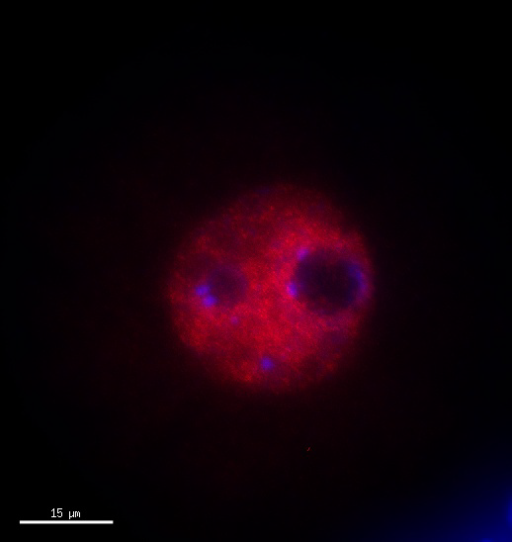
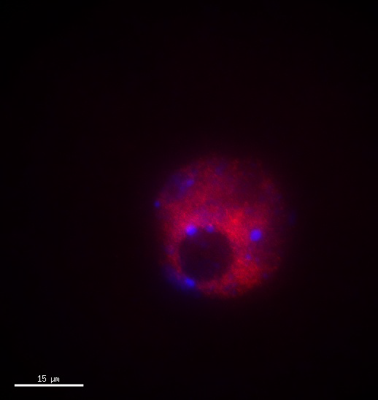
Supplementary Movie 2. Non-Surrounding Nucleolus (NSN) oocyte
ZSCAN4
ZSCAN4
Nucleolus
Nucleolus

Slide 3
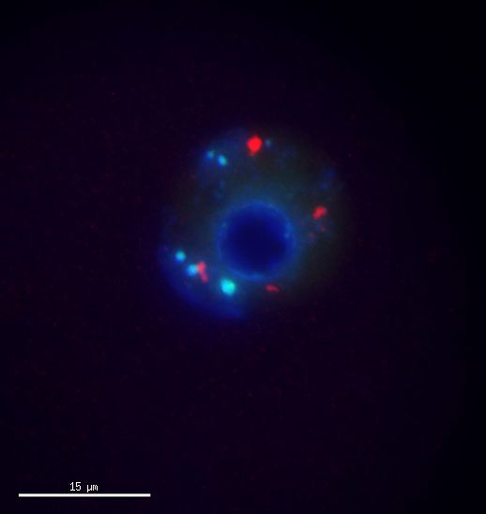
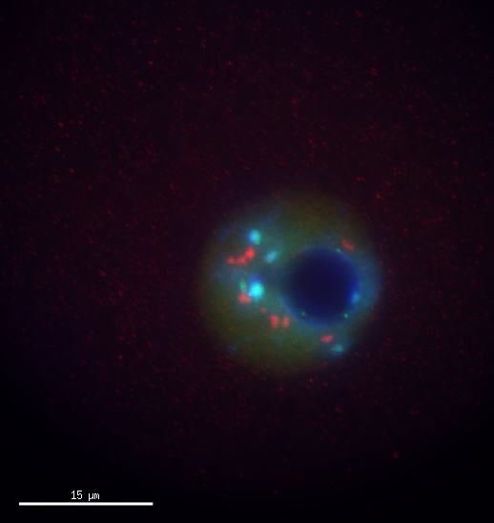
Supplementary Movie 3. Surrounding Nucleolus (SN) oocyte
Centromere (CREST)
ZSCAN4
Centromere (CREST)
ZSCAN4
Nucleolus
Nucleolus

Slide 4
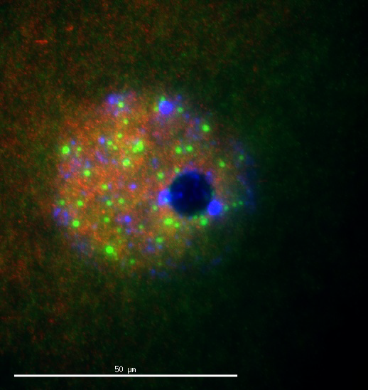
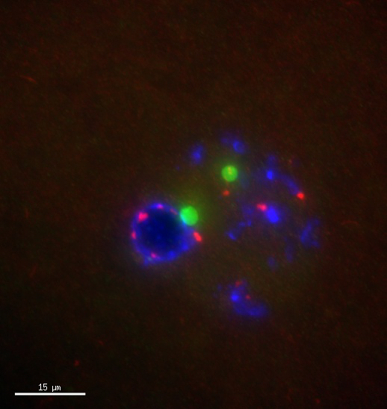
Supplementary Movie 4. Non-Surrounding Nucleolus (NSN) oocyte
NSN
SN
ZSCAN4
pol2 ser2P
ZSCAN4
pol2 ser2P

