Slide 1


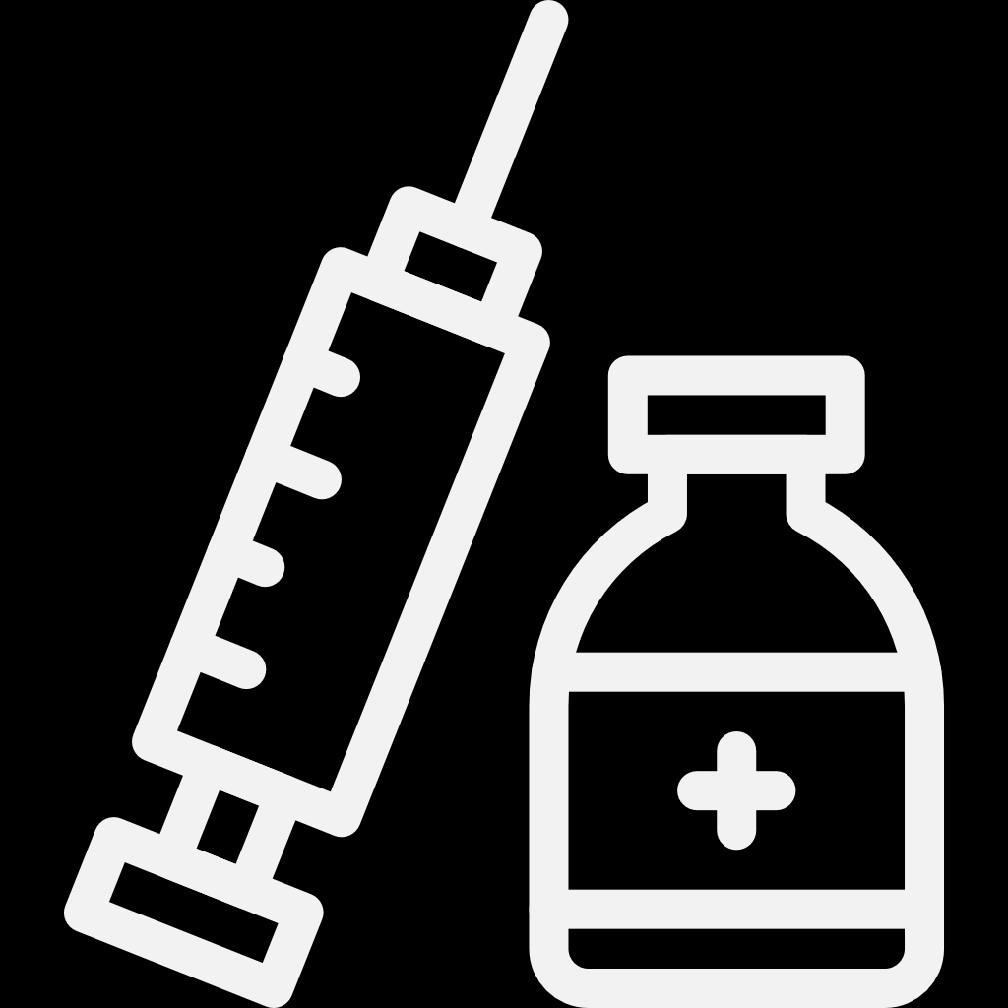



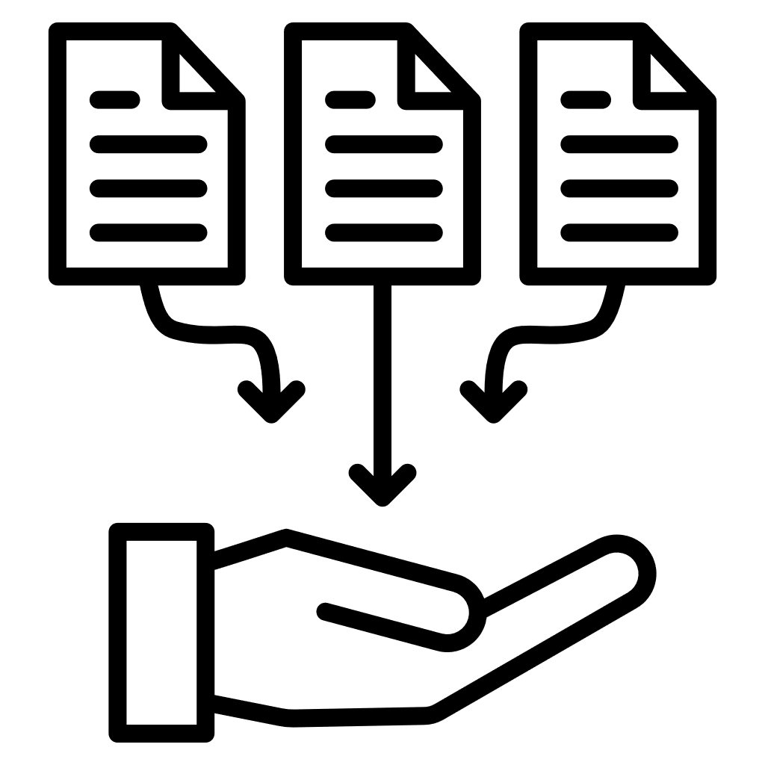
VTE & Bleeding Risk In Obese Patients Hospitalized For Surgery
Conclusion
VTE rates are non-negligible in surgical patients with obesity receiving TPX with enoxaparin.
Individual risk stratification is warranted to identify doses/duration of pharmacological TPX.
Background
Results
Among hospitalized patients, 67.6% were female, 24.4% were elderly (≥65 years), and 41%
were severely obese (BMI >40 kg/m²)
Optimal dose and duration of TPX in obese patients undergoing surgeries is uncertain.
Enoxaparin in hospital
VTE at 90 days
Major bleeding at 90 days
Objective
Median hospitalization
Median TPX duration
5%
5%
4.9%
5%
5%
To assess the time-course, rates and risk factors for VTE and MB in patients with obesity during surgery.
3 days
(IQR, 2–5)
2 Days
(IQR, 2–4)
4%
4%
4%
4%
60%
60.0%
Cumulative Incidence (%)
3%
3%
Study Design
3%
2.5%
3%
Cumulative Incidence (%)
2.5%
Population: 30,492 USA adult patients with obesity from Optum Market Clarity database, hospitalized between 2010–2021 for surgery and, receiving enoxaparin TPX.
Patients on TPX (%)
39.5%
Highest
40%
2%
2%
1.7%
2%
2%
1.2%
1.5%
20%
Lowest
Highest
1%
1%
1%
1%
Lowest
Key Criteria: Age ≥18 years, BMI ≥30 kg/m², and ≥1 year health plan enrolment.
0%
Standard Dose
≤40 mg
0%
0%
Abdominal/
Pelvic
0%
0%
High Dose
>40 mg
Overall
Thorax
Overall
Orthopedic
Thorax
Adequacy of TPX
Predictor of Prior VTE (HR [95%CI])
Predictors of bleeding (HR [95%CI])
Data Collection: Demographics, surgery details, clinical conditions, medication use.
Enoxaparin duration was shorter than hospital duration in patients with surgery + obesity
VTE:
5.62 (4.71–6.7)
Strongest
Cancer:
1.6 (1.32–1.93)
Major bleeding: 2.62 (1.29–5.32)
Strongest
Non-major bleeding:
2.45 (1.92–3.12)
United States
BMI, body mass index; IQR, inter quartile range; TPX, thromboprophylaxis; VTE, venous thromboembolism.

