Slide 1
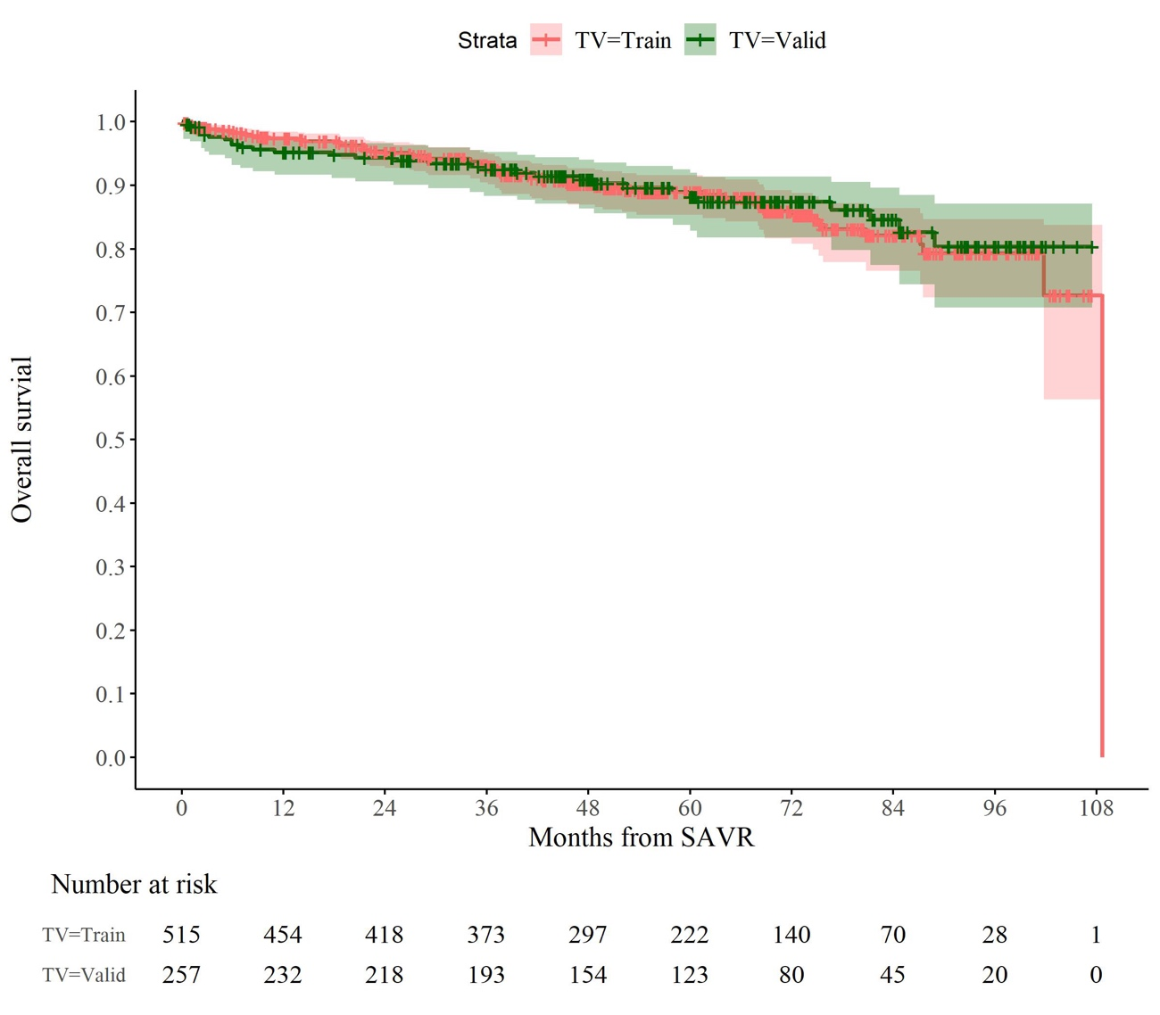


TV=Deriv
TV=Deriv
TV=Valid

