Slide 1
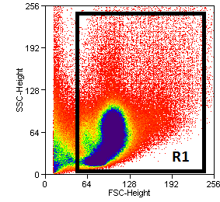
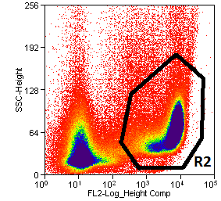
A.
B.
Panel A – plasma level of SDF-1 in G-CSF mobilized HO-1-deficient and control mice measured by ELISA. Panel B – gating strategy to sort Gr-1⁺ granulocytes from BM.
Supplementary Figure 1

