Slide 1
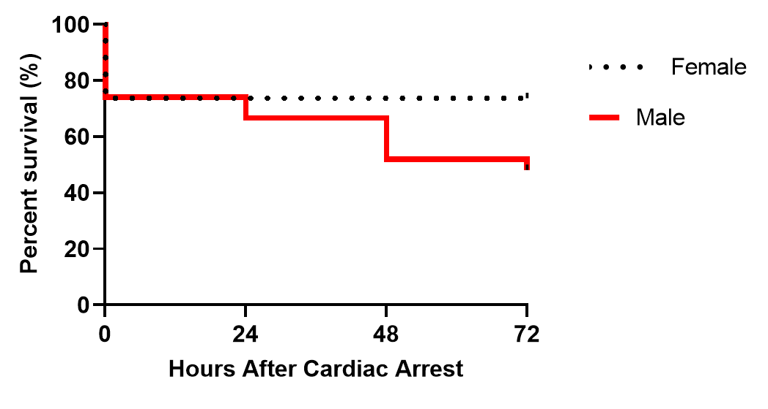
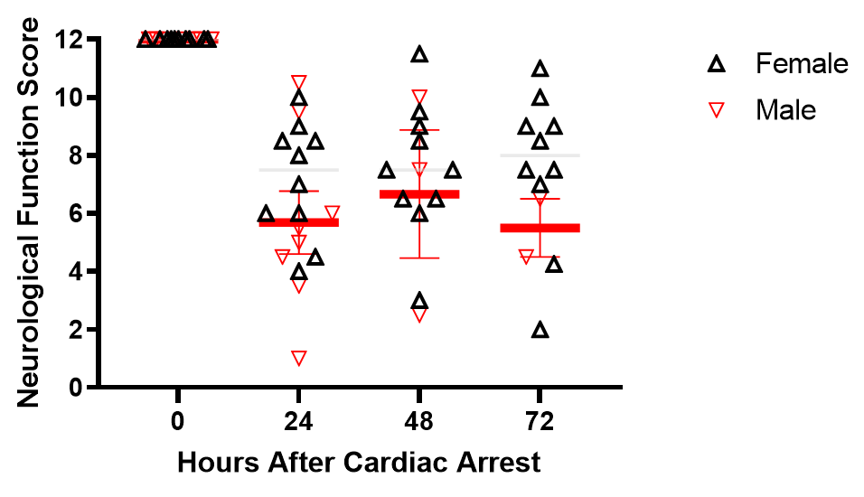
Supplemental Figure 1: Characteristics of Cardiac Arrest Mice – Sex Differences
Survival (Male versus Female)
A
B
Neurological Function Score (Male versus Female)

