Slide 1
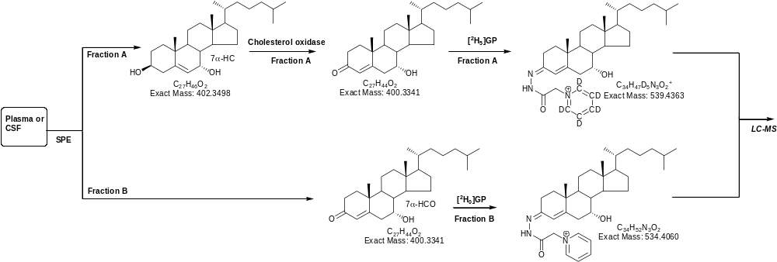
ESM_2 (Griffiths)

