Slide 1
Drp-1 82kDa
MFN2 80kDa
marker
marker
80kDa
80kDa
Sham VCI Mdivi-1 ML385
Sham VCI Mdivi-1 ML385
Sham VCI Mdivi-1 ML385
Sham VCI Mdivi-1 ML385
56
80kDa
48
80kDa
29
24
56KDa
13
p-NFR2 68kDa
GPX4 22kDa

Slide 2
HO-1 33kDa
mfn-1 84kDa
200kDa
marker
130kDa
80kDa
Sham VCI Mdivi-1 ML385
48kDa
Sham VCI Mdivi-1 ML385
tubulin 50kDa
tubulin 50kDa
80kDa
80kDa
48kDa
Sham VCI Mdivi-1 ML385
48kDa
Sham VCI Mdivi-1 ML385

Slide 3
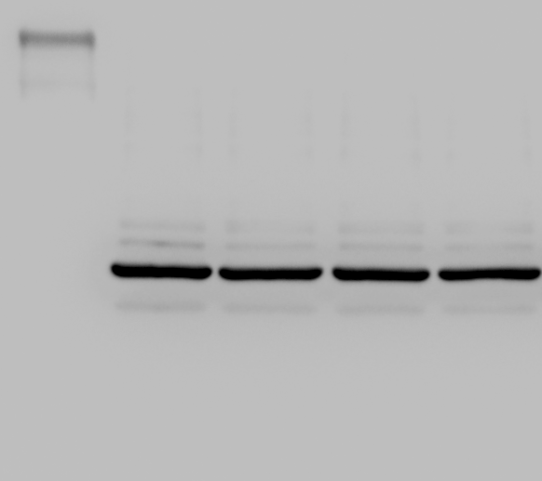
Cleave-Caspase-3 17kDa
NFR2 90kDa
130Da
108kDa
35kDa
Pro-Caspase-3
Cleave-Caspase-3
17kDa
Sham VCI Mdivi-1 ML385
tubulin 50kDa
tubulin 50kDa
Sham VCI Mdivi-1 ML385
Con OGD Mdivi-1 Fer-1 ML385

