Slide 1
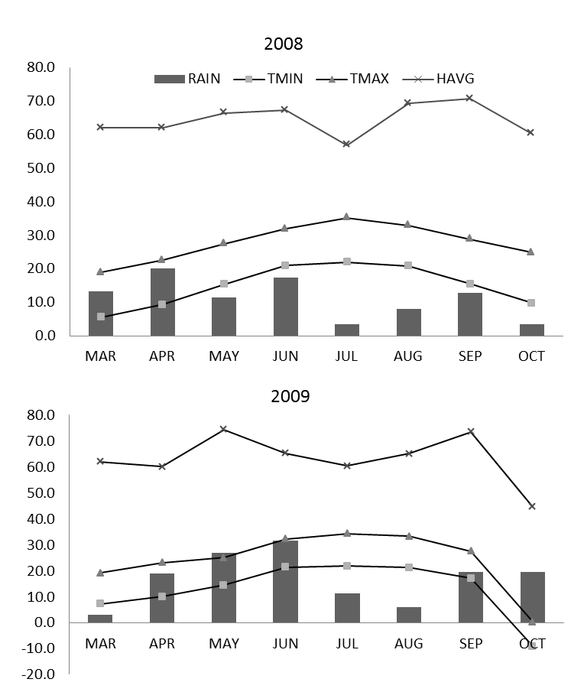
Uppalapati et al., Supplementary Figure 4 (revised)

