Slide 1
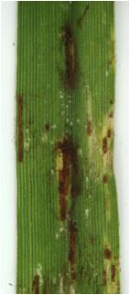
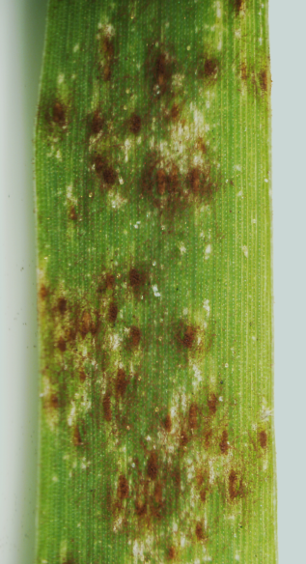
Uppalapati et al., Supplementary Figure 5
Summer
Kanlow
Alamo
HR
Cave-in-Rock

