Slide 1
Supplemental Figures
Multi-site Milling Strategy Reveals Significant Variation in Biomass Composition of Switchgrass (Panicum virgatum) Grown at Ten Locations
Journal: BioEnergy Research
David J. Thomas, Jason Bonnette, Steven D. Masterson, Robert B. Mitchell, Thomas Juenger, Laura E. Bartley
Corresponding Author: Laura E. Bartley (laura.bartley@wsu.edu)

Slide 2
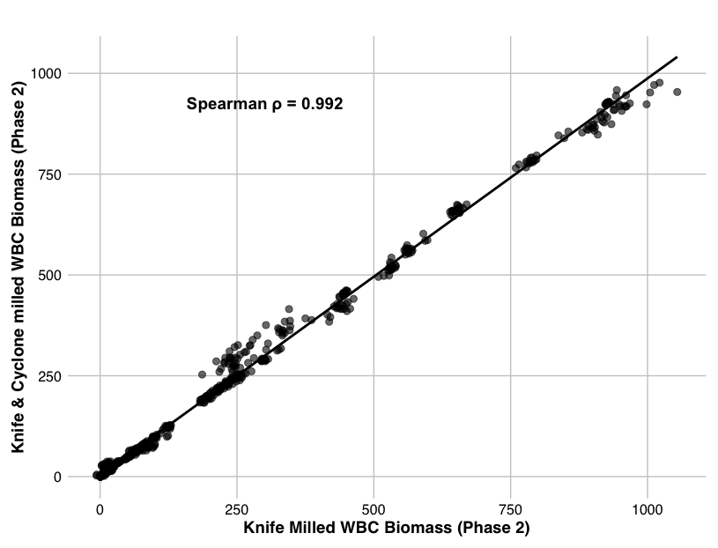
Figure S1. Near-infrared reflectance spectroscopy (NIRS) compositional trait predictions of same biomass are overall highly correlated between milling treatments. Biomass (stripped culms) of WBC clones milled with a knife mill at three sites in Texas (TX1, TX2, and TX3) and then again with a single cyclone mill are highly correlated (Spearman r = 0.992), although 18/45 (40%) of traits have an r below 0.70 and above 0.40. N = 6 per site for each milling treatment. See Supplemental Table S2 for Spearman Rho values for each trait.

Slide 3
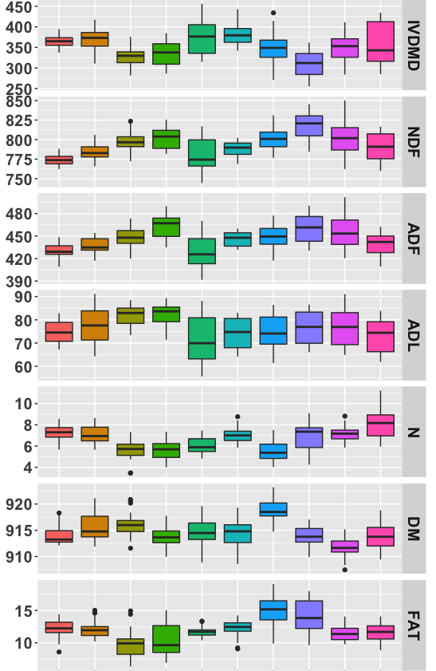
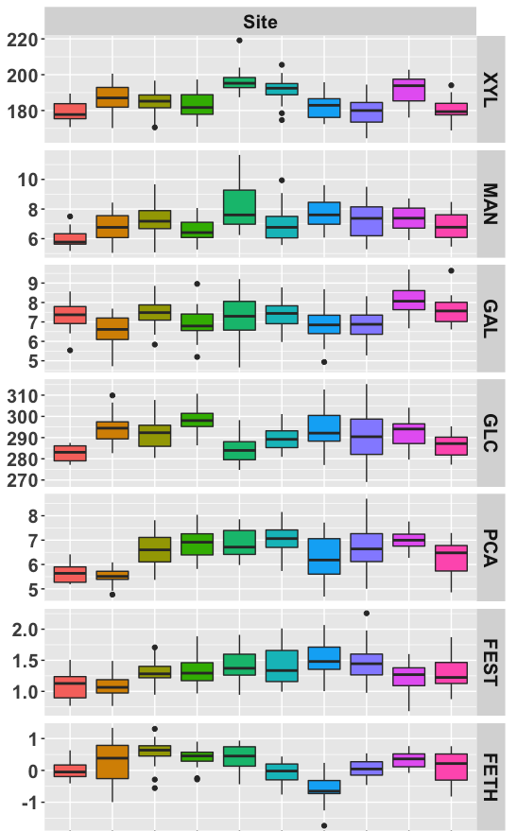
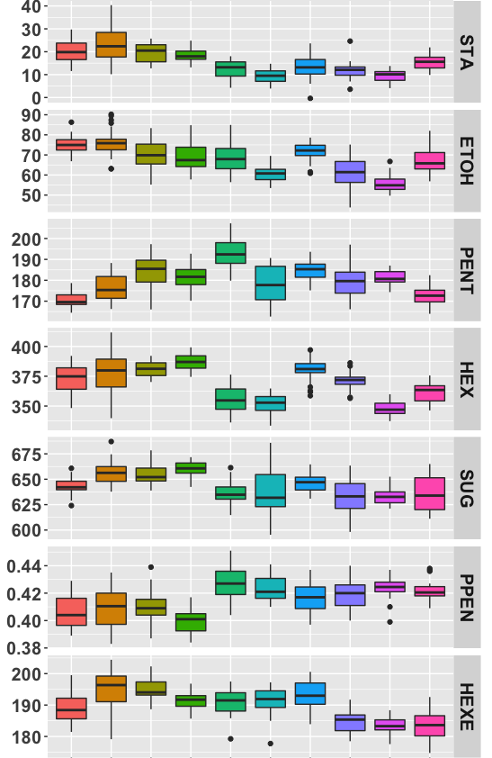
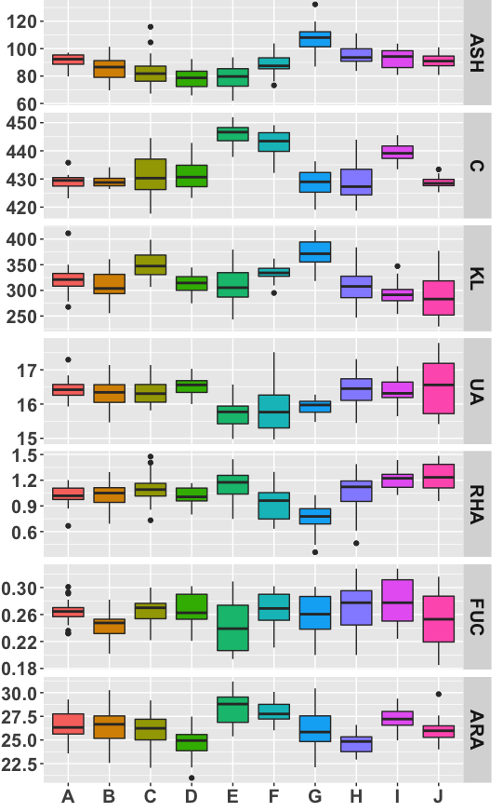
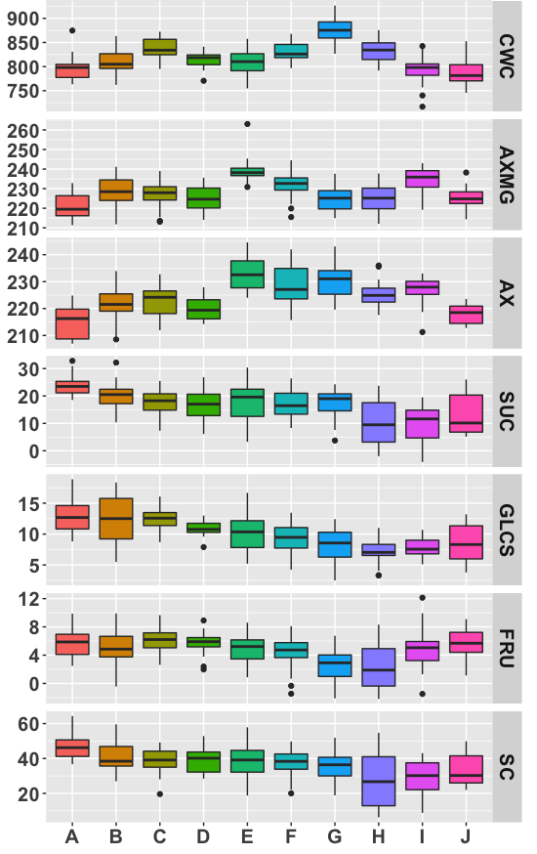
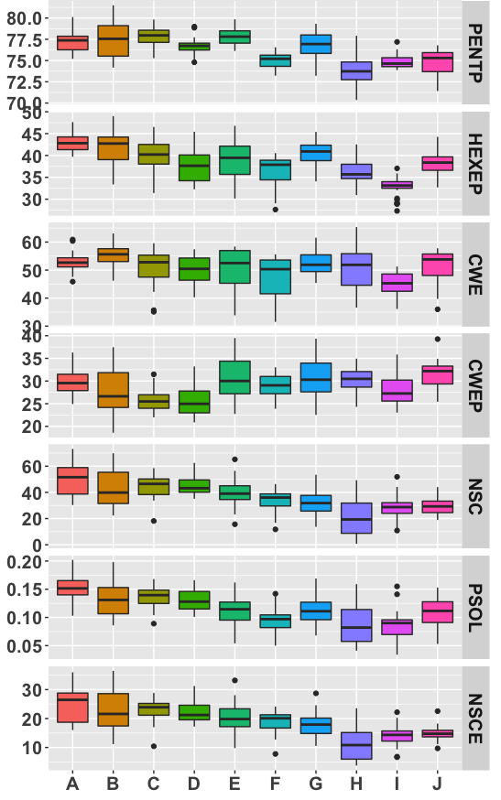
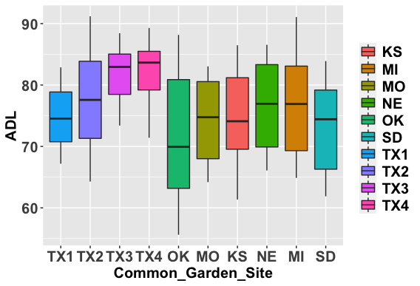
4.9e-16
< 2.2e-16
< 2.2e-16
< 2.2e-16
2.7e-12
< 2.2e-16
< 2.2e-16
< 2.2e-16
4.2e-09
2.6e-12
< 2.2e-16
1.0e-14
< 2.2e-16
< 2.2e-16
< 2.2e-16
< 2.2e-16
2.0e-13
< 2.2e-16
< 2.2e-16
< 2.2e-16
< 2.2e-16
< 2.2e-16
< 2.2e-16
< 2.2e-16
< 2.2e-16
< 2.2e-16
< 2.2e-16
< 2.2e-16
< 2.2e-16
3.4e-09
< 2.2e-16
2.5e-16
< 2.2e-16
1.2e-12
< 2.2e-16
< 2.2e-16
1.2e-11
4.4e-05
< 2.2e-16
1.1e-12
< 2.2e-16
< 2.2e-16
Location
Location
Location
Figure S2. Near-infrared reflectance spectroscopy (NIRS) compositional trait predictions for lowland switchgrass genotype, WBC, grown at ten locations is highly significantly variable across locations in all traits. The four sites within Texas often show an increasing or decreasing trend in many traits such as NDF, ADF, ETOH, while the other six sites rank change depending on the site. Several traits increase from OK in the south to NE in the north, but then decrease between NE and SD such as NDF, ADF, and ASH, with the opposite trend in IVDMD and FRU. ANOVA P values shown for individual traits by site. Refer to Table S4 for a complete list of trait descriptions.

