Slide 1
Table S1. Results of pH and conductivity according to dilution buffer condition
Buffer No. | Sample:Buffer ratio | pH | Conductivity (mS/cm)
1 (pH 7.5) | 1:0.8 | 7.36 | 6.12
 | 1:0.9 | 7.37 | 5.83
 | 1:1 | 7.37 | 5.60
 | 1:1.1 | 7.37 | 5.51
 | 1:1.2 | 7.36 | 5.30
 | 1:1.3 | 7.36 | 5.00
 | 1:1.4 | 7.36 | 4.96
2 (pH 7.7) | 1:0.8 | 7.41 | 6.03
 | 1:0.9 | 7.41 | 5.86
 | 1:1 | 7.44 | 5.75
 | 1:1.1 | 7.44 | 5.52
 | 1:1.2 | 7.44 | 5.45
 | 1:1.3 | 7.45 | 5.15
 | 1:1.4 | 7.45 | 5.05
3 (pH 8.0) | 1:0.8 | 7.46 | 6.19
 | 1:0.9 | 7.46 | 5.98
 | 1:1 | 7.53 | 5.58
 | 1:1.1 | 7.53 | 5.30
 | 1:1.2 | 7.53 | 5.12
 | 1:1.3 | 7.55 | 4.89
 | 1:1.4 | 7.56 | 4.76

Slide 2
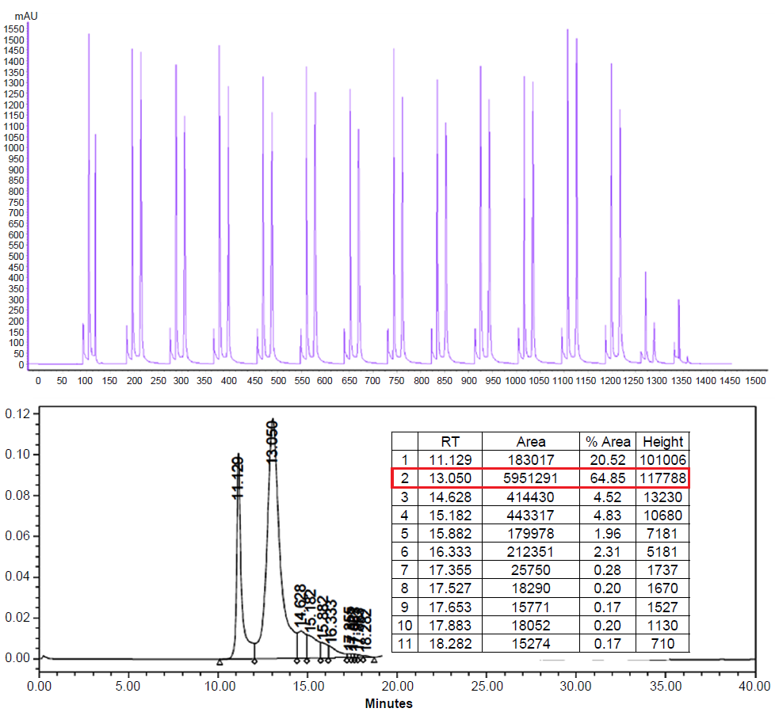
A
1500
1200
900
600
300
100
0
Absorbance (mAu)
0 200 400 600 800 1000 1200 1400
Time (min)
B
120
100
80
60
Absorbance (mAu)
40
20
0
0 5 10 15 20 25 30 35 40
Time (min)
Fig. S1. Results of advanced continuous process run 2. (A) A size exclusion chromatogram of periodic counter-current chromatography (PCC). (B) Purity by size exclusion high-performance liquid chromatography. AU: absorbance unit, RT: residence time.

Slide 3
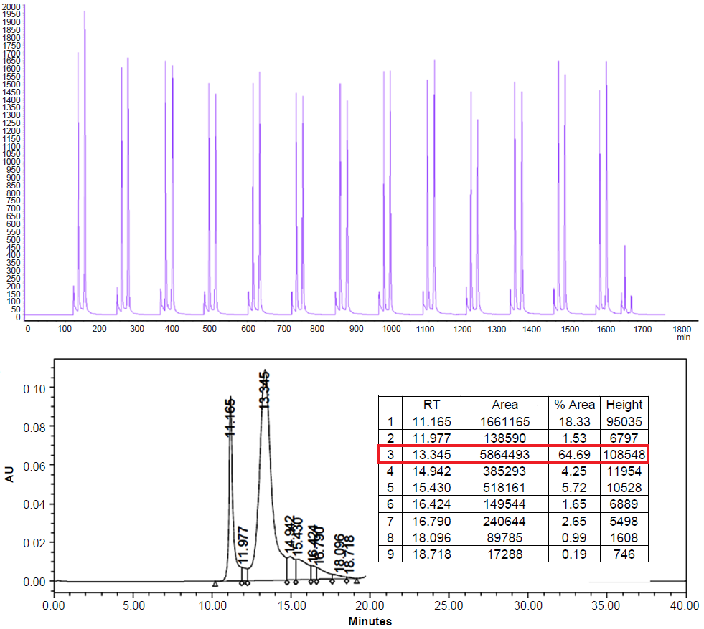
A
2000
1800
1500
1200
Absorbance (mAu)
900
600
300
0
0
300
600
900
1200
1500
1800
Time (min)
B
100
80
60
Absorbance (mAu)
40
20
0
0 5 10 15 20 25 30 35 40
Time (min)
Fig. S2. Results of advanced continuous process run 3. (A) A size exclusion chromatogram of periodic counter-current chromatography (PCC). (B) Purity by size exclusion high-performance liquid chromatography. AU: absorbance unit, RT: residence time.

Slide 4
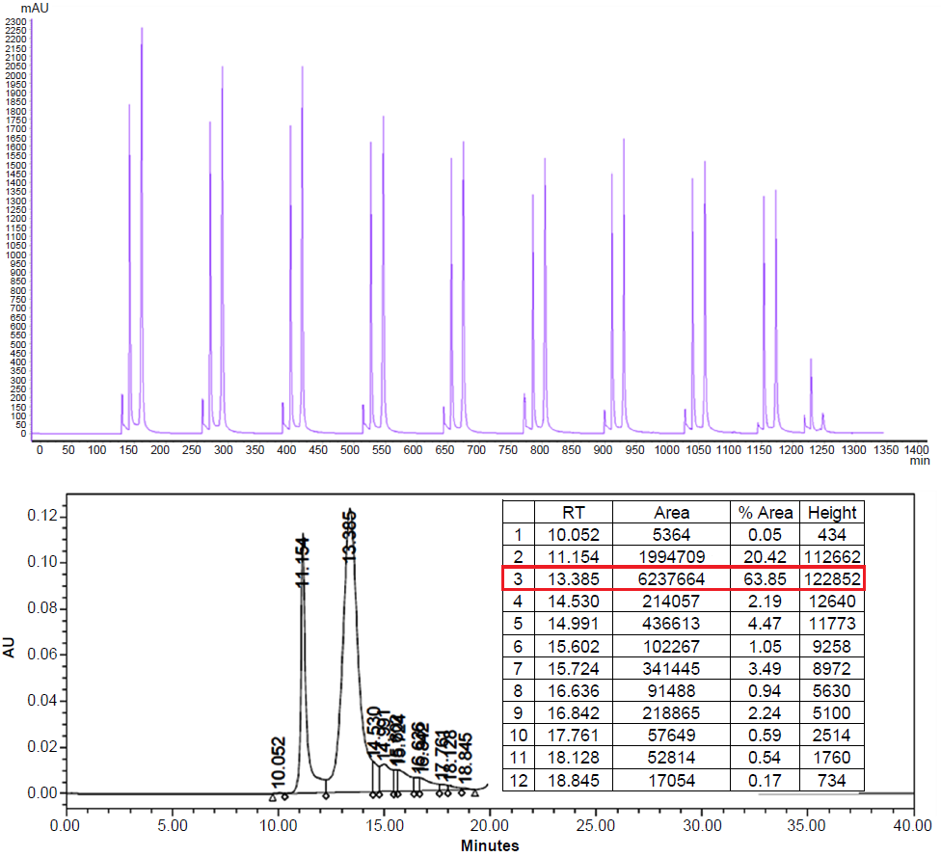
A
2300
2100
1800
1500
1200
Absorbance (mAu)
900
600
300
0
0
200
400
600
800
1000
1200
1400
Time (min)
B
120
100
80
Absorbance (mAu)
60
40
20
0
0 5 10 15 20 25 30 35 40
Time (min)
Fig. S3. Results of advanced continuous process run 4. (A) A size exclusion chromatogram of periodic counter-current chromatography (PCC). (B) Purity by size exclusion high-performance liquid chromatography. AU: absorbance unit, RT: residence time.

Slide 5
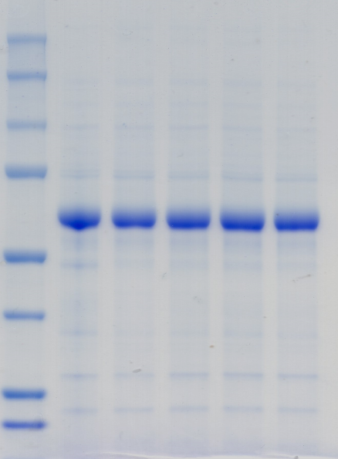
Supplementary Figure 4
Conventional
Advanced
M
1 2 3 4
Run
250
150
100
75
50
37
25
20
(kDa)
Fig. S4. Results of pH and conductivity according to dilution buffer condition. M: molecular markers.

