Slide 1
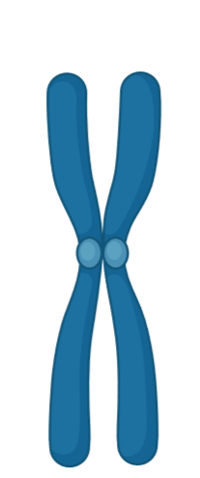
Supplementary Figure 1 Schematic representation of haplotype marker analysis
Chromosome 6
PLN p.(Arg14del)
PLN p.(Arg14del)
D6S303
D6S412
PLN-650
PLN-200
PLN-50
PLN+200
D6S304
Genetic markers
*
118,250K
118,700K
118,850K
119,100K
119,450K
116,050K
120,550K

Slide 2
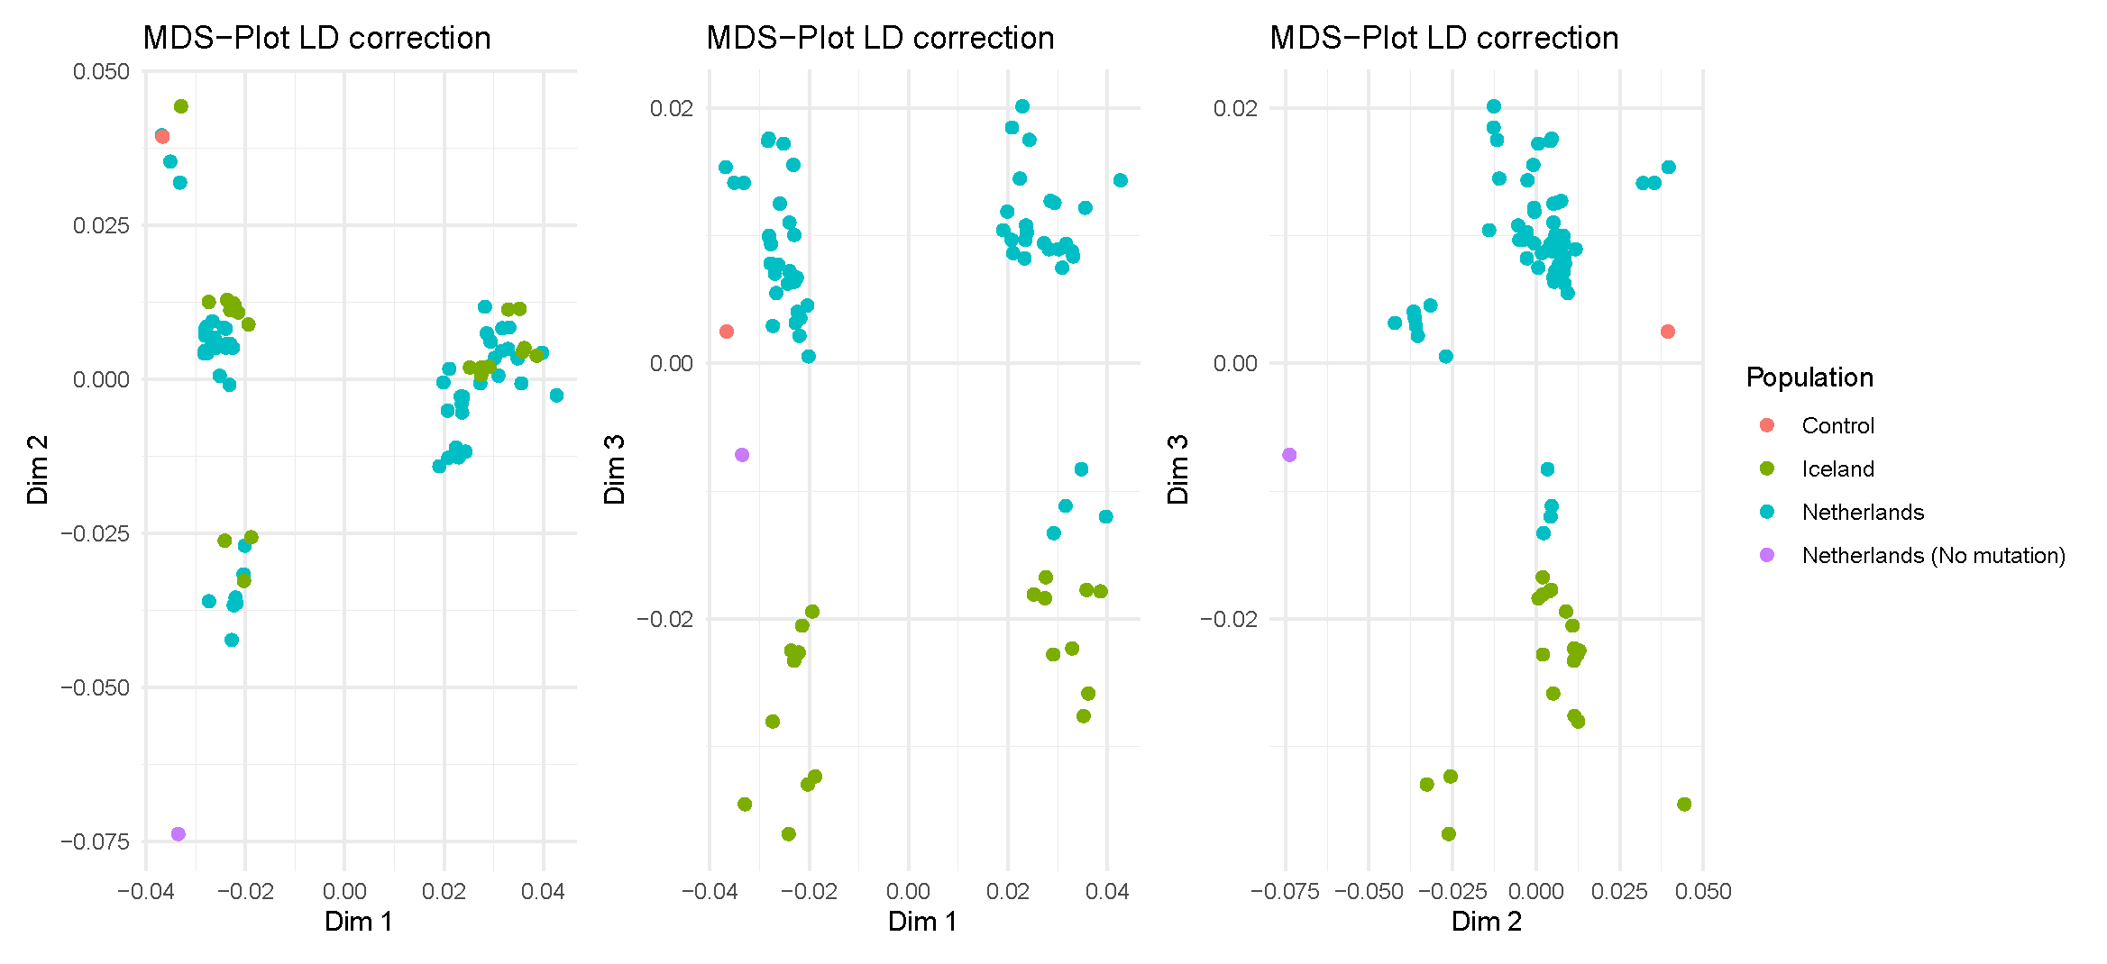
Supplementary Figure 2 Multidimensional scaling plot demonstrating genetic clustering of Icelandic samples with Dutch PLN p.(Arg14del) individuals
A
B
C
Control
Iceland
Netherlands
Netherlands (no PLN p.(Arg14del) variant)

Slide 3
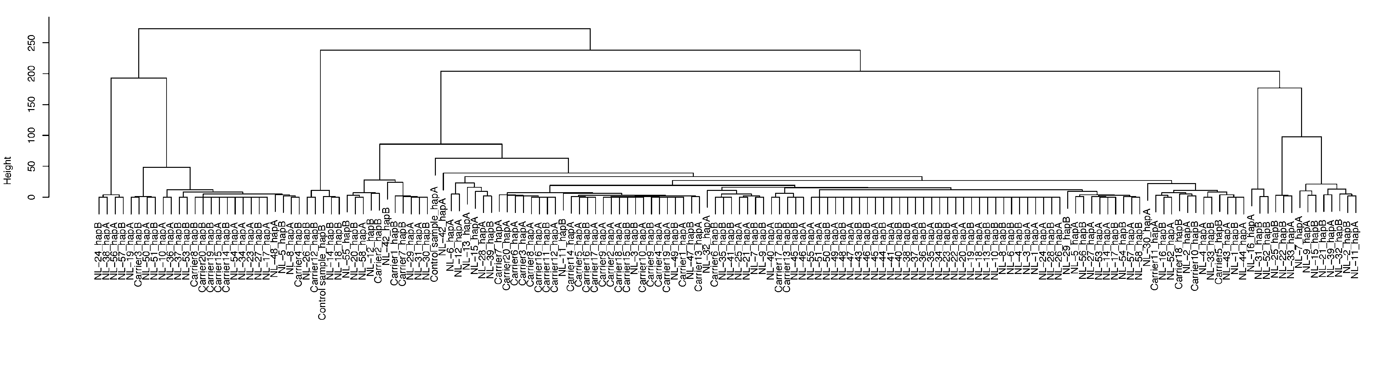
Supplementary Figure 3 Dendogram showing the genetic relationship between Icelandic (Carrier#) and Dutch p.(Arg14del)-positive individuals (NL-#)

