Slide 1
Suppl. Fig. 1
Bias
⊕
Low risk of bias
Selection of participants (selection bias) | Confounding variables (selection bias) | Measurement of exposure (performance bias) | Blinding of outcome assessments (detection bias) | Incomplete outcome data (attrition bias) | Selective outcome reporting (reporting bias)
？
Unclear risk of bias
⊖
High risk of bias
No Study name
1 | Gifu University | ? | ⊕ | ⊕ | ⊖ | ⊕ | ⊕
2 | Kurume University | ? | ⊕ | ⊕ | ⊖ | ⊕ | ⊕
3 | Kanazawa University | ? | ⊕ | ⊕ | ⊖ | ⊕ | ⊕
4 | Kyusyu Breast Cancer Study Group | ? | ⊕ | ⊕ | ⊖ | ⊕ | ⊕
5 | Hiroshima City Hiroshima Citizens Hospital | ? | ⊕ | ⊕ | ⊖ | ⊕ | ⊕
6 | Hiroshima University | ? | ⊕ | ⊕ | ⊖ | ⊕ | ⊕
7 | Saitama Medical University | ? | ⊕ | ⊕ | ⊖ | ⊕ | ⊕
8 | Yokkaichi Municipal Hospital | ? | ⊕ | ⊕ | ⊖ | ⊕ | ⊕
9 | Showa University | ? | ⊕ | ⊕ | ⊖ | ⊕ | ⊕
10 | Shinko Hospital | ? | ⊕ | ⊕ | ⊖ | ⊕ | ⊕
11 | St. Marianna University | ? | ⊕ | ⊕ | ⊖ | ⊕ | ⊕
12 | Chiba University | ? | ⊕ | ⊕ | ⊖ | ⊕ | ⊕
13 | Kinki Breast Cancer Study Group | ? | ⊕ | ⊕ | ⊖ | ⊕ | ⊕
14 | Kinki Breast Cancer Study Group | ? | ⊕ | ⊕ | ⊖ | ⊕ | ⊕
15 | Tsukuba University | ? | ⊕ | ⊕ | ⊖ | ⊕ | ⊕
16 | Tokyo Women's Medical University Medical Center East | ? | ⊕ | ⊕ | ⊖ | ⊕ | ⊕

Slide 2
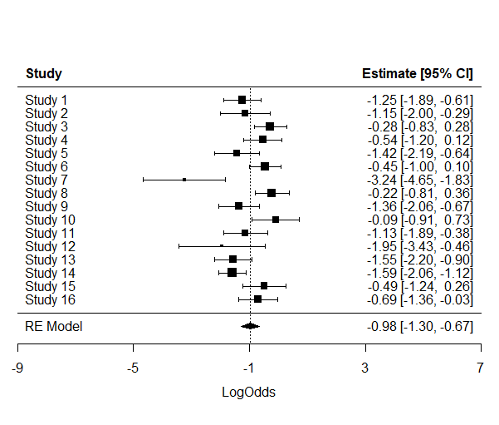
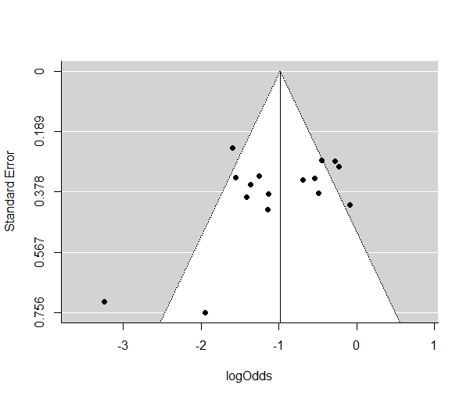
Suppl. Fig. 2
a
pCR rate
1. Gifu Univ.
2. Kurume Univ.
3. Kanazawa Univ.
4. Kyusyu BCSG
5. Hiroshima City HCH
6. Hiroshima Univ.
7. Saitama Medical Univ.
8. Yokkaichi Municipal Hosp.
9. Showa Univ.
10. Shinko Hosp.
11. St. Marianna Univ.
12. Chiba Univ.
13. KBCSG (1231)
14. KBCSG (1215)
15. Tsukuba Univ.
16. Tokyo Women’s Medical Univ.
0.22 [0.13, 0.35]
0.24 [0.12, 0.43]
0.43 [0.30, 0.57]
0.37 [0.23, 0.53]
0.20 [0.10, 0.34]
0.39 [0.27, 0.52]
0.04 [0.01, 0.14]
0.44 [0.31, 0.59]
0.20 [0.11, 0.34]
0.48 [0.29, 0.68]
0.24 [0.13, 0.41]
0.13 [0.03, 0.39]
0.17 [0.10, 0.29]
0.17 [0.11, 0.25]
0.38 [0.22, 0.56]
0.33 [0.20, 0.49]
0.27 [0.21, 0.34]
I² ＝ 68.8%, p<0.01
b

Slide 3
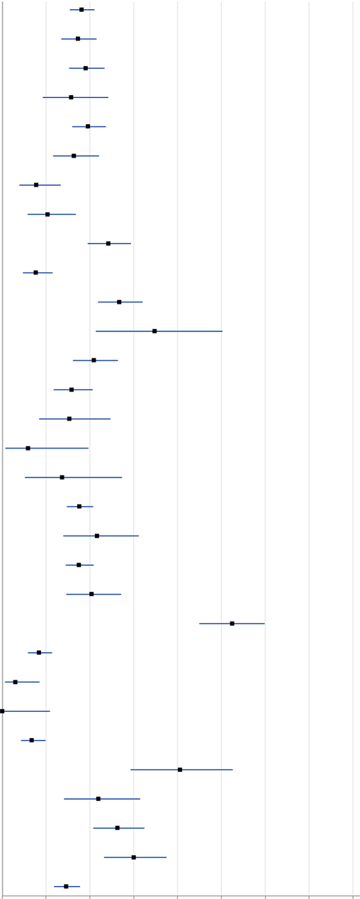
Suppl. Fig. 3
a
ypT0 ypN0
Subgroup | Categories | Cases | % of pCR | (95% CI)
 |  |  | Cases (%)
Total |  | 745 | 135 (18.1%) | (15.4 - 21.1)
Menopause | Pre | 360 | 62 (17.2%) | (13.5 - 21.5)
 | Post | 383 | 73 (19.1%) | (15.2 - 23.4)
Age | <40 | 102 | 16 (15.7%) | (9.2 - 24.2)
 | 40-59 | 434 | 85 (19.6%) | (16.0 - 23.6)
 | ≥60 | 208 | 34 (16.3%) | (11.6 - 22.1)
Nuclear Grade | 1 | 143 | 11 (7.7%) | (3.9 - 13.3)
 | 2 | 135 | 14 (10.4%) | (5.8 - 16.8)
 | 3 | 306 | 74 (24.2%) | (19.5 - 29.4)
Ki-67 | <40 | 263 | 20 (7.6%) | (4.7 - 11.5)
 | 40≥ | 307 | 82 (26.7%) | (21.8 - 32.0)
cStage | I | 46 | 16 (34.8%) | (21.4 - 50.2)
 | IIA | 258 | 54 (20.9%) | (16.1 - 26.4)
 | IIB | 278 | 44 (15.8%) | (11.7 - 20.7)
 | IIIA | 85 | 13 (15.3%) | (8.4 - 24.7)
 | IIIB | 34 | 2 (5.9%) | (0.7 - 19.7)
 | IIIC | 44 | 6 (13.6%) | (5.2 - 27.4)
Nab-PTX | Nab-PTX → A | 648 | 114 (17.6%) | (14.7 - 20.7)
 | A → Nab-PTX | 97 | 21 (21.6%) | (13.9 - 31.2)
 | Q3w | 571 | 100 (17.5%) | (14.5 - 20.9)
 | weekly | 172 | 35 (20.3%) | (14.6 - 27.1)
Clinical Response | cCR | 183 | 96 (52.5%) | (45.0 - 59.9)
 | PR | 421 | 35 (8.3%) | (5.9 - 11.4)
 | SD | 100 | 3 (3.0%) | (0.6 - 8.5)
 | PD | 32 | 0 (0.0%) | (0.0 - 10.9)
Subtype | Luminal | 343 | 23 (6.7%) | (4.3 - 9.9)
 | HER2-rich | 74 | 30 (40.5%) | (29.3 - 52.6)
 | Luminal/HER2 | 96 | 21 (21.9%) | (14.1 - 31.5)
 | TNBC | 232 | 61 (26.3%) | (20.7 - 32.5)
HER2 | positive | 170 | 51 (30.0%) | (23.2 -37.5)
 | negative | 575 | 84 (14.6%) | (11.8 - 17.8)
0
10
20
30
(%)
50
60
40
70
80

Slide 4
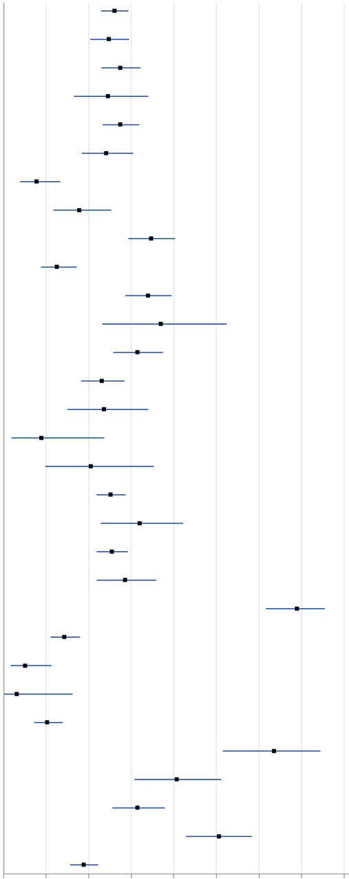
Suppl. Fig. 3
b
ypT0/is ypN0
Subgroup | Categories | Cases | % of pCR | (95% CI)
 |  |  | Cases (%)
Total |  | 745 | 194 (26.0%) | (22.9 - 29.3)
Menopause | Pre | 360 | 89 (24.7%) | (20.4 - 39.5)
 | Post | 383 | 105 (27.4%) | (23.0 - 32.2)
Age | <40 | 102 | 25 (24.5%) | (16.5 - 34.0)
 | 40-59 | 434 | 119 (27.4%) | (23.3 - 31.9)
 | ≥60 | 208 | 50 (24.0%) | (18.4 - 30.4)
Nuclear Grade | 1 | 143 | 11 (7.7%) | (3.9 - 13.3)
 | 2 | 135 | 24 (17.8%) | (11.7 - 25.3)
 | 3 | 306 | 106 (34.6%) | (29.3 - 40.3)
Ki-67 | <40 | 263 | 33 (12.5%) | (8.8 - 17.2)
 | ≥40 | 307 | 104 (33.9%) | (28.6 - 39.5)
cStage | I | 46 | 17 (37.0%) | (23.2 - 52.5)
 | IIA | 258 | 81 (31.4%) | (25.8 - 37.4)
 | IIB | 278 | 64 (23.0%) | (18.2 - 28.4)
 | IIIA | 85 | 20 (23.5%) | (15.0 - 34.0)
 | IIIB | 34 | 3 (8.8%) | (1.9 - 23.7)
 | IIIC | 44 | 9 (20.5%) | (9.8 - 35.3)
Nab-PTX | Nab-PTX → A | 648 | 163 (20.5%) | (21.9 - 28.7)
 | A → Nab-PTX | 97 | 31 (32.0%) | (22.9 - 42.2)
 | Q3w | 571 | 145 (25.4%) | (21.9 - 29.2)
 | weekly | 172 | 49 (28.5%) | (21.9 - 35.9)
Clinical Response | cCR | 183 | 126 (68.9%) | (61.6 - 75.5)
 | PR | 421 | 60 (14.3%) | (11.1 - 18.0)
 | SD | 100 | 5 (5.0%) | (1.6 - 11.3)
 | PD | 32 | 1 (3.1%) | (0.1 - 16.2)
Subtype | Luminal | 343 | 35 (10.2%) | (7.2 - 13.9)
 | HER2-rich | 74 | 47 (63.5%) | (51.5 - 74.4)
 | Luminal/HER2 | 96 | 39 (40.6%) | (30.7 - 51.1)
 | TNBC | 232 | 73 (31.5%) | (25.5 - 37.9)
HER2 | positive | 170 | 86 (50.6%) | (42.8 - 58.3)
 | negative | 575 | 108 (18.8%) | (15.7 - 22.2)
0
10
20
30
(%)
50
60
40
70
80

Slide 5
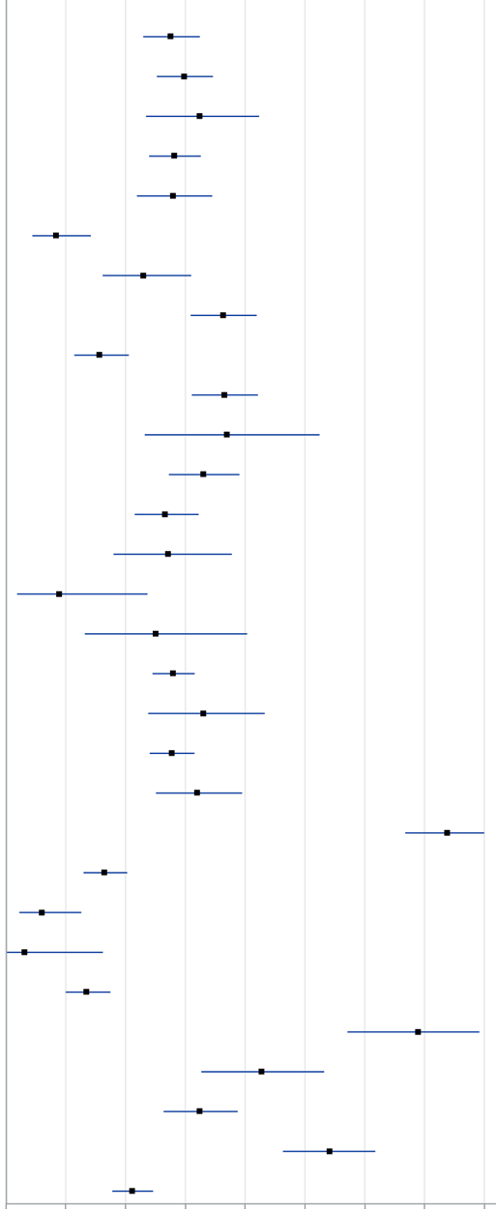
Suppl. Fig. 3
c
ypT0/is ypNX
Subgroup | Categories | Cases | % of pCR | (95% CI)
 |  |  | Cases (%)
Total |  | 745 | 213 (28.6%) | (25.4 - 32.0)
Menopause | Pre | 360 | 99 (27.5%) | (23.0 - 32.4)
 | Post | 383 | 114 (29.8%) | (25.2 - 34.6)
Age | <40 | 102 | 33 (32.4%) | (23.4 - 42.3)
 | 40-59 | 434 | 122 (28.1%) | (23.9 - 32.6)
 | ≥60 | 208 | 58 (27.9%) | (21.9 - 34.5)
Nuclear Grade | 1 | 143 | 12 (8.4%) | (4.4 - 14.2)
 | 2 | 135 | 31 (23.0%) | (16.2 - 31.0)
 | 3 | 306 | 111 (36.3%) | (30.9 - 41.9)
Ki-67 | <40 | 263 | 41 (15.6%) | (11.4 - 20.5)
 | ≥40 | 307 | 112 (36.5%) | (31.1 - 42.1)
cStage | I | 46 | 17 (37.0%) | (23.2 - 52.5)
 | IIA | 258 | 85 (32.9%) | (27.2 - 39.0)
 | IIB | 278 | 74 (26.6%) | (21.5 - 32.2)
 | IIIA | 85 | 23 (27.1%) | (18.0 - 37.8)
 | IIIB | 34 | 3 (8.8%) | (1.9 - 23.7)
 | IIIC | 44 | 11 (25.0%) | (13.2 - 40.3)
Nab-PTX | Nab-PTX → A | 648 | 181 (27.9%) | (24.5 - 31.6)
 | A → Nab-PTX | 97 | 32 (33.0%) | (23.8 - 43.3)
 | Q3w | 571 | 158 (27.7%) | (24.0 - 31.5)
 | weekly | 172 | 55 (32.0%) | (25.1 - 39.5)
Clinical Response | cCR | 183 | 135 (73.8%) | (66.8 - 80.0)
 | PR | 421 | 69 (16.4%) | (13.0 - 20.3)
 | SD | 100 | 6 (6.0%) | (2.2 - 12.6)
 | PD | 32 | 1 (3.1%) | (0.1 - 16.2)
Subtype | Luminal | 343 | 46 (13.4%) | (10.0 - 17.5)
 | HER2-rich | 74 | 51 (68.9%) | (57.1 - 79.2)
 | Luminal/HER2 | 96 | 41 (42.7%) | (32.7 - 53.2)
 | TNBC | 232 | 75 (32.3%) | (26.4 - 38.8)
HER2 | positive | 170 | 92 (54.1%) | (46.3 - 61.8)
 | negative | 575 | 121 (21.0%) | (17.8 - 24.6)
0
10
20
30
(%)
50
60
40
70
80

Slide 6
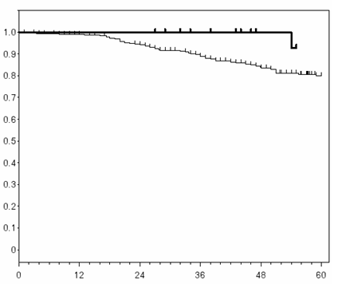
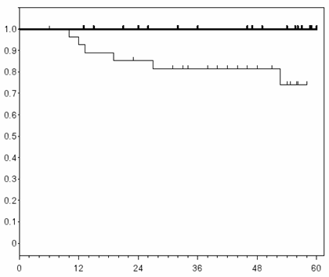
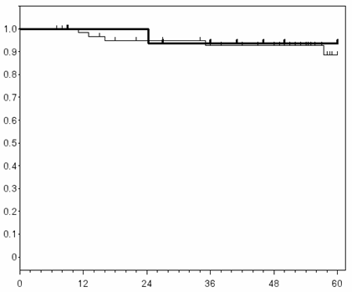
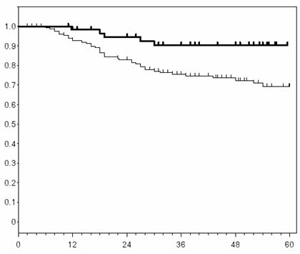
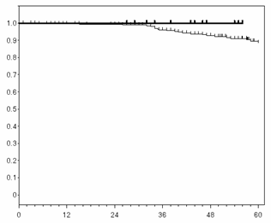
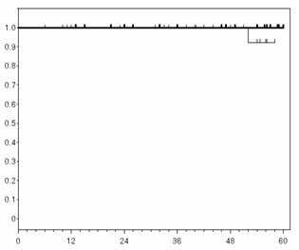
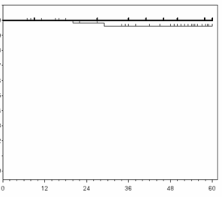
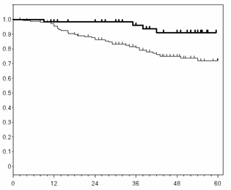
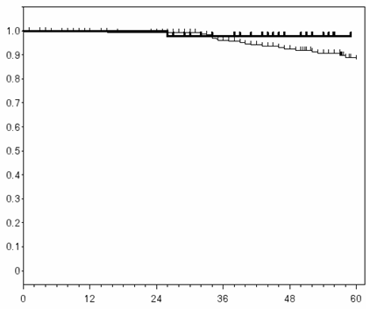
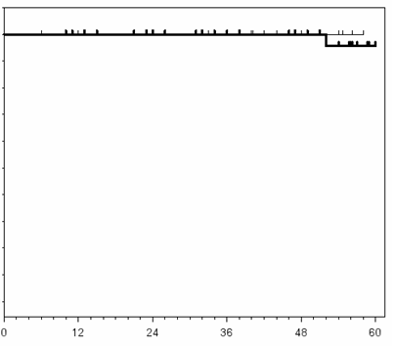
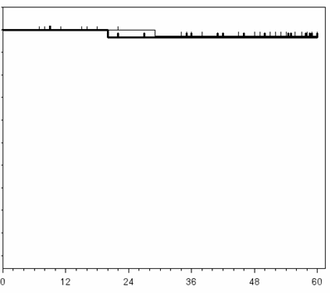
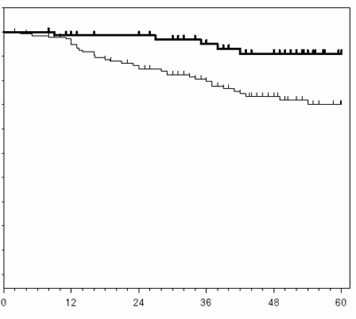
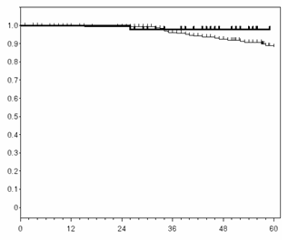
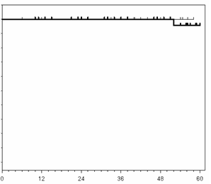
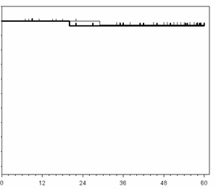
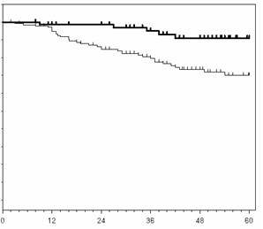
Suppl. Fig. 4
a
ypT0 ypN0
Luminal
HER2-rich
Luminal-HER2
TNBC
DFS
HR: 0.23 [0.03-1.63]
P=0.105
HR: -
P=0.012
HR: 0.64 [0.08-5.53]
P=0.686
HR: 0.28 [0.11-0.71]
P=0.004
Number at risk
(Months)
(Months)
(Months)
(Months)
Mo
pCR(+)
pCR(-)
0 | 12 | 24 | 36 | 48 | 60
23 | 23 | 23 | 19 | 14 | 10
304 | 287 | 267 | 216 | 161 | 96
0 | 12 | 24 | 36 | 48 | 60
26 | 26 | 22 | 19 | 17 | 7
29 | 25 | 22 | 18 | 12 | 5
0 | 12 | 24 | 36 | 48 | 60
17 | 16 | 16 | 12 | 10 | 6
61 | 56 | 50 | 43 | 39 | 13
0 | 12 | 24 | 36 | 48 | 60
59 | 56 | 50 | 39 | 34 | 22
157 | 134 | 115 | 85 | 58 | 30
OS
HR: -
P=0.125
HR: -
P=0.267
HR: 1.33 [0.12-14.81]
P=0.817
HR: 0.26 [0.09-0.73]
P=0.006
Number at risk
(Months)
(Months)
(Months)
(Months)
Mo
pCR(+)
pCR(-)
0 | 12 | 24 | 36 | 48 | 60
23 | 23 | 23 | 19 | 14 | 10
290 | 275 | 268 | 221 | 170 | 102
0 | 12 | 24 | 36 | 48 | 60
26 | 26 | 22 | 19 | 17 | 7
29 | 25 | 24 | 21 | 14 | 7
0 | 12 | 24 | 36 | 48 | 60
18 | 17 | 17 | 14 | 12 | 7
60 | 56 | 50 | 43 | 39 | 14
0 | 12 | 24 | 36 | 48 | 60
58 | 55 | 51 | 41 | 34 | 22
155 | 137 | 119 | 90 | 59 | 31
ｂ
ypT0/is ypNX
Luminal
HER2-rich
Luminal-HER2
TNBC
DFS
(Survival)
HR: 0.46 [0.17-1.28]
P=0.128
HR: 0.18 [0.03-0.97]
P=0.025
HR: 1.28 [0.26-6.37]
P=0.76
HR: 0.36 [0.17-0.77]
P=0.006
Number at risk
(Months)
(Months)
(Months)
(Months)
Mo
pCR(+)
pCR(-)
0 | 12 | 24 | 36 | 48 | 60
46 | 46 | 44 | 39 | 27 | 16
281 | 264 | 246 | 196 | 148 | 90
0 | 12 | 24 | 36 | 48 | 60
39 | 37 | 32 | 27 | 24 | 11
16 | 14 | 12 | 10 | 5 | 1
0 | 12 | 24 | 36 | 48 | 60
33 | 30 | 29 | 23 | 20 | 10
45 | 42 | 37 | 32 | 29 | 9
0 | 12 | 24 | 36 | 48 | 60
73 | 68 | 62 | 47 | 40 | 24
143 | 122 | 103 | 77 | 52 | 28
OS
(Survival)
HR: 0.21 [0.03-1.57]
P=0.095
HR, -
P=0.610
HR: 2.71 [0.25-29.89]
P=0.397
HR: 0.24 [0.1-0.62]
P=0.001
Number at risk
(Months)
(Months)
(Months)
(Months)
Mo
pCR(+)
pCR(-)
0 | 12 | 24 | 36 | 48 | 60
23 | 23 | 23 | 39 | 27 | 16
290 | 275 | 268 | 196 | 148 | 90
0 | 12 | 24 | 36 | 48 | 60
26 | 26 | 22 | 19 | 17 | 7
29 | 25 | 24 | 21 | 14 | 7
0 | 12 | 24 | 36 | 48 | 60
18 | 17 | 17 | 14 | 12 | 7
60 | 56 | 50 | 43 | 39 | 14
0 | 12 | 24 | 36 | 48 | 60
58 | 55 | 51 | 41 | 34 | 22
155 | 137 | 119 | 90 | 59 | 31

