Slide 1
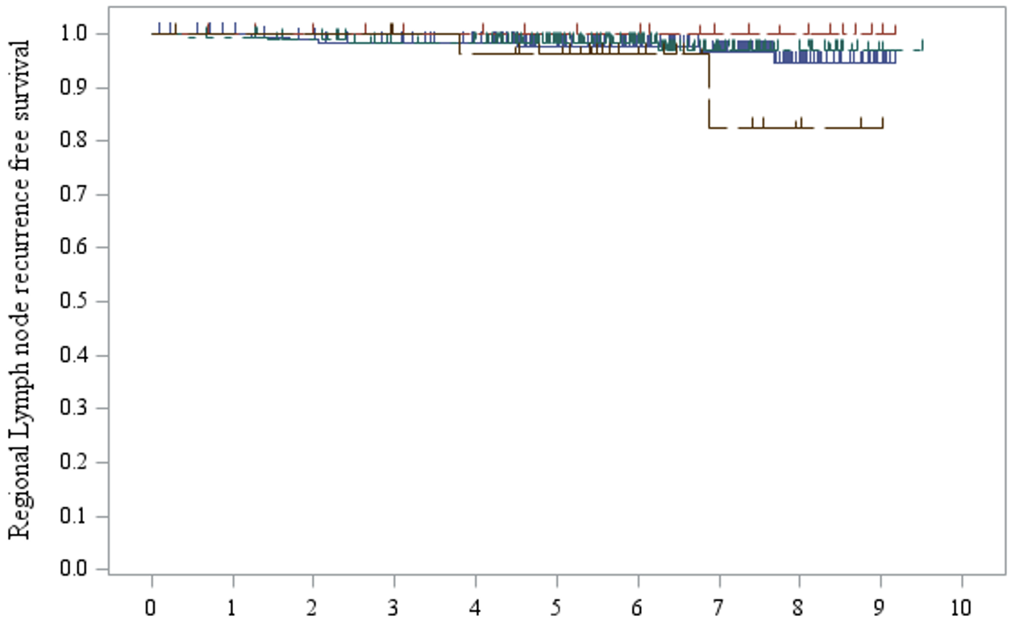
Supplementary Figure 1
5-year regional node recurrence-free survival rate (95% confidence interval)
ALND and 1-positive SLN 97.7% (93.9% to 99.1%)
ALND and 2 or 3-positive SLNs 100% (100% to 100%)
SNB and 1-positive SLN 98.3% (94.8% to 99.4%)
SNB and 2 or 3-postive SLNs 96.3% (76.5% to 99.5%)
Year
At risk
ALND and 1-positive SLN group
187 | 182 | 176 | 171 | 159 | 140 | 112 | 81 | 34 | 6 | 0
22 | 21 | 19 | 18 | 17 | 15 | 14 | 10 | 8 | 2 | 0
179 | 177 | 172 | 160 | 157 | 123 | 84 | 40 | 18 | 2 | 0
30 | 29 | 29 | 27 | 26 | 23 | 13 | 6 | 3 | 1 | 0
ALND and 2 or 3-positive SLN group
SNB and 1-positive SLN group
SNB and 2 or 3-positive SLN group

