Slide 1
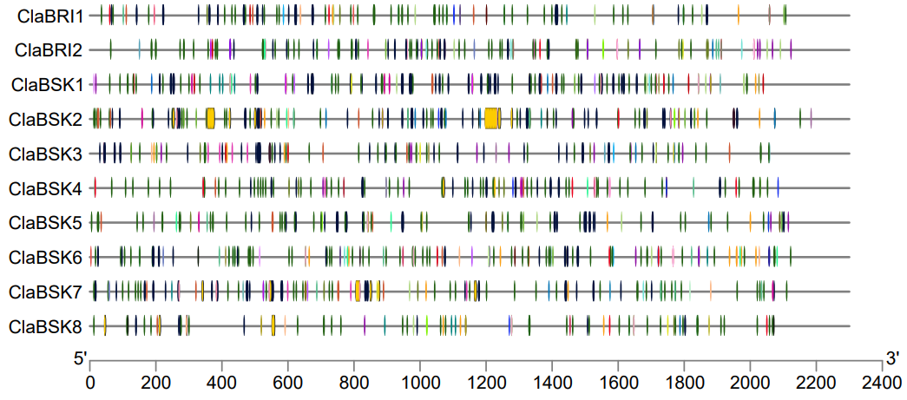
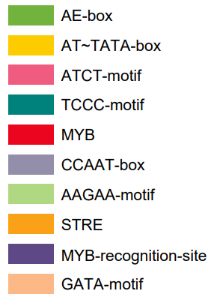
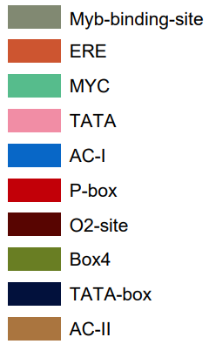
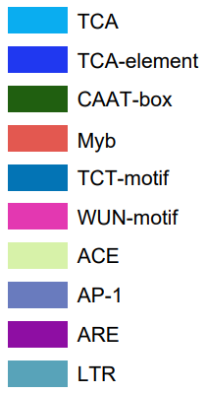
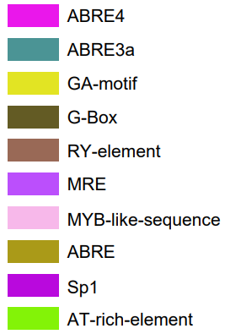
Fig. S1 Predicted cis‐acting elements in the promoters of ClaBRI and ClaBSK genes. The identified elements are: ABA‐responsive elements (ABRE), MYB‐binding site (MBS), low‐temperature‐responsive elements (LTR), jasmonic acid‐responsive elements (CGTCA‐motif), stress‐responsive elements (TC‐rich repeats), TCA‐elements (related to the SA response), ARE, ERE, ACE and MRE core. The scale denotes the positions of cis‐regulatory elements in regard to the translation start site (taken as +1 bp).

