Slide 1



The EXERRT trial – “EXErcise to Regadenoson in Recovery Trial”: A phase 3b, open-label, parallel group, randomized, multicenter study to assess regadenoson administration following an inadequate exercise stress test as compared to regadenoson without exercise for myocardial perfusion imaging using a SPECT protocol
Journal of Nuclear Cardiology | Official Journal of the American Society of Nuclear Cardiology
Gregory S. Thomas; MemorialCare Heart & Vascular Institute, Long Beach Memorial; S. James Cullom, AdaptivePharma, Leawood, KS; Therese M. Kitt; Astellas Pharma Global Development, Inc.; Kathleen M. Feaheny; Astellas Pharma Global Development, Inc.; Karthikeyan Ananthasubramaniam, Heart and Vascular Institute, Henry Ford Hospital; Robert J. Gropler; Division of Radiological Sciences, Mallinckrodt Institute of Radiology, Washington University School of Medicine; Diwakar Jain; Cardiovascular Nuclear Imaging Laboratory, New York Medical College, Westchester Medical Center; Randall C. Thompson; St. Luke’s Mid America Heart Institute and and University of Missouri-Kansas City.
EXERRT Investigators meeting, April 22, 2012
Copyright American Society of Nuclear Cardiology

Slide 2
BACKGROUND
Journal of Nuclear Cardiology | Official Journal of the American Society of Nuclear Cardiology
1. Current stress MPI protocols require a pre-test decision whether a patient will undergo exercise or pharmacologic stress.
2. The bolus administration of regadenoson provides patients an opportunity to attempt symptom-limited treadmill exercise first and administer regadenoson in patients who fail to achieve an adequate work-load. However, this approach has not been comprehensively studied.
Copyright American Society of Nuclear Cardiology

Slide 3
METHODS
Journal of Nuclear Cardiology | Official Journal of the American Society of Nuclear Cardiology
Study type: Multi-center, multi-national, open-label, randomized parallel design
Study subjects: Patients referred for a clinically indicated exercise or pharmacologic stress test
Study endpoints:
  Primary endpoint: Non-inferiority of regadenoson administered during recovery from inadequate exercise compared with administration without exercise
  Secondary endpoint: Safety
Study variables: Number of reversible perfusion defects using a 17-segment model; adverse events; and blood pressure, heart rate and ECG response.
Copyright American Society of Nuclear Cardiology

Slide 4
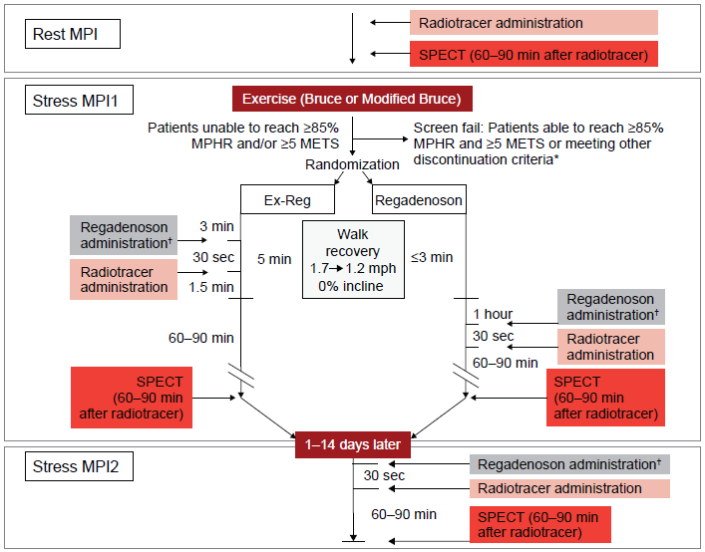
METHODS
Journal of Nuclear Cardiology | Official Journal of the American Society of Nuclear Cardiology
*Patients experiencing signs or symptoms of ischemia prior to receiving regadenoson were not to be randomized
†Administered intravenously over 10 seconds
MPI, myocardial perfusion imaging; SPECT, single photon emission computed tomography
Copyright American Society of Nuclear Cardiology

Slide 5
Primary Endpoint
Journal of Nuclear Cardiology | Official Journal of the American Society of Nuclear Cardiology
Copyright American Society of Nuclear Cardiology

Slide 6
Heart to Background Ratios
Journal of Nuclear Cardiology | Official Journal of the American Society of Nuclear Cardiology
*P<0.001
Target-to-background ratios were higher for stress MPI1 in the Ex-Reg group compared to the arm when regadenoson was given at rest
Copyright American Society of Nuclear Cardiology

Slide 7
Clinically Significant Treatment-Emergent Cardiac Events
Journal of Nuclear Cardiology | Official Journal of the American Society of Nuclear Cardiology
 | Ex-Reg |  | Regadenoson
 | Stress MPI1 Regadenoson Following Exercise (n = 575) | Stress MPI2 Regadenoson (n = 544) | Stress MPI1 Regadenoson (n = 567) | Stress MPI2 Regadenoson (n = 548)
Any cardiac event | 17 (3.0) | 5 (0.9) | 3 (0.5) | 2 (0.4)
Any ECG abnormality | 16 (2.8) | 5 (0.9) | 3 (0.5) | 2 (0.4)
ST-T depression (≥2 mm) | 13 (2.3) | 3 (0.6) | 2 (0.4) | 2 (0.4)
ST-T elevation (≥1 mm) | 3 (0.5) | 2 (0.4) | 1 (0.2) | 0
Major cardiac adverse events | 2 (0.3) | 0 | 0 | 0
ACS | 1 (0.2)* | 0 | 0 | 0
MI | 1 (0.2)* | 0 | 0 | 0
Adverse event of unstable angina | 0 | 0 | 0 | 0
*Both patients experienced ischemic symptoms and ECG changes during exercise or recovery prior to regadenoson
ACS, acute coronary syndrome; ECG, electrocardiogram; MI, myocardial infarction; MPI, myocardial perfusion imaging
Copyright American Society of Nuclear Cardiology

Slide 8
CONCLUSIONS
Journal of Nuclear Cardiology | Official Journal of the American Society of Nuclear Cardiology
1. No difference in the detection of ischemia during MPI when regadenoson is given during walk recovery (“Ex-Reg”) compared to regadenoson without exercise (“Regadenoson”).
2. The Ex-Reg protocol resulted in improved Heart to Background ratios (Heart to Liver and Heart to Gut) compared to Regadenoson.
3. Regadenoson should not be administered at 3 minutes of recovery to patients who develop signs or symptoms of ischemia during sub-maximal exercise or recovery.
Copyright American Society of Nuclear Cardiology

