Slide 1




Imaging of atherosclerosis, targeting LFA-1 on inflammatory cells with ¹¹¹In-DANBIRT
Journal of Nuclear Cardiology | Official Journal of the American Society of Nuclear Cardiology
E.J. Meester^{1,2} Msc; B.J. Krenning³ MD, PhD; R.H. de Blois² PhD; J.P. Norenberg⁴ PhD, PharmD; M. de Jong² PhD; M.R. Bernsen² PhD; K Van der Heiden¹ PhD
¹ Department of Biomedical Engineering, Thorax Center, Erasmus MC, Rotterdam, The Netherlands
² Department of Radiology & Nuclear Medicine, Erasmus MC, Rotterdam, The Netherlands
³ Department of Cardiology, Thorax Center, Erasmus MC, Rotterdam, The Netherlands
⁴Radiopharmaceutical Sciences, University of New Mexico, Albuquerque, NM, USA
Copyright American Society of Nuclear Cardiology

Slide 2
BACKGROUND
Journal of Nuclear Cardiology | Official Journal of the American Society of Nuclear Cardiology
1- Inflammatory cells play a crucial role in atherosclerotic plaque formation and destabilization.
2- Current imaging methods have limitations in their ability to visualize inflammation.
3- ¹¹¹In-DOTA-butylamino-NorBIRT (¹¹¹In-DANBIRT) is a novel radioligand which binds to Leukocyte Function associated-Antigen-1 (LFA-1), expressed on inflammatory cells.
4- This study evaluated ¹¹¹In-DANBIRT for the visualization of atherosclerotic plaque inflammation in mice.
Copyright American Society of Nuclear Cardiology

Slide 3
METHODS
Journal of Nuclear Cardiology | Official Journal of the American Society of Nuclear Cardiology
Study type: Experimental study/Preclinical animal study
Study subjects: atherosclerotic mice, and human plaque sample
Study endpoints:
  In vivo radioligand uptake in mice atherosclerotic plaques
  In vitro uptake in human plaque material
  Radioligand specificity
Copyright American Society of Nuclear Cardiology

Slide 4
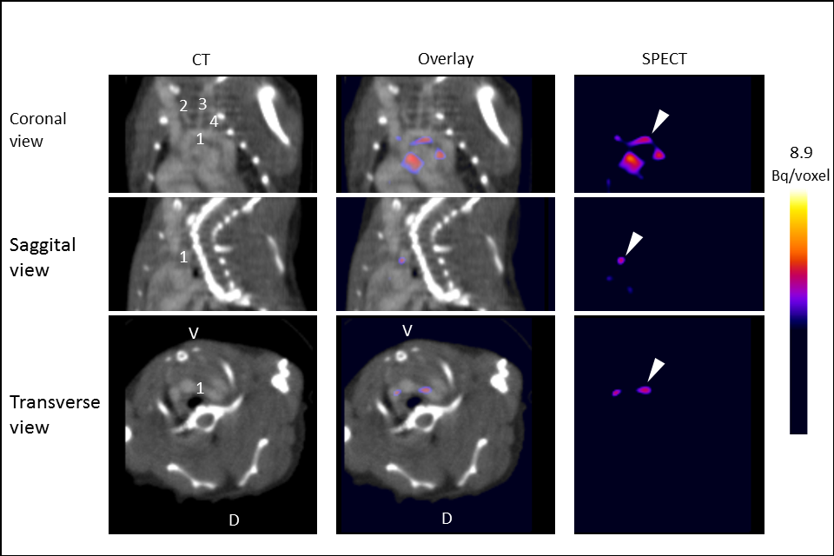
RESULTS
Journal of Nuclear Cardiology | Official Journal of the American Society of Nuclear Cardiology
In vivo uptake of ¹¹¹In-DANBIRT in atherosclerotic mice. In vivo contrast enhanced CT, SPECT, and overlay images of ApoE^{-/-} mouse thorax in coronal, sagittal, and transverse view. 1=aortic arch; 2=right common carotid artery; 3=left common carotid artery; 4=left subclavian artery. V=ventral, D=dorsal. Arrowheads indicate radioactive hot spots (¹¹¹In-DANBIRT uptake) in the aortic arch.
Copyright American Society of Nuclear Cardiology

Slide 5
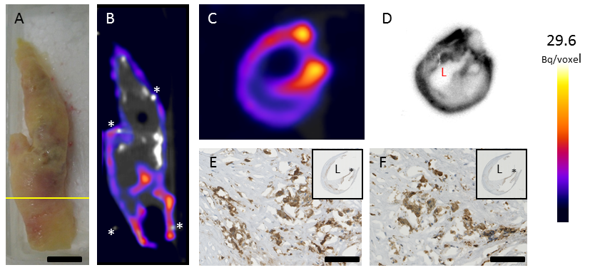
RESULTS
Journal of Nuclear Cardiology | Official Journal of the American Society of Nuclear Cardiology
Ex vivo ¹¹¹In-DANBIRT imaging of LFA-1 in a human atherosclerotic plaque. Bright field photo (A, scale bar=10mm)) and coronal view of SPECT/CT scan (B) of a carotid endarterectomy specimen incubated with ¹¹¹In-DANBIRT. SPECT/CT imaging shows heterogeneous uptake of ¹¹¹In-DANBIRT. Calcified regions of the plaque are visible in bright white in the CT view. Pins used as landmarks are indicated by asterisks (*). Transverse view of SPECT/CT scan (C) and ex vivo autoradiographic image of 1 mm thick slice (D) of specimen, at the location indicated by a yellow line in A. Histological sections adjacent to D stained for LFA-1 (E) or CD68 (F), scalebar=100 µm. Insets show overview of the histological section, asterisks shows location of zoomed area. L=Lumen.
Copyright American Society of Nuclear Cardiology

Slide 6
CONCLUSIONS
Journal of Nuclear Cardiology | Official Journal of the American Society of Nuclear Cardiology
1- ¹¹¹In-DANBIRT uptake correlates to cells expressing LFA-1 and CD68
2- ¹¹¹In-DANBIRT detects plaque inflammation in vivo in a mouse model of atherosclerosis, and shows uptake in human plaque tissue ex vivo
3- Radiolabelled DANBIRT shows potential as a relevant nuclear imaging tracer to detect atherosclerotic inflammation
Copyright American Society of Nuclear Cardiology

