Slide 1
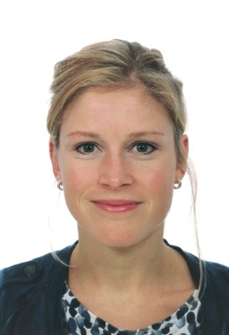



¹⁸F-sodium fluoride positron emission tomography assessed microcalcifications in culprit and non-culprit human carotid plaques
Journal of Nuclear Cardiology | Official Journal of the American Society of Nuclear Cardiology
  Hop H¹, de Boer SA¹, Reijrink M¹, Kamphuisen PW¹, de Borst MH², Pol RA³, Zeebregts CJ³, Hillebrands JL⁴, Slart RHJA⁵, Boersma HH^{5,6}, Doorduin J⁵, Mulder DJ¹
  University Medical Center Groningen 1. Dept. of Internal Medicine, div. of Vascular Medicine. 2. Dept. of Internal Medicine, div. of Nephrology. 3. Dept. of Surgery, div. of Vascular Surgery. 4. Dept. of Pathology. 5. Dept. of Nuclear Medicine and Molecular Imaging. 6. Dep. Of Clinical Pharmacy and Pharmacology
Copyright American Society of Nuclear Cardiology

Slide 2
BACKGROUND
Journal of Nuclear Cardiology | Official Journal of the American Society of Nuclear Cardiology
¹⁸F-NaF PET targets microcalcifications, which are associated with plaque vulnerability.
¹⁸F-NaF was higher in culprit than in non-culprit coronary plaques of patients with myocardial infarction.
Data on carotid plaques is limited.
Little is known on the relation between active microcalcification (PET) and established calcification (CT) in carotid plaques.
Copyright American Society of Nuclear Cardiology

Slide 3
METHODS
Journal of Nuclear Cardiology | Official Journal of the American Society of Nuclear Cardiology
Study type: translational, in vitro study
Study subjects: carotid plaques from stroke patients undergoing surgery
Study endpoints:
  microPET assessed ¹⁸F-NaF uptake in culprit and non-culprit human carotid plaques.
  Pattern of ¹⁸F-NaF PET uptake versus calcification pattern on microCT.
Variables:¹⁸F-NaF uptake in %Inc/g, CT VOI, ¹⁸F-NaF PET VOI
Copyright American Society of Nuclear Cardiology

Slide 4
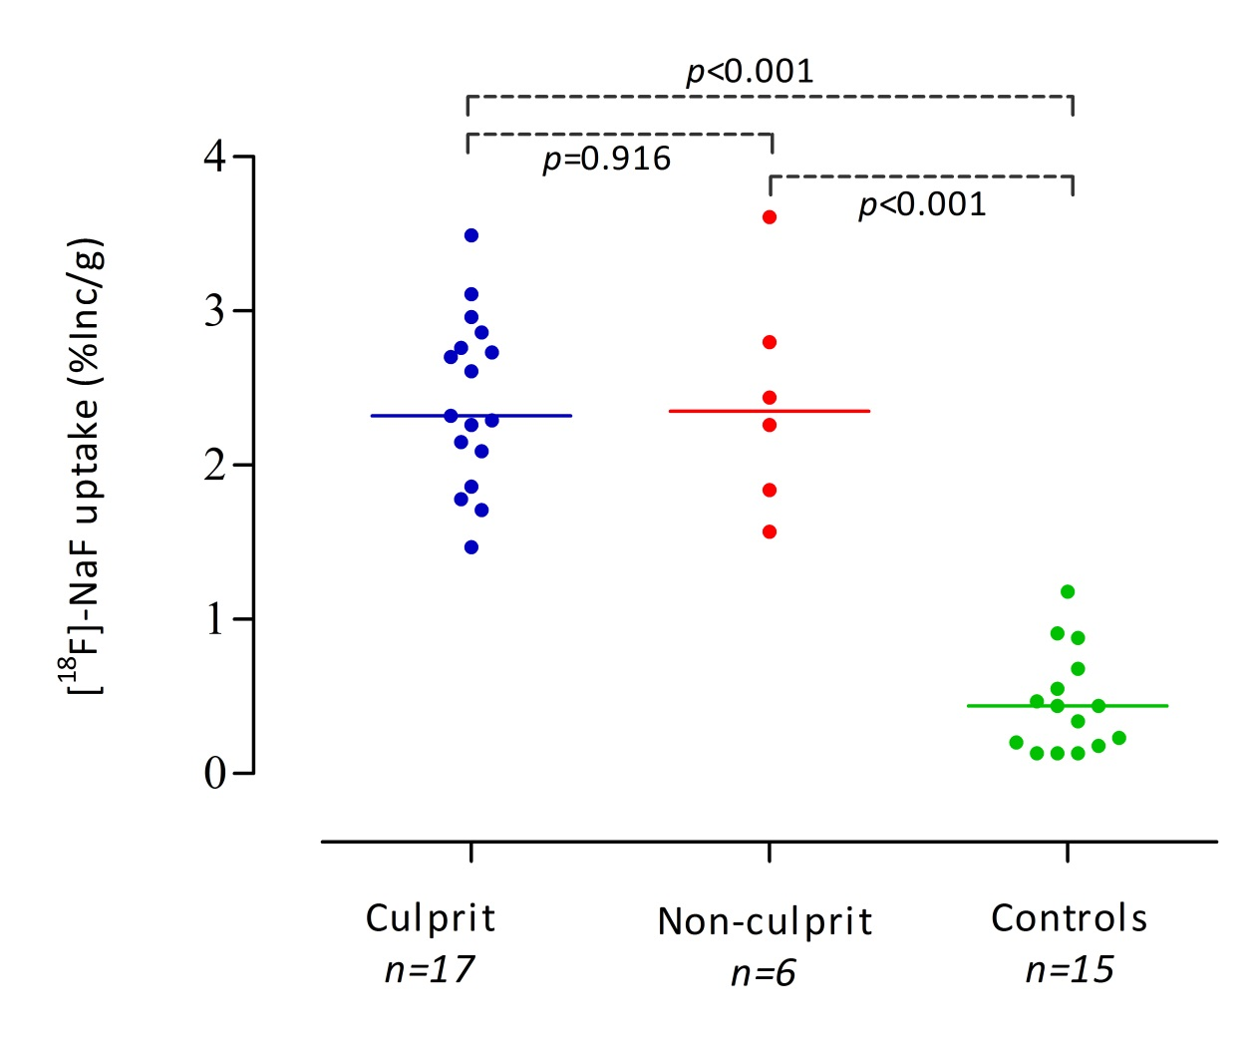
RESULTS
Journal of Nuclear Cardiology | Official Journal of the American Society of Nuclear Cardiology
H
Figure shows PET assessed ¹⁸F-NaF uptake, as measure of microcalcification, in human carotid plaques and renal arteries of healthy kidney donors, which were used as negative controls.
Data expressed as percentage ¹⁸F-NaF uptake of the total incubation dose per gram of tissue (% Inc/g).
Horizontal line represents the median.
Copyright American Society of Nuclear Cardiology

Slide 5
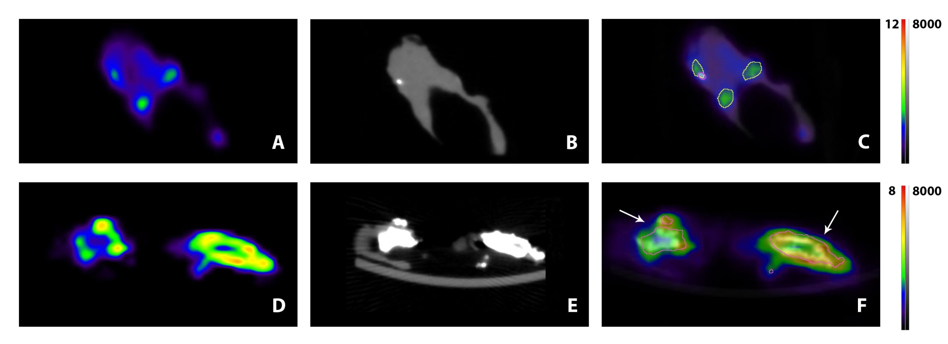
RESULTS
Journal of Nuclear Cardiology | Official Journal of the American Society of Nuclear Cardiology
Figure shows sagittal views of ¹⁸F-NaF microPET (A,D) microCT (B,E) and fused (C,F) images of human carotid plaques. A heterogeneous distribution of ¹⁸F-NaF uptake with clear hotspots can be seen. Volumes of interest are drawn around CT calcification areas in image C and F (white calcification, pink line). In image C only one small calcification (pink line) can be seen in the areas of increased ¹⁸F-NaF uptake (green spots).In image F, the relatively large calcifications (white arrows) show the most intense ¹⁸F-NaF uptake at their surface.
Scale PET images in %Inc/g, scale CT images in HU
Copyright American Society of Nuclear Cardiology

Slide 6
CONCLUSIONS
Journal of Nuclear Cardiology | Official Journal of the American Society of Nuclear Cardiology
Calcification patterns on ¹⁸F-NaF PET and CT are different
¹⁸F-NaF has the potential to identify high- risk carotid plaques.
¹⁸F-NaF uptake in culprit and non-culprit carotid plaques of high-risk patients was similar, probably due to the advanced nature of atherosclerosis in our study patients.
Further prospective studies on ¹⁸F-NaF uptake and symptomatology are required.
Copyright American Society of Nuclear Cardiology

