Slide 1




Added value of ¹⁸F-FDG-PET/CT and cardiac CTA in suspected transcatheter aortic valve endocarditis
Journal of Nuclear Cardiology | Official Journal of the American Society of Nuclear Cardiology
Ali R. Wahadat, MD^{1,2,3,*}
Wilco Tanis, MD, PhD^{3,*}
Laurens E. Swart, MD^{1,2}
Asbjørn Scholtens, MD⁴
Gabriel P. Krestin, MD, PhD¹
Nicolas M.D.A. van Mieghem, MD, PhD²
Carolina A.M. Schurink, MD^{5,6}
Tycho I.G. van der Spoel, MD, PhD^{3,7}
Floris S. van den Brink, MD^{8,9}
Tessel Vossenberg, MD⁹
Riemer H.J.A. Slart, MD, PhD¹⁰
Andor W.J.M. Glaudemans, MD, PhD¹⁰
Jolien W. Roos-Hesselink, MD, PhD²
Ricardo P.J. Budde, MD, PhD^{1,2}
¹Department of Radiology and Nuclear Medicine, Erasmus Medical Center, Rotterdam, The Netherlands;
²Department of Cardiology, Thoraxcenter, Erasmus Medical Center, Rotterdam, The Netherlands;
³Department of Cardiology, Haga Teaching Hospital, The Hague, The Netherlands;
⁴Department of Nucleair Medicine, Meander Medical Center, Amersfoort, The Netherlands;
⁵Department of Medical Microbiology and Infectious Diseases, Erasmus Medical Center, Rotterdam, The Netherlands;
⁶Departement of Internal Medicine, Erasmus Medical Center, Rotterdam, The Netherlands;
⁷Department of Cardiology, Utrecht Medical Center, Utrecht, The Netherlands;
⁸Department of Cardiology, St. Antonius Medical Center, Nieuwegein, The Netherlands;
⁹Department of Cardiology, Leeuwarden Medical Center, Leeuwarden, The Netherlands;
¹⁰Medical Imaging Center, Department of Nuclear Medicine & Molecular Imaging, University Medical Center of Groningen, Groningen, The Netherlands;
Copyright American Society of Nuclear Cardiology

Slide 2
BACKGROUND
Journal of Nuclear Cardiology | Official Journal of the American Society of Nuclear Cardiology
1- Transcatheter-implanted aortic valve infective endocarditis (TAVI-IE) is difficult to diagnose
2- New diagnostic tools: ¹⁸F-FDG PET/CT and cardiac CTA
3- What is the additional diagnostic value of these two imaging techniques?
Copyright American Society of Nuclear Cardiology

Slide 3
METHODS
Journal of Nuclear Cardiology | Official Journal of the American Society of Nuclear Cardiology
Study type:(Select all that apply)
  Retrospective observational
Study subjects: patients with the age of >18 years who underwent ¹⁸F-FDG-PET/CT and/or CTA for suspected TAVI-IE
Study endpoints:
  Primary end point(s): The diagnosis of rejected- possible- or definite TAVI-IE based on 1. modified Duke criteria, 2. the ESC criteria and 3. the Endocarditis Team consensus
  Secondary end point(s): none
Study variables: blood culture results, echocardiographic results, PET/CT results, CTA results, SUV_{max} and SUV_{ratio,} other minor modified Dukes criteria/ ESC criteria
Copyright American Society of Nuclear Cardiology

Slide 4
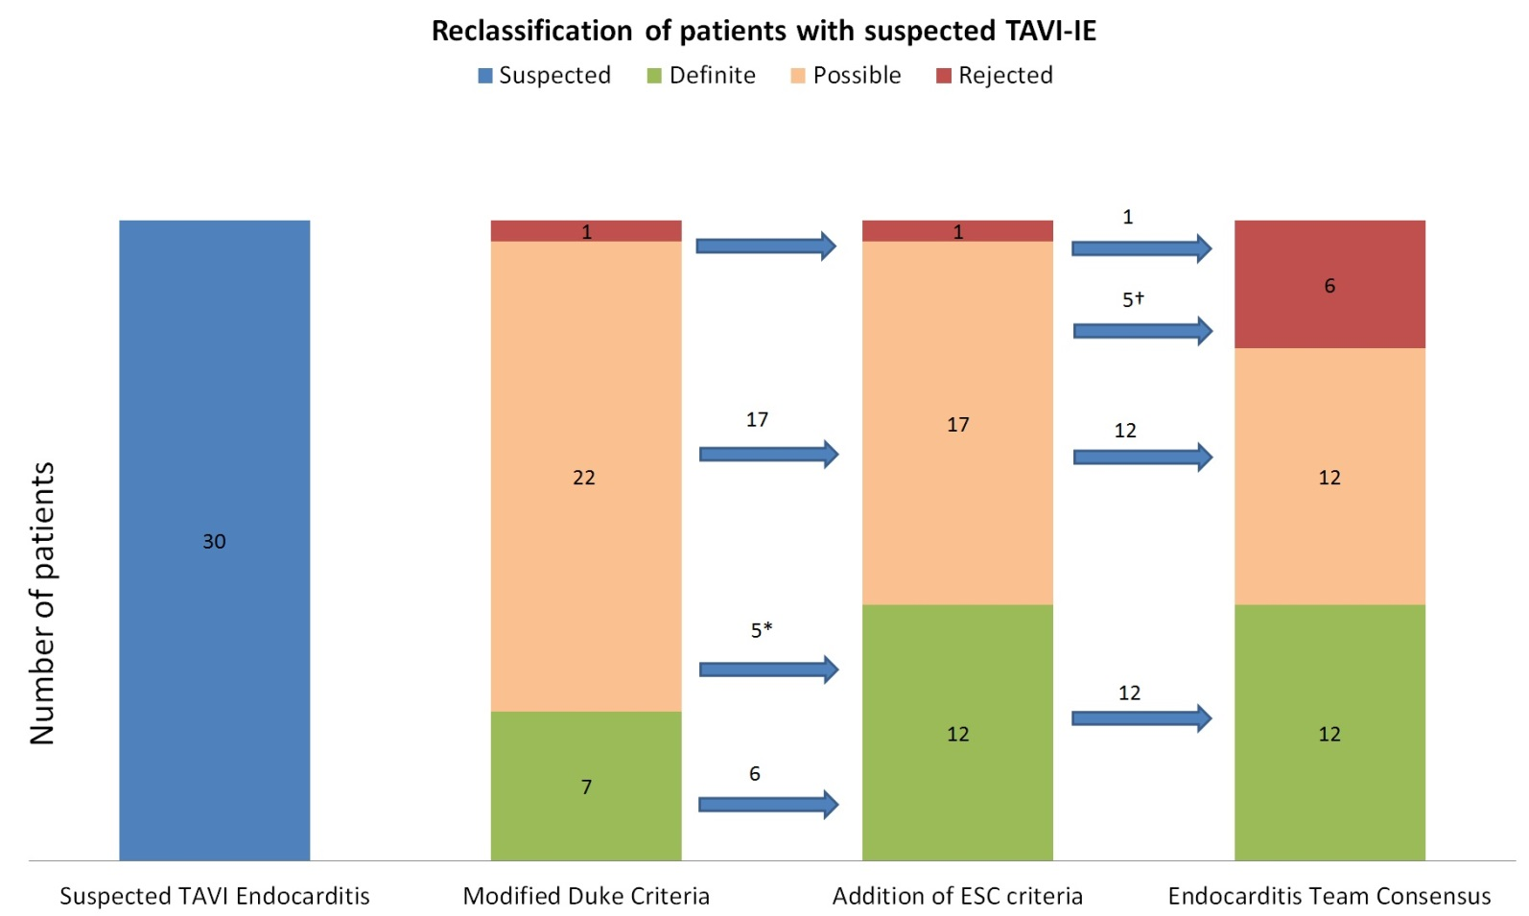
RESULTS
Journal of Nuclear Cardiology | Official Journal of the American Society of Nuclear Cardiology
Fig. 1: Distribution of patients with suspected Endocarditis based on Modified Duke Criteria, ESC-criteria, and Endocarditis Team consensus based on ESC-criteria
Copyright American Society of Nuclear Cardiology

Slide 5
CONCLUSIONS
Journal of Nuclear Cardiology | Official Journal of the American Society of Nuclear Cardiology
1- Addition of ¹⁸F-FDG-PET/CT and/or CTA changed the final diagnosis in 33% of the cases
Copyright American Society of Nuclear Cardiology

