Slide 1


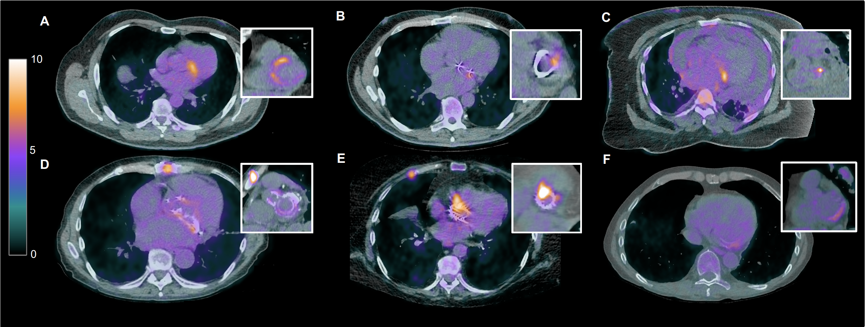
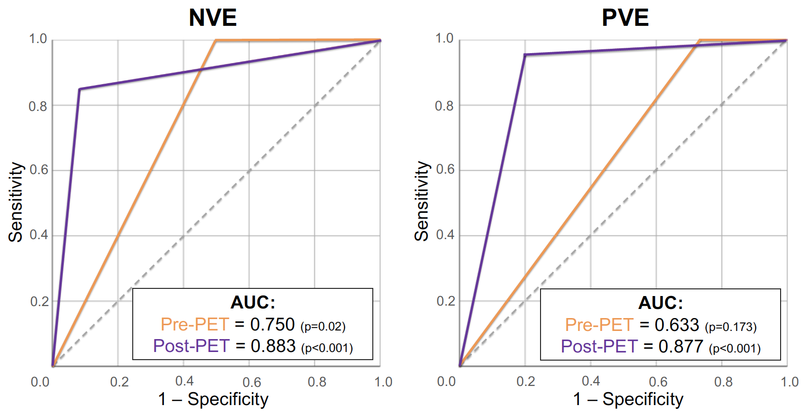
Native Valve Endocarditis
Prosthetic Valve Endocarditis
Re-classification pre- and post-PET over modified Duke Criteria
Pre-PET
Post-PET
Pre-PET
Post-PET
14
14
14
13
16
21
12
19
2
3
0.89 – Net-reclassification Index – 0.90
Definite Possible Rejected
DOI XXX
@primustime

