Slide 1
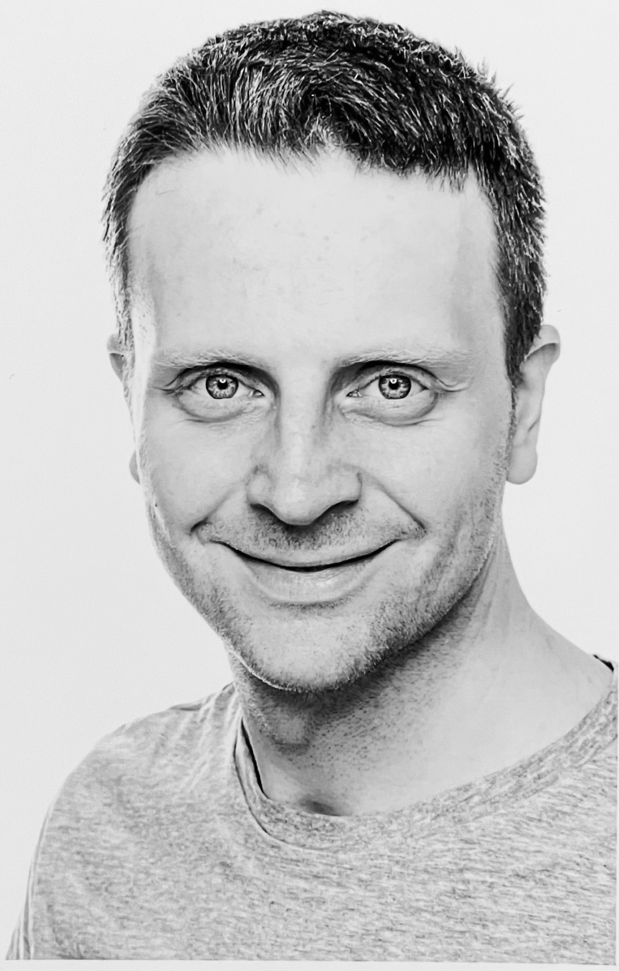


Quantitative Myocardial Perfusion SPECT/CT for the Assessment of Myocardial Tracer Uptake in Patients with Three-Vessel Coronary Artery Disease – Initial Experiences and Results
Journal of Nuclear Cardiology | Official Journal of the American Society of Nuclear Cardiology
Sebastian Lehner; Isabel Nowak; Mathias Zacherl, Julia Brosch-Lenz, Maximilian Fischer, Harun Ilhan; Rübenthaler Johannes; Astrid Gosewisch; Peter Bartenstein; Andrei Todica
  Departments of Nuclear Medicine, Cardiology and Radiology, University Hospital Munich, Munich, Germany and Ambulatory Healthcare Center Dr. Neumaier & Colleagues, Radiology, Nuclear Medicine, Radiation Therapy, Regensburg, Germany
Head shot of author
required
Copyright American Society of Nuclear Cardiology

Slide 2
BACKGROUND
Journal of Nuclear Cardiology | Official Journal of the American Society of Nuclear Cardiology
Myocardial perfusion scintigraphy (MPS) is traditionally semiquantative.
Life-threatening balanced ischemia might thus be overlooked.
Quantitative MPS (SUV SPECT) might be able to improve this situation.
First evaluation of quantitative MPS datasets for routine clinical imaging and the detection of reduced myocardial blood flow.
Copyright American Society of Nuclear Cardiology

Slide 3
METHODS
Journal of Nuclear Cardiology | Official Journal of the American Society of Nuclear Cardiology
Study type: retrospective
Study subjects: patients that presented for viability imaging to our institution
Study endpoints:
  Primary end point(s): SUV SPECT to detect patients with reduced myocardial uptake in three-vessel CAD
  Secondary end point(s): Use of quantitative MPS datasets for routine clinical imaging
Study variables TPD, SUV_{max}, SUV_{peak}, SUV_{mean}
Copyright American Society of Nuclear Cardiology

Slide 4
RESULTS
Journal of Nuclear Cardiology | Official Journal of the American Society of Nuclear Cardiology
Above Patients with TVCAD showed significantly reduced SUV_{max} and SUV_{peak}.
Right ROC analysis for SUV_{peak} and SUV_{max} to differentiate between patients with and without TVCAD, AUC=0.75 for SUV_{peak} and AUC=0.73 for SUV_{max}. Cut-off values optimized for sensitivity and specificity are 4.62 for SUV_{peak} and 5.04 for SUV_{max}
Copyright American Society of Nuclear Cardiology

Slide 5
CONCLUSIONS
Journal of Nuclear Cardiology | Official Journal of the American Society of Nuclear Cardiology
Absolute quantification of myocardial tracer uptake in MPS is feasible.
Routine clinical reporting from quantitative datasets is possible, caution should be exterted for therapy monitoring (adhere to one method!).
Quantitative MPS is able to detect reduced myocardial tracer uptake in patients with three-vessel CAD in resting conditions as an indicator of chronically reduced myocardial blood flow.
Copyright American Society of Nuclear Cardiology

