Slide 1



Low-dose CT from myocardial perfusion SPECT/CT allows the detection of anemia in preoperative patients
Journal of Nuclear Cardiology | Official Journal of the American Society of Nuclear Cardiology
^{a,b}Antonio G. Gennari, MD, ^{a,b}Hannes Grünig, MD, ^{a,b}Dominik C. Benz, MD, ^{a,b}Stephan Skawran, MD, ^{a,b}Alexander Maurer, MD, ªAhmad MA Abukwaik, MD, ^{a,b}Alexia Rossi, MD, PhD, ^{a,b,c}Catherine Gebhard, MD, PhD, ^{a,b}Ronny R. Buechel, MD, ^{a,b,d}Michael Messerli, MD
ªDepartment of Nuclear Medicine, University Hospital Zurich, Switzerland
^{b}University of Zurich, Zurich, Switzerland
^{c}Center for Molecular Cardiology, University of Zurich, Zurich, Switzerland
^{d}Maastricht UMC+, Heart and Vascular Center, Maastricht, the Netherlands
Copyright American Society of Nuclear Cardiology

Slide 2
BACKGROUND
Journal of Nuclear Cardiology | Official Journal of the American Society of Nuclear Cardiology
1- In preoperative patients, anemia has been linked to poorer surgical outcome rates and to a higher need for red blood cells transfusion
2 - Unenhanced computed tomography (CT) is able to detect anemia, but preoperative scans usually lack an unenhanced phase
3 – In patients with elevated cardiovascular risk and poor functional capacity myocardial perfusion single-photon emission computed tomography (SPECT) is used stratify the preoperative cardiovascular risk
4 - Low-dose CT myocardial perfusion SPECT-derived images could prompt anemia detection and correction reducing perioperative morbidity and mortality
Copyright American Society of Nuclear Cardiology

Slide 3
METHODS
Journal of Nuclear Cardiology | Official Journal of the American Society of Nuclear Cardiology
Study type: Retrospective, cross-sectional, study
Study subjects: Patients who underwent a preoperative myocardial perfusion SPECT/CT between 2015 and 2017, for whom hemoglobin and hematocrit values were available
Study endpoints:
  Primary end points: To evaluate the diagnostic accuracy of preoperative low-dose CT images in the detection of anemia
  Secondary end point: To compare the diagnostic accuracy of CT and hematocrit in the detection of anemia
Study variables:
  Hemoglobin (g/l), Hematocrit (%), Aortic rim sign, Interventricular septum sign, CT quantitative measurements (Hunsfield Units)
Copyright American Society of Nuclear Cardiology

Slide 4
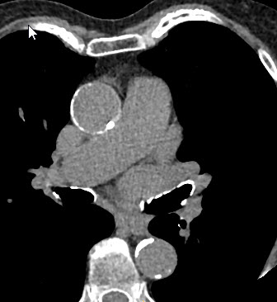
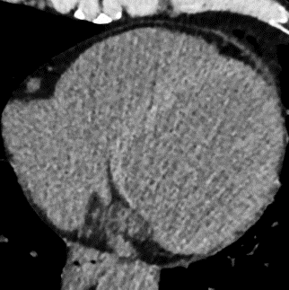
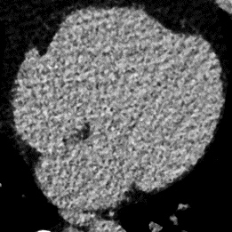
RESULTS
Journal of Nuclear Cardiology | Official Journal of the American Society of Nuclear Cardiology
 | Sensitivity | Specificity | PPV | NPV | AUC
 | 57.3% (CI: 47.5-66.7%) | 76.5% (CI: 67.8-83.8%) | 69.2% (CI: 58.7-78.5%) | 65.9% (CI: 57.4-73.8%) | 0.669 (CI: 0.609-0.729)
 | 71.8% (CI: 62.4-80.0%) | 94.1% (CI: 88.3-97.6%) | 91.9% (CI: 83.9-96.7%) | 78.3% (CI: 70.7-84.8%) | 0.830 (CI: 0.782-0.877)
 | 88.2% (CI: 80.6-93.6%) | 95.8% (CI: 90.5-98.6%) | 95.1% (CI: 88.9-98.4%) | 89.8% (CI: 83.1-94.4%) | 0.920 (CI: 0.885-0.955)
Aortic rim sign
Interventricular septum sign
Quantitative measurements
CT quantitative measurement were calculated as the difference between interventricular septum’s density and the mean intraventricular densities
Copyright American Society of Nuclear Cardiology

Slide 5
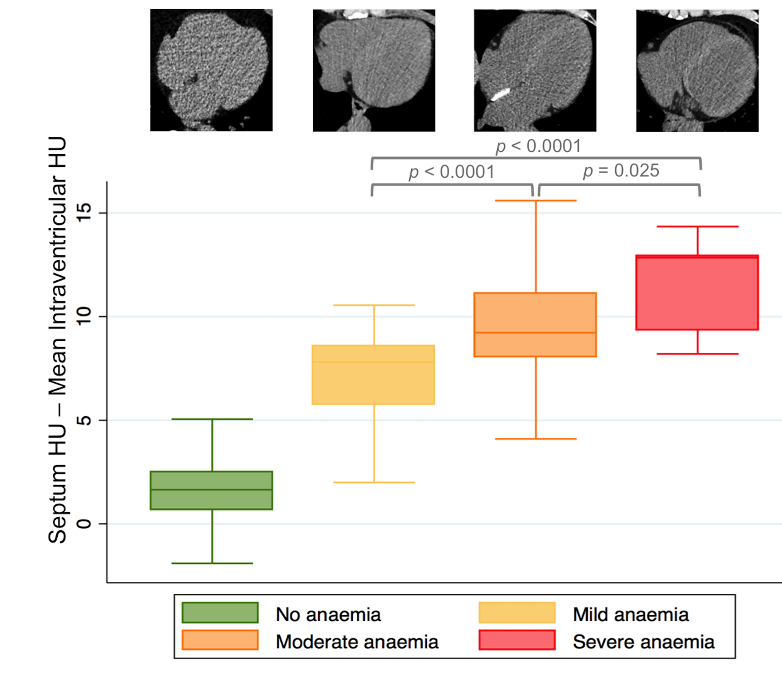
RESULTS
Journal of Nuclear Cardiology | Official Journal of the American Society of Nuclear Cardiology
Quantitative measurement were able to discriminate anemia and its severity
Copyright American Society of Nuclear Cardiology

Slide 6
RESULTS
Journal of Nuclear Cardiology | Official Journal of the American Society of Nuclear Cardiology
 | Sensitivity | Specificity | PPV | NPV | AUC
Quantitative measurements | 88.2% (CI: 80.6-93.6%) | 95.8% (CI: 90.5-98.6%) | 95.1% (CI: 88.9-98.4%) | 89.8% (CI: 83.1-94.4%) | 0.920 (CI: 0.885-0.955)
Hematocrit | 87.2% (CI: 74.3-89.3%) | 95.8% (CI: 90.5-98.6%) | 94.8% (CI: 88.3-98.3%) | 85.7% (CI: 78.6-91.2%) | 0.893 (CI: 0.853-0.932)
Copyright American Society of Nuclear Cardiology

Slide 7
CONCLUSIONS
Journal of Nuclear Cardiology | Official Journal of the American Society of Nuclear Cardiology
1 - Quantitative measurements better detected anemia compared to qualitative ones
2 - Quantitative CT measurement, allows the discrimination of anemia severity in preoperative patients
3 - Quantitative measurement and hematocrit have similar diagnostic accuracy in the diagnosis of anemia
Copyright American Society of Nuclear Cardiology

