Slide 1




Multi-task Deep Learning in myocardial blood flow and cardiovascular risk traits from PET myocardial perfusion imaging
Journal of Nuclear Cardiology | Official Journal of the American Society of Nuclear Cardiology
Ming Wai Yeung^{1,2}, Jan Walter Benjamins¹, Remco JJ Knol MD, PhD³, Friso M van der Zant MD, PhD³ , Folkert W Asselbergs, MD, PhD², Pim van der Harst MD, PhD^{1,2}, Luis Eduardo Juarez-Orozco MD, PhD^{1,2}
University of Groningen, University Medical Center Groningen, Department of Cardiology, 9700 RB Groningen, the Netherlands
Department of Cardiology, Division of Heart & Lungs, University Medical Center Utrecht, University of Utrecht, Utrecht, the Netherlands
Cardiac Imaging Division Alkmaar, Northwest Clinics, Department of Nuclear Medicine, Alkmaar, The Netherlands
Head shot of author
required
Institution
Picture/Logo
Optional
Copyright American Society of Nuclear Cardiology

Slide 2
BACKGROUND
Journal of Nuclear Cardiology | Official Journal of the American Society of Nuclear Cardiology
1- Positron emission tomography (PET) summarized in topographical polar maps allows quantitative evaluation of myocardial perfusion
2- Deep learning (DL) constitutes a novel analytical tool for direct image evaluation
3- Studies on the implementation of Deep Learning (DL) for the identification of myocardial ischemia on PET imaging are scarce
4- It is unknown whether DL may provide insights into complex patterns associated with the presence of cardiovascular risk traits
Copyright American Society of Nuclear Cardiology

Slide 3
METHODS
Journal of Nuclear Cardiology | Official Journal of the American Society of Nuclear Cardiology
Study type:(Select all that apply)
  observational.
Study subjects: 241 excluded due to missing data resulting in 944 subjects in final analysis
Study aim:
  Develop DL models with PET myocardial perfusion polar maps for detection of impaired myocardial flow reserve and cardiovascular risk traits on an individual-patient basis
  Visualize the regions associated with corresponding model prediction in attention heatmap
Approach:
  Transfer learning + multitasking learning
  Occlusion sensitivity + GradCAM method
Copyright American Society of Nuclear Cardiology

Slide 4
RESULTS
Journal of Nuclear Cardiology | Official Journal of the American Society of Nuclear Cardiology
Output | Prevalence | AUC using Rest PM | AUC using Stress PM | AUC using Reserve PM | AUC using stacked PMs
Impaired MFR in any segment | 67.50% | 0.68 (0.57 - 0.78) | 0.68 (0.55 - 0.79) | 0.94 (0.87 - 0.98) | 0.90 (0.82 - 0.96)
Diabetes | 15.4% | 0.62 (0.50 - 0.75) | 0.62 (0.49 - 0.75) | 0.65 (0.51 - 0.79) | 0.52 (0.38 - 0.66)
Dyslipidaemia | 33.2% | 0.52 (0.44 - 0.60) | 0.46 (0.38 - 0.55) | 0.54 (0.42 - 0.64) | 0.58 (0.47 - 0.69)
Arterial hypertension | 52.2% | 0.47 (0.37 - 0.58) | 0.60 (0.50 - 0.69) | 0.60 (0.49 - 0.69) | 0.59 (0.50 - 0.69)
Sex | 48.9% female | 0.81 (0.73 - 0.88) | 0.65 (0.55 - 0.75) | 0.65 (0.55 - 0.74) | 0.66 (0.57 - 0.75)
Smoking | 13.6% | 0.71 (0.58 - 0.85) | 0.47 (0.41 - 0.56) | 0.49 (0.42 - 0.58) | 0.50 (0.41 - 0.61)
Copyright American Society of Nuclear Cardiology

Slide 5
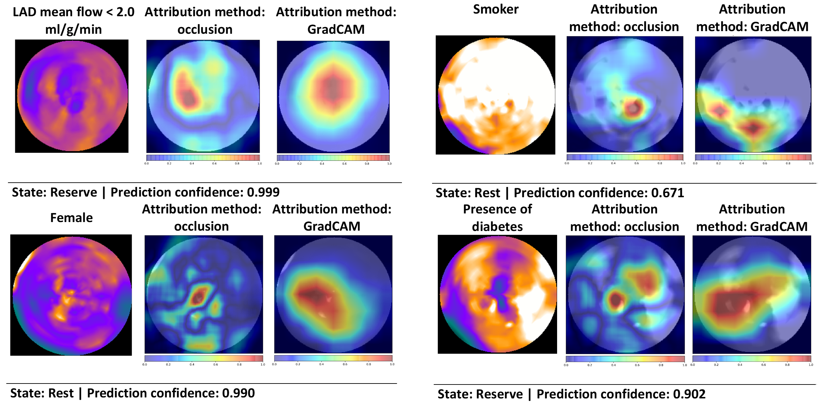
RESULTS
Journal of Nuclear Cardiology | Official Journal of the American Society of Nuclear Cardiology
Each attention map was generated with one representative polar map from a patient from the test set previously unseen by the model in the development process.
Copyright American Society of Nuclear Cardiology

Slide 6
CONCLUSIONS
Journal of Nuclear Cardiology | Official Journal of the American Society of Nuclear Cardiology
1- Multi-task DL is able to identify
  An impaired myocardial flow reserve (ischemia)
  cardiovascular risk factors (sex, smoking and diabetes)
from quantitative PET myocardial perfusion polar maps
Copyright American Society of Nuclear Cardiology

