Slide 1
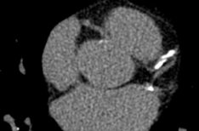
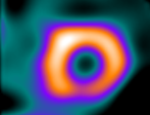
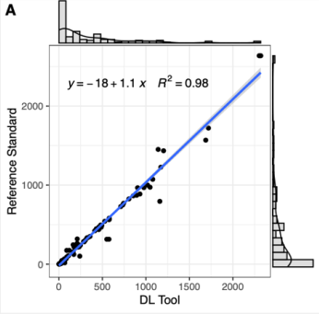
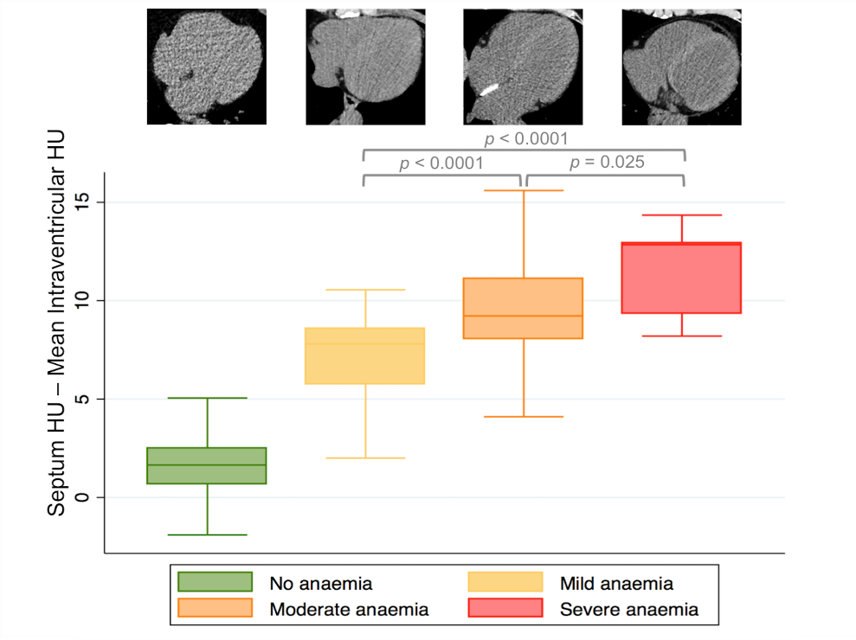
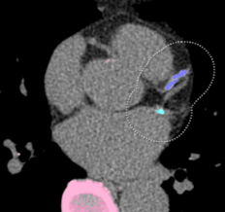
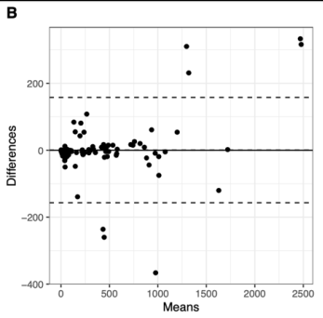


Fully Automated Deep Learning Powered Calcium Scoring
in Patients undergoing Myocardial Perfusion Imaging
CT before betablocker (n = 56)
56 patients
CT after betablocker (n = 56)
myocardial scintigraphy
Fully automated DL-based CACS assessment of all scans (n = 112)
DL-CACS
44.9 HU
49.3 HU
Diagnostic accuracy assessment
45.5 HU
A DL tool enables fully automated and accurate estimation of CAC scores in patients
undergoing SPECT-MPI.
Sartoretti T et al. JNC 2022

