Slide 1




Comparison of the prognostic value of impaired stress myocardial blood flow, myocardial flow reserve, and myocardial flow capacity on low-dose Rubidium-82 SiPM PET/CT
Journal of Nuclear Cardiology | Official Journal of the American Society of Nuclear Cardiology
  Matthieu Dietz,^{a,b} Christel H. Kamani,^{a,c} Gilles Allenbach,ª Vladimir Rubimbura,^{c} Stephane Fournier,^{c,d} Vincent Dunet,^{d,e} Giorgio Treglia,^{a,d} Marie Nicod Lalonde,^{a,d} Niklaus Schaefer,^{a,d} Eric Eeckhout,^{c,d} Olivier Muller,^{c,d} and John O. Prior,^{a,d}*
  ªNuclear Medicine and Molecular Imaging Department, Lausanne University Hospital, Lausanne, Switzerland.
  ^{b}INSERM U1060, CarMeN laboratory, University of Lyon, Lyon, France.
  ^{c}Department of Cardiology, University Hospital of Lausanne, University of Lausanne, Lausanne, Switzerland.
  ^{d}University of Lausanne, Lausanne, Switzerland.
  ^{e}Department of Diagnostic and Interventional Radiology, Lausanne University Hospital, Lausanne, Switzerland.
Copyright American Society of Nuclear Cardiology

Slide 2
BACKGROUND
Journal of Nuclear Cardiology | Official Journal of the American Society of Nuclear Cardiology
1- The myocardial flow capacity (MFC) concept is a precise regional approach integrating both myocardial flow reserve (MFR) and stress myocardial blood flow (MBF) through the physiologic severity of coronary artery disease to depict regional quantitative flow metrics on a per pixel basis.
2- SiPM PET including smaller crystals allows for the reduction of the standard dose.
3- The objective of the current study was to compare on a SiPM PET camera, halving the activity and radiation dose of Rubidium-82 (⁸²Rb), the prognostic value for cardiovascular events of stress MBF, MFR, and MFC.
Copyright American Society of Nuclear Cardiology

Slide 3
METHODS
Journal of Nuclear Cardiology | Official Journal of the American Society of Nuclear Cardiology
234 participants with suspected myocardial ischemia were prospectively enrolled to undergo ⁸²Rb cardiac SiPM PET/CT. Participants had widespread utilization of preventative therapies.
The endpoint of the study was major adverse cardiovascular event (MACE), defined as cardiac death, myocardial infarction, delayed revascularization (> 6 months post-PET/CT), hospitalization for congestive heart failure or de novo stable angina.
Perfusion was assessed quantitatively measuring MBF in milliliter per minute per gram at rest and stress, with a 1-tissue compartment model. MFC pixels (n=513 on the polar map) having both MFR ≤ 1.5 and stress MBF ≤ 1.1 mL/min/g were defined as severely reduced MFC (MFC_{severe}) and were quantified as percent of left ventricle.
The Youden index was used to select optimal thresholds.
Copyright American Society of Nuclear Cardiology

Slide 4
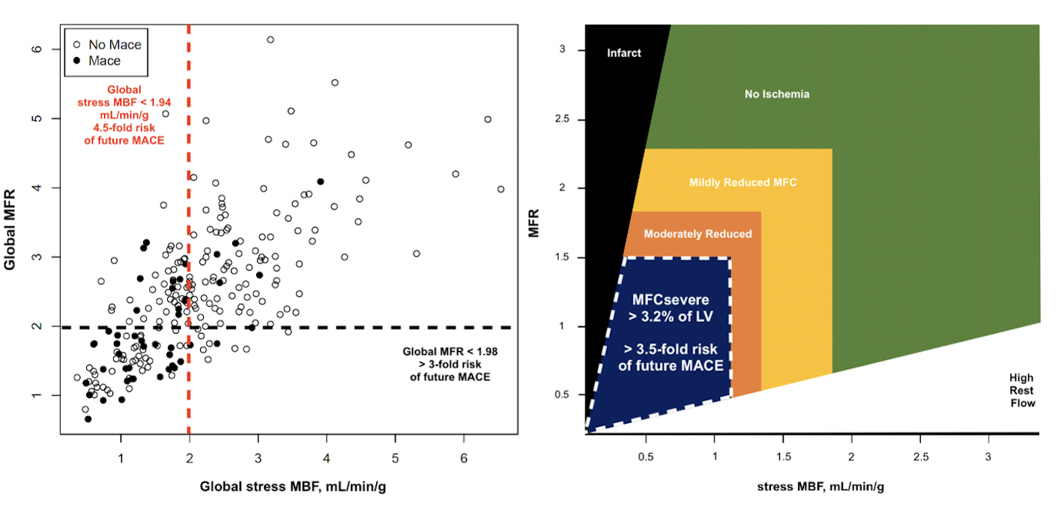
RESULTS
Journal of Nuclear Cardiology | Official Journal of the American Society of Nuclear Cardiology
In multivariate analysis with 3 separate models including each time clinical risk factors and separately reduced global stress MBF, reduced global MFR, and increased regional MFC_{severe}, each one of these PET variables emerged as powerful independent predictors of MACE.
Copyright American Society of Nuclear Cardiology

Slide 5
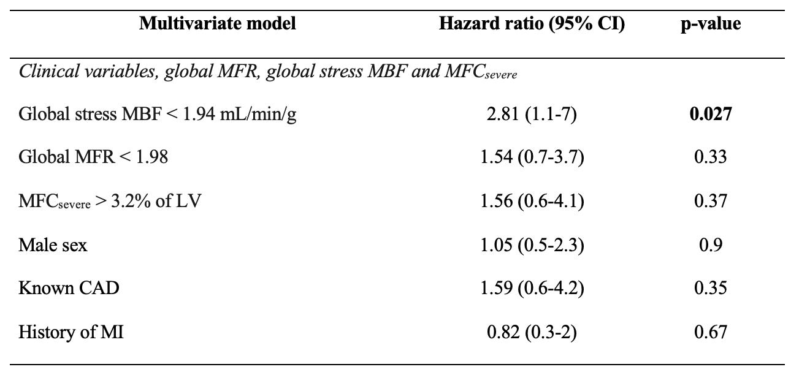
RESULTS
Journal of Nuclear Cardiology | Official Journal of the American Society of Nuclear Cardiology
However, for the most comprehensive model including clinical parameters and all global MFR, global stress MBF and MFC_{severe} impairments, only reduced global stress MBF remained as an independent prognostic factor for MACE.
Copyright American Society of Nuclear Cardiology

Slide 6
CONCLUSIONS
Journal of Nuclear Cardiology | Official Journal of the American Society of Nuclear Cardiology
1- Using the latest SiPM PET technology with low-dose ⁸²Rb, halving the standard activity to deliver <1 mSv for a 70-kg patient, impaired global stress MBF, global MFR, and regional MFC were powerful predictors of cardiovascular events, outperforming traditional cardiovascular risk factors, even in a population with widespread utilization of preventative therapies.
2- However, only reduced global stress MBF independently predicted MACE, being superior to global MFR and regional MFC impairments in the current study.
Copyright American Society of Nuclear Cardiology

