Slide 1
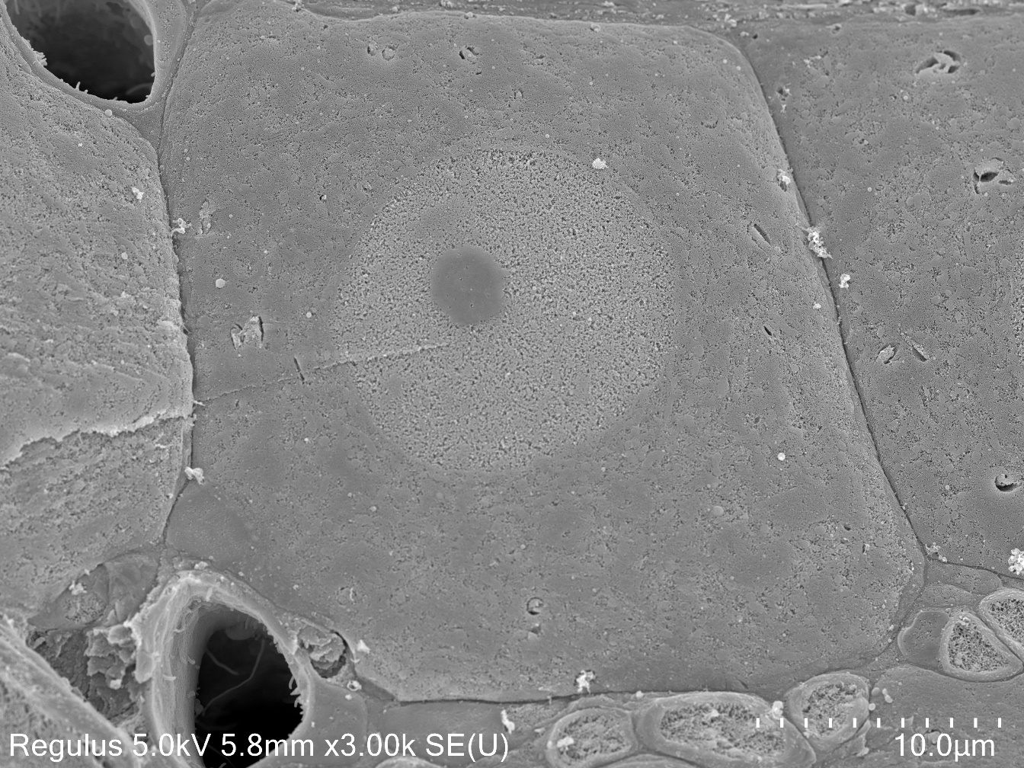
10µm
Koga et al., Supplementary Information Figure 1
(SI Fig. 1)

