Slide 1
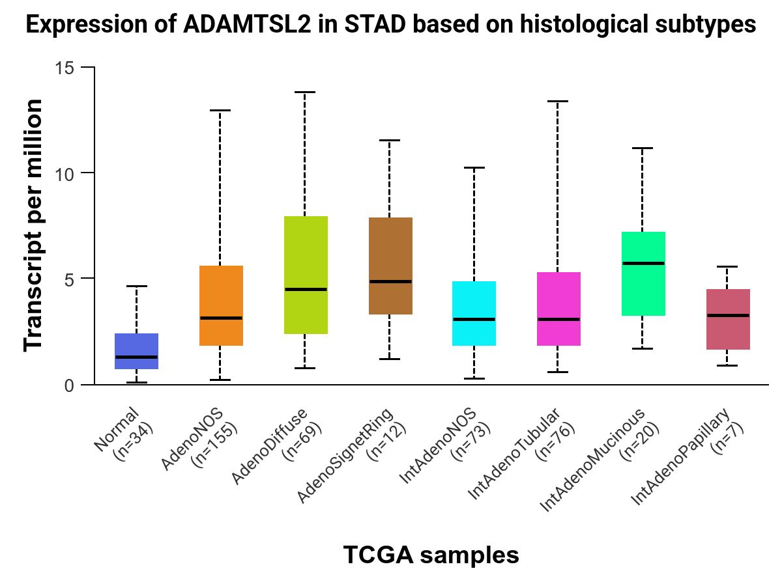
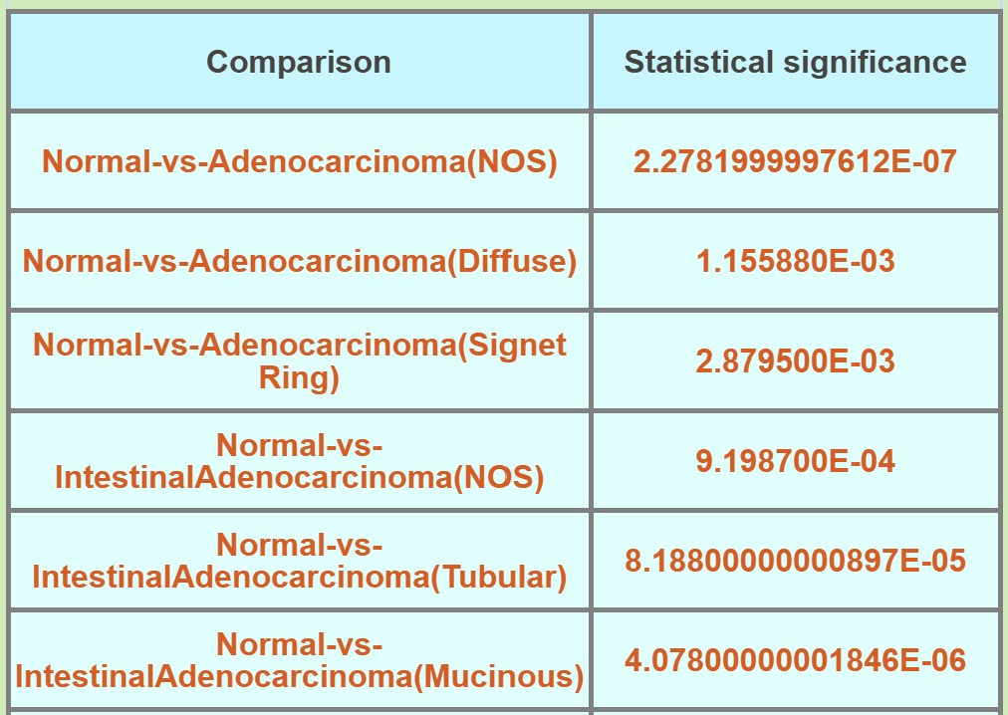
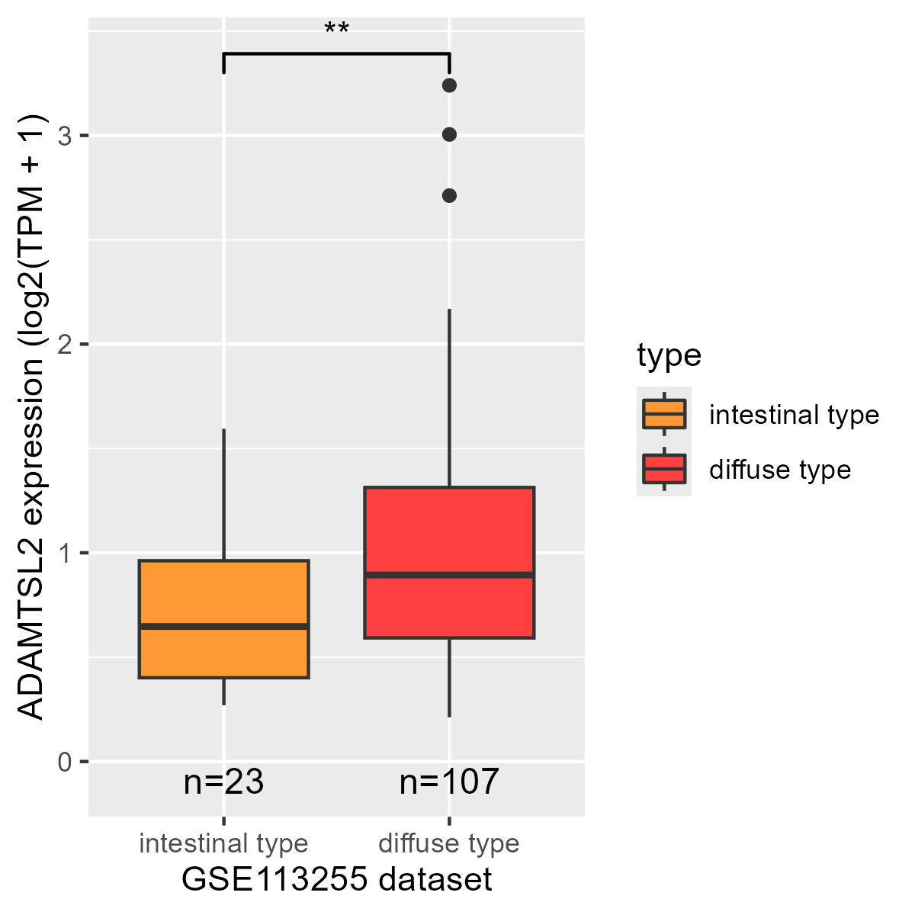
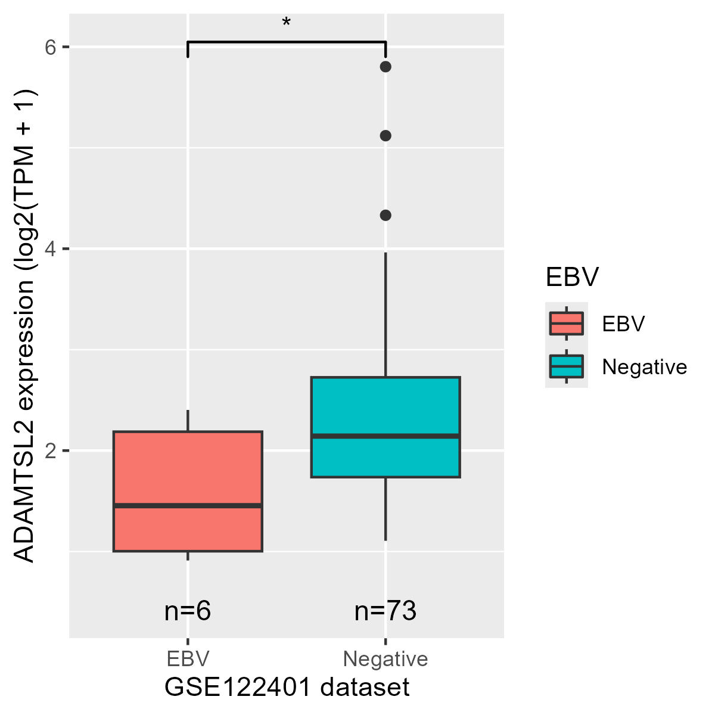
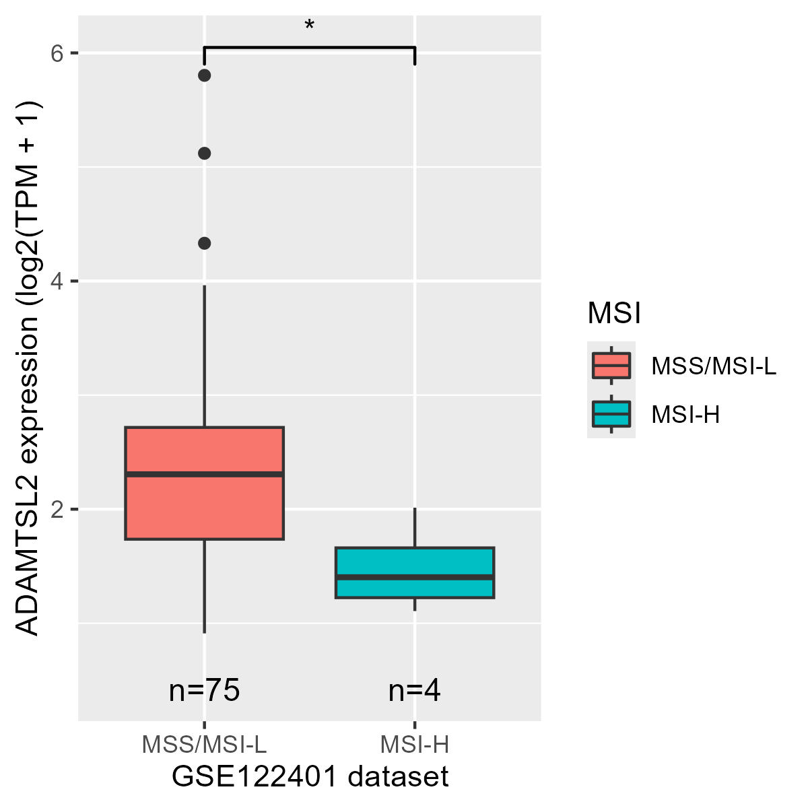
A
B
C
D
E
Notes:
Supplement 2. The expression of ADAMTSL2 mRNA in various subtypes of gastric cancer. (A-B) The expression of ADAMTSL2 in various histological subtypes of the TCGA GC dataset (https://ualcan.path.uab.edu/cgi-bin/TCGAExResultNew2.pl?genenam=ADAMTSL2&ctype=STAD). (C-E) The expression of ADAMTSL2 in various subtypes of the GC GSE113255 and GSE122401 datasets.

Slide 2
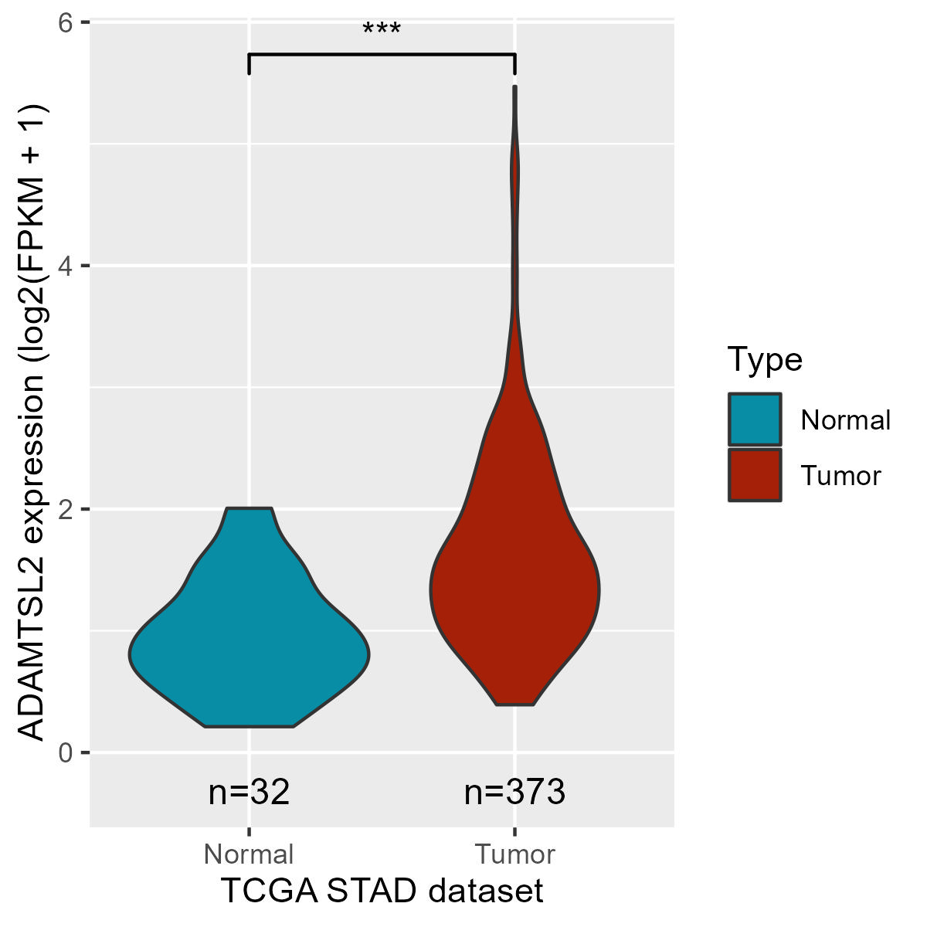
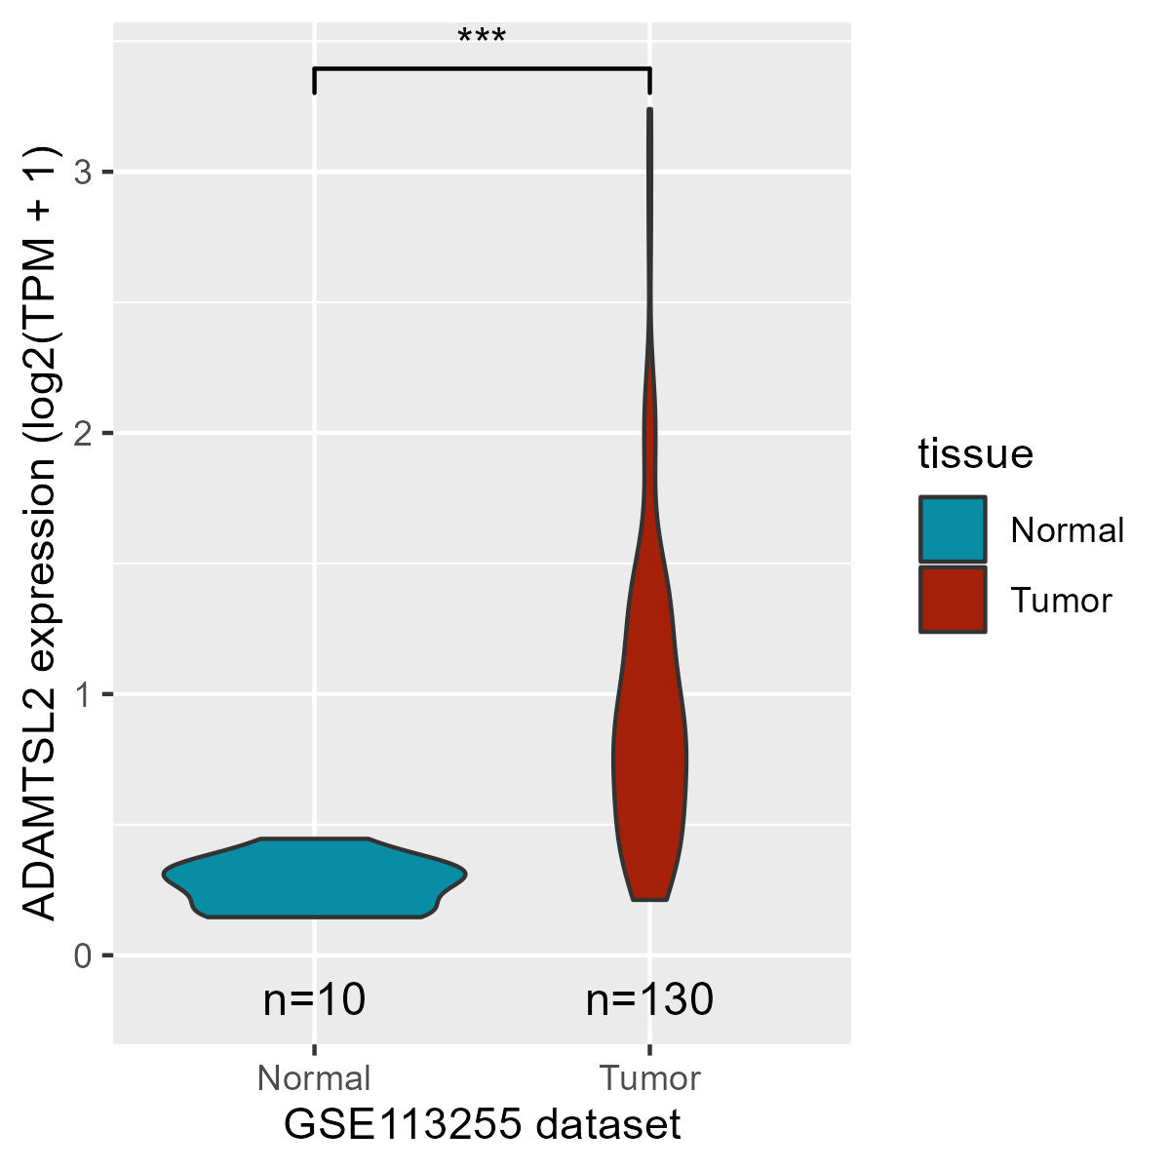
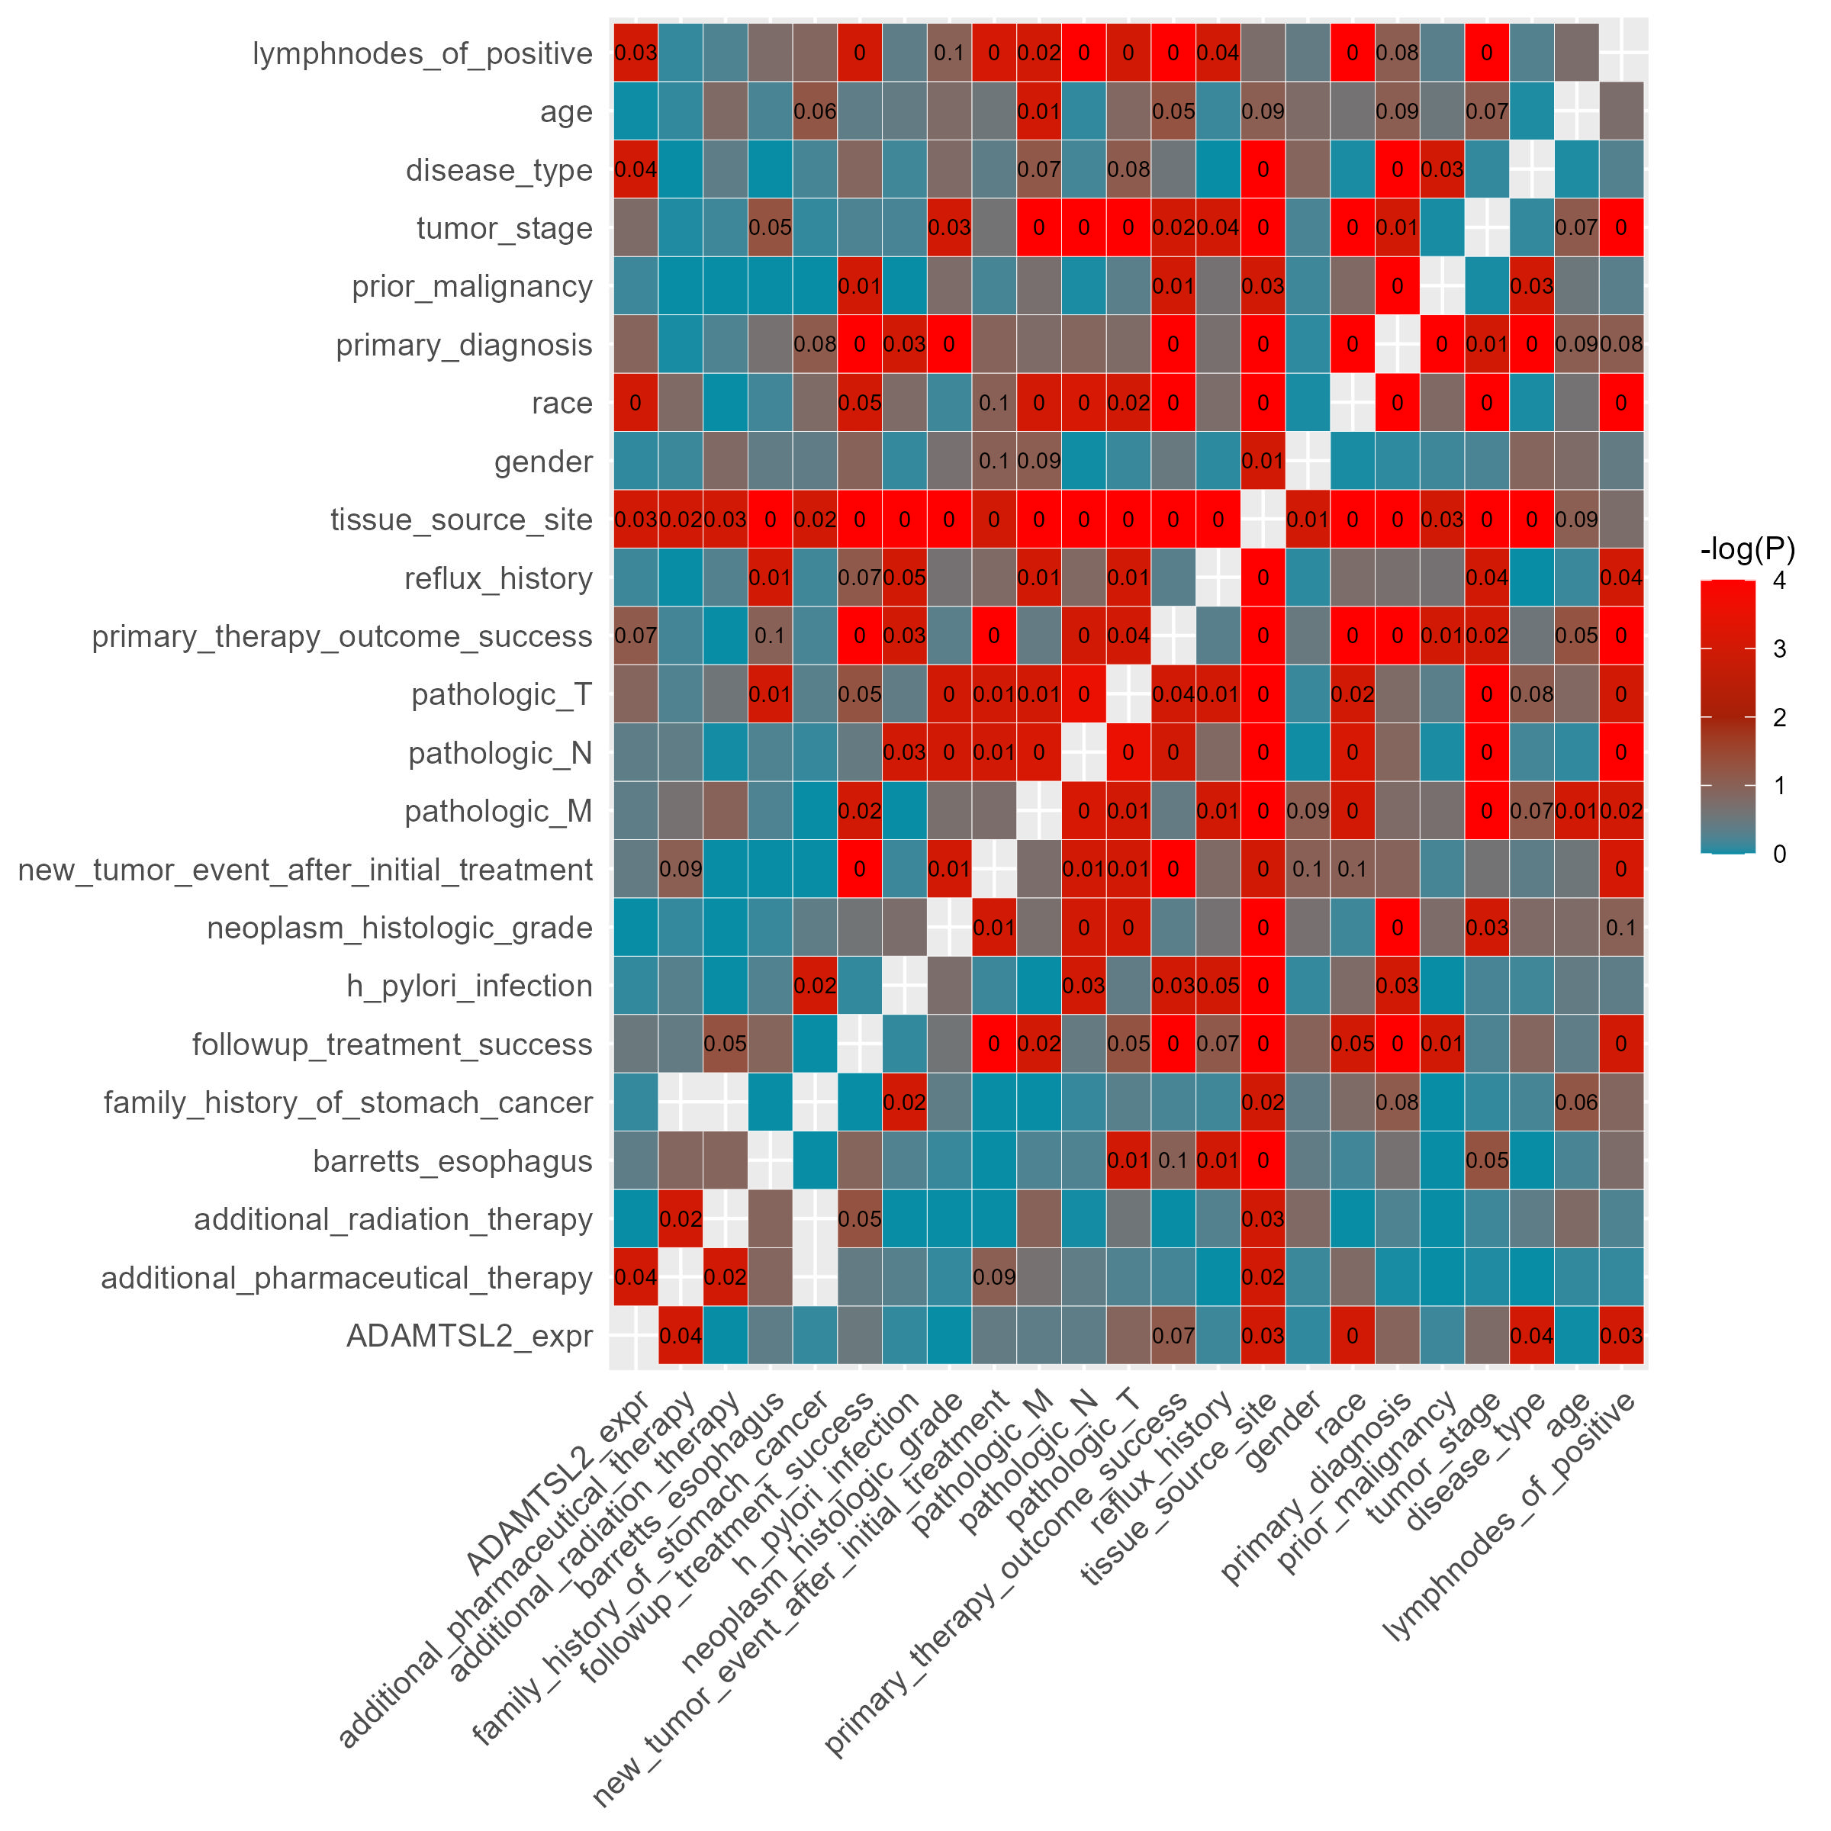
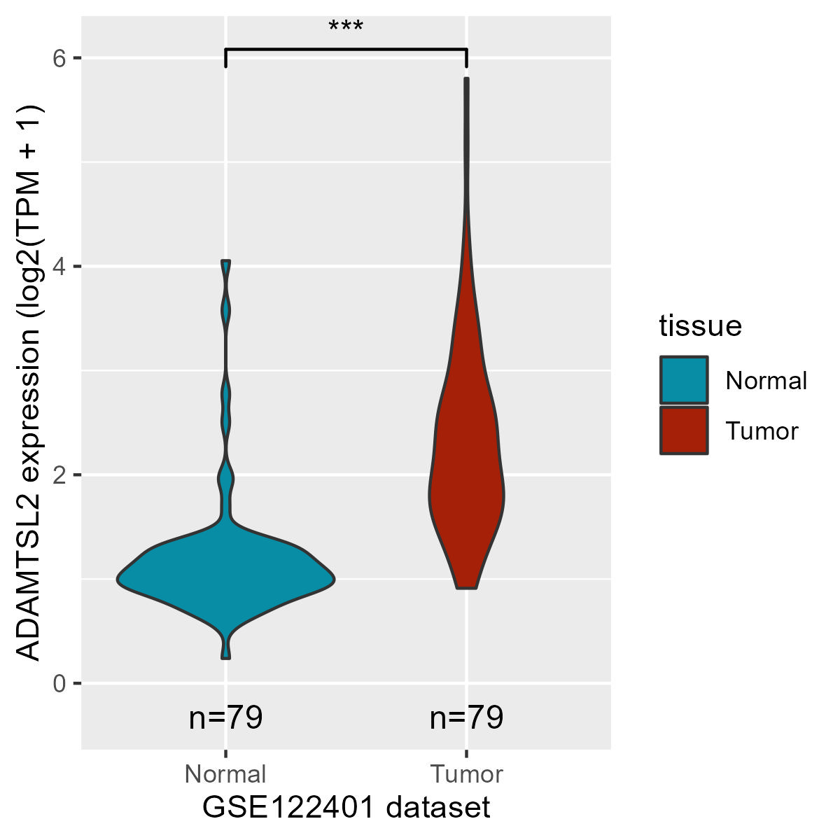
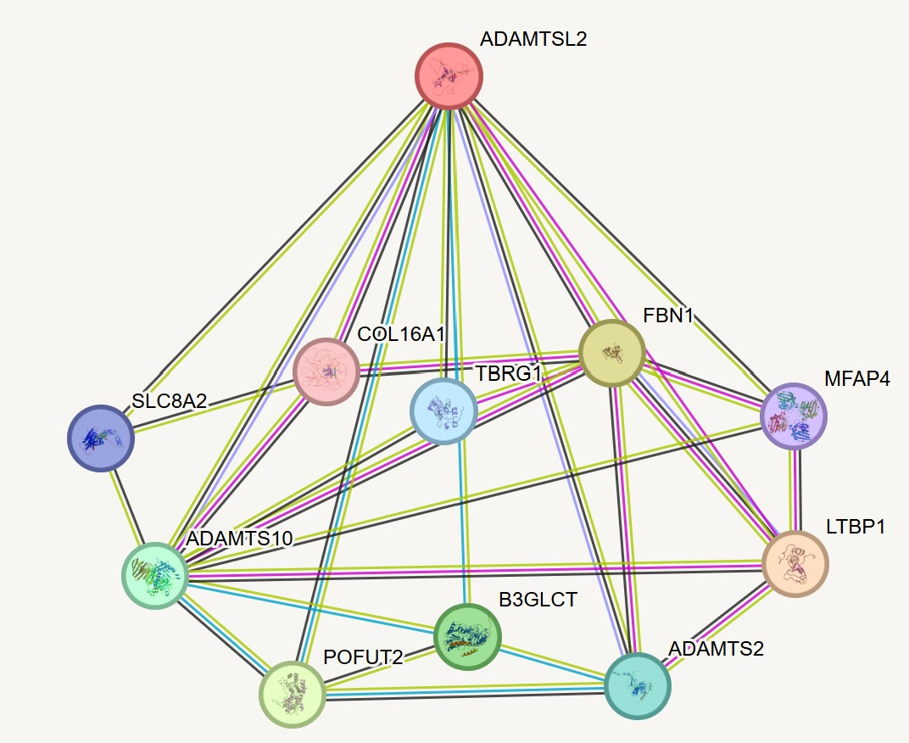
A
B
E
C
D
Notes:
Supplement 3. The expression level of ADAMTSL2 in GC tumors and normal tissues, and the correlation between ADAMTSL2 expression and clinicopathological features in tumor tissues. (A-C) The expression levels of ADAMTSL2 in GC tumors and normal tissues in TCGA, GSE113255 and GSE122401 datasets. (D) Results of the analysis of molecules interacting with ADAMTSL2 (STRING: https://cn.string-db.org/cgi/network?taskId=bYo3qdzdxFB2&sessionId=b961jUZJBPbh). (E) Results of correlation analysis between ADAMTSL2 expression (Group by median) level and clinicopathological parameters of GC patients (TCGA dataset).

