Slide 1
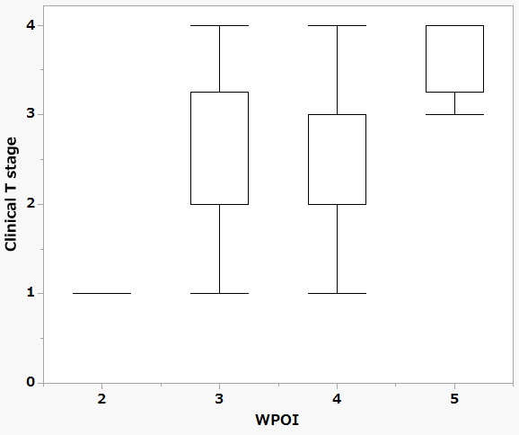
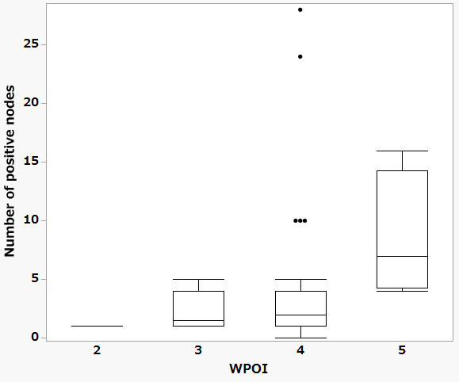
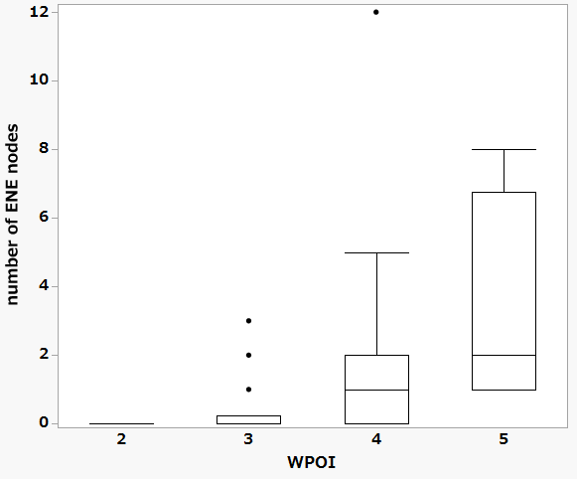
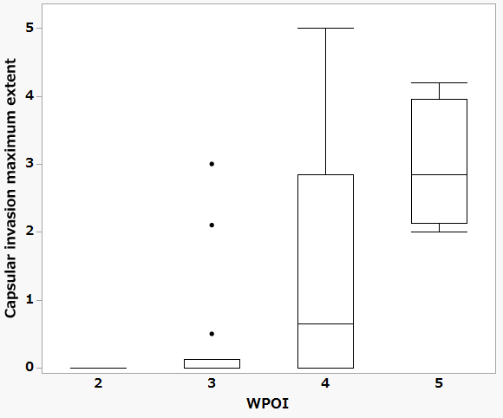
Supplemental Figure 2: Intergroup comparison of individual parameters stratified by WPOI grade
A
B
*
C
*
D
*
(mm)
* P < .05

