Slide 1
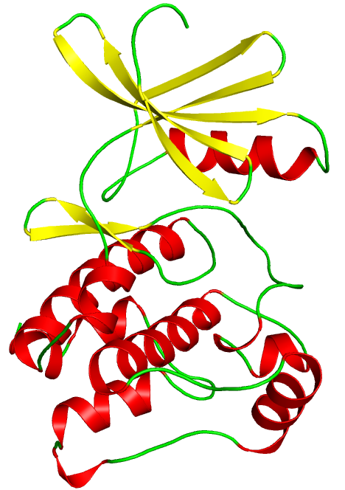
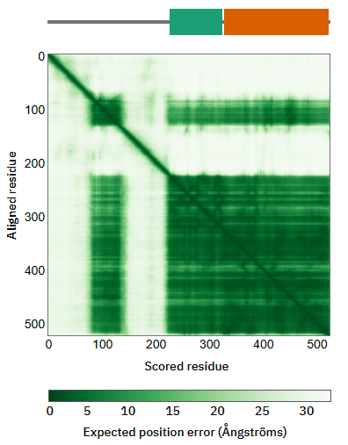
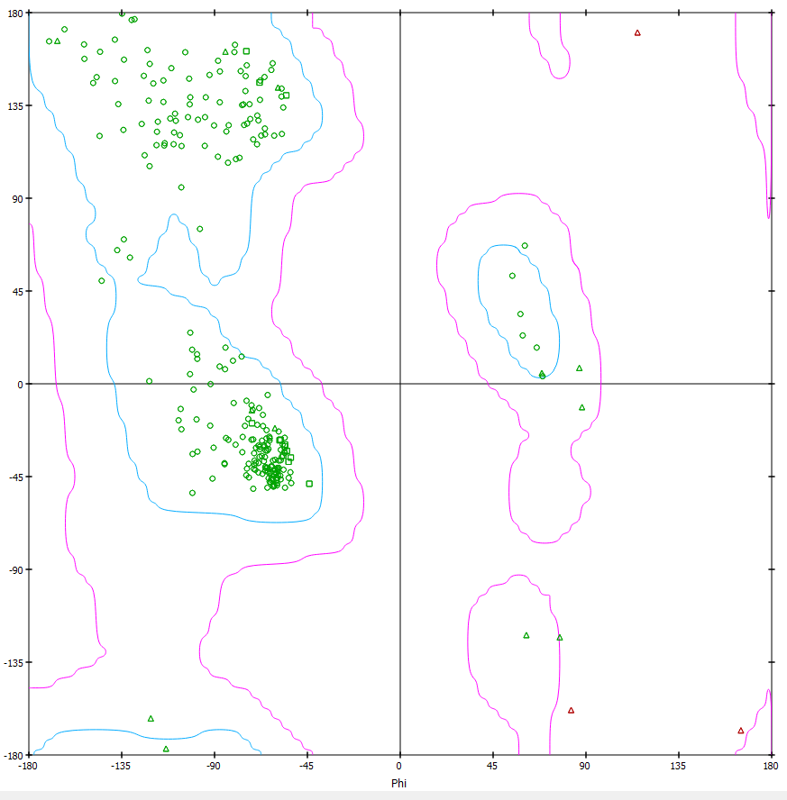

A
B
Predicted Aligned Error (PAE)
C
Average pLDDT: 94.08
Figure S1: AlphaFold predicted model of PAK2. (A) Cartoon representation of the kinase domain of PAK2 (Y294-F499). (B) Predicted Aligned Error (PAE) plot of the PAK2 model where it showed an average pLDDT score of 94.08. (C) Ramachandran plot showed most of the amino acid residues in allowed region.

