Slide 1
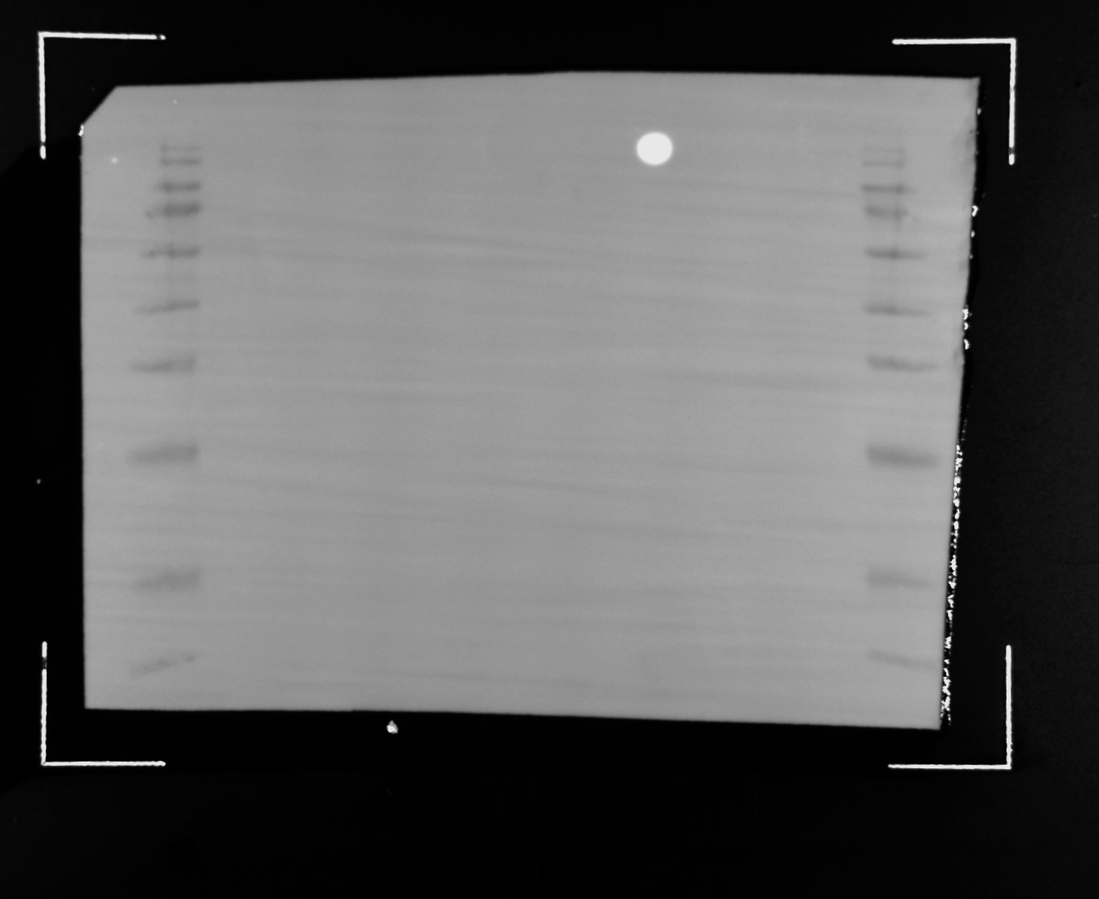
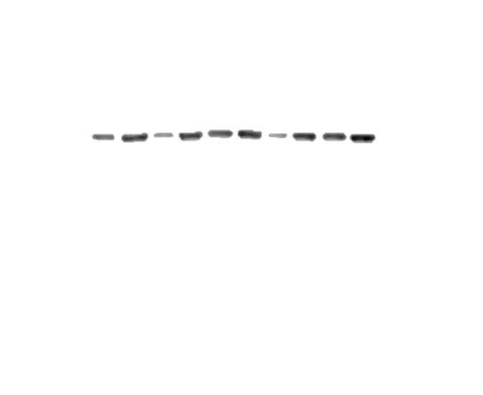
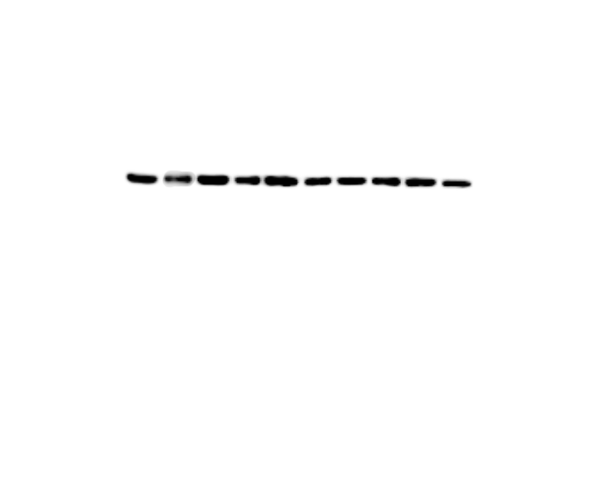
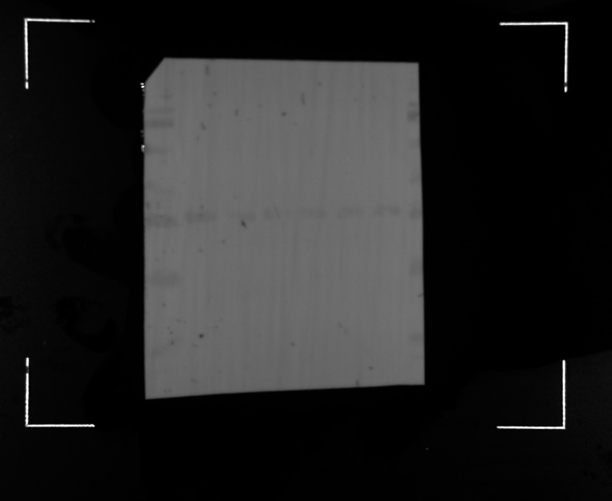
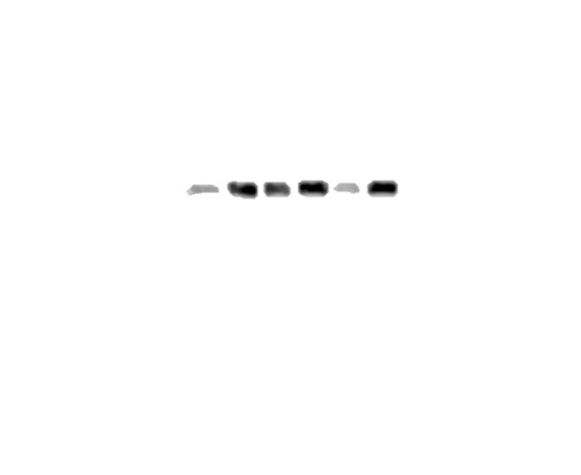
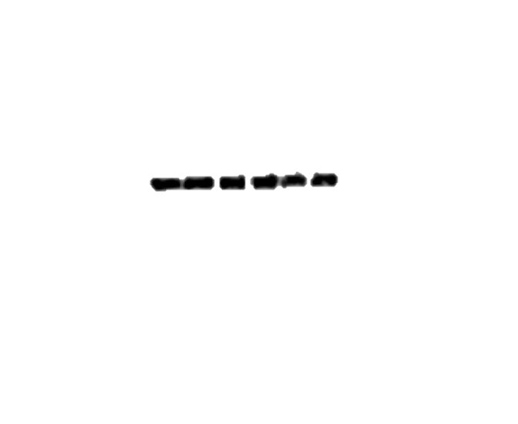
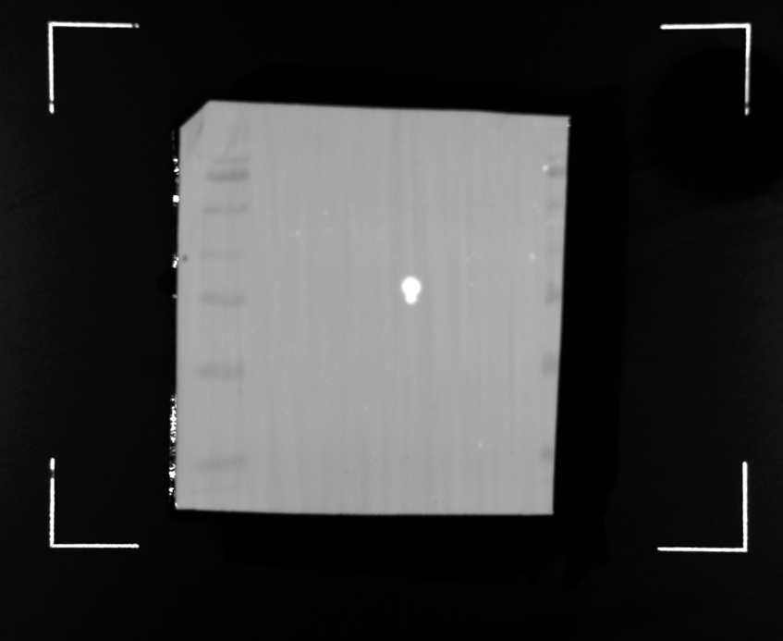
Figure 1G
MFSD3
1N 1T 2N 2T 3N 3T 4N 4T 5N 5T
48kDa
1N 1T 2N 2T 3N 3T 4N 4T 5N 5T
48kD
GAPDH
35kDa
35kDa
25kDa
25kDa
6N 6T 7N 7T 8N 8T
MFSD3
48kDa
6N 6T 7N 7T 8N 8T
GAPDH
48kDa
35kDa
35kDa
25kDa
25kDa

Slide 2
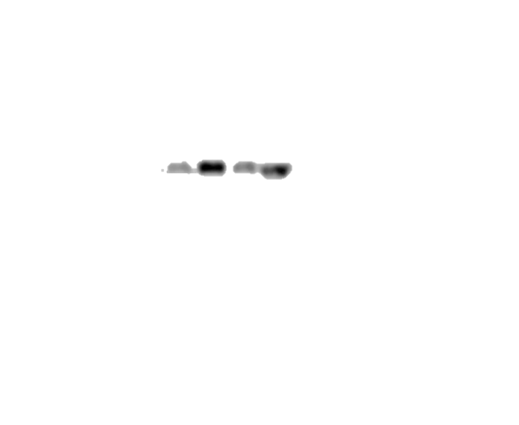
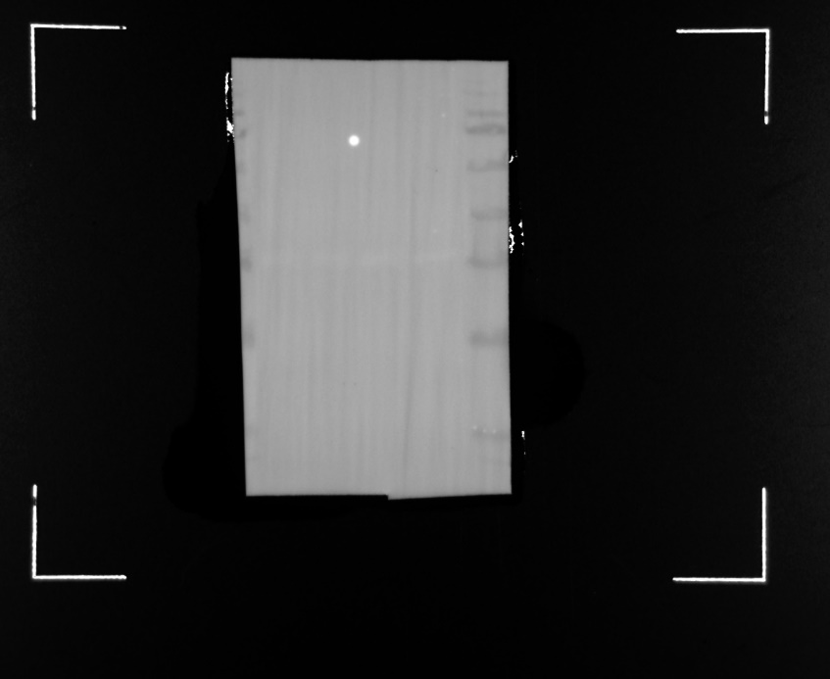
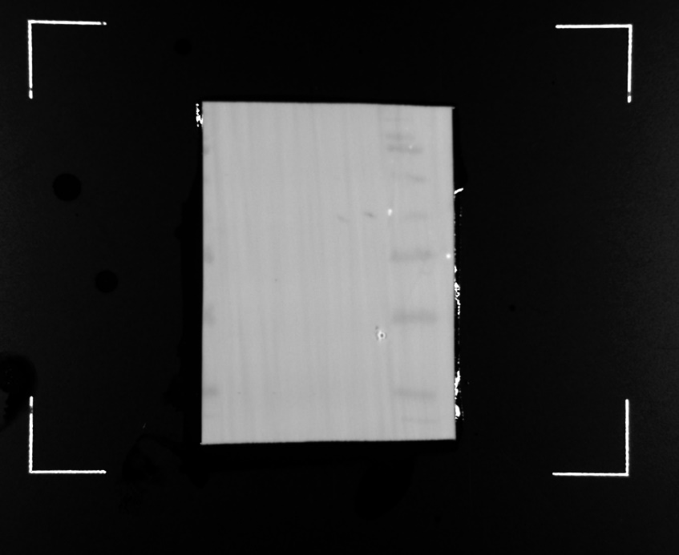

Figure 1G
9N 9T 10N 10T
48kDa
MFSD3
48kDa
GAPDH
9N 9T 10N 10T
35kDa
35kDa
25kDa
25kDa

Slide 3
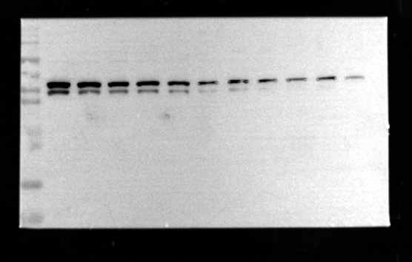
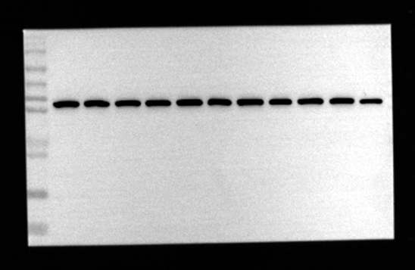
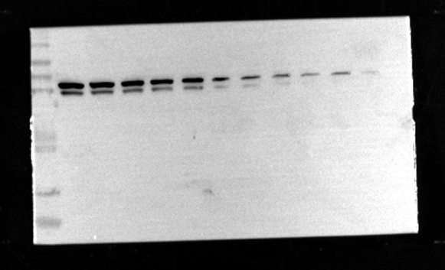
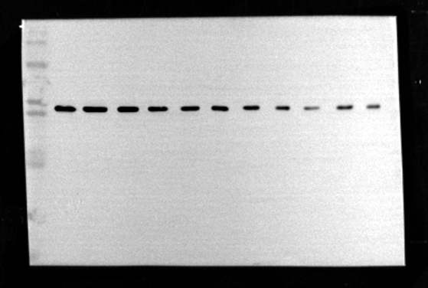
Figure 9A
Palbociclib
Palbociclib
40 43 46 49 52 55 58 61 64 67 70 (℃)
40 43 46 49 52 55 58 61 64 67 70 (℃)
250
150
250
100
150
70
100
50
MFSD3
70
40
50
35
40
GAPDH
35
25
25
20
20
15
15
10
10
Dabrafenib
Dabrafenib
40 43 46 49 52 55 58 61 64 67 70 (℃)
40 43 46 49 52 55 58 61 64 67 70 (℃)
250
250
150
150
100
100
70
MFSD3
70
50
50
40
40
GAPDH
35
35
25
25
20
20
15
15
10
10

Slide 4
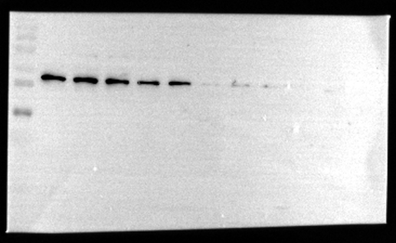
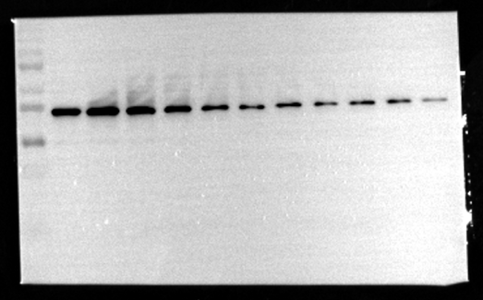
Figure 9A
DMSO
DMSO
200
40 43 46 49 52 55 58 61 64 67 70 (℃)
200
40 43 46 49 52 55 58 61 64 67 70 (℃)
140
140
100
100
90
90
68
68
55
MFSD3
55
GAPDH
40
40
30
30
20
20
13
13
8
8

