Slide 1
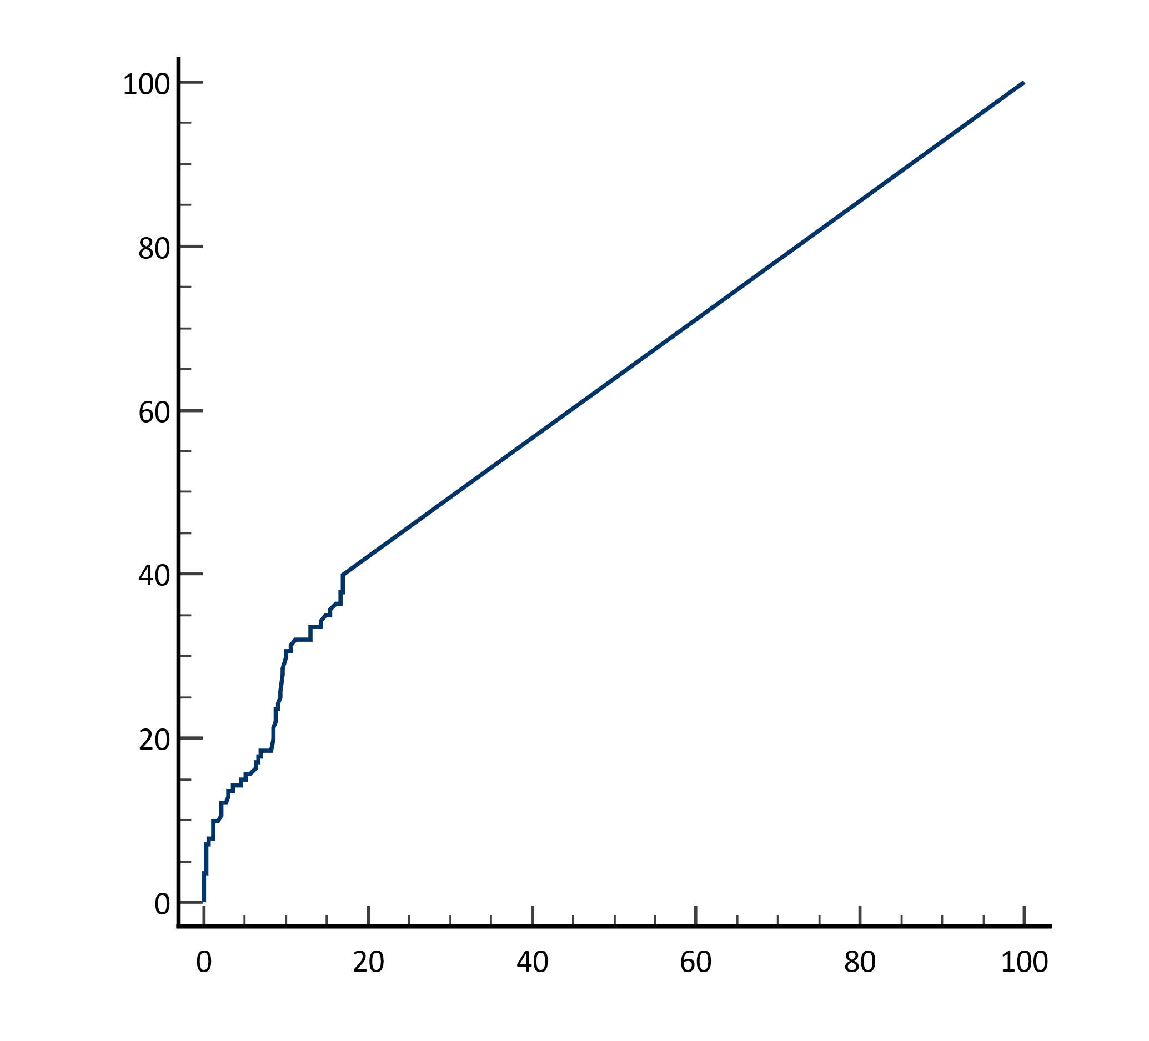
AUC: 0.620
95% CI: 0.54-0.63
P<0.001
Cutoff: >0.0
Sensitivity: 40.0%
Specificity: 83.0%
Sensitivity
100 - Specificity

