Slide 1
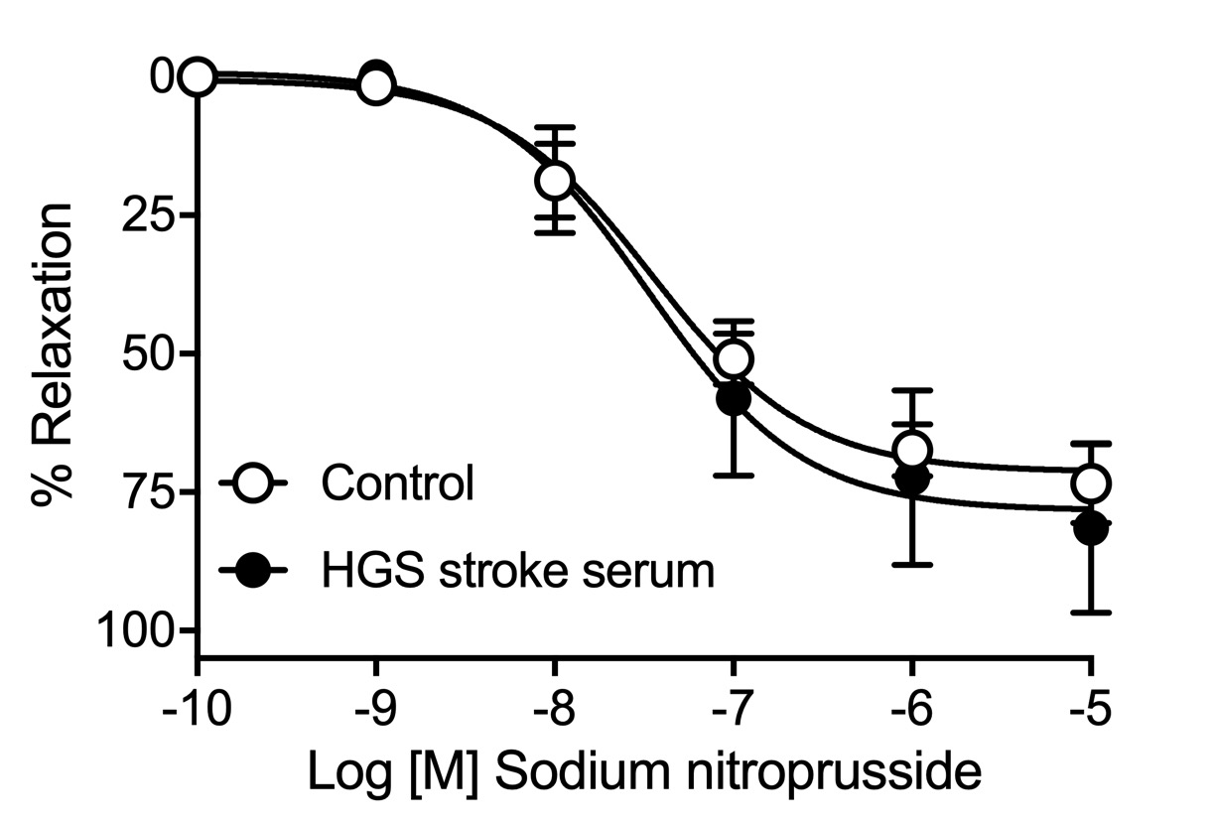
Article title: Serum from stroke patients with high grade carotid stenosis promotes cyclooxygenase-dependent endothelial dysfunction in non-ischemic mice carotid arteries
Journal name: Translational Stroke Research
Author names: Lídia Puertas-Umbert, Núria Puig, Mercedes Camacho, Ana Paula Dantas, Rebeca Marín, Joan Martí-Fàbregas, Elena Jiménez-Xarrié, Sonia Benítez, Pol Camps-Renom, Francesc Jiménez-Altayó
Affiliation and e-mail address of the corresponding author: Department of Pharmacology, Therapeutics and Toxicology, School of Medicine, Universitat Autònoma de Barcelona, Barcelona, Spain; francesc.jimenez@uab.cat
Supplementary Figure 2. Concentration-response curves to sodium nitroprusside in male OF-1 mice common carotid arteries incubated in the absence (Control) or presence (10%) of high-grade stenosis (HGS) stroke serum. Results are mean ± SEM of n = 7 per group.
Notes:
Supplementary Figure 2. Concentration-response curves to sodium nitroprusside (SNP) in male OF-1 mice common carotid arteries incubated in the absence (Control) or presence (10%) of high-grade stenosis (HGS) stroke serum. Results are mean ± SEM of n = 7 per group.

