Slide 1
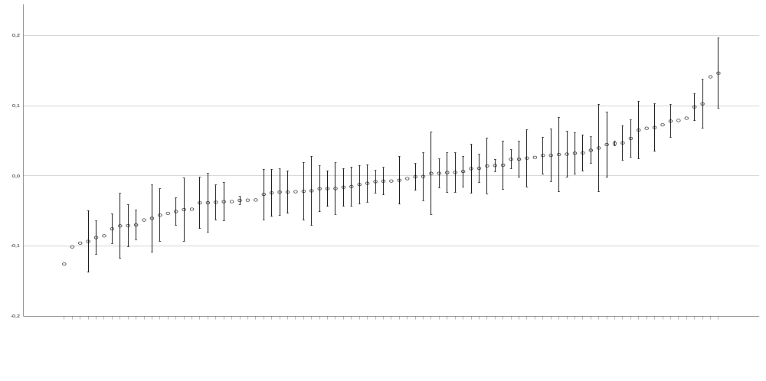
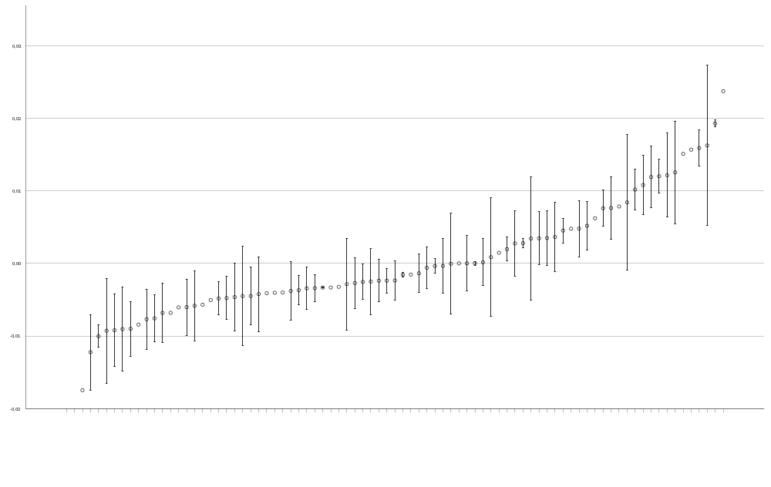
c
0.2
0.1
0.0
Residuals, log antenna length
-0.1
-0.2
species
d
0.03
0.02
0.01
Residuals, log width of 4th fore tarsomere
0.00
-0.01
-0.02
#
#
#
#
#
#
#
#
#
#
species
Online Figure 3 c-d: Interspecific comparison of residuals of log-transformed (c) antenna length and
(d) tarsus width against log-transformed fore body length. Representatives of Dianous are underlined in (c).
In (d), representatives with bilobed tarsi are underlined, with sub-bilobed tarsi are labeled by “#”, or
non-labeled in the case of non-bilobed tarsi. Shown are arithmetic means ± standard deviations of the
residuals. For sample sizes see Online Tab. 1.

