Slide 1
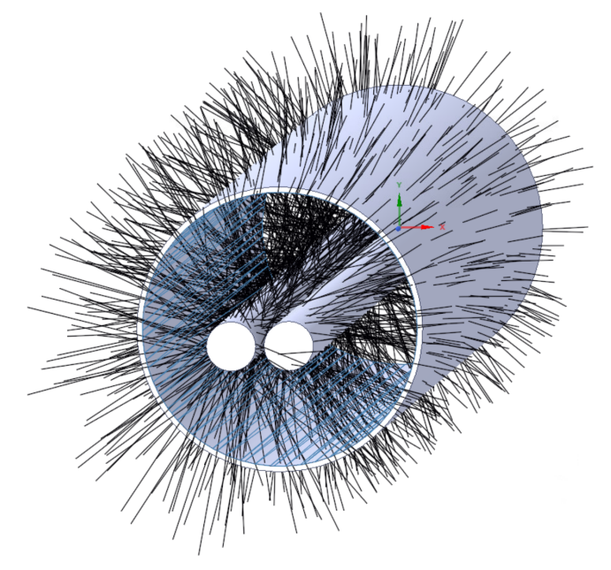
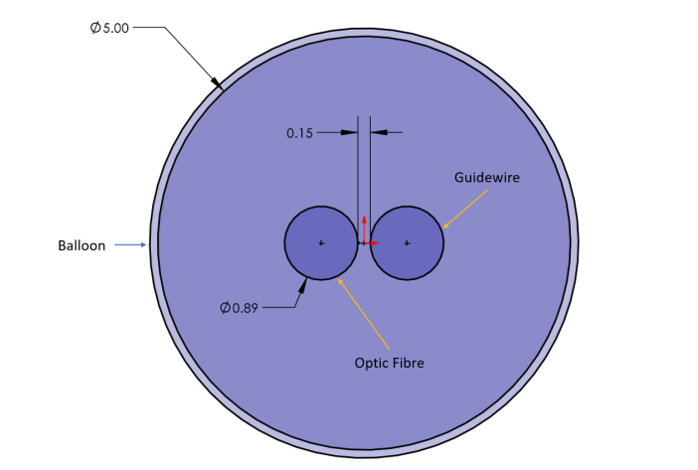
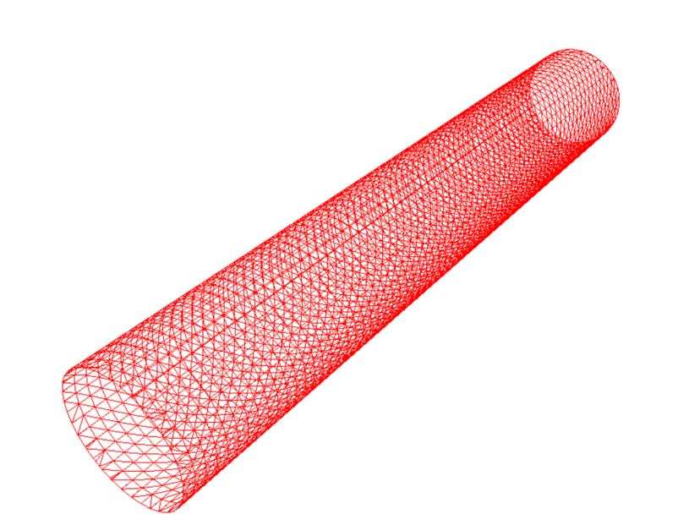
Online Resource 1
a
b
c
FO
GW
A: Illustration of cross-section of stylised 30.0mm long angioplasty balloon with dedicated fibre-optic port. Numerical parameters associated with balloon diameter (5.00mm), guidewire and fibre optic diameters (0.89mm) and inter-port distance (0.15mm) are provided for ANSYS-SPEOS evaluation of guidewire shadowing.
B: ANSYS-SPEOS triangular mesh elements for surface irradiance studies of balloon catheter.
C: Three-dimensional re-construction of light ray trajectories used by ANSYS-SPEOS in stylised angioplasty balloon. Intra-balloon fibre optic (FO) is demonstrated on the left, GW on the right, arranged in parallel

