Slide 1
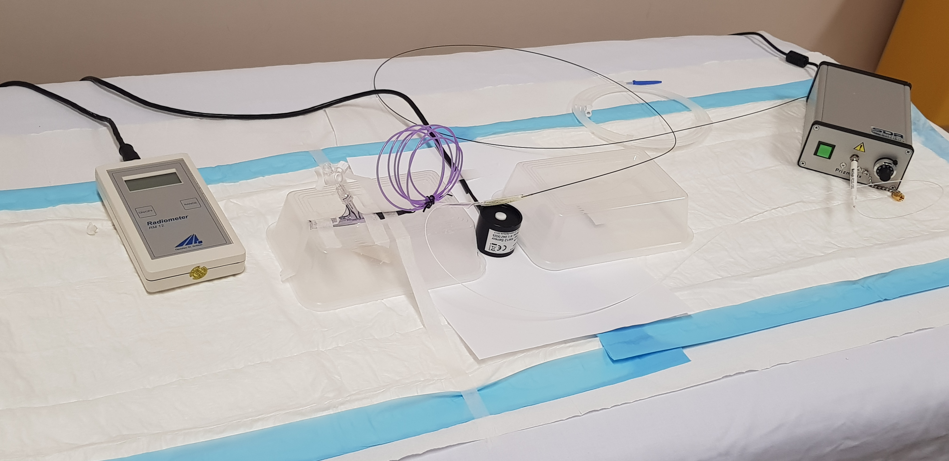
Online Resource 3a
Light Sensor (500-650nm)
Portable UV Light Source
Balloon
Light Sensor Display
GW
Fibre Optic
Light Sensor

