Slide 1
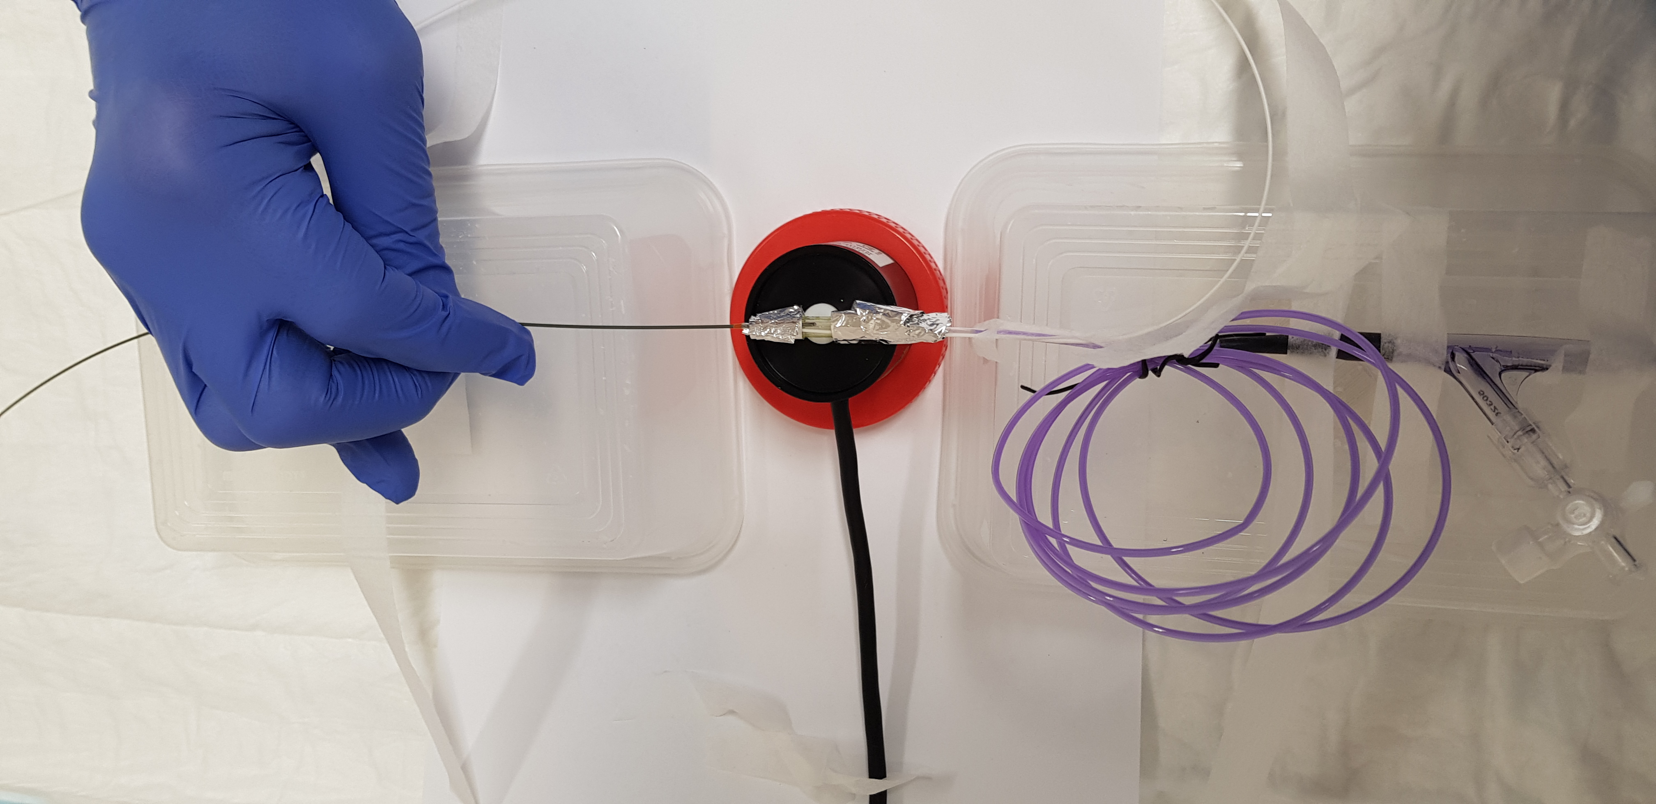
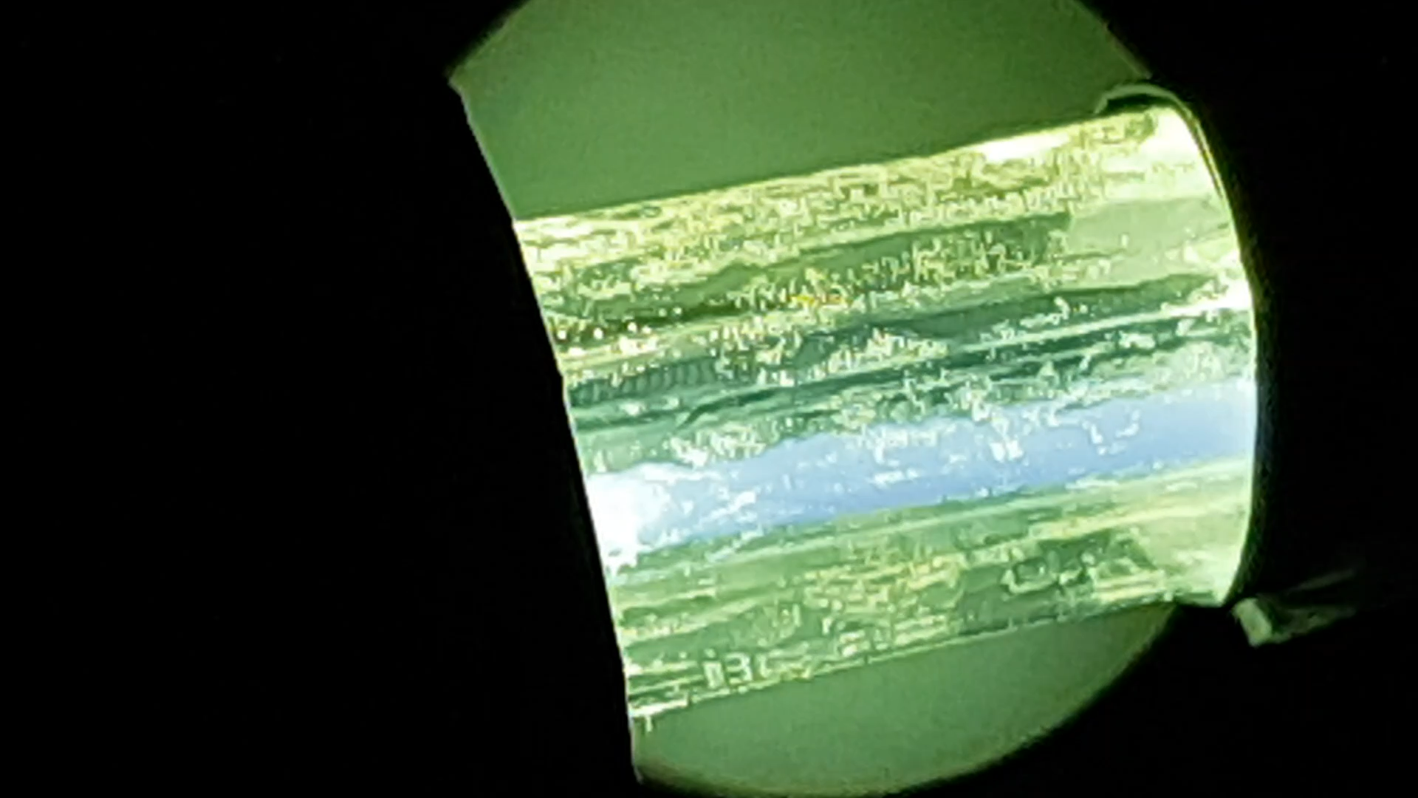
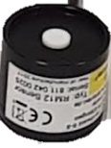
Online Resource 3b
(i)
(ii)
Foil
Balloon Catheter
UV Fiber
Guidewire
(iii)
Foil
Foil
Light Sensor

