Slide 1
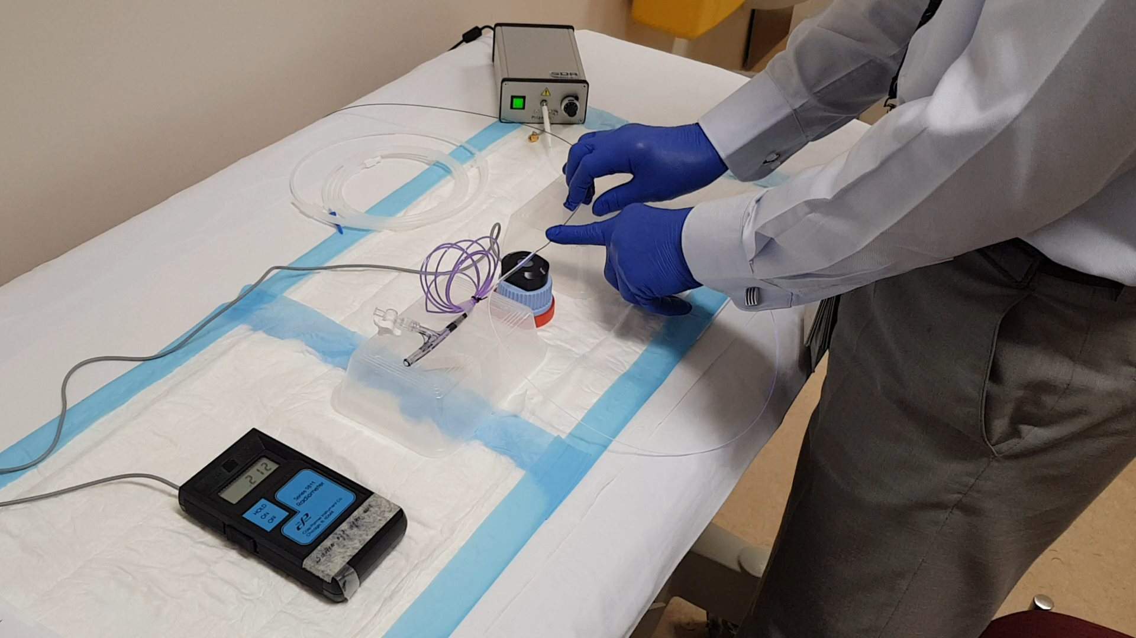
Online Resource 4c

